Slide 1



Labyrinth Escape using Deep Reinforcement Learning
Artash Nath
Grade 8 Student, Toronto, Canada
Twitter: @wonrobot
Email: Artash.Nath@gmail.com

Slide 2
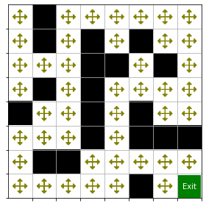
Problem
Create a Deep Reinforcement Learning Model to solve a simple labyrinth
We need to predict the Q-Values for each point in the maze

Slide 3
Methodology
Explore the environment, collect samples of actions taken, and rewards obtained
Train a Neural Network to predict optimal action for each state in the maze
Test it by seeing if it can find the exit from any starting point in the maze

Slide 4
Model Learning Process
At the start, randomly predicts a legal move
Collects reward / penalty for the new state
Adds move made, and reward obtained to a data frame
Trains itself on the data frame, with moves made as inputs and rewards obtained as outputs
Predicts rewards for all possible movements, and makes movement with the highest reward

Slide 5
Neural Network
STATE → (X, Y)
INPUT (2,)
Action Taken | Reward Obtained
Action 1 | Reward 1
Action 2 | Reward 2
Action 3 | Reward 3
Dense (64,)
Dense (64,)
…
Output (4,)
Action N-1 | Reward N-1
Action N | Reward N
Prob (Up, Down, Left, Right)

Slide 6
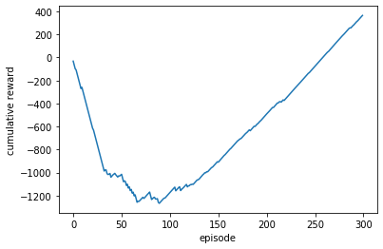
Results

