Slide 1

Using Autoencoders and Support Vector Machines (SVMs) for Face Classification in Medical Robots during #COVID19
Artash Nath
artash.nath@gmail.com
Twitter @wonrobot
SCS_3546 Deep Learning
University of Toronto
7 April 2020

Slide 2
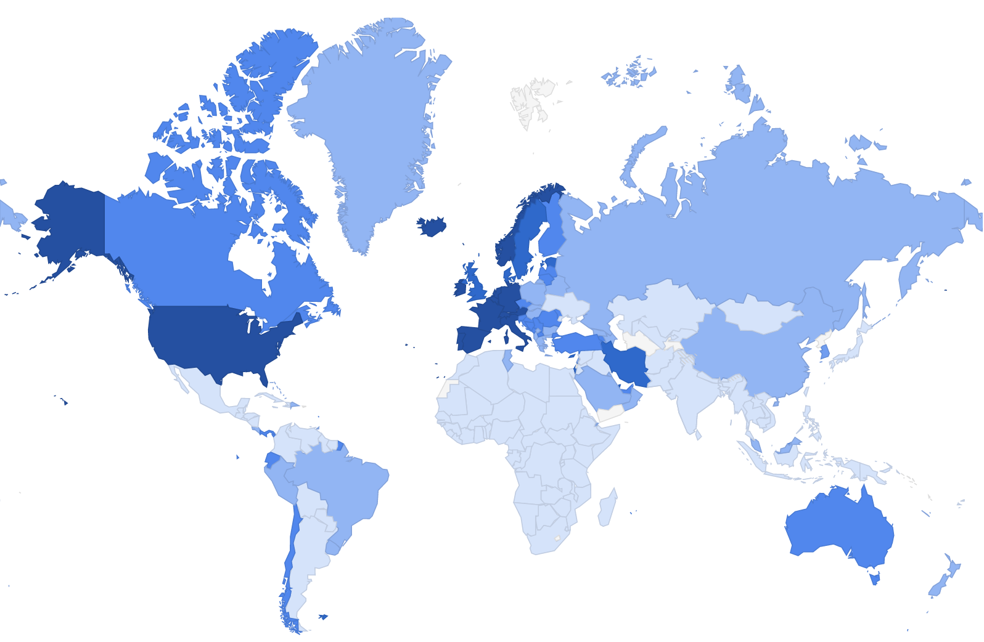
Background:
COVID19 is a global pandemic. Rising cases, limited health care facilities and personal protection equipment mean health care workers are under stress.
Robots can play a big role in monitoring patients in nursing homes and long-term care facilities for symptoms of #COVID19.
Goal:
Provide accurate and real-time face detection in telepresence robots to recognize patients and deliver personalised health monitoring.

Slide 3
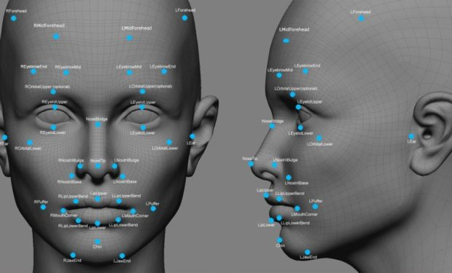
How do we recognize human faces?
Neurons in our brain respond to particular features of a face and allow us to identify a person.
We store these features, use them to recreate the face, and recognize it when we see it again.
Color
Gender
Age
Race
Hair style / color
Eye shape / color
Scars / tattoos
Forehead shape
Jawline
Lip size
Image: eForensics Magazine, (Courtesy of Google Images)

Slide 4
Autoencoders Neural Network
Input
Image
Output
Image
ENCODER
DECODER
CODE
(4 Nodes)
Encoder: Efficiently compresses the image and encodes data (Code)
Decoder: Reconstructs the image using compressed data (Code)
Goal: Tries to make the decoded Output as close as possible to the Input

Slide 5
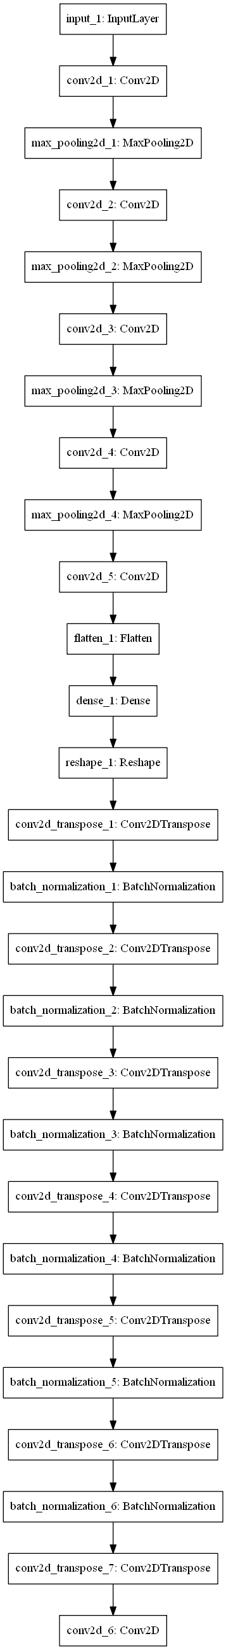
Autoencoder Architecture
Convolutional Transpose Layers and Batch Normalisation
Convolutional and Max Pooling Layer
DECODER
Dense Units
ENCODER
CODE

Slide 6
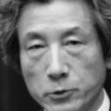
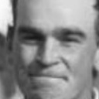
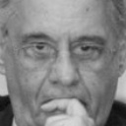
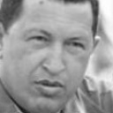
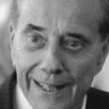

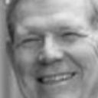
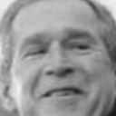
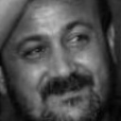
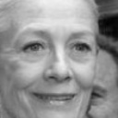
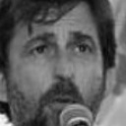
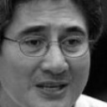
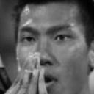
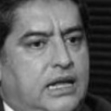
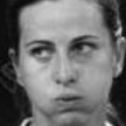
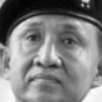
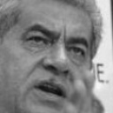
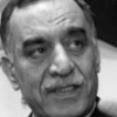
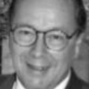
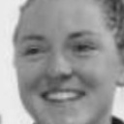
Dataset Used For Training the Autoencoder
Labeled Faces in the Wild (LFW):
13 000 images of human faces
Image size : 128 x 128 pixels
Grayscale
Train Test ratio :
http://vis-www.cs.umass.edu/lfw/

Slide 7
Autoencoder Error Function: Train and Test Loss
Trained for 2 hours on a single GPU
30 epochs
Batch Size : 8
Test MSE: 0.0151
Train MSE: 0.0149
Reaches high accuracy within 10 epochs
No Overfitting

Slide 8
Encoder Model
Input
ENCODER
CODE
(4 Nodes)
[Feature 1, Feature 2
Feature 3, Feature 4]
Encoder model is Ready
Can encode any image into 4 feature values

Slide 9
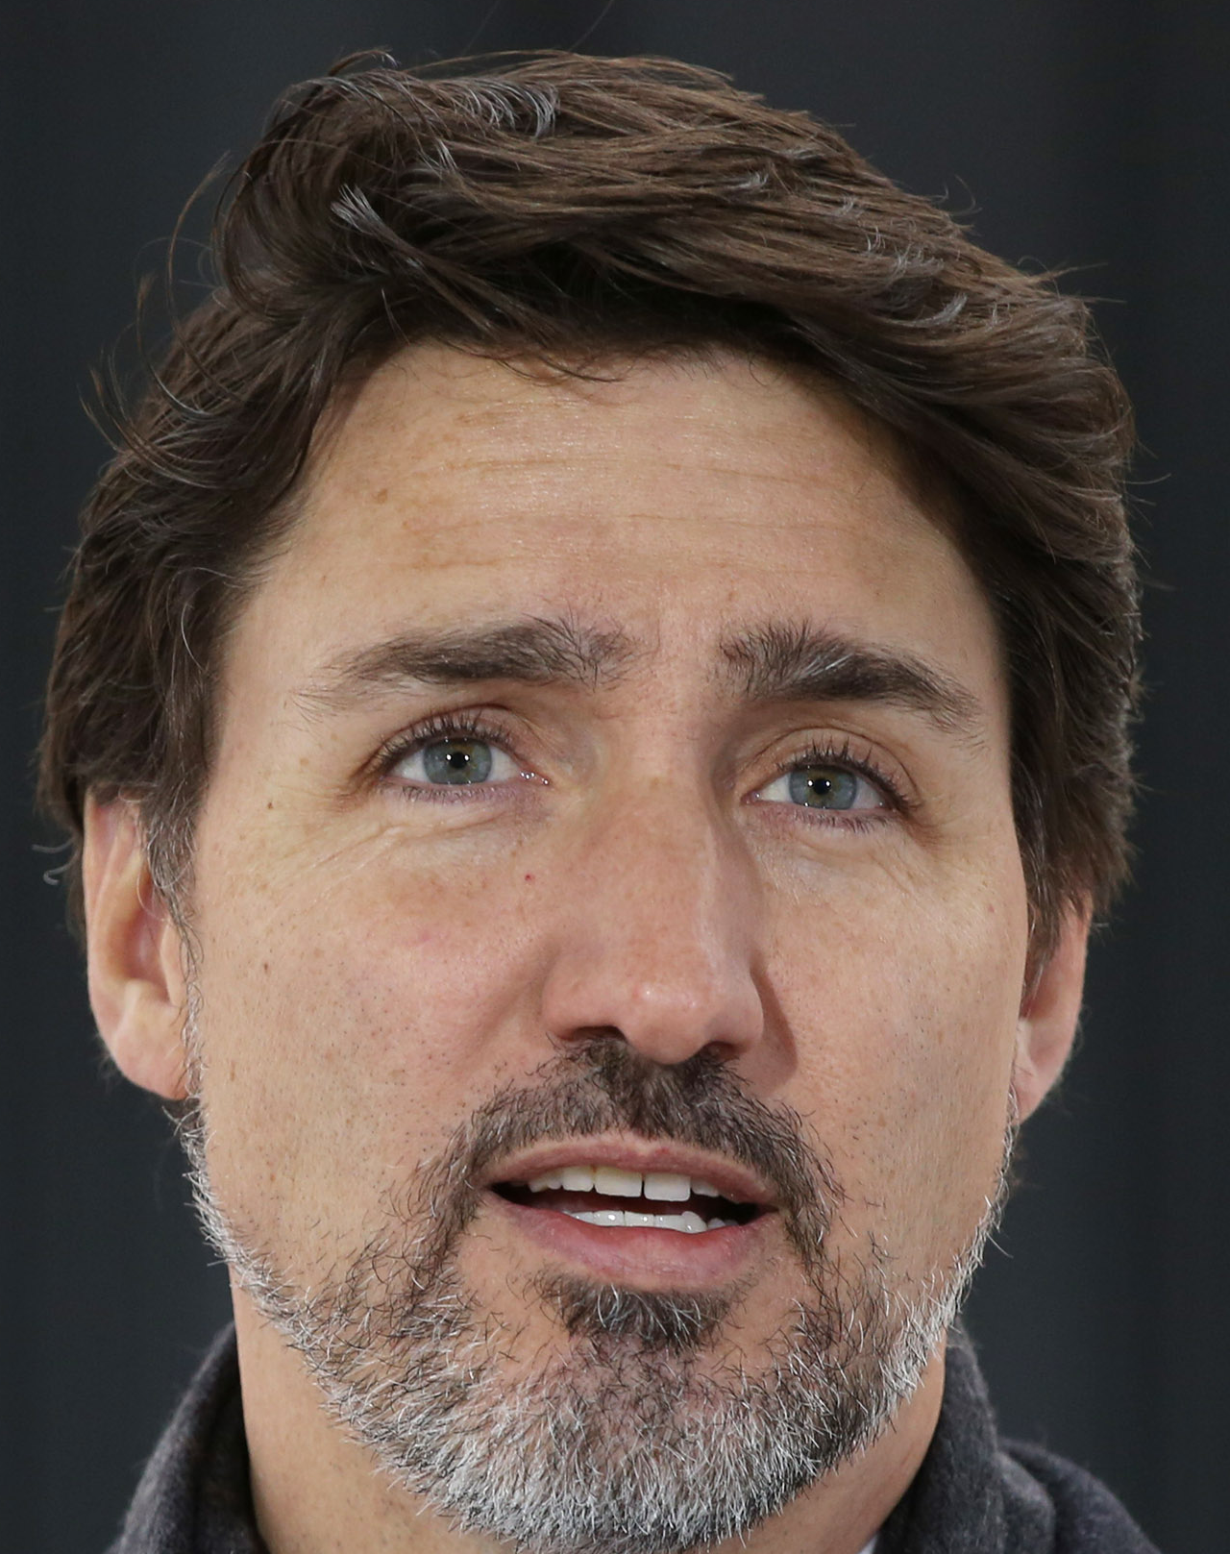
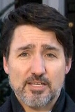
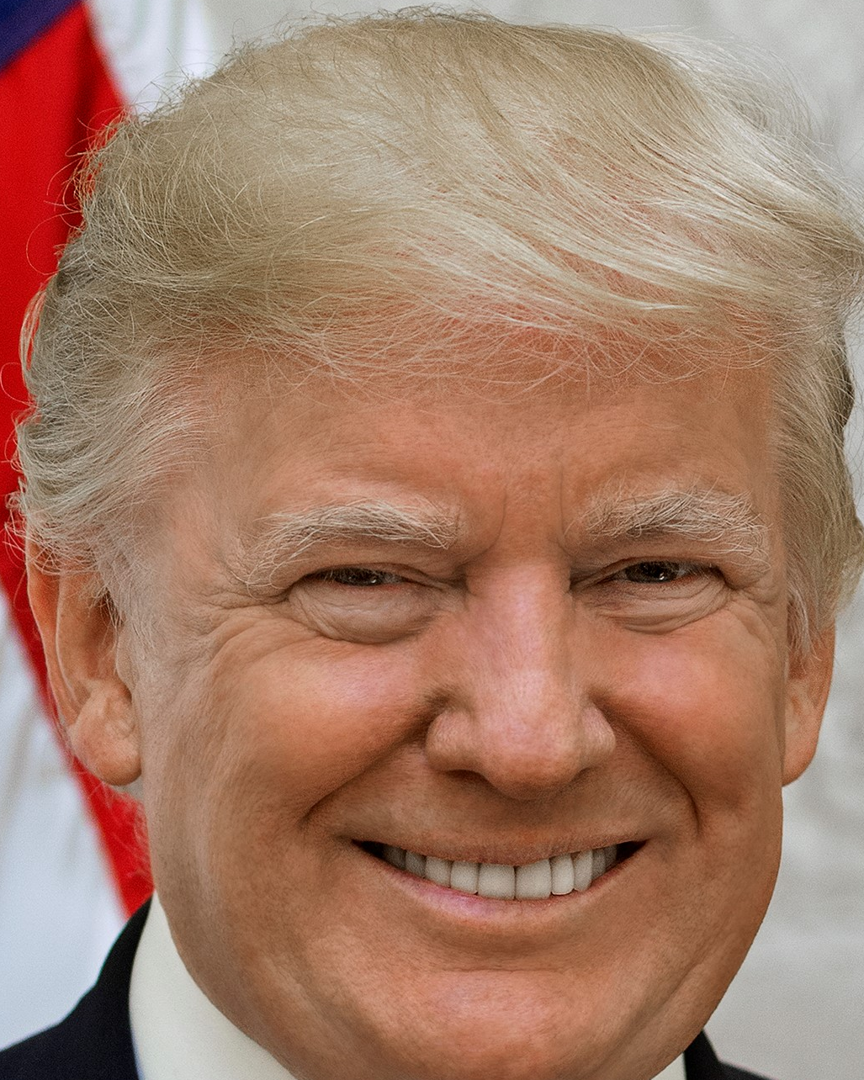
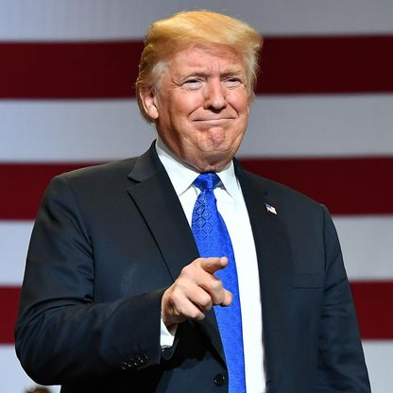
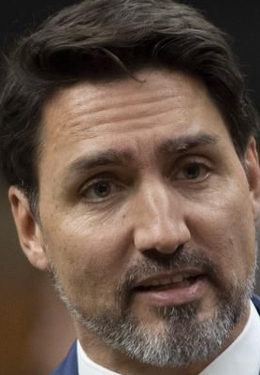
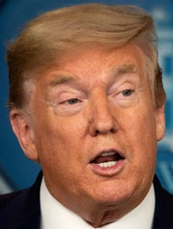
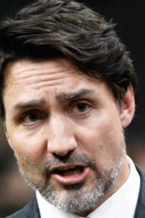
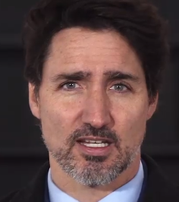
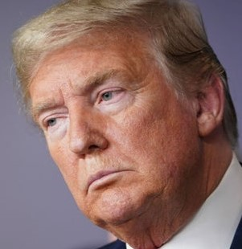
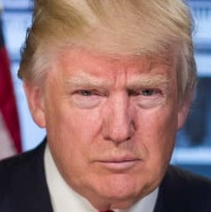
Images from 2 different People : Trump and Trudeau
Trudeau
Trump

Slide 10
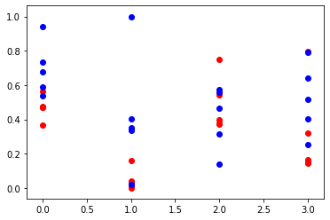
Values and Features
Trudeau
Trump
Feature 1
Feature 2
Feature 3
Feature 4

Slide 11
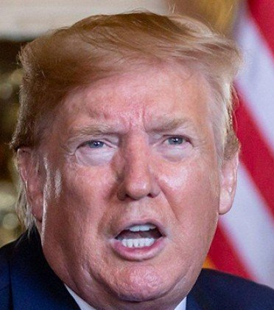
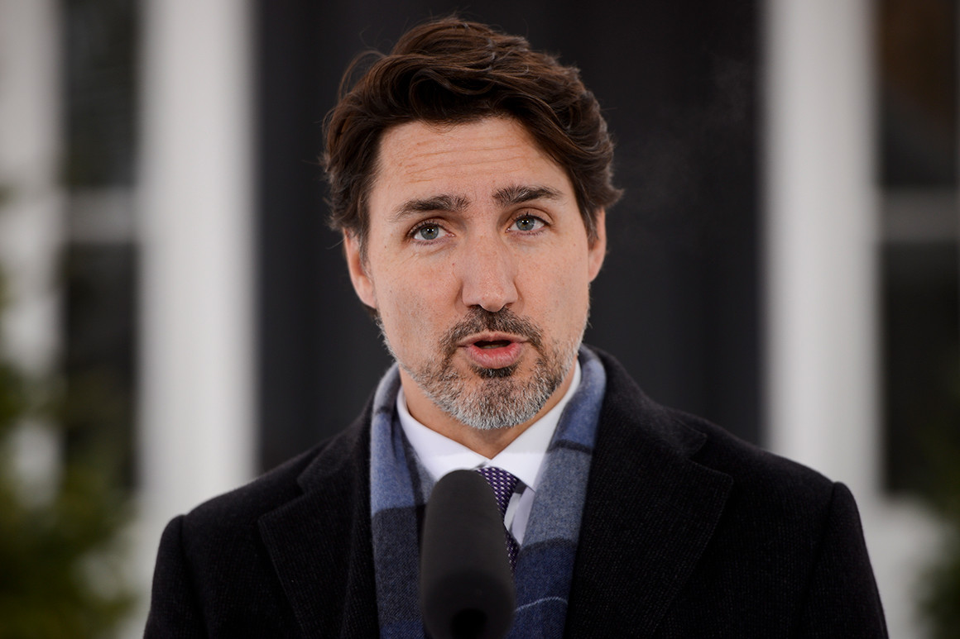
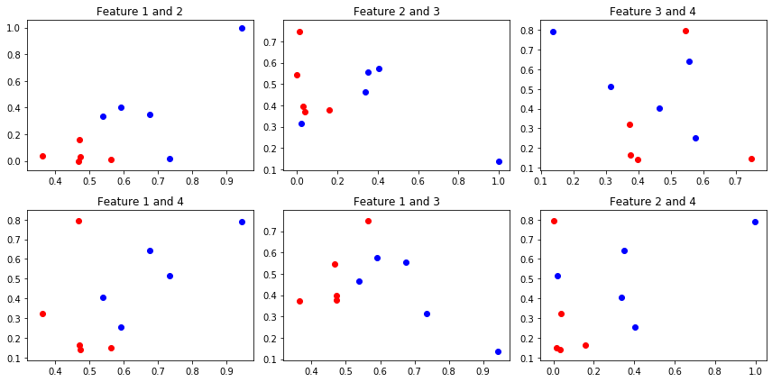
Multi-Dimensional Plot
Trudeau
Trump

Slide 12
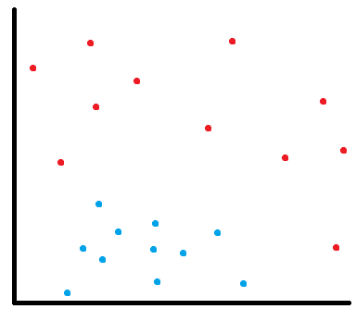
Applying Non-linear Support Vector Machine To Identify Images Based On Their Features
Accurate even when working with small datasets (only 5 images per person used)
Works with multi-dimensional Data (4 features)
Works with multiple classes (2 people)
Feature B
Feature A

Slide 13
Trudeau
TRAIN IMAGES
Trump

Slide 14
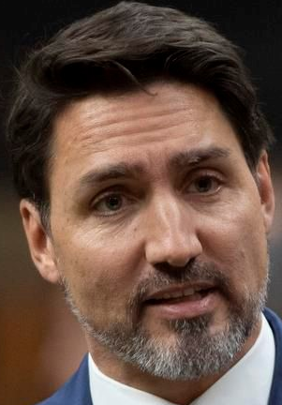
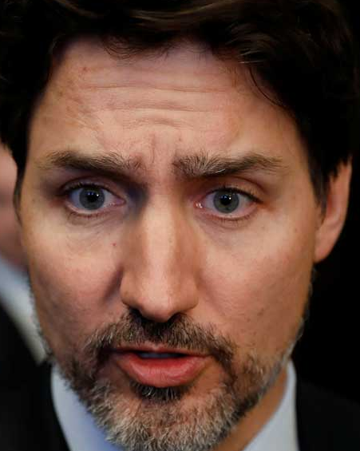
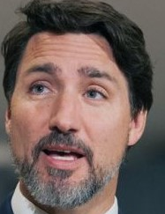
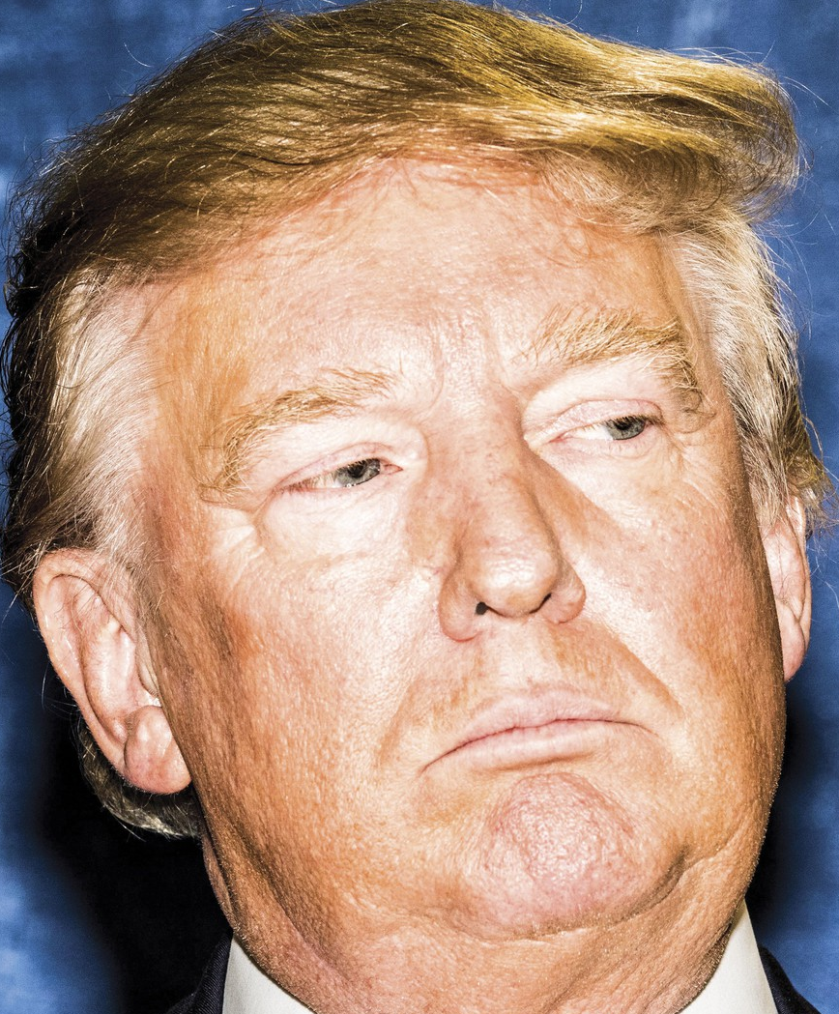
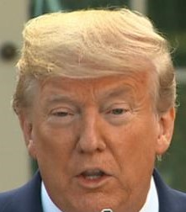
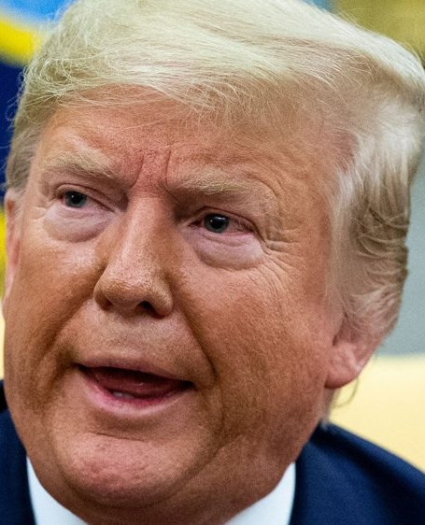
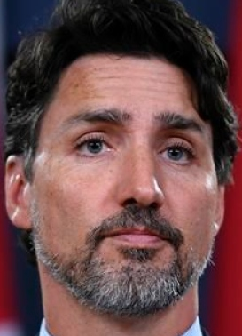
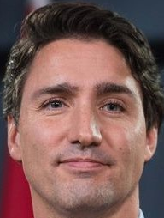
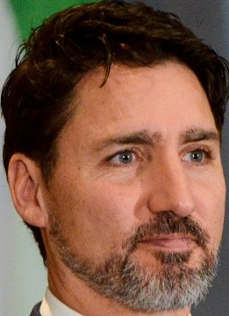
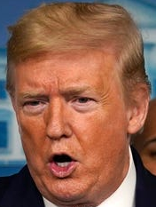
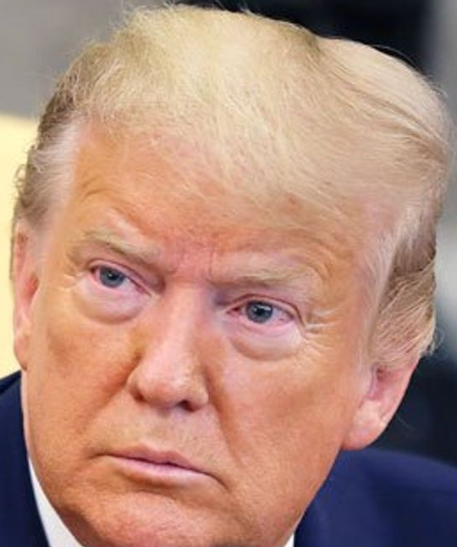
Trudeau
TEST IMAGES
Trump

Slide 15
Final Prediction Model
Input
Trudeau (1)
ENCODER
CODE
(4 Nodes)
[[Feature 1, Feature 2]
Support Vector Machine
[Feature 3, Feature 4 ]]
Trump (-1)
Encoder encodes image to extract 4 feature values
SVM classifies these 4 values to find out who do they belong to

Slide 16
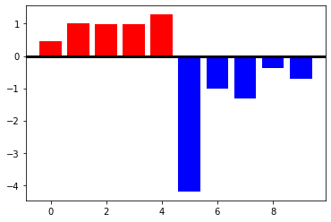
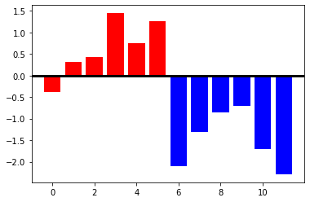
Prediction by ???
Trudeau
Trump
TRAIN
TEST
All positive values are Trudeau Predictions. All negative values are Trump Predictions

Slide 17








Live Prediction Implementation

