Slide 1
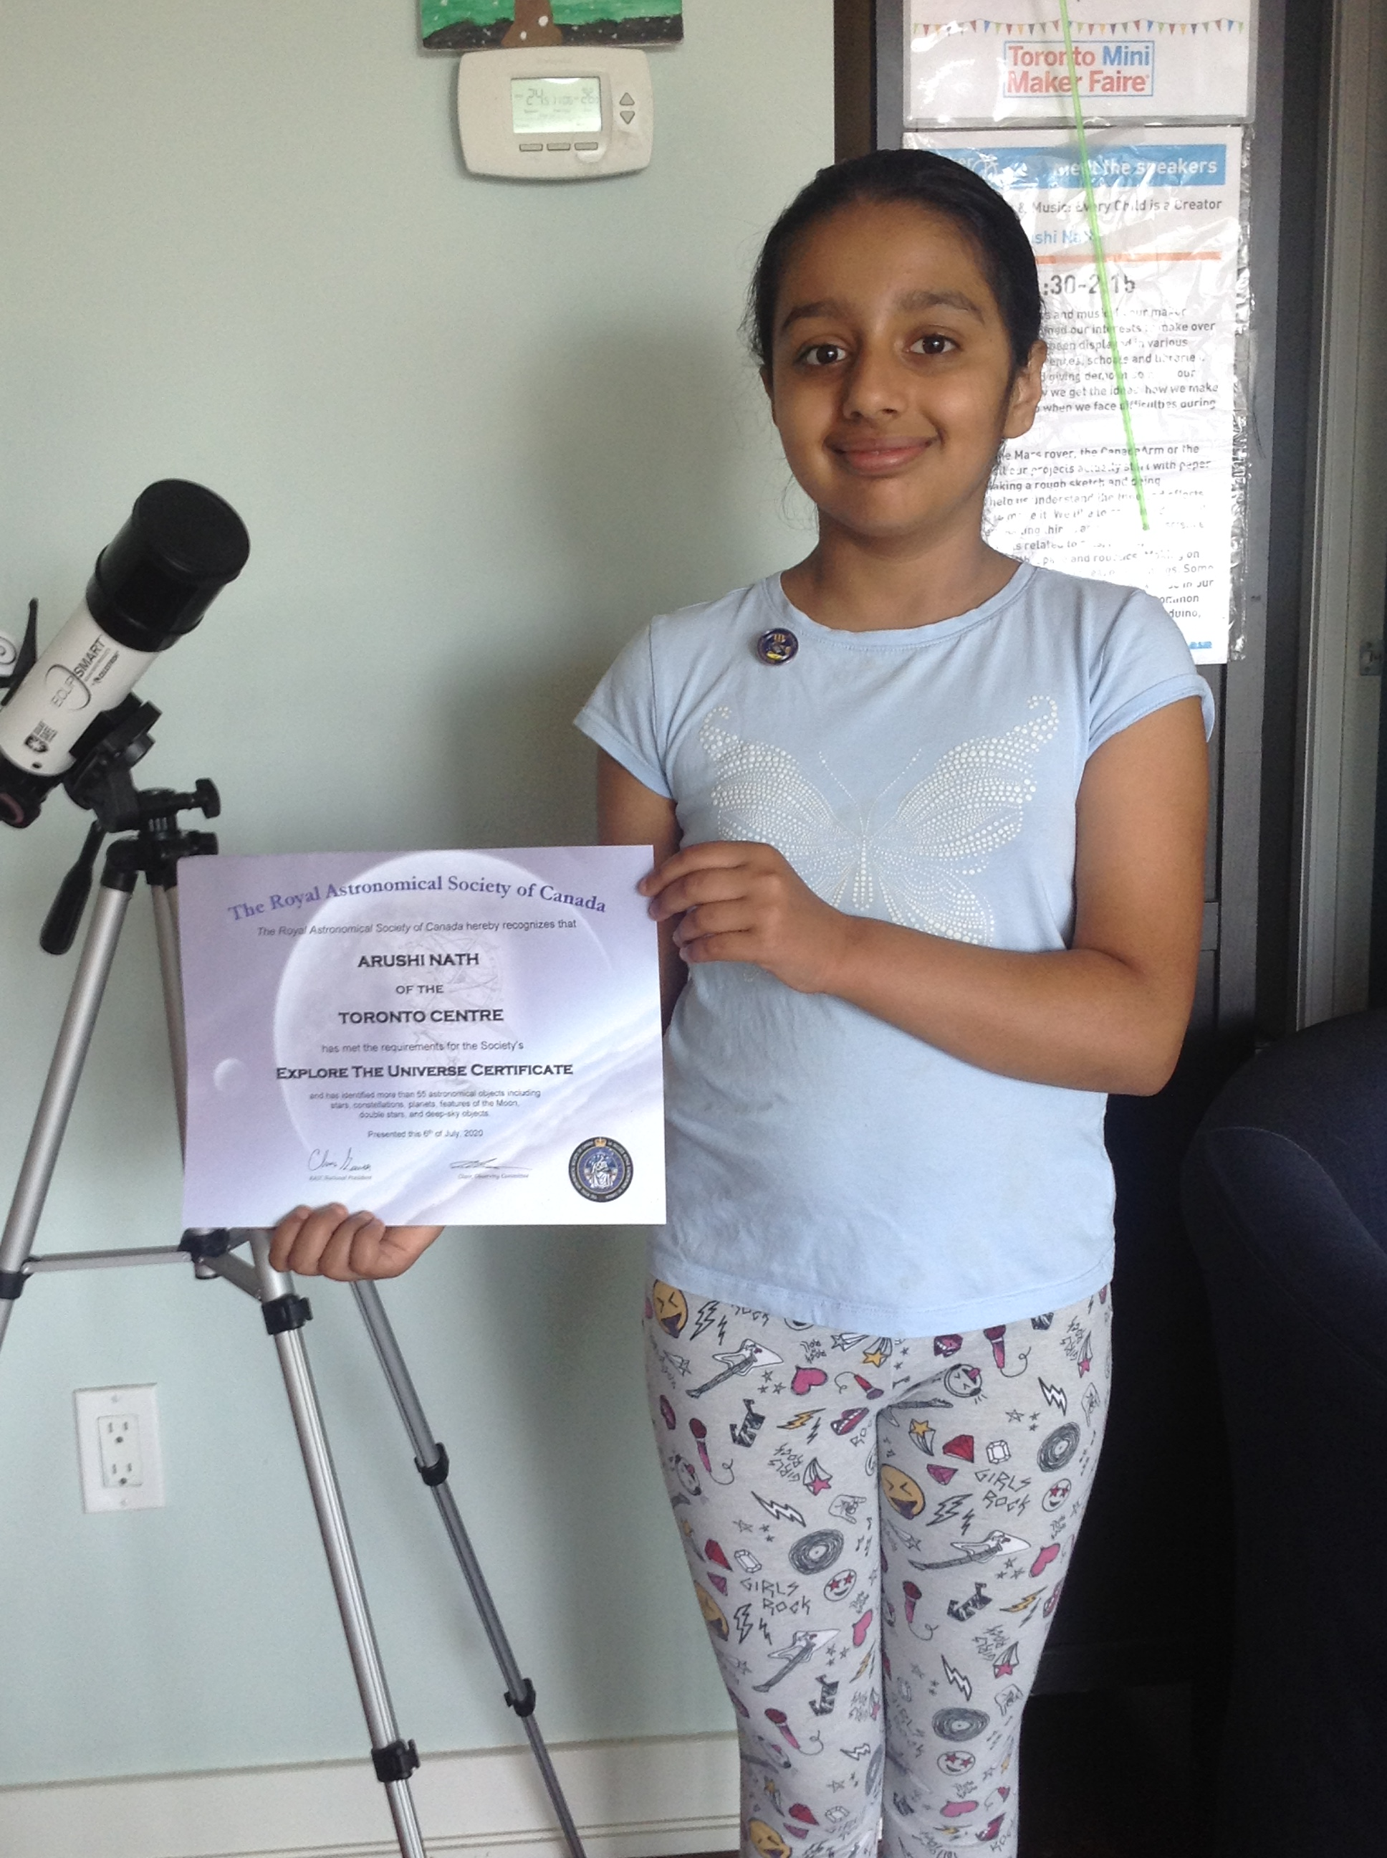

My Travels around the Universe for 6 years to complete RASC Explore the Universe Certificate
Arushi Nath (Grade 6)
Recreational Astronomy Night Meeting
Royal Astronomical Society of Canada, Toronto
16 September 2020
Website: www.HotPopRobot.com
Twitter: @Wonrobot

Slide 2
How most kids start learning about the Universe?
Twinkle, twinkle little star, how I wonder what you are?
Sun rises in the East, sets in the West
Sun is the star you can see during day time
Moon has phases: Full Moon

Slide 3
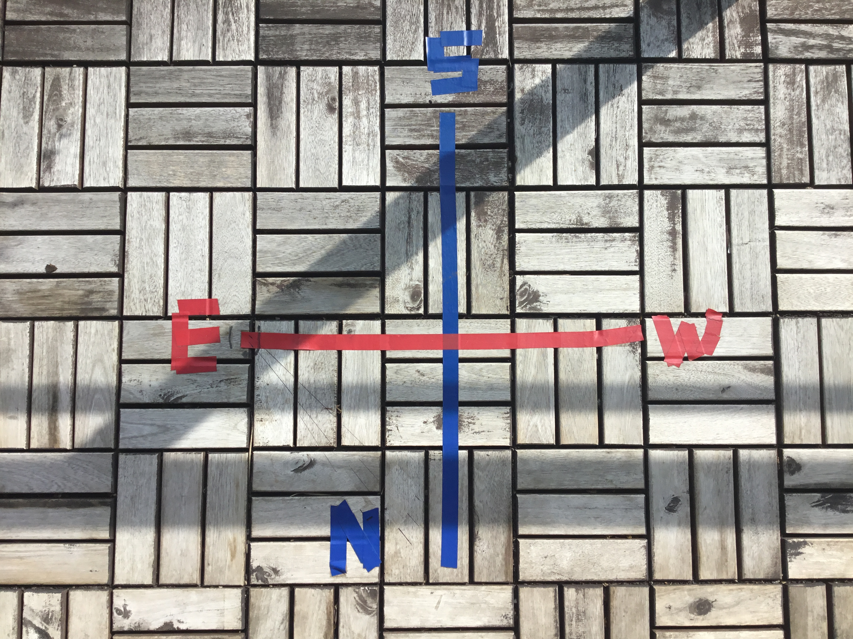
Learning @Home
Directions: N. E. W. S
Lake Ontario
Sun in the morning time
Sun in the evening time

Slide 4
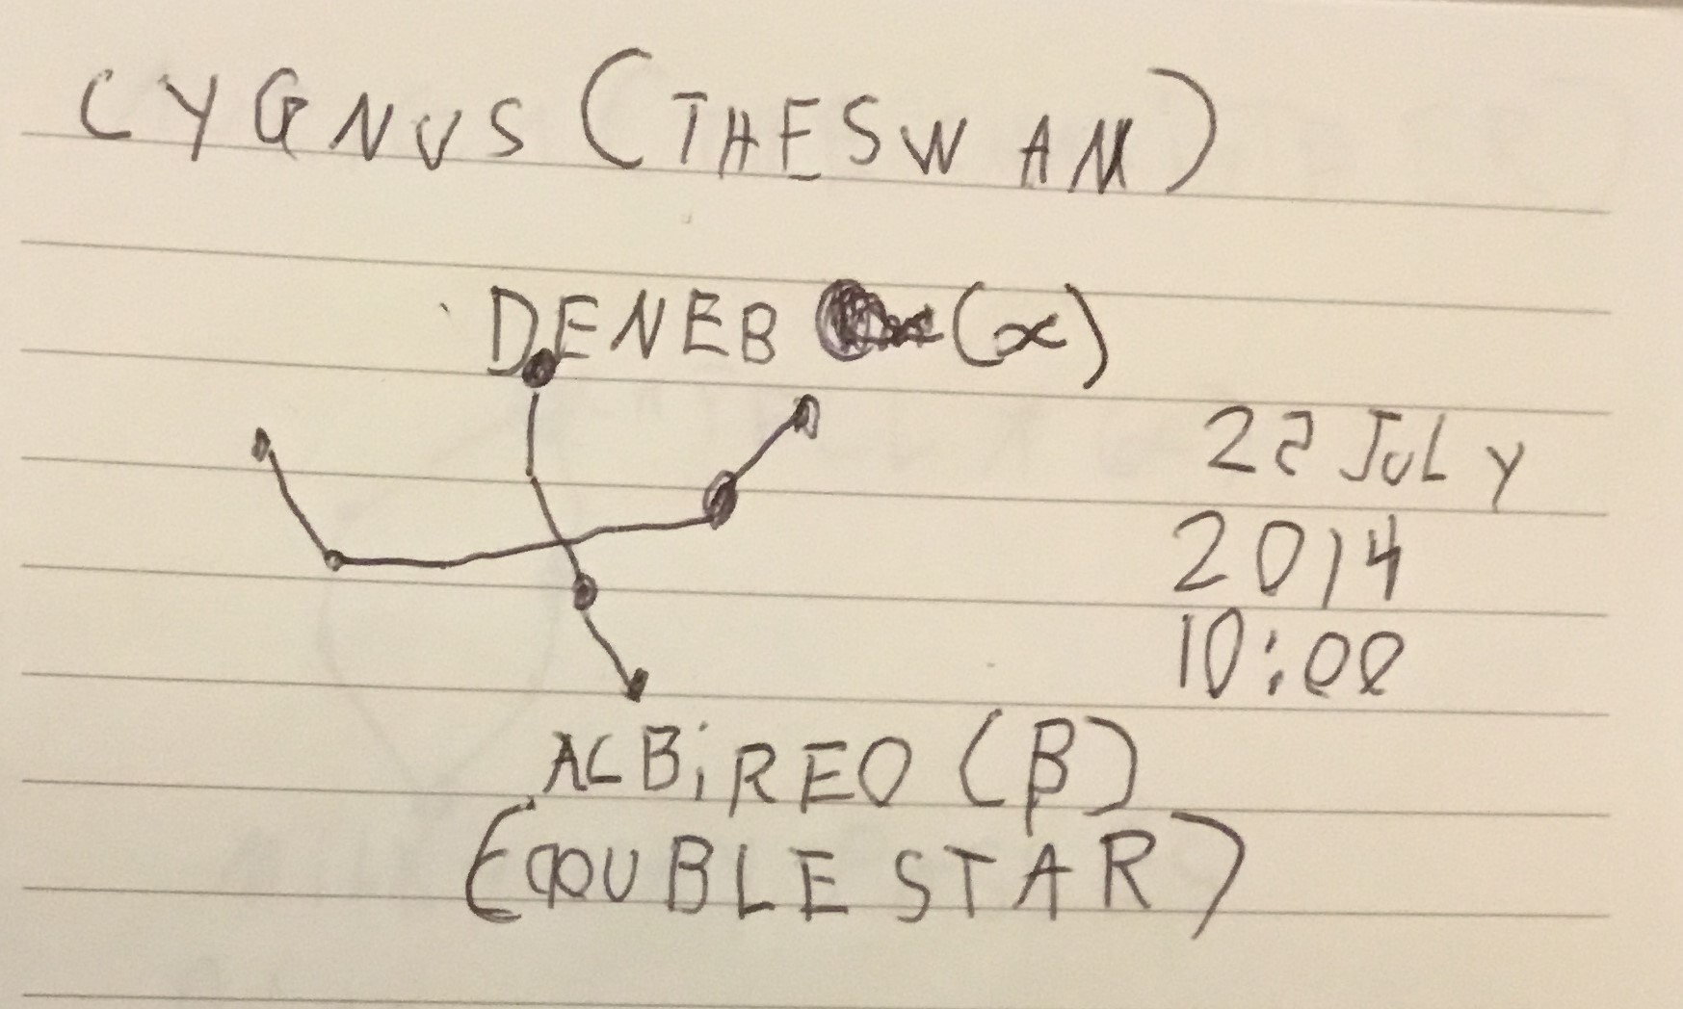
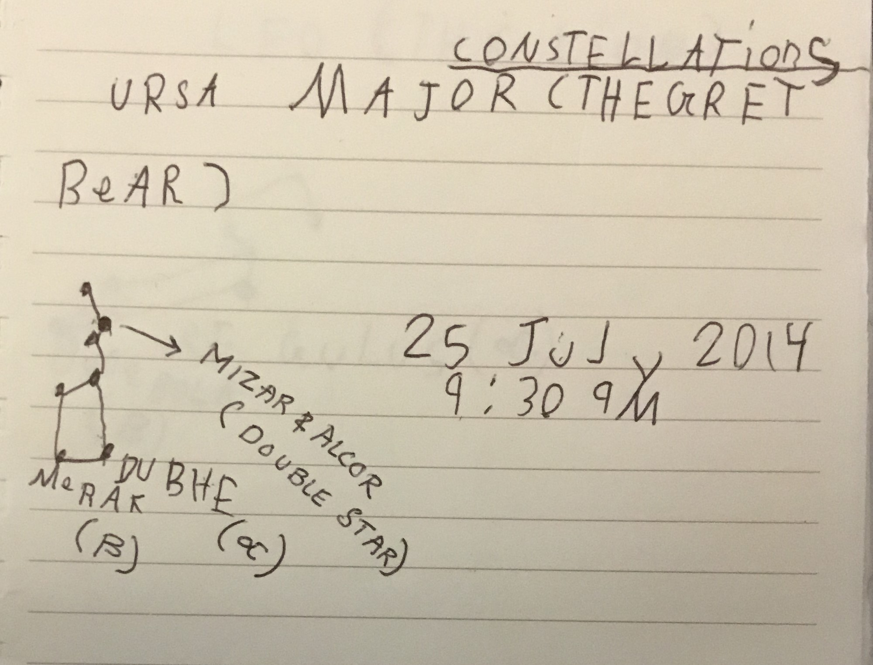
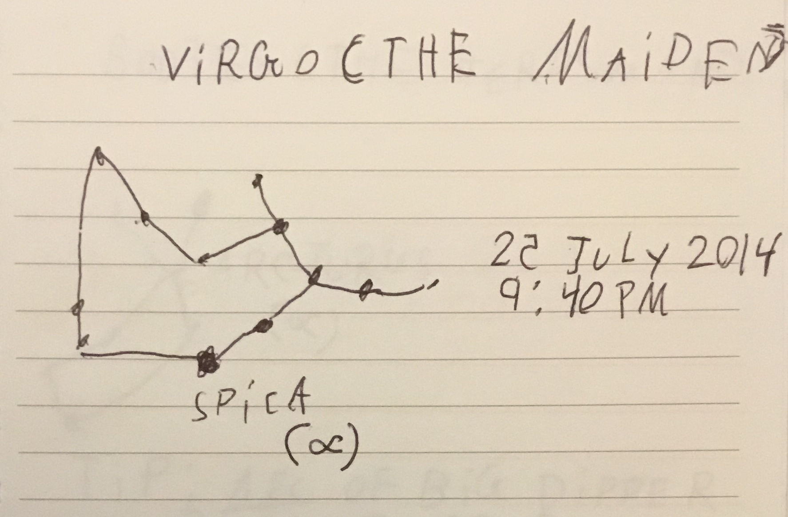
Constellations
Learning @Home

Slide 5
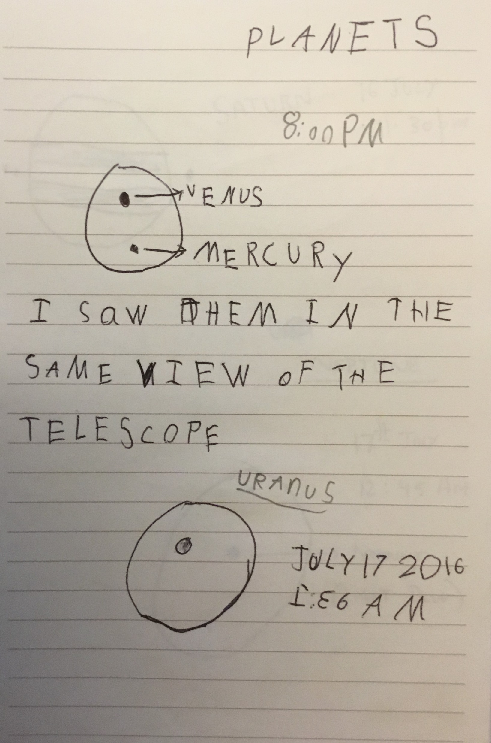
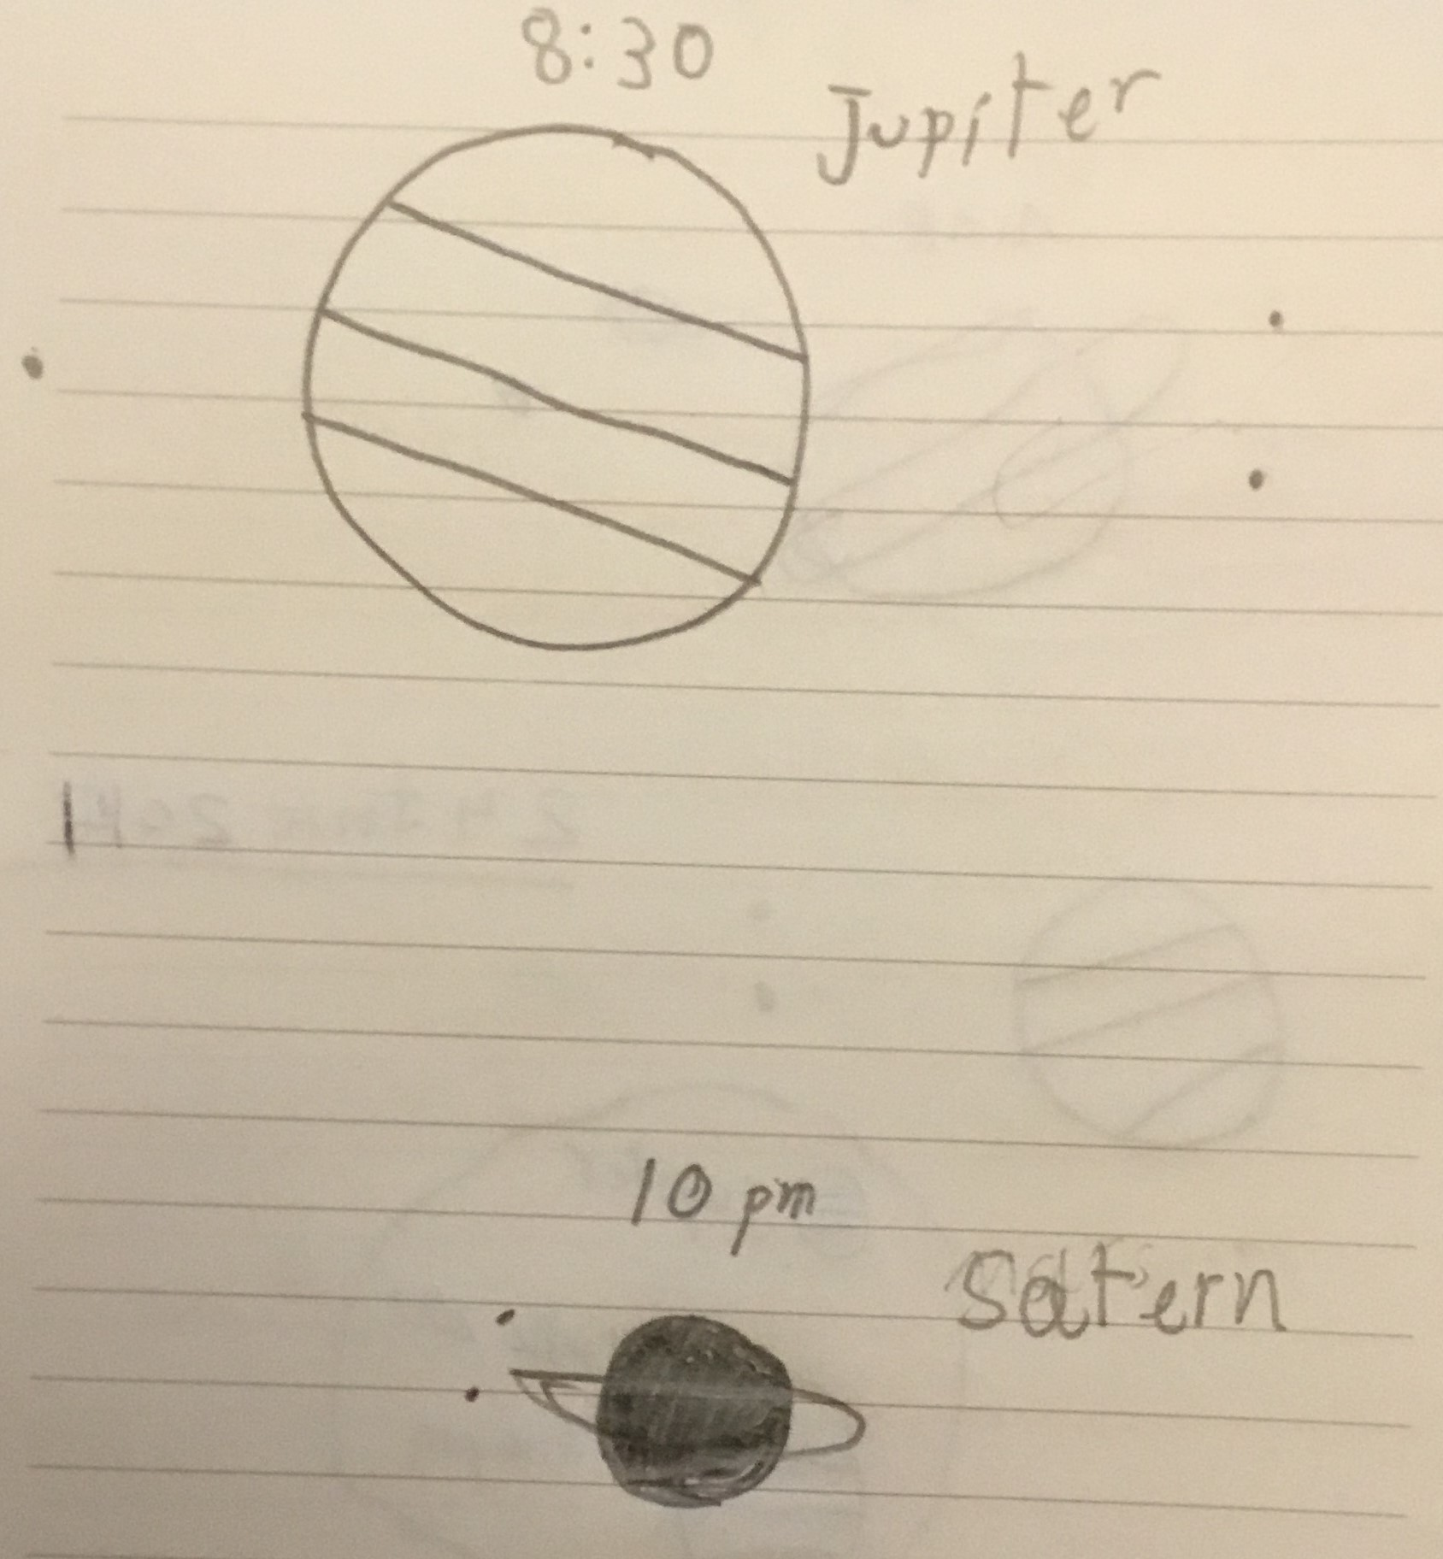
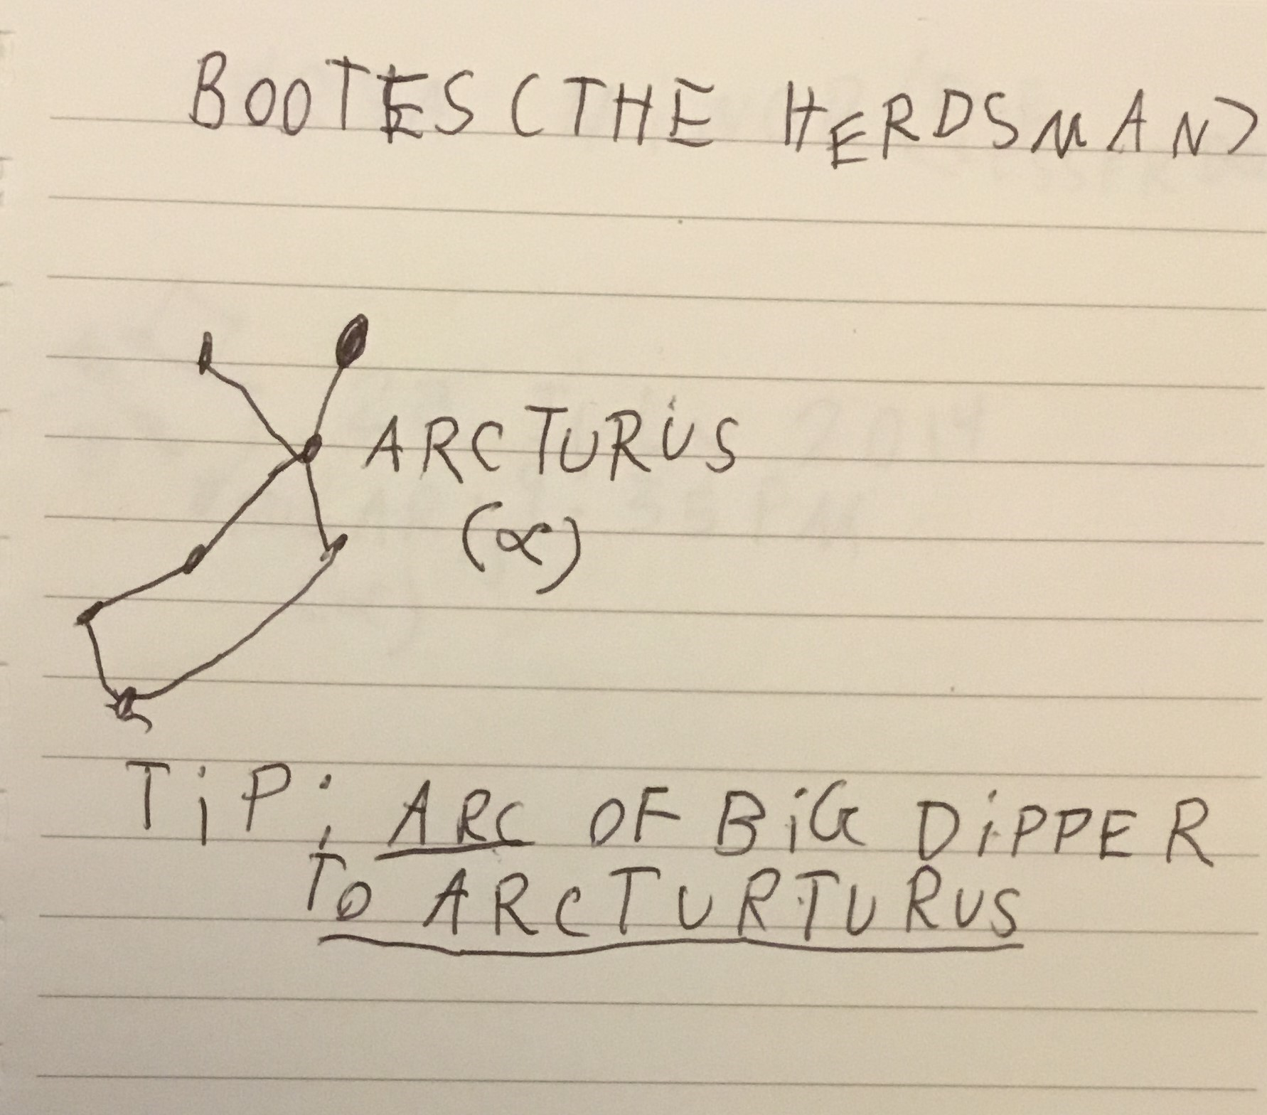
Learning @RASC Bayview Village Park
Planets + Rhymes to do constellation hopping!

Slide 6
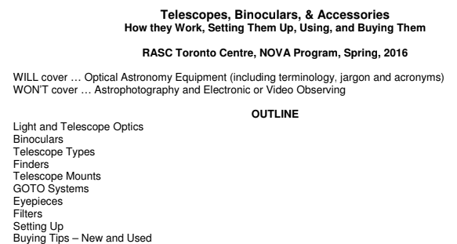
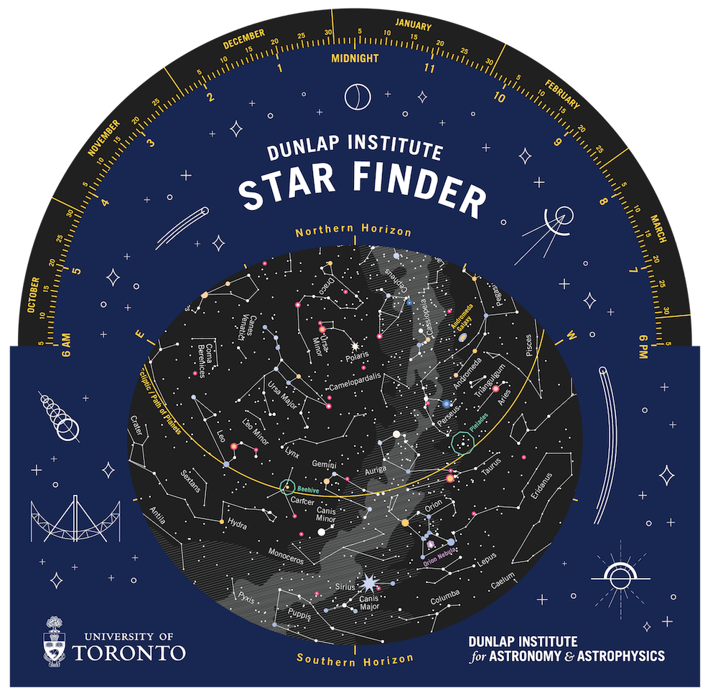
Star Finder, Telescopes and Binoculars
Learning @RASC NOVA Lectures at Fort York Library

Slide 7

Sky this Month presentations
Solar Eclipses
Projects taken by members
Meteor Showers, Comets, Globular Clusters
International Space Station passes
Learning @RASC Talks at Ontario Science Centre, David Dunlap Observatory and University of Toronto

Slide 8
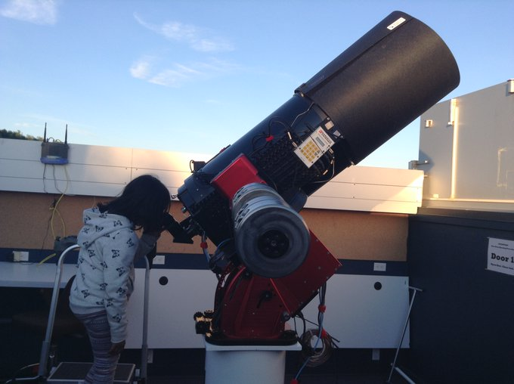
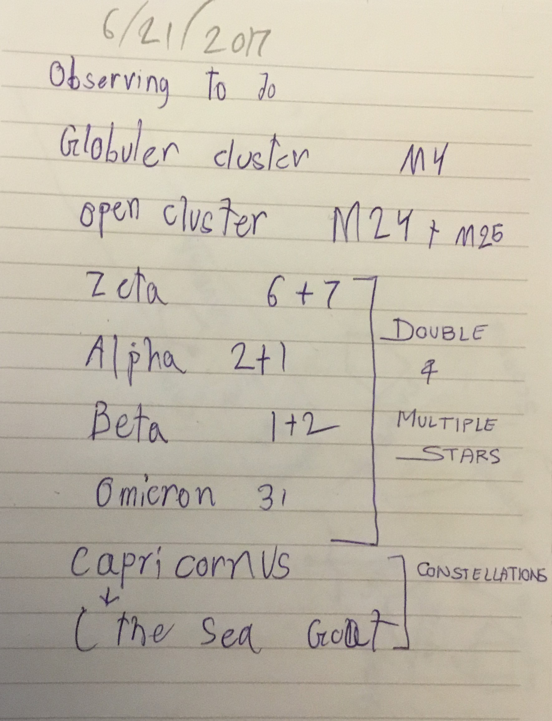
Observing technique and Observing plans
Learning @Carr Astronomical Observatory

Slide 9
Universe keeps moving around me!
If I Observe for… | What changes do I see?
Minutes | Movement of Sun shadows (using sundial)
Hours | Change of Position of the Moon and Planets in the night sky
Days | Phases of the Moon
Weeks | 2 Sky Objects come together
Months | News Constellations appear at Night

Slide 10
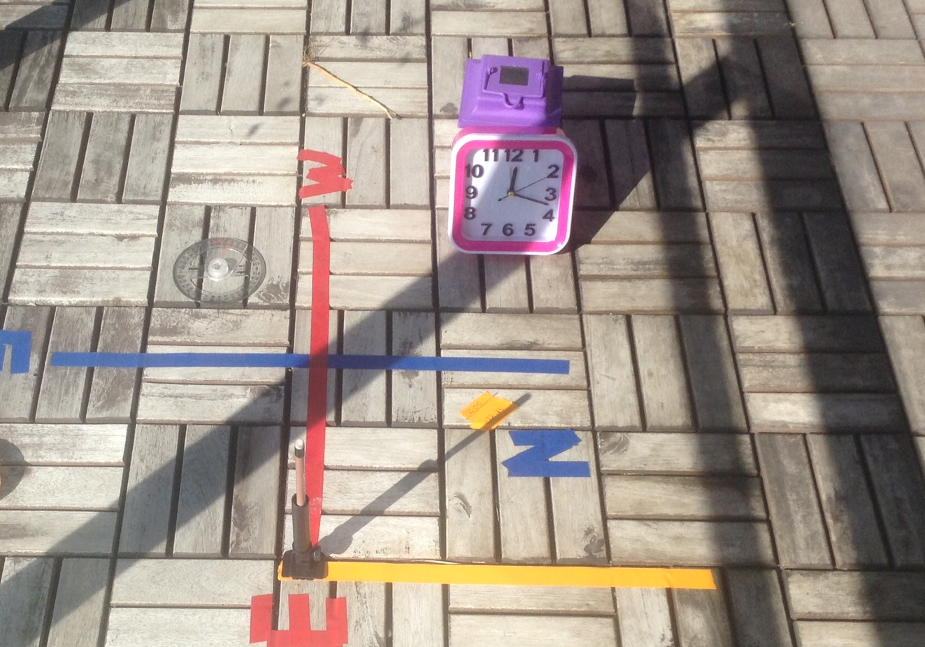
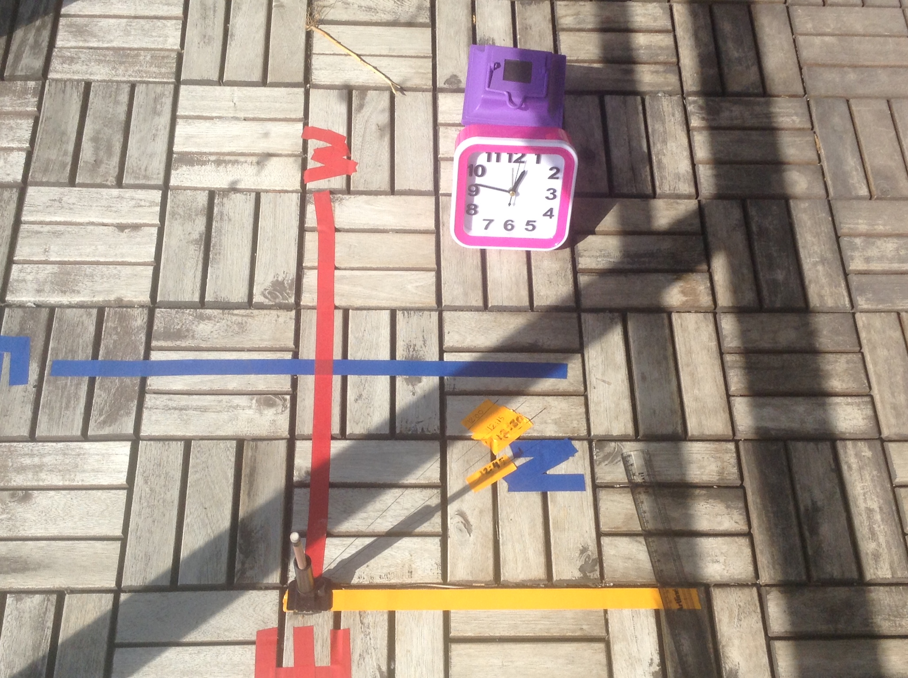
Minutes Time Cycle: Movement of Sun Shadows (using sundial)

Slide 11
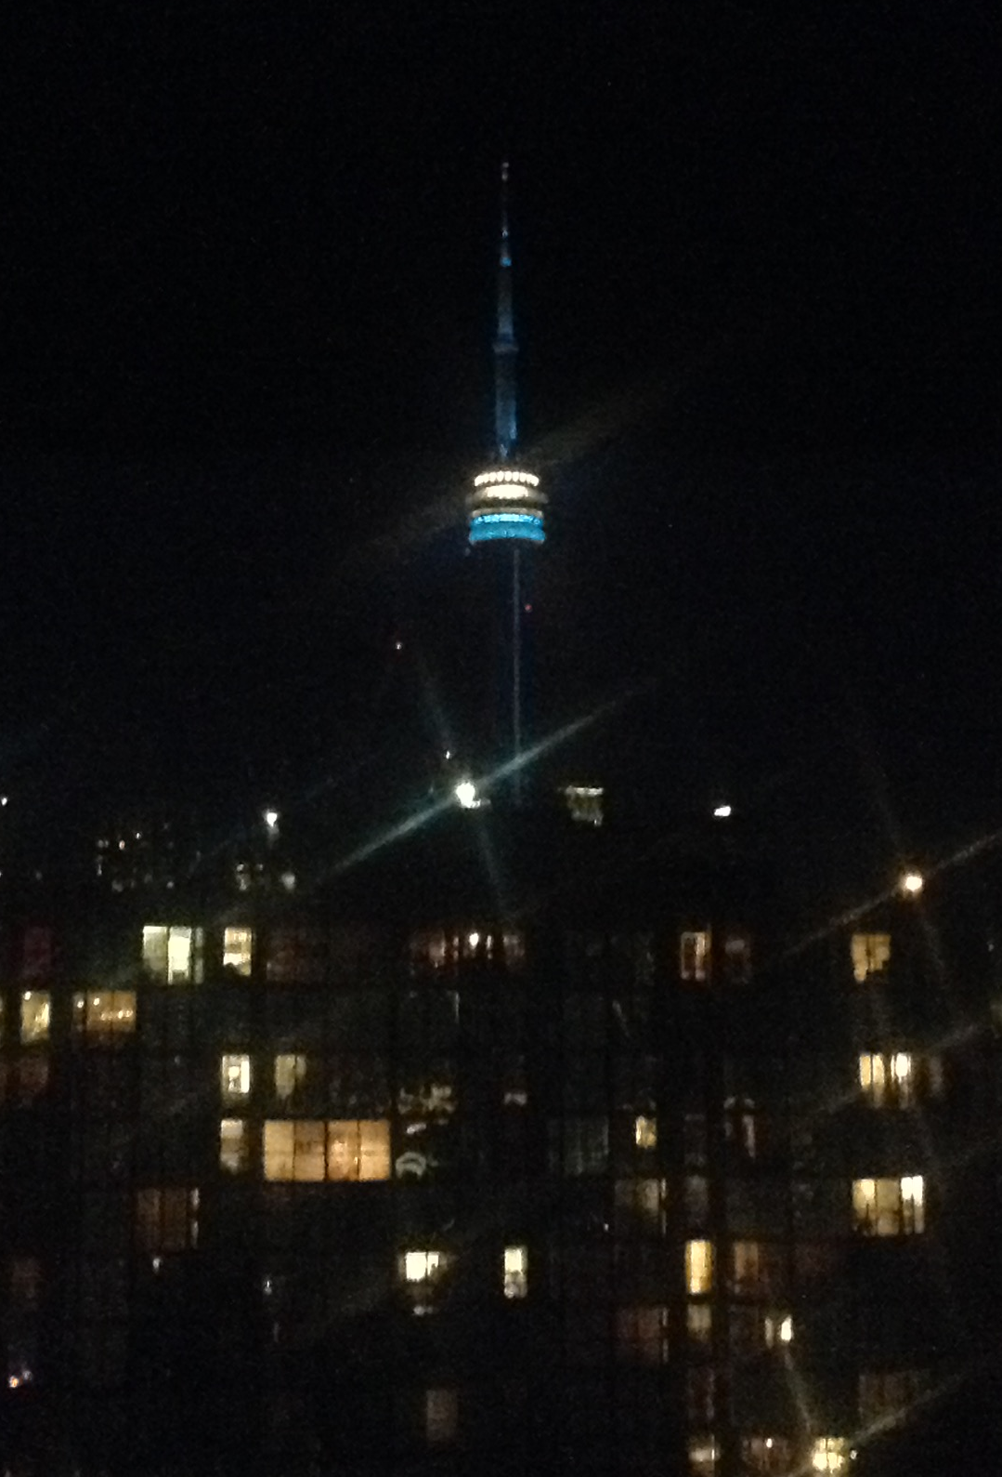
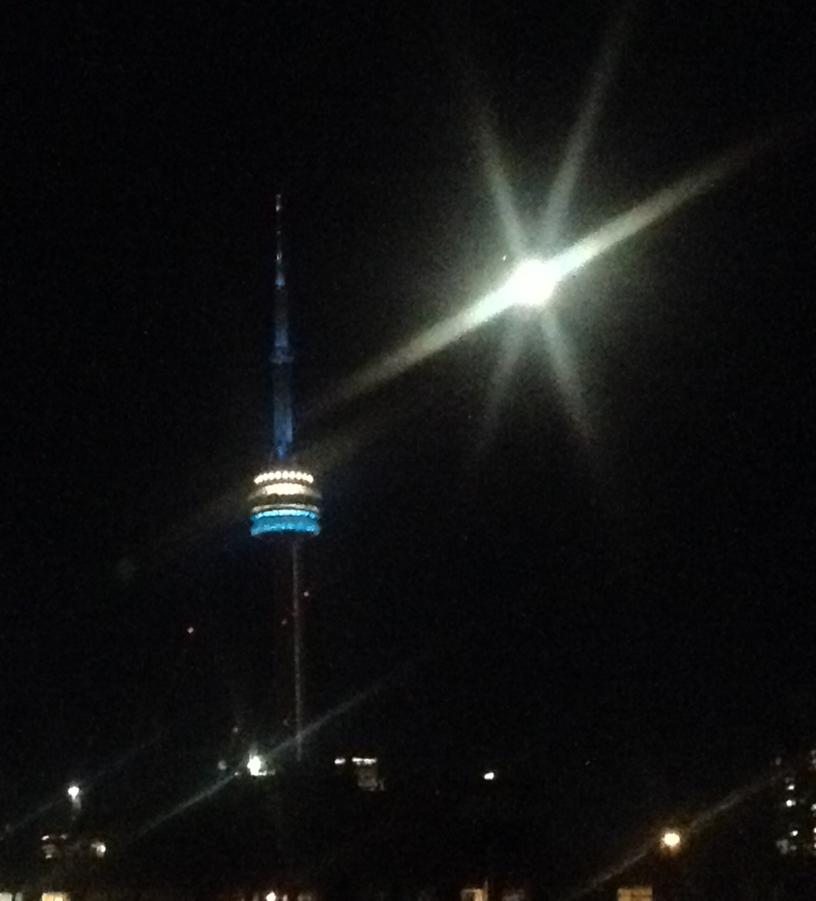
Hours Time Cycle: Movement of Moon
6 September 2020, 10pm
6 September 2020, 11pm

Slide 12
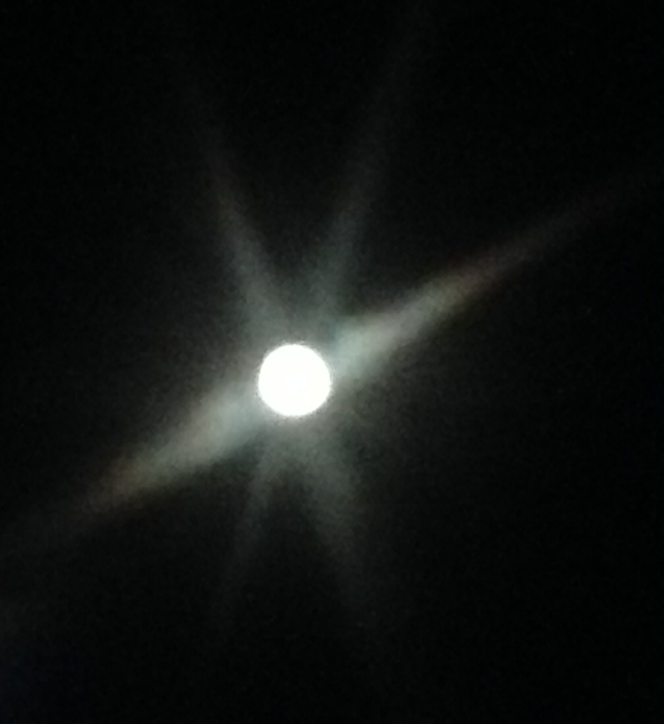
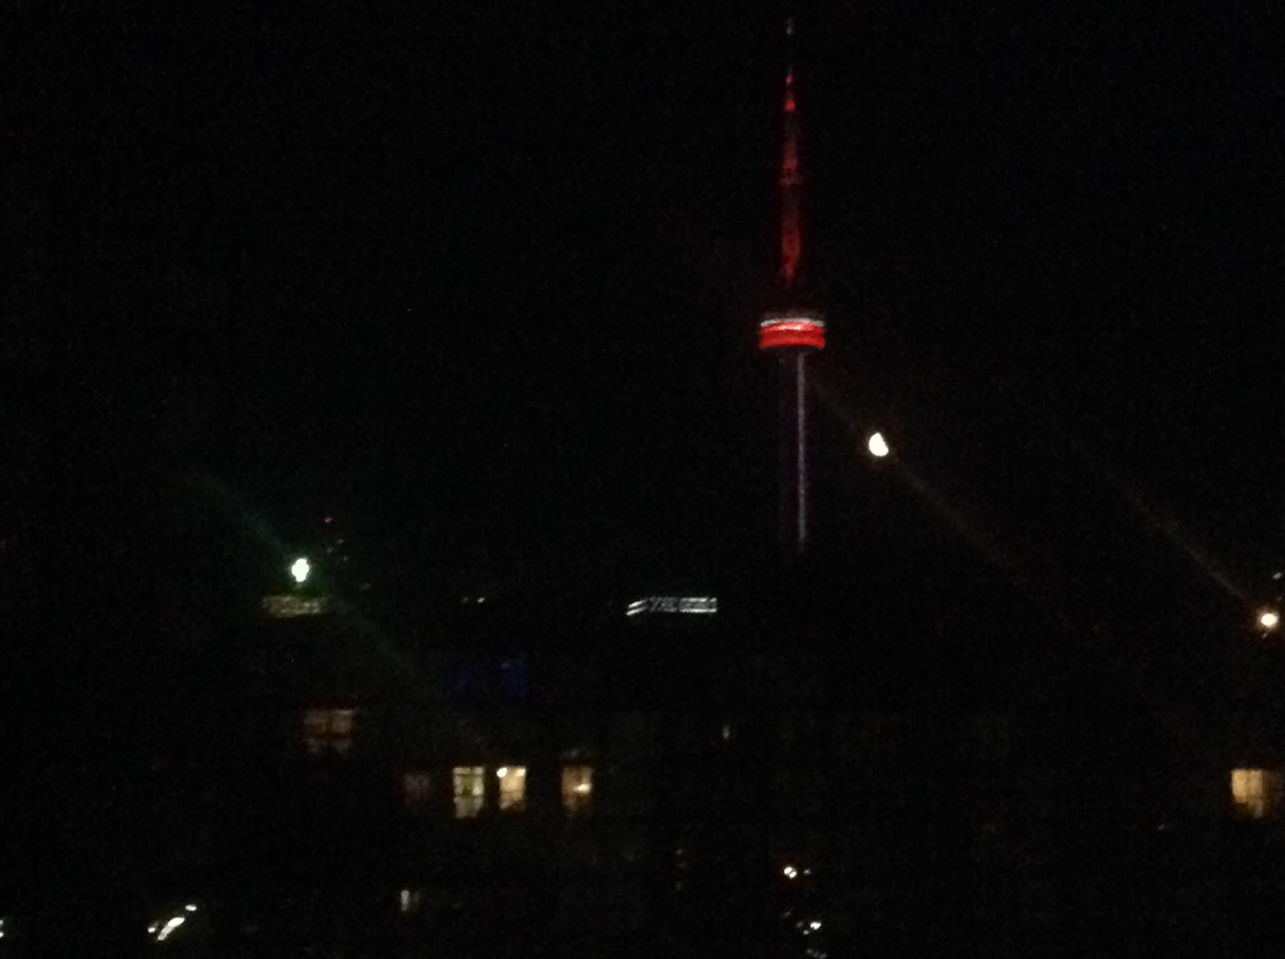
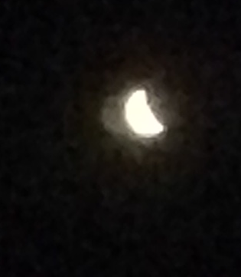
Days Time Cycle: Phases of Moon
Coming Soon!
Full Moon
Last Quarter
Waning Crescent
New Moon

Slide 13
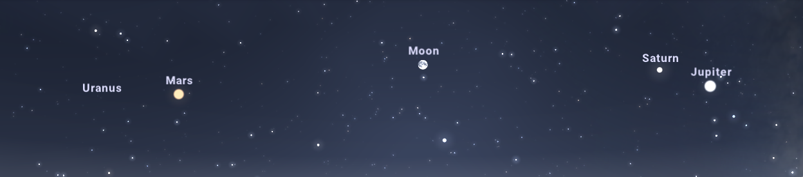
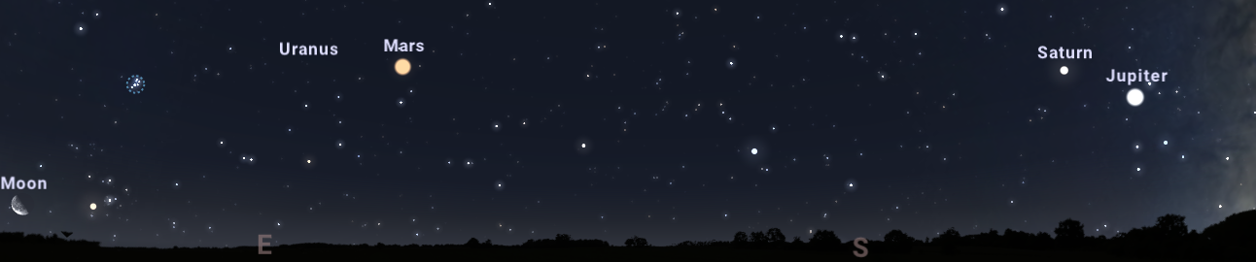
Weeks Time Cycle: 2 Sky objects coming closer
Moon and Mars Distance
September 1, 2020
Mars
Moon
September 9, 2020
Mars
Moon

Slide 14
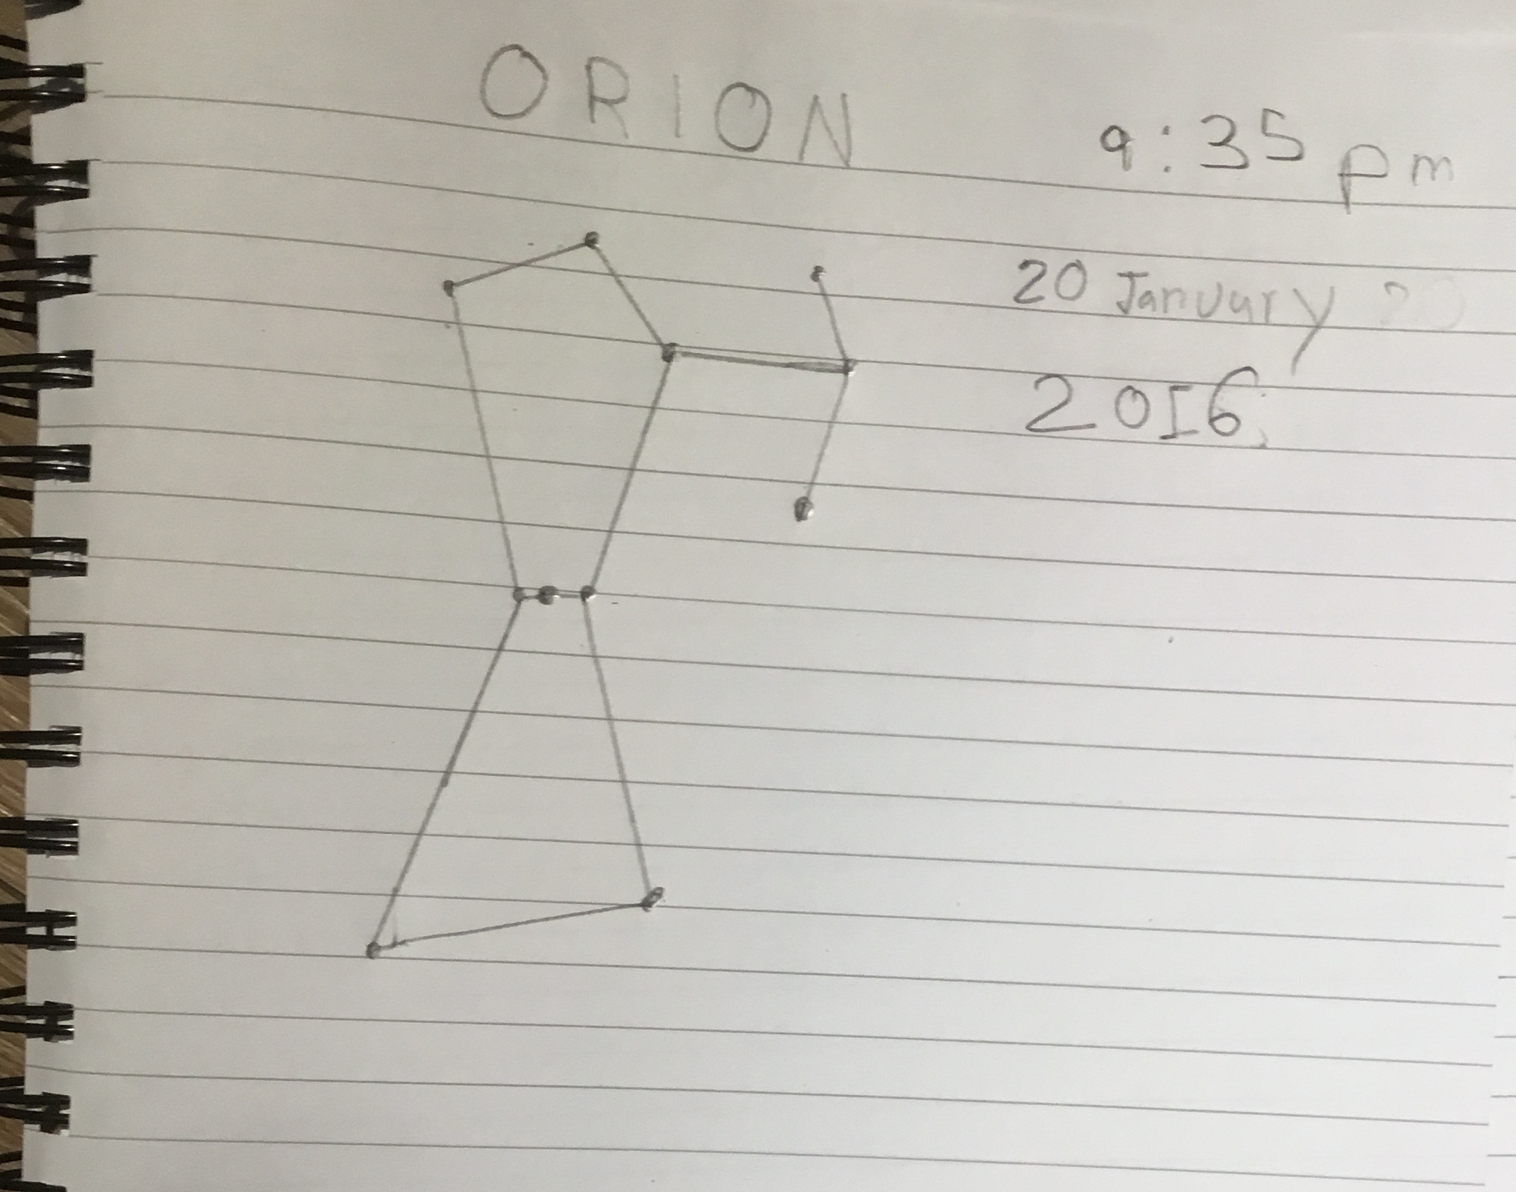
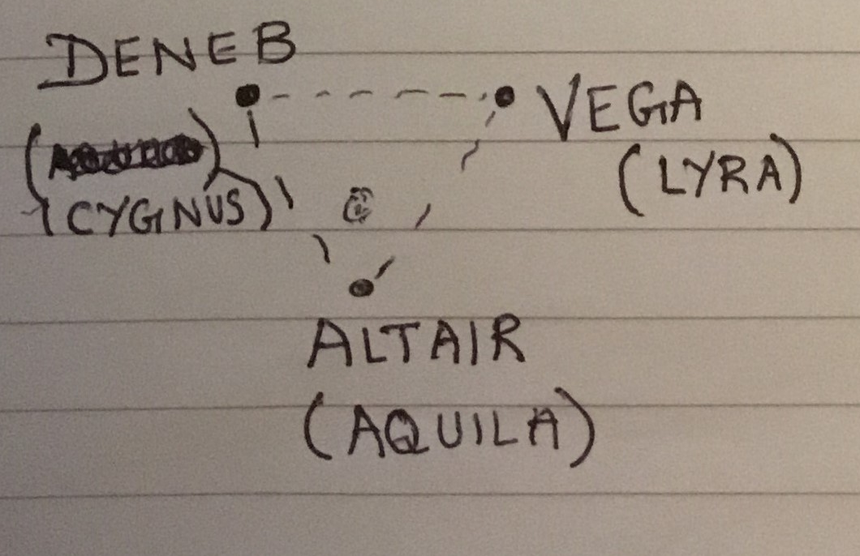
Months Time Cycle: New constellations appear in the Sky
Summer and Winter Season Constellations
Summer Triangle
Orion

Slide 15
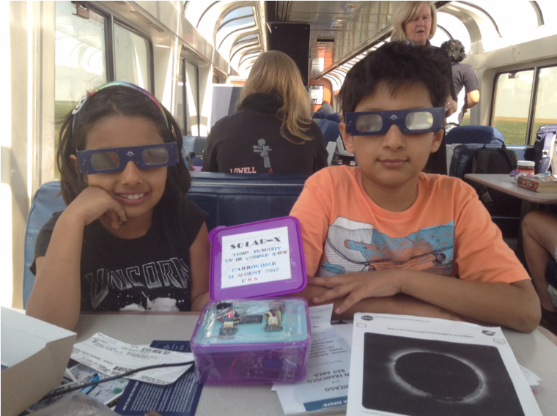

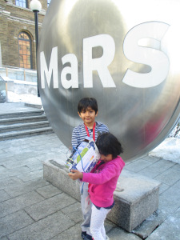
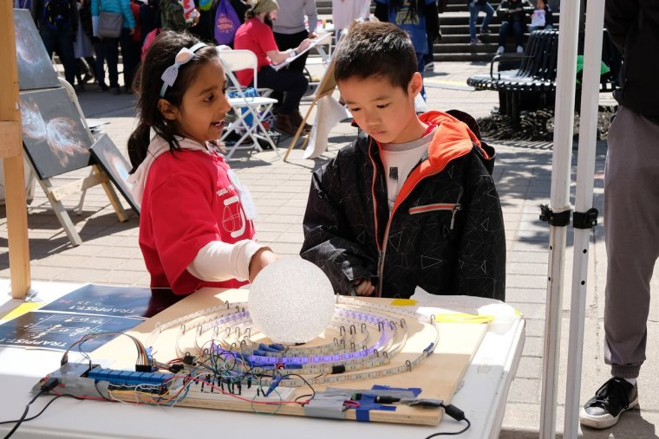
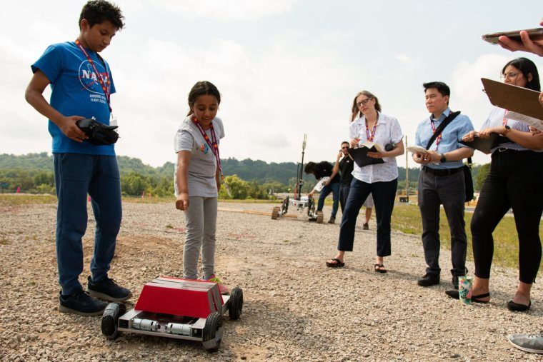
Made many Astronomy Instruments + Space Projects!

Slide 16
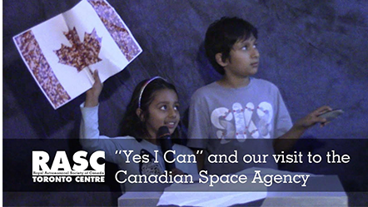
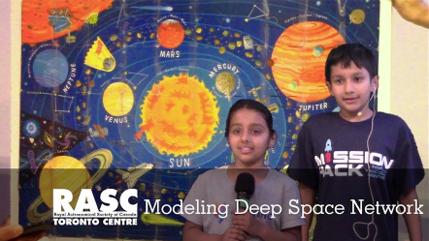
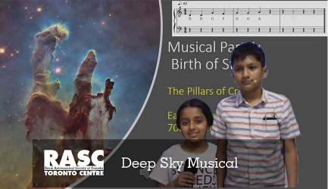
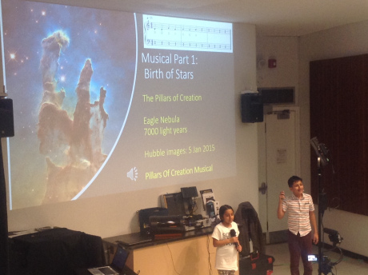
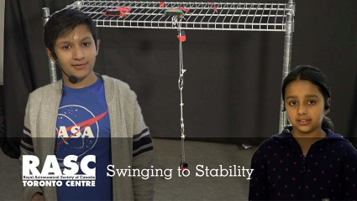
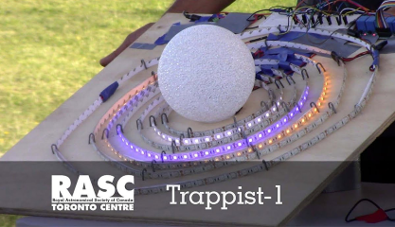
11 Presentations @ RASC Recreational Astronomy Nights + my first solo Astronomy presentation!
!

Slide 17
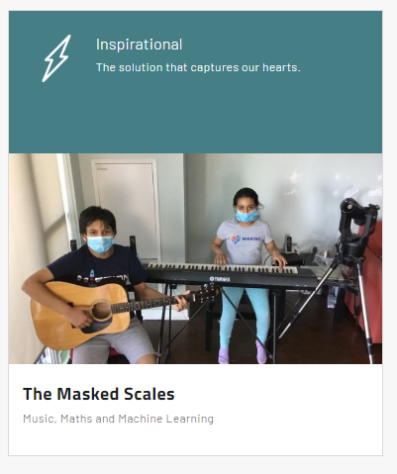
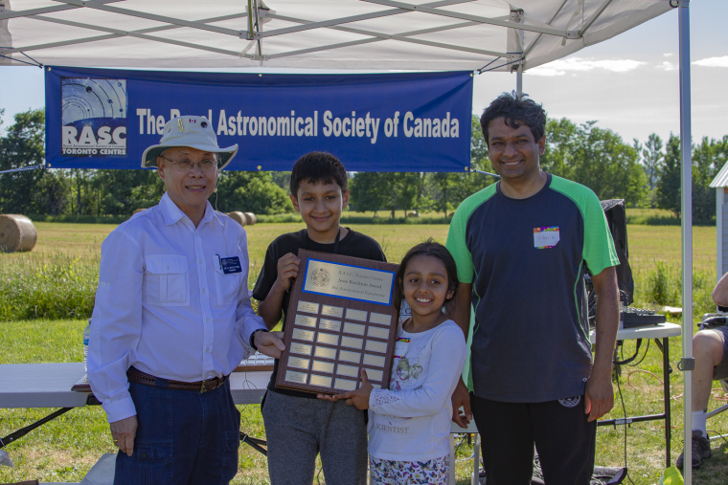
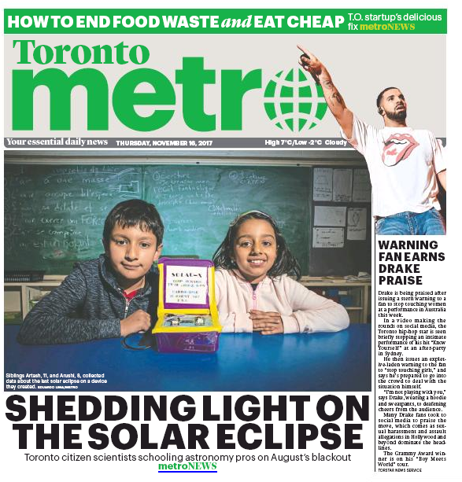
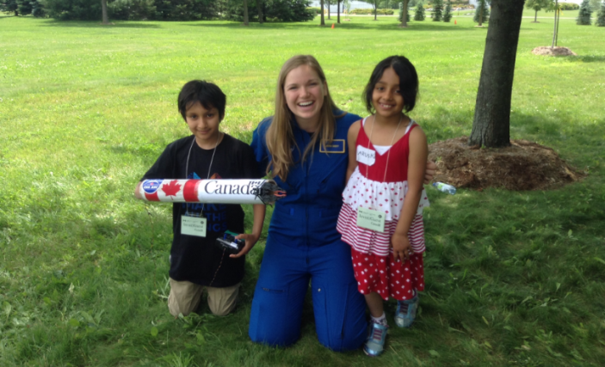
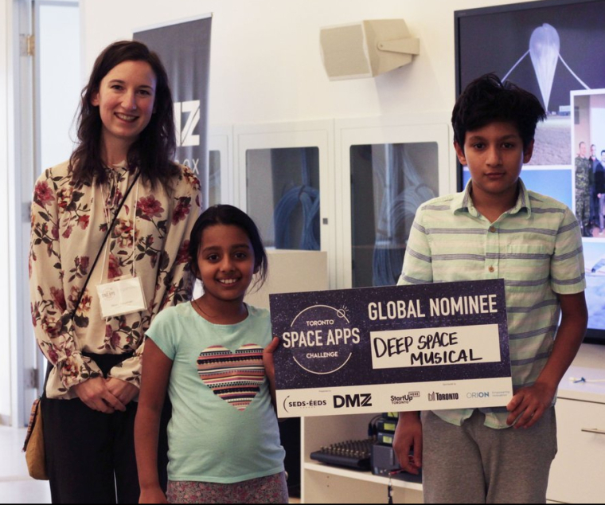
Won some Awards!
2020 Global Winners
NASA SpaceApps COVID19
Challenge
Jesse Ketchum Award 2017
NASA SpaceApps Winner 2018
Canada SpaceApps National Winner 2017

Slide 18
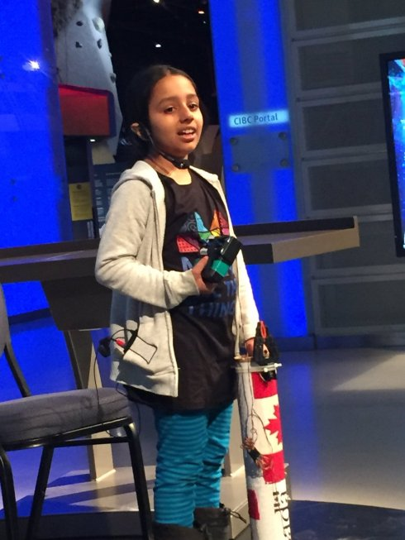
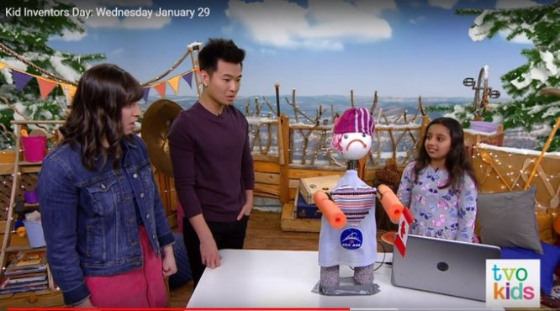
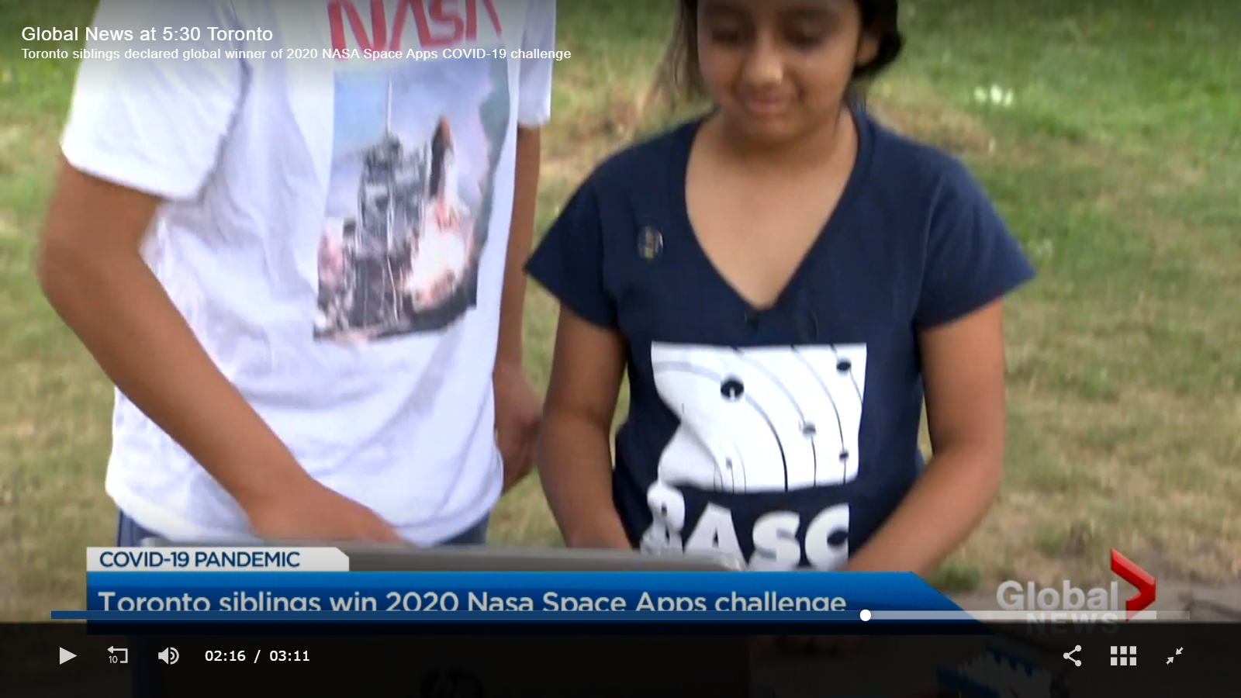
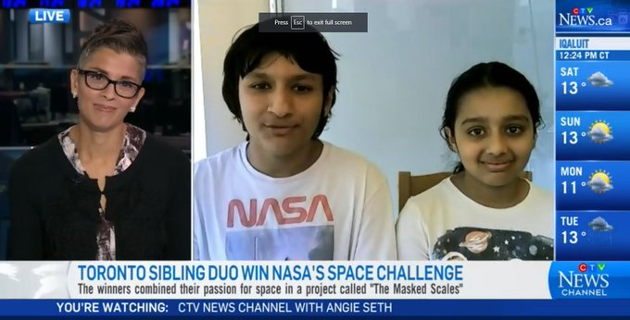
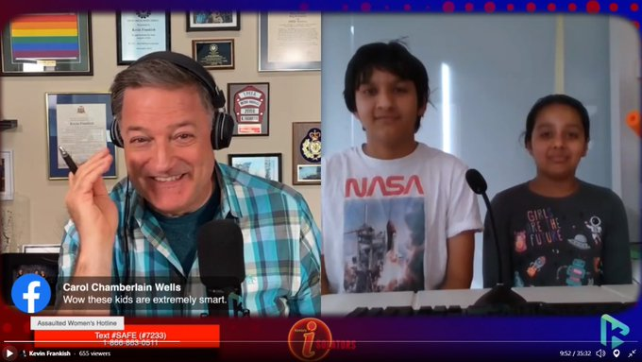
Outreach about RASC in English and Francais
TVO Kids 2020
Global News Canada 2020
International Day for Women and Girls in Science, Ontario Science Centre
Kevin Frankish Show 2020
CTV News Toronto 2020

Slide 19
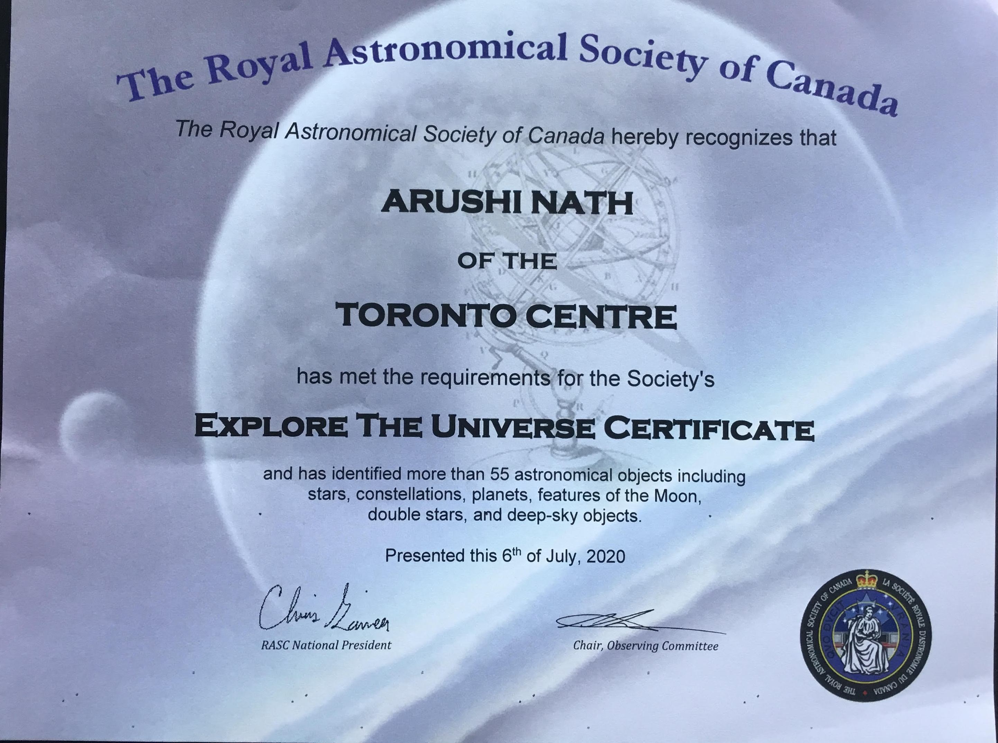
Explore the Universe Certificate:
The journey was fun and exciting!

Slide 20
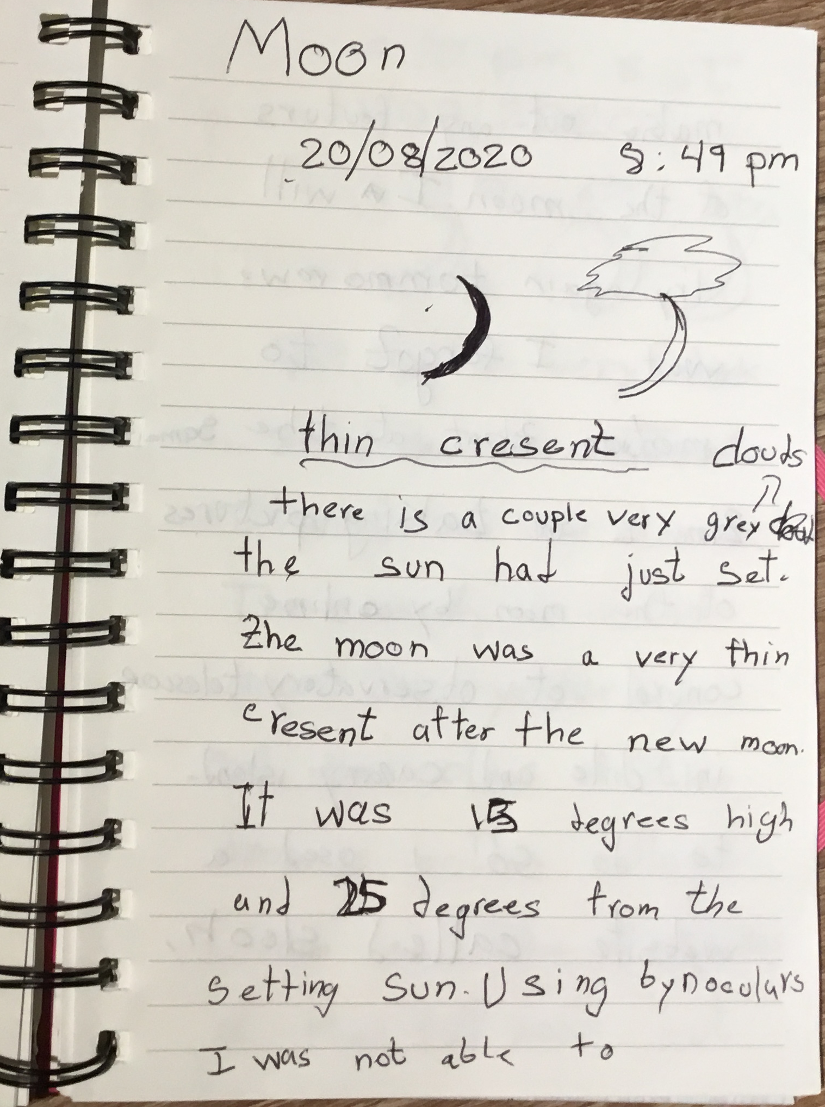
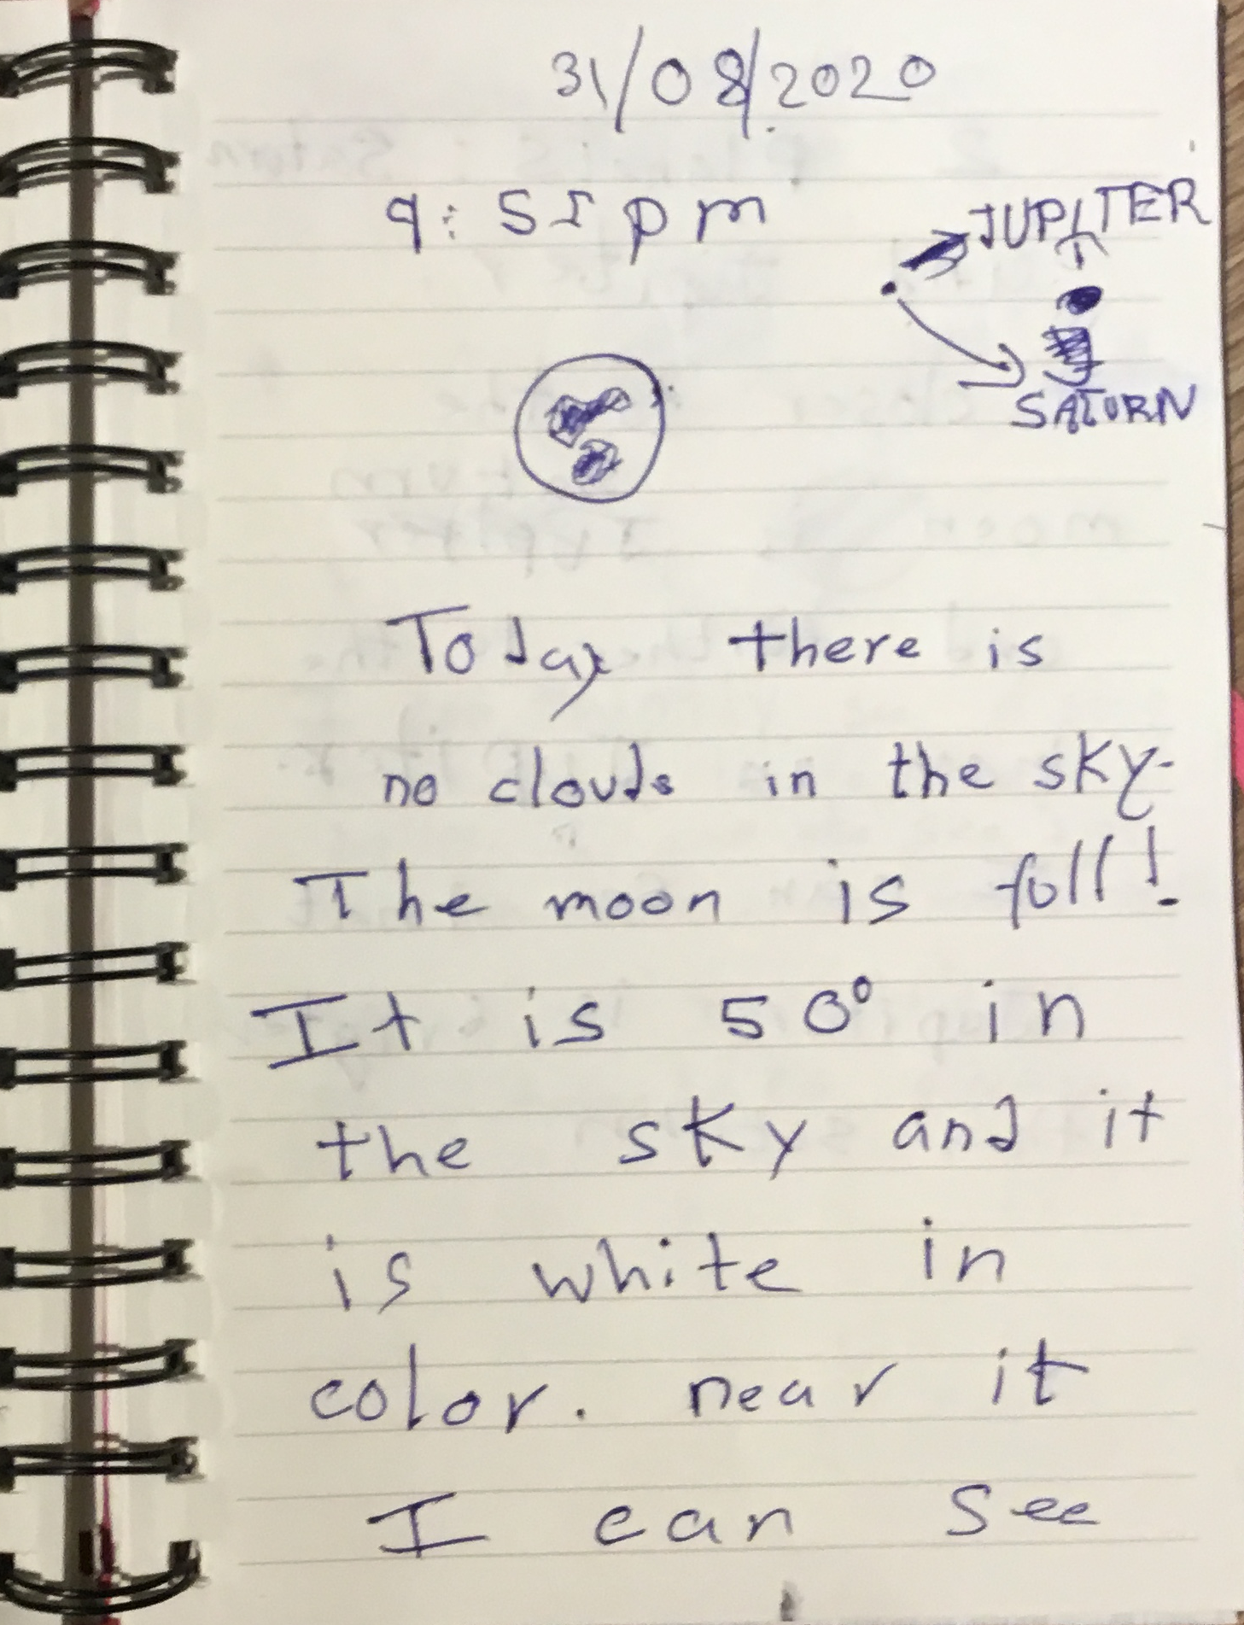
The Space journey has only started!

Slide 21
My Travels around the Universe for 6 years to complete RASC Explore the Universe Certificate
Arushi Nath (Grade 6)
Recreational Astronomy Night Meeting
Royal Astronomical Society of Canada, Toronto
16 September 2020
Website: www.HotPopRobot.com
Twitter: @Wonrobot

