Slide 1

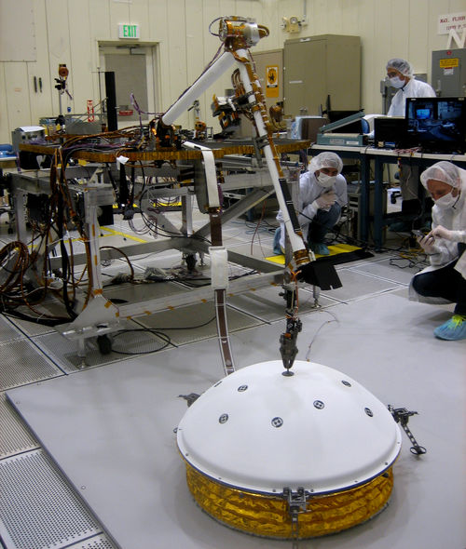
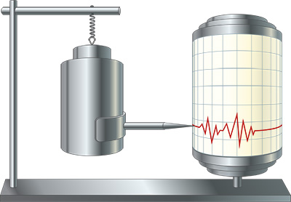

From Outer Space to Sub Surface:
Seismic vibrations, how to measure them, and the impact of COVID19 lockdown
Artash Nath
Grade 8 Student
Twitter: @wonrobot www.HotPopRobot.com
Artash.Nath@gmail.com
Royal Astronomical Society of Canada, Toronto,
15 July 2020

Slide 2
Seismic Vibrations
Tell Stories!
Geology of Planets
Interior structure, tectonic plate movements, volcanoes
Weather Phenomena
Wind and dust storms
Meteor Strikes
Human Activities
Transport, mining, rocket launches

Slide 3
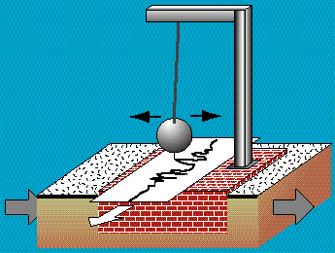
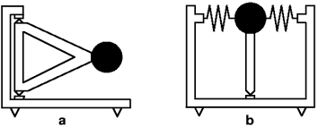
Seismometers: To Measure Seismic Vibrations
Simple Pendulum with a heavy mass!
3 separate pendulums to record displacement along 3 axis:
north-south
east-west
up-down
Inverted Pendulum: for more sensitivity
up-down
east-west / north-south
inverted pendulum designs

Slide 4
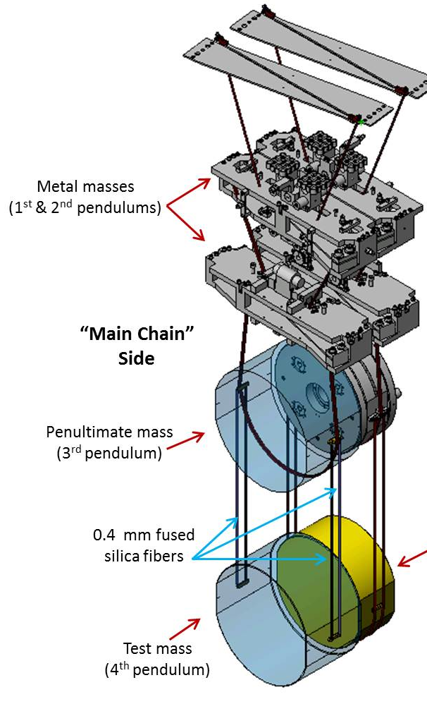
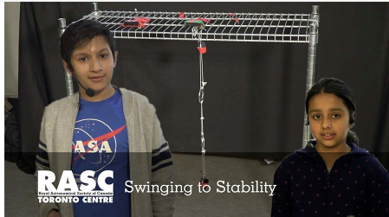
Astronomy:
Are Seismic Vibrations desirable or undesirable?
Both
Desirable to understand Planetary Geology
Undesirable to detect Gravitational Waves: Laser Interferometer Gravitational-Wave Observatory (LIGO)
In both cases we make use of Pendulums!
Check out my previous 2019 RASC Toronto talk on how LIGO uses Quadruple Pendulums to eliminate seismic vibrations

Slide 5
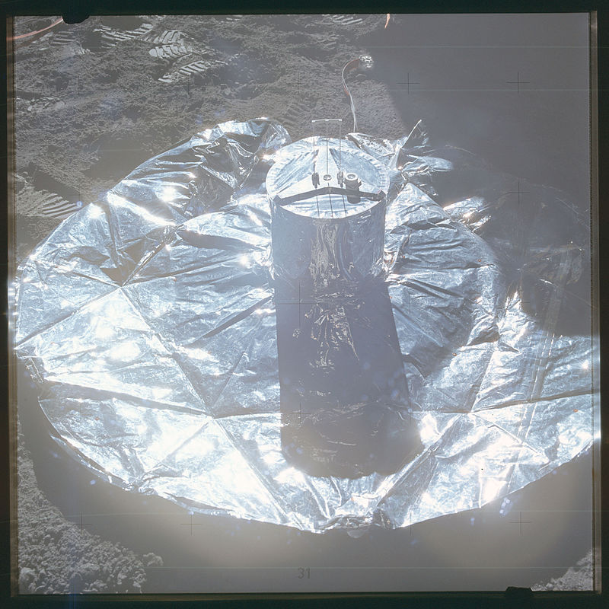
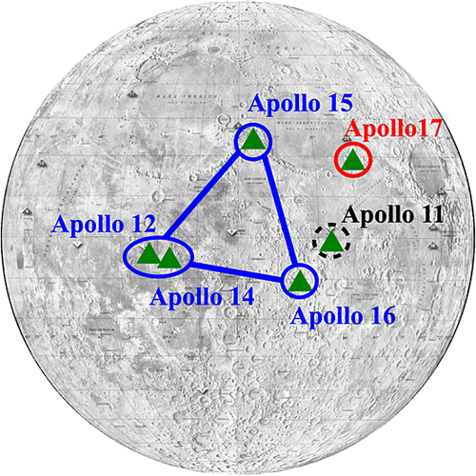
Moon: Apollo Missions (1969-1972)
Apollo Missions 11, 12, 14, 15, 16 carried seismometers
Readings came until 1977
Apollo 11 seismometer lasted only ~3 weeks.
Apollo 17 carried a Gravimeter: to measure difference in the force of gravity from one place to another
Image Credit: https://agupubs.onlinelibrary.wiley.com/doi/full/10.1002/2014JE004724

Slide 6
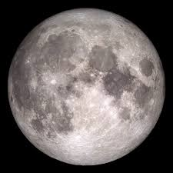
Lunar Quakes: Causes + Data
Causes:
Tidal Forces: Gravitational forces exerted by Earth
Global Contraction: Moon is shrinking as its interior cools
Data (between 1969 and 1977)
28 shallow moonquakes, ranging from magnitude 1.5 to 5.0 on the Richter scale
> 1700 meteoroid impacts (almost 1 per day) with impactor masses between 0.5 and 5000 kilograms

Slide 7
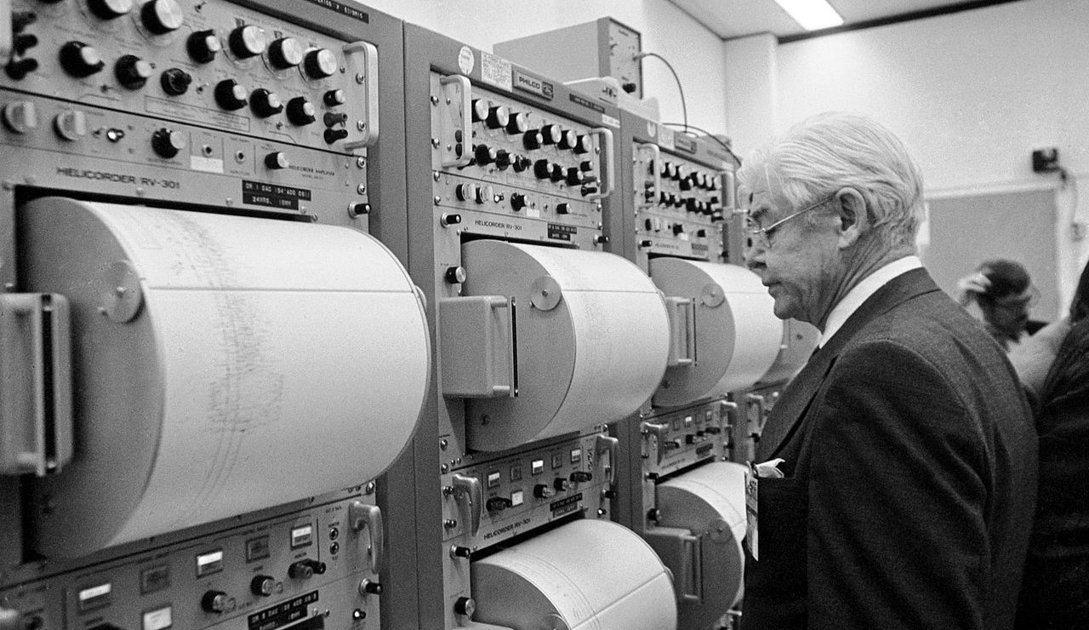
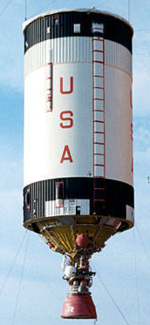
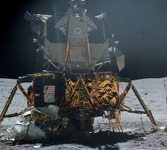
Artificial Lunar Quakes Observed
Third stages of several Saturn V rockets, and Ascent stages of lunar modules were deliberately crashed into the Moon.
Produced seismic events of known times and locations - helped to calibrate the network of seismometers.
Seismometer readings from Apollo 17 Saturn S-IVB impacting the Lunar surface arrive at NASA
Image Credit: https://en.wikipedia.org/wiki/Lunar_seismology

Slide 8
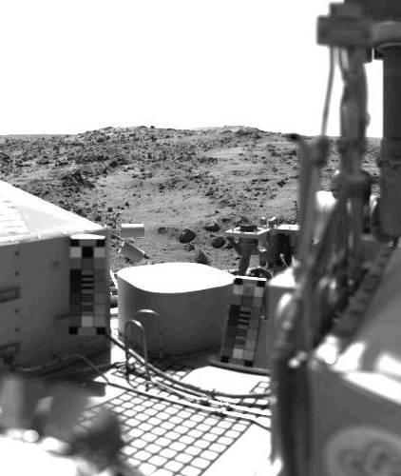
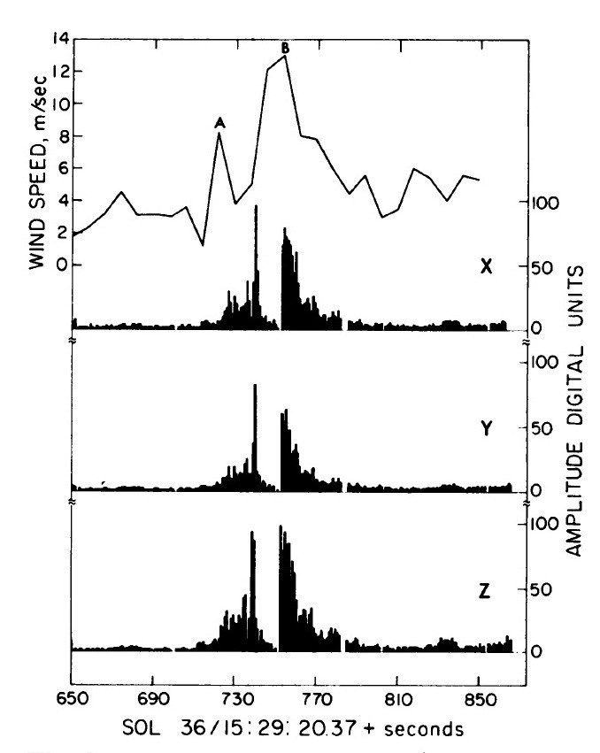
Mars: Viking Lander Missions (1976)
Viking 1 seismometer did not get activated
Viking 2 seismometer operated for 500+ sols
Seismometers mounted on top bay. Affected by Wind Noise + lander’s equipment activity
Only one event (on Sol 80) was considered as possible seismic event. But upper limits to seismic vibrations were calculated
seismometer
Image Credit: https://www.drewexmachina.com/2018/11/21/viking-the-first-seismometers-on-mars/

Slide 9
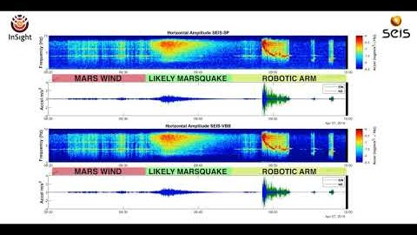
First Likely Mars Quake Heard by
NASA InSight
(April 6, 2019, the 128th Martian day, or sol, of the mission)
https://mars.nasa.gov/news/8430/nasas-insight-detects-first-likely-quake-on-mars/?site=insight

Slide 10
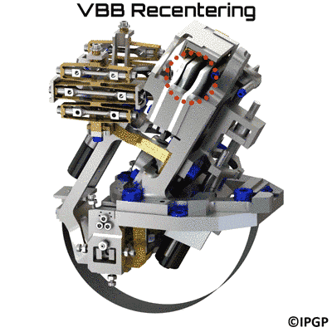
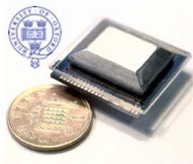
Mars: NASA Insight (2018)
Landed in the Elysium Planitia region of Mars on 26 Nov 2018.
SEIS (Seismic Experiment for Interior Structure):
the round, dome-shaped instrument
2 Sets of Seismometers:
3 axis Very Broad Band (VBB) sensors:
0.01-10 Hz frequency bandwidth (Main Instrument)
3 axis Short Period (SP) sensors:
0.1-50 Hz frequency bandwidth (for Redundancy)

Slide 11
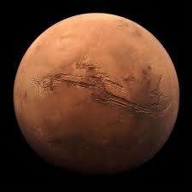
Mars Quakes
Causes + Data
Causes:
Global Contraction: Constant internal cooling process, which happens inside most rocky planets
Data (through 30 September 2019): 174 events
24 events (magnitude 3 – 4) propagating from as far down as the planet’s mantle
150 small-magnitude events occurring frequently and propagating from the crust (wind, landslides, unsure)
Mars quakes resemble more closely to those of moon quakes than earthquakes

Slide 12



Seismic Vibrations on Earth
Train Signal
Cruise Ship Signal
Wind Signal
Human Activities
Mining / Explosion

Slide 13
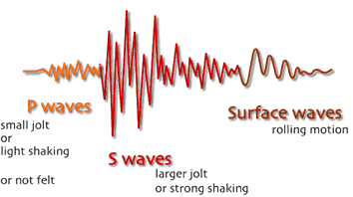
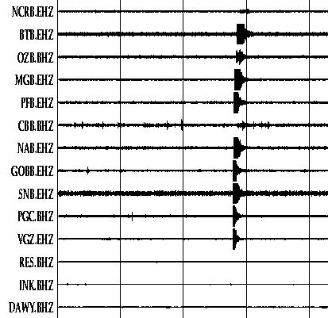
Earthquake Signals
Signals become very strong in very short time
These may be aftershocks
P, S, Surface Waves from the same earthquake that have travelled in different ways and at different speeds
Several stations register the signal
Source: https://earthquake.usgs.gov/learn/glossary/?term=S%20wave

Slide 14
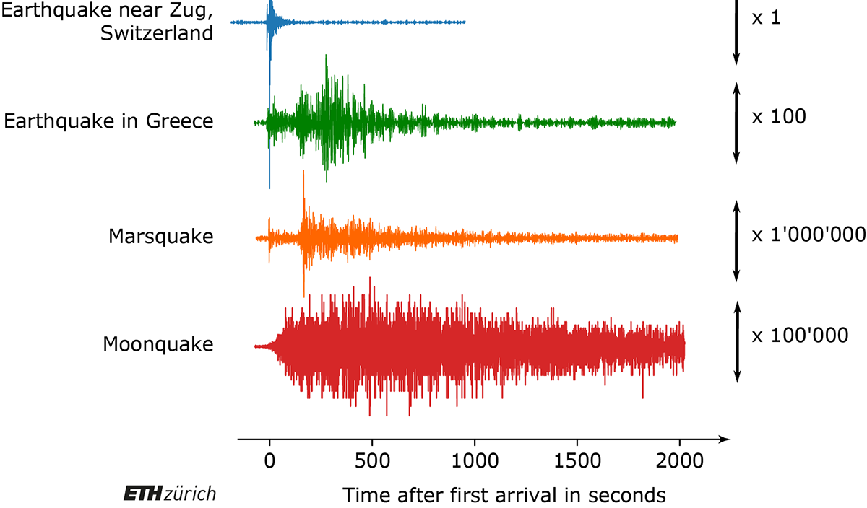
Quakes: Earth vs. Mars vs Moon
Earthquakes: Larger magnitudes, Shorter duration
Moon + Mars quakes: Longer duration. Smaller magnitudes
Earthquakes release lot more energy than Moon and Mars quakes

Slide 15
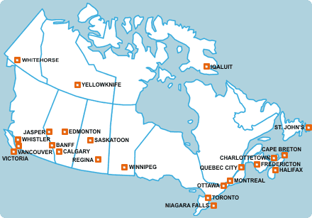


Using Seismic Vibrations to Study Impact of COVID19 Lockdown on Canadian Cities
Calgary, AB Edmonton, AB
Montreal, QC Ottawa, ON
Toronto, ON Yellowknife, NWT
https://softwareunderground.org/

Slide 16

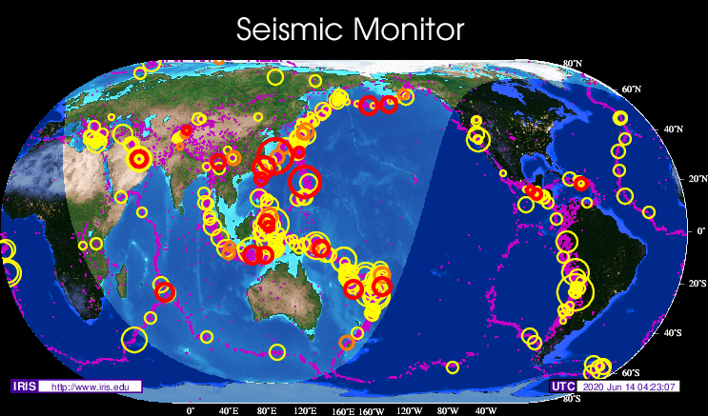
Data Source
Data Type
Data files type:
MiniSEED (MSEED) containing Waveform data
Python library:
ObsPy to download and process MSEED files
http://ds.iris.edu/ds/nodes/dmc/data/

Slide 17
Raw Data Processing – Overlapping and Averaging
9,486,720,000‬ lines of seismic data used for Analysis
To Analyse the Trend
The RMS (average displacement) was calculated for each 15-minute period inside the main Probabilistic Power Spectral Densities (PPSD) files, with an overlap of 50%. The same is done for each 24-hour period in the data
Followed tutorial by Thomas Lecocq (github.com/ThomasLecocq/SeismoRMS) on visualizing and plotting seismic data over time

Slide 18
Calgary, AB
State of Emergency: 15 March 2020
31% decrease in seismic vibrations after lockdown
Network: CN
Station: TD022
Channel: HHZ
Location: --

Slide 19
Edmonton, AB
State of Emergency: 15 March 2020
14% decrease in seismic vibrations after lockdown
Network: CN
Station: TD002
Channel: HHZ
Location: --

Slide 20
Montreal, QC
State of Emergency: 27 March 2020
34 % decrease in seismic vibrations after lockdown
Network: CN
Station: MNTQ
Channel: HHZ
Location: --

Slide 21
Ottawa, ON
State of Emergency: 25 March 2020
8% increase in seismic vibrations after lockdown
Network: CN
Station: OTT
Channel: HHZ
Location: --

Slide 22
Yellowknife, NWT
State of Emergency: 24 March 2020
44 % decrease in seismic vibrations after lockdown
Network: CN
Station: YKAW1
Channel: HHZ
Location: --

Slide 23
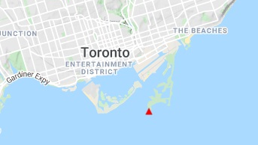
Toronto, ON
State of Emergency: 23 March 2020
34 % decrease in seismic vibrations after lockdown
Network: CN
Station: TORO
Channel: HHZ
Location: --

Slide 24
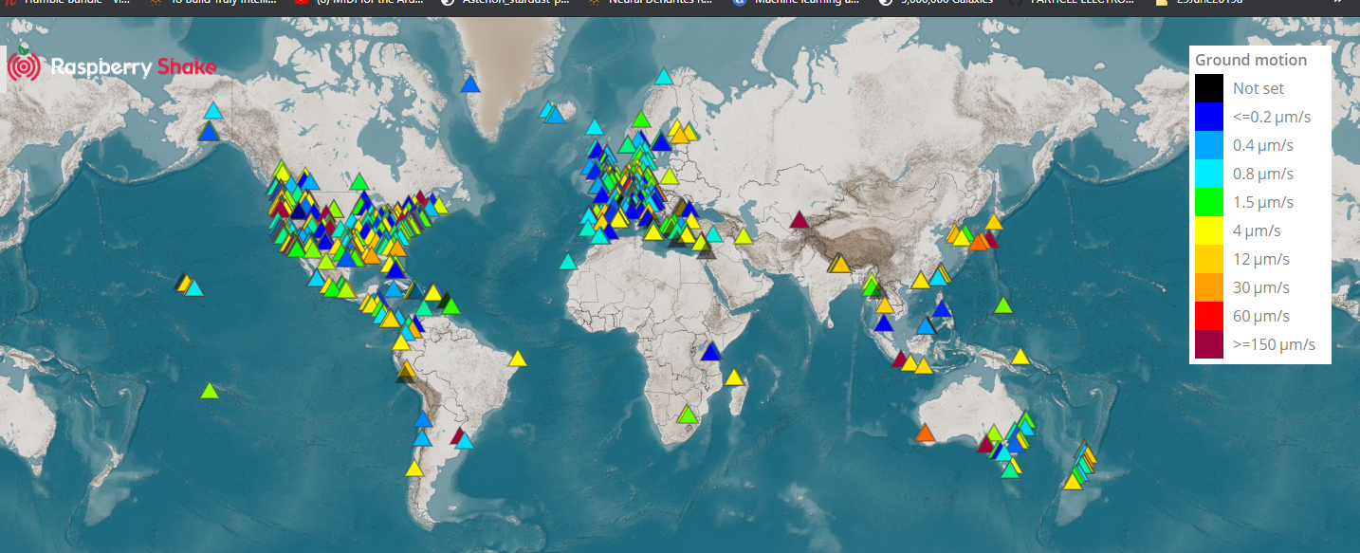
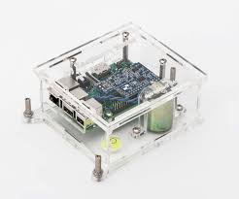
LIVE DEMO:
Raspberry Shake Community Seismic Network
My Toronto Seismic Station using Raspberry Shake https://raspberryshake.net/stationview/#?net=AM&sta=RC893

Slide 25
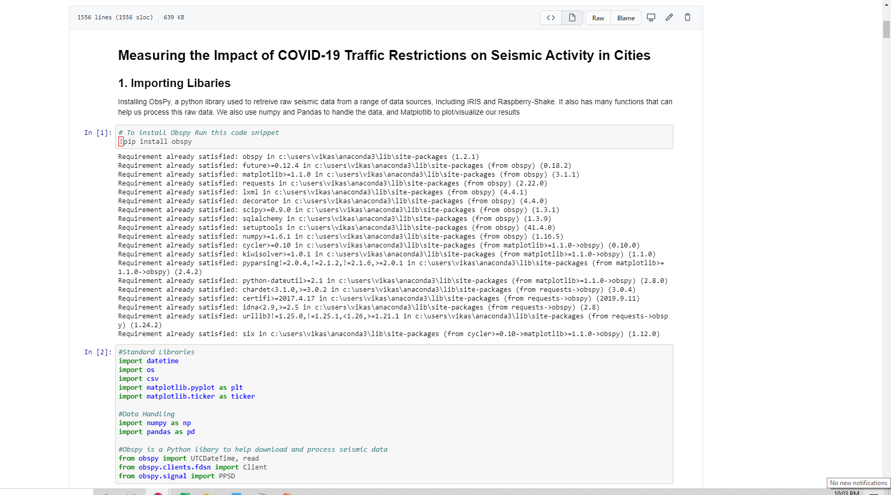
My Online Training Module:
Do It Yourself Seismic Analysis
GitHub : Artash-N
https://github.com/Artash-N/COVID19-Impact-on-Seismic-Activity
Join Software Underground Community: Place for scientists that like rocks and computers. https://softwareunderground.org/

Slide 26
From Outer Space to Sub Surface:
Seismic vibrations, how to measure them, and the impact of COVID19 lockdown
Artash Nath
Grade 8 Student
Twitter: @wonrobot www.HotPopRobot.com
Artash.Nath@gmail.com
Royal Astronomical Society of Canada, Toronto,
15 July 2020

