Slide 1
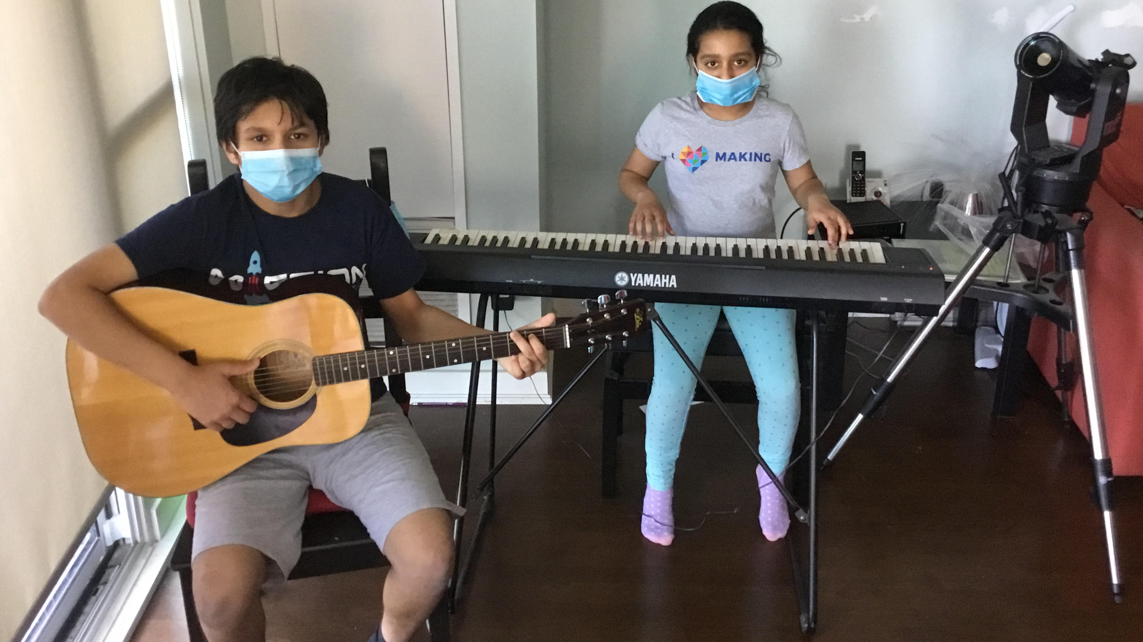
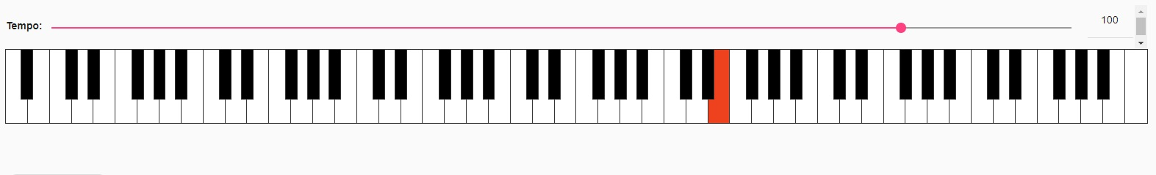
The Masked Scales
Sonification of COVID19 Lockdown Impacts in Toronto, Canada
Artash Nath (Grade 8)
Arushi Nath (Grade 5)
Co-Founders, www.HotPopRobot.com
Twitter: @wonrobot
Toronto, Canada

Slide 2
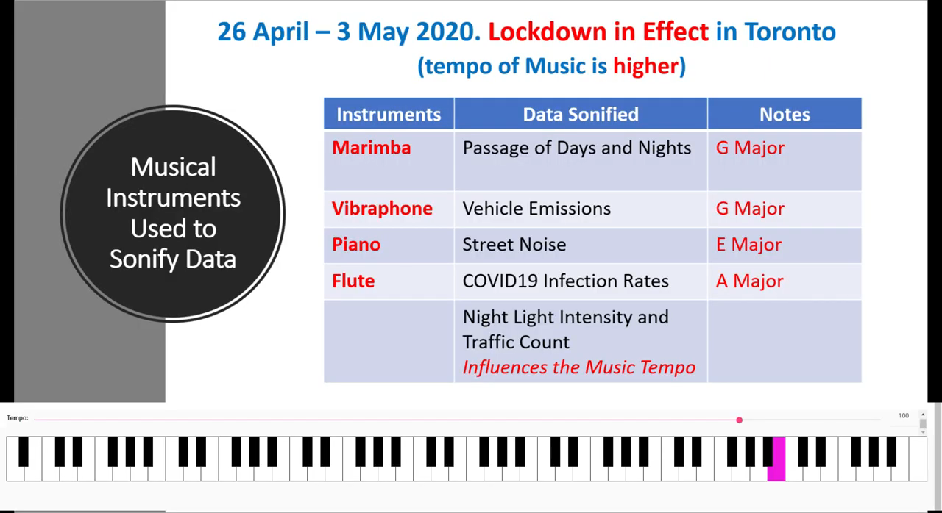
Music

Slide 3
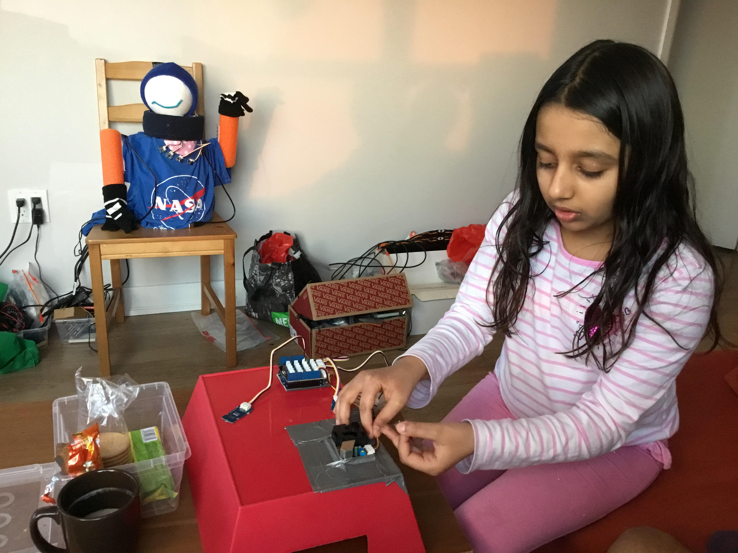
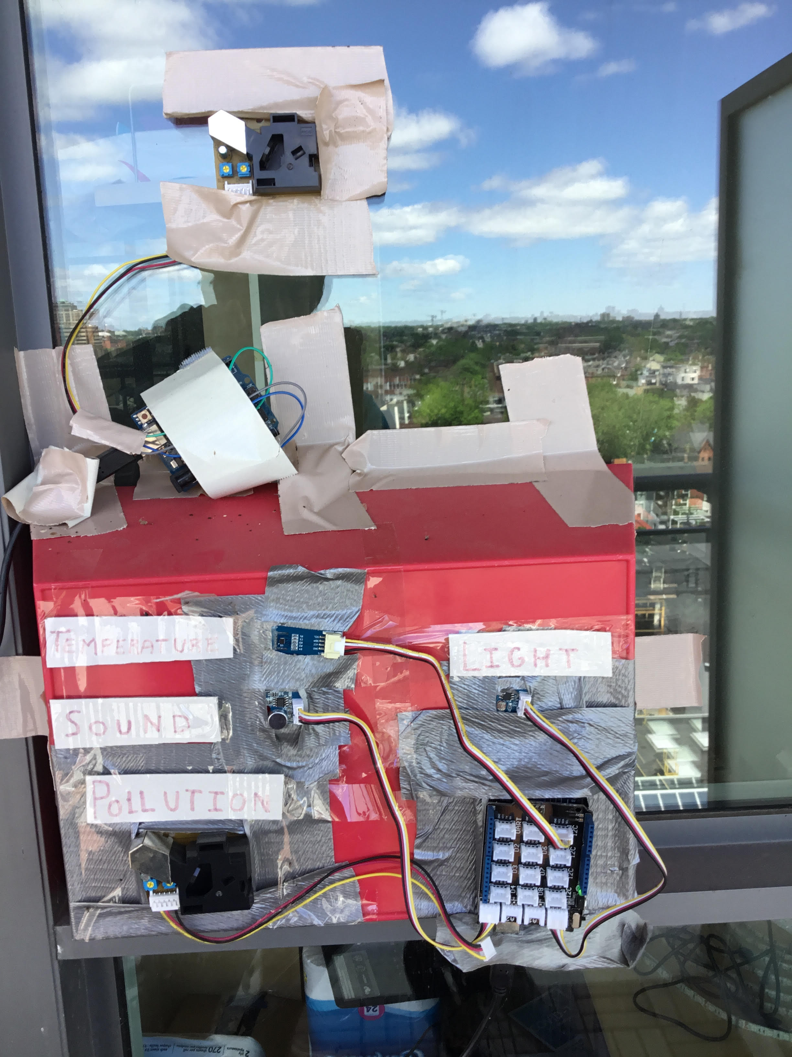
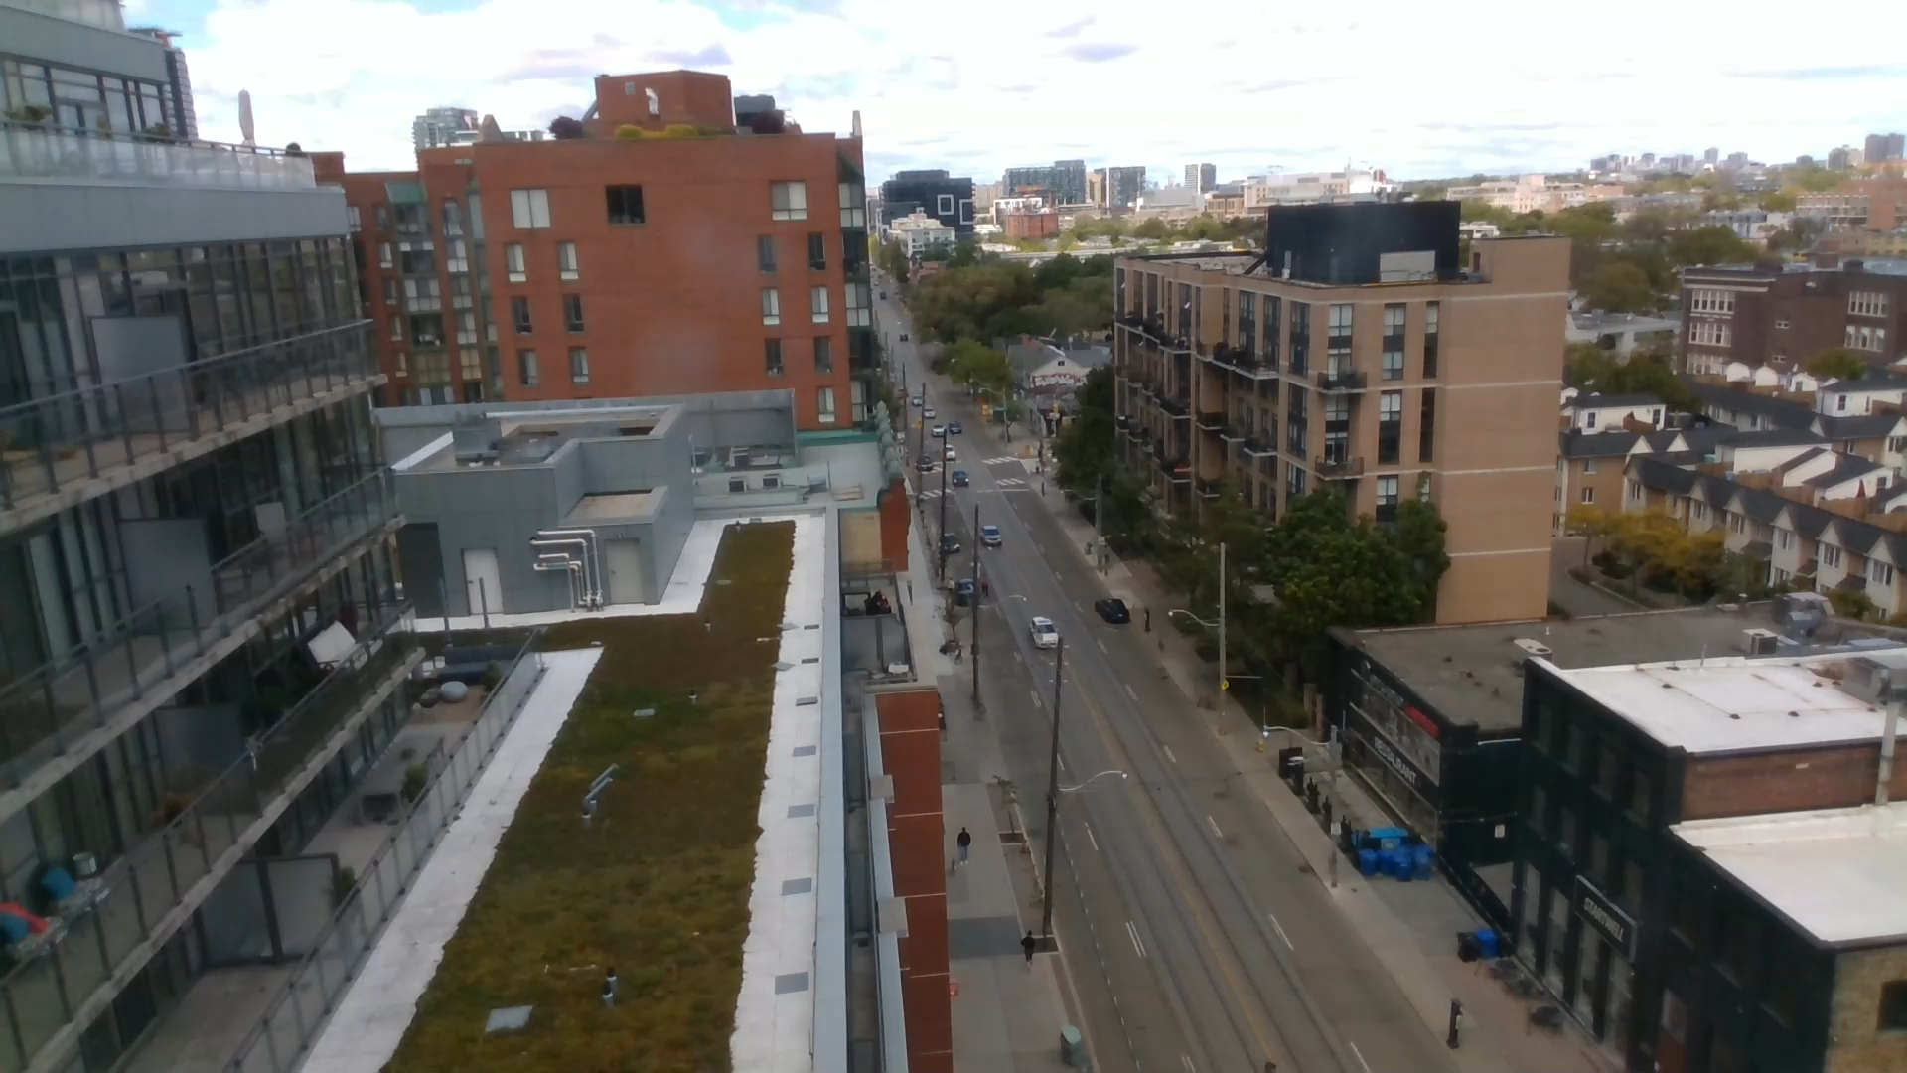
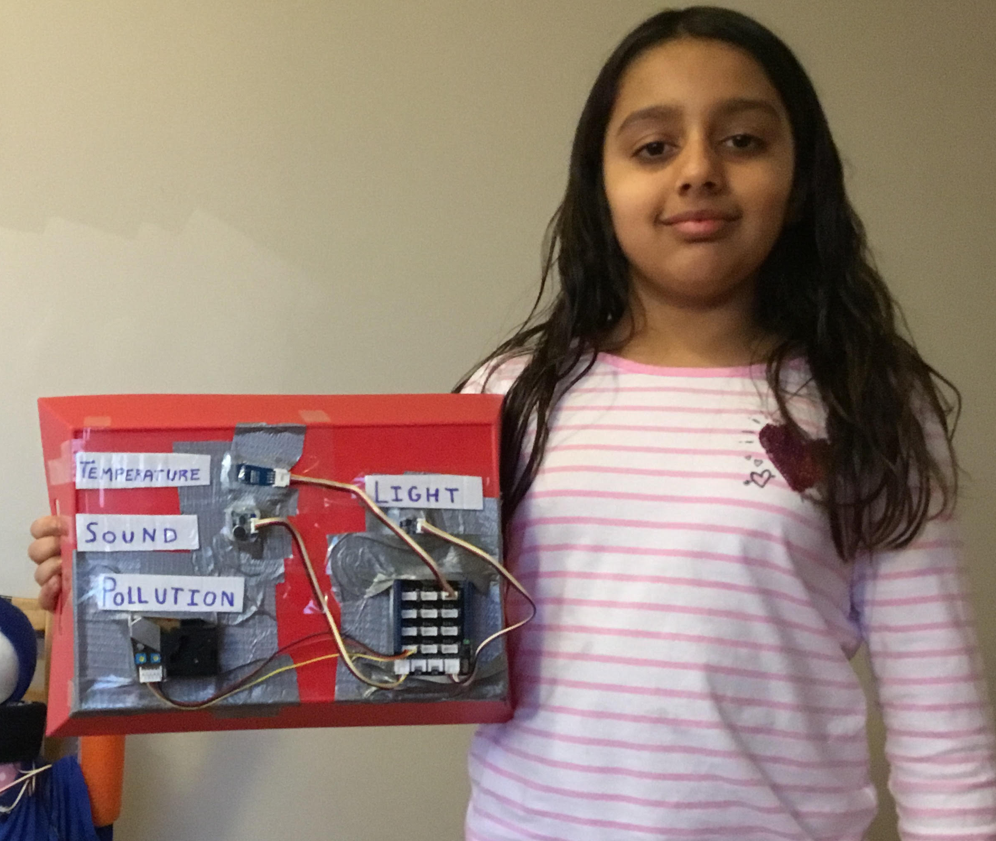
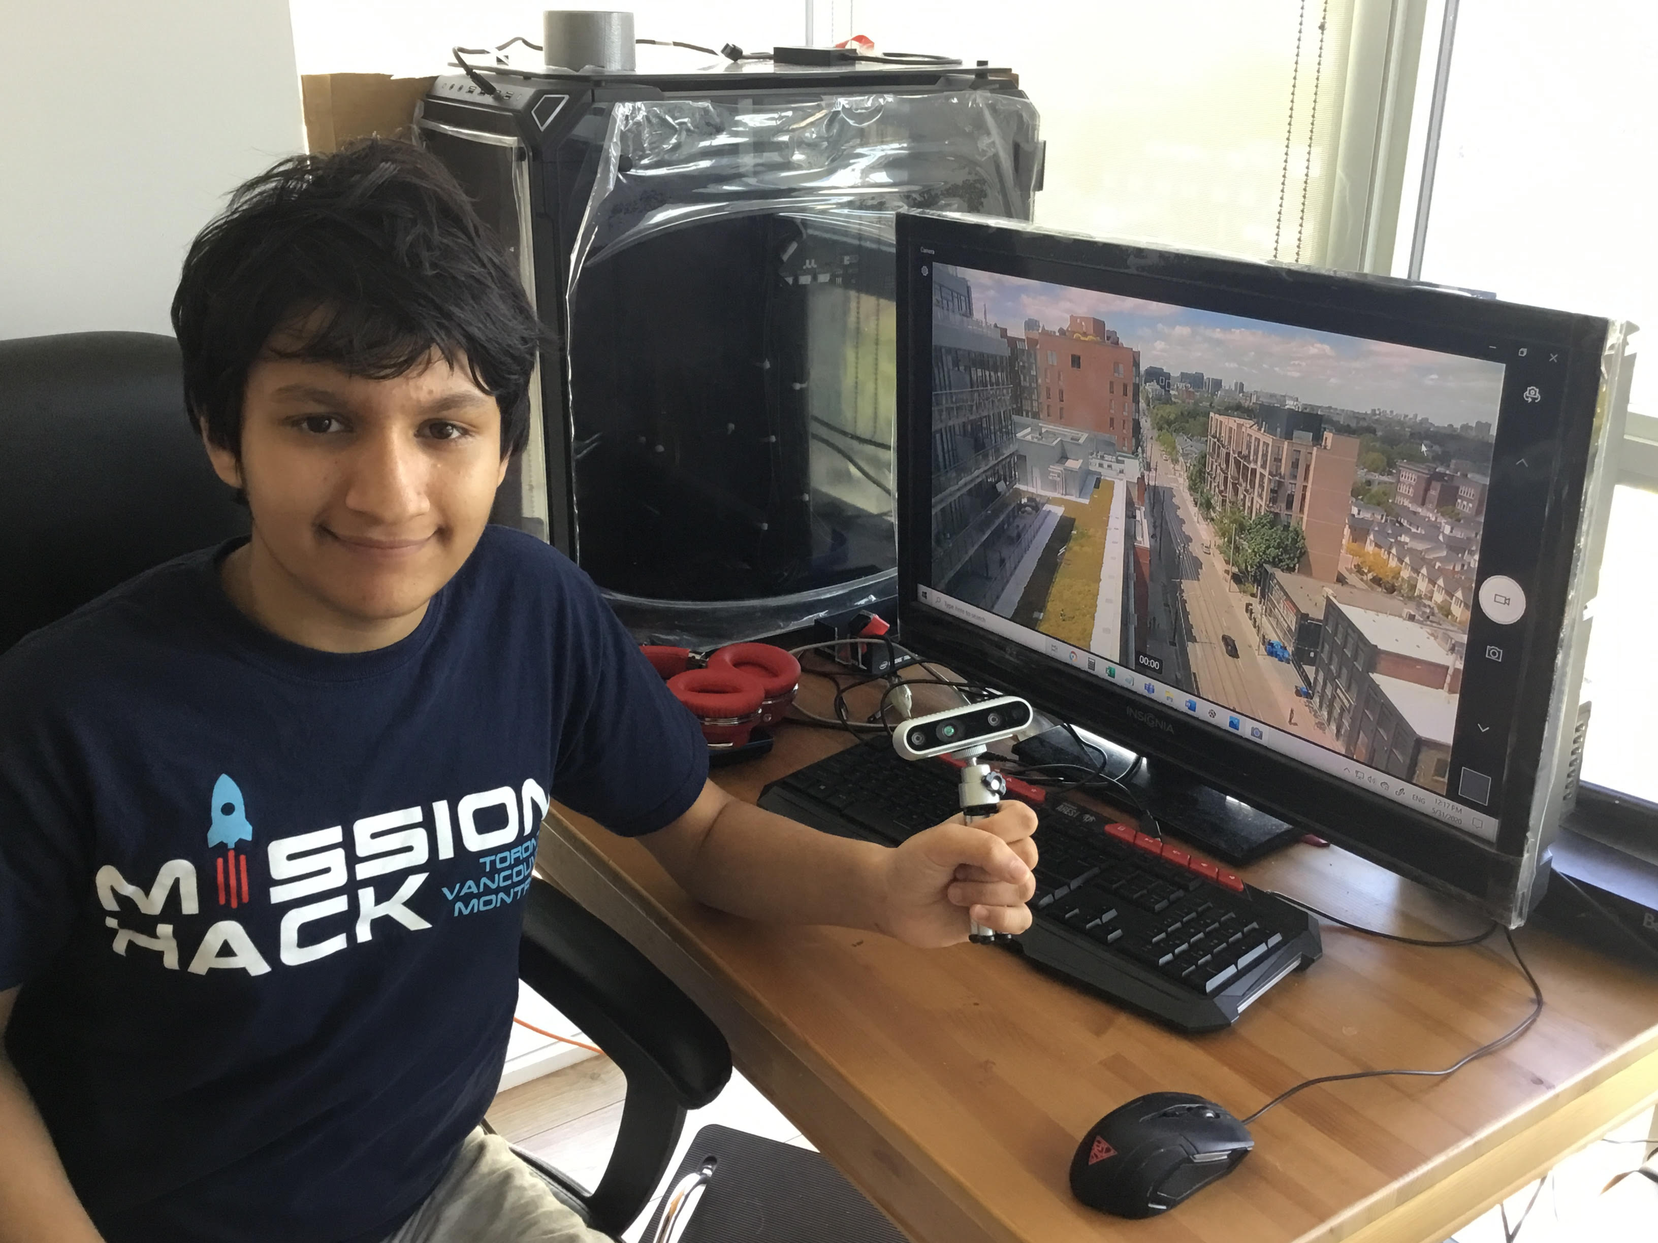
Live Vehicle Count from Street Camera using Machine Learning
Building our Instrument to measure Light, Noise, Pollution
Our Home-Made Instrument + Camera Collecting Environmental and Traffic Data during COVID19 Lockdown in Toronto

Slide 4
6 Datasets Used
Data Collected from Home-Made Instrument
Street Noise (Microphone)
Vehicular Emissions (PM 2.5 Sensor)
Vehicular Count on Street (Intel RealSense Camera)
Light Intensity Data (Light Sensor to analyze day and night data)
External Data Sources
NASA Night Light Data (Suomi / VIIRS Data)
https://worldview.earthdata.nasa.gov
2. Toronto COVID19 Infection Data (City of Toronto)
https://www.toronto.ca/home/covid-19/covid-19-latest-city-of-toronto-news/covid-19-status-of-cases-in-toronto/

Slide 5
Techniques Used for
Data Analysis
Machine Learning Algorithm
for real-time vehicle counting from Street Camera
Arduino to Python Serial Bridge
To transmit data from Sensors to Python for analysis
NASA Worldview Compare Tool
https://worldview.earthdata.nasa.gov
Data Sonification
Musical Algorithm software http://musicalgorithms.org/ to convert data into Music

Slide 6
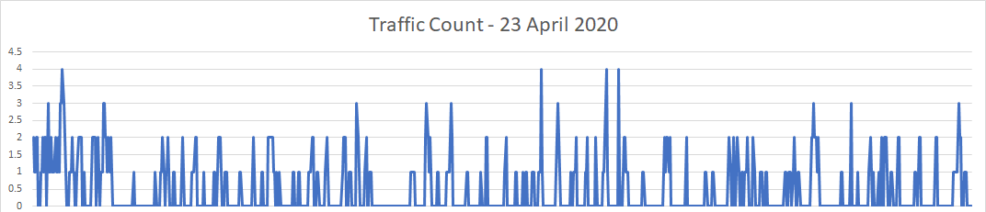
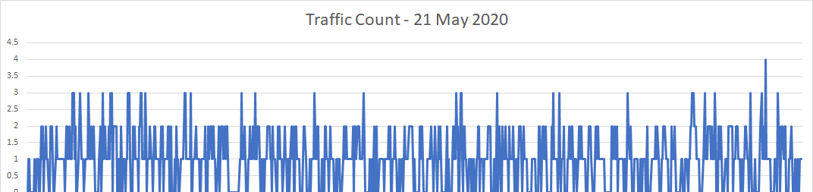

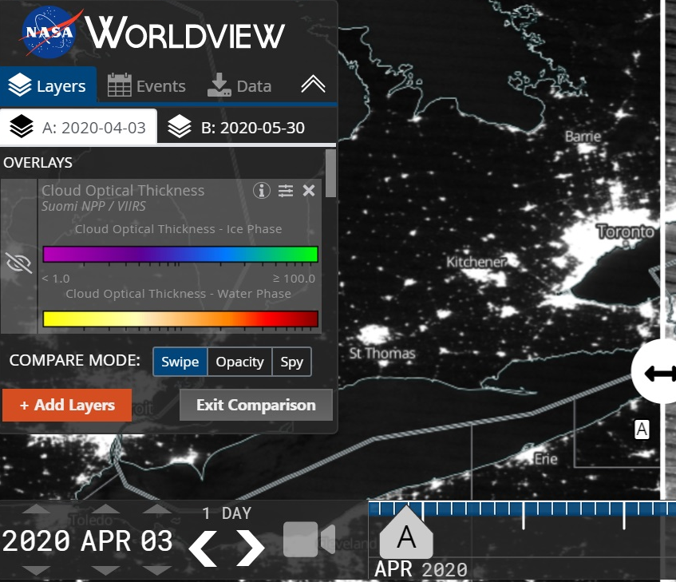
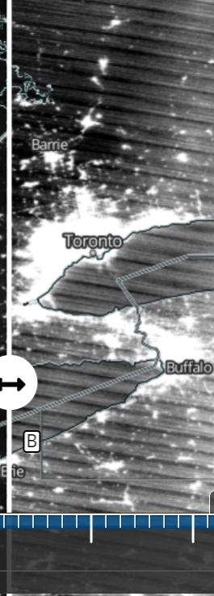
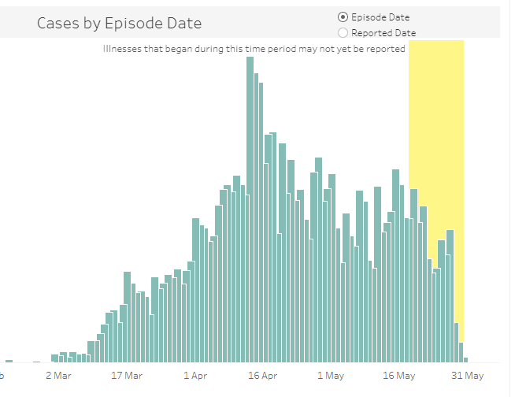

Overall Impact of COVID19 Lockdown in Toronto
During Lockdown (26 April – 3 May)
After Lockdown (3 May onwards)
Live Traffic Count (King Street)
During Lockdown
During Lockdown
After
After
Night Lights in Toronto (NASA Soumi/VIIRS)
COVID19 Cases
(Toronto)
During Lockdown (3 April)
After ( 30 May)
After
During Lockdown
During Lockdown
After

Slide 7
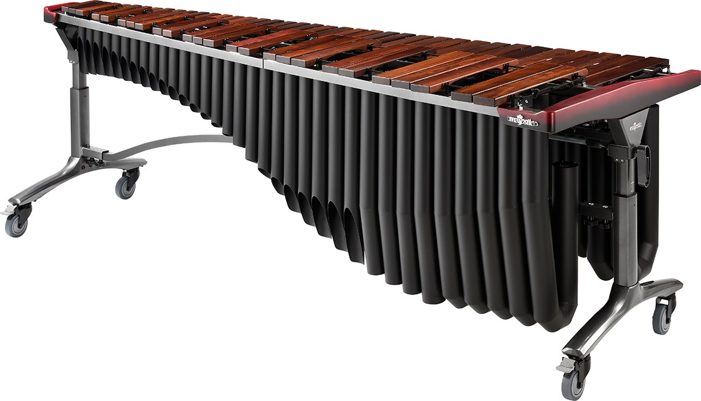
Night Lights in Toronto (NASA Soumi/VIIRS)

Slide 8
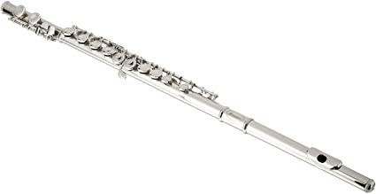
COVID-19 Cases in Toronto

Slide 9
Traffic Count in Toronto (King St)

Slide 10
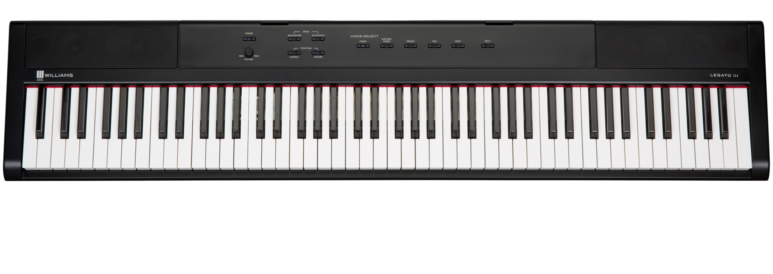
Street Sound Levels

Slide 11
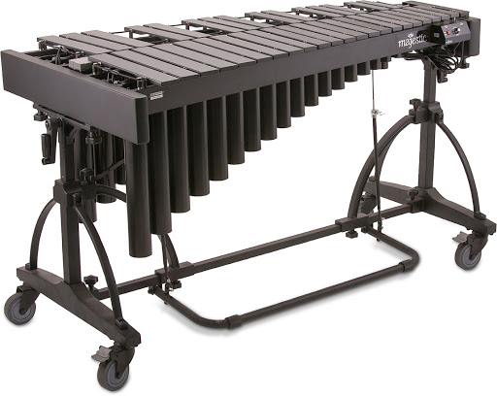
Pollution (PM 2.5 emissions) from Traffic

Slide 12
Seismic Vibrations in Toronto
Data taken from Leslie Spit Seismic Monitoring Station
34 % Decrease in Seismic Activity after Lockdown Start

Slide 13
Musical Instruments Used to Sonify Data
Sonified the Values from Different Instruments to create a Lockdown Musical for Toronto
Instruments | Data Sonified | Notes
Marimba | Passage of Days and Nights | G Major
Vibraphone | Vehicle Emissions | G Major
Piano | Street Noise | E Major
Flute | COVID19 Infection Rates | A Major

