Slide 1
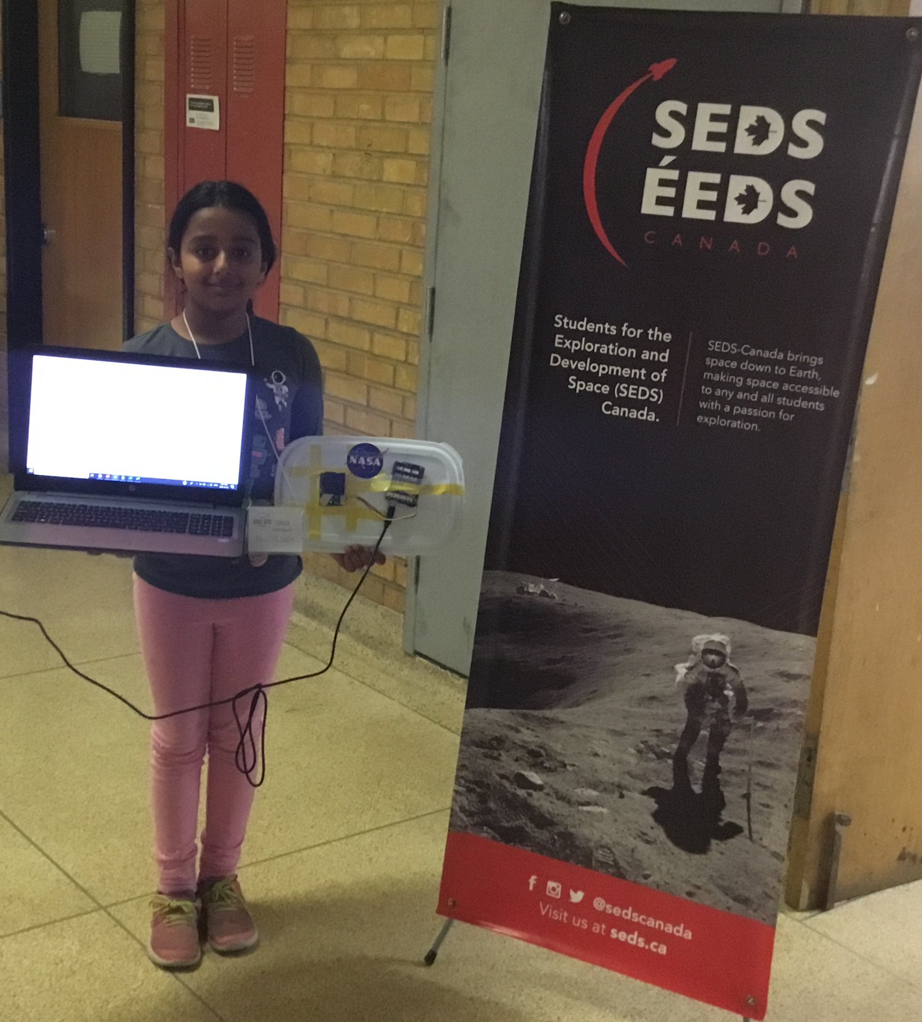

Schools and NASA Aiding Climate action by Kids (S.N.A.C.K)
Arushi Nath
HotPopRobot twitter @wonrobot
Toronto, 20 October 2019

Slide 2
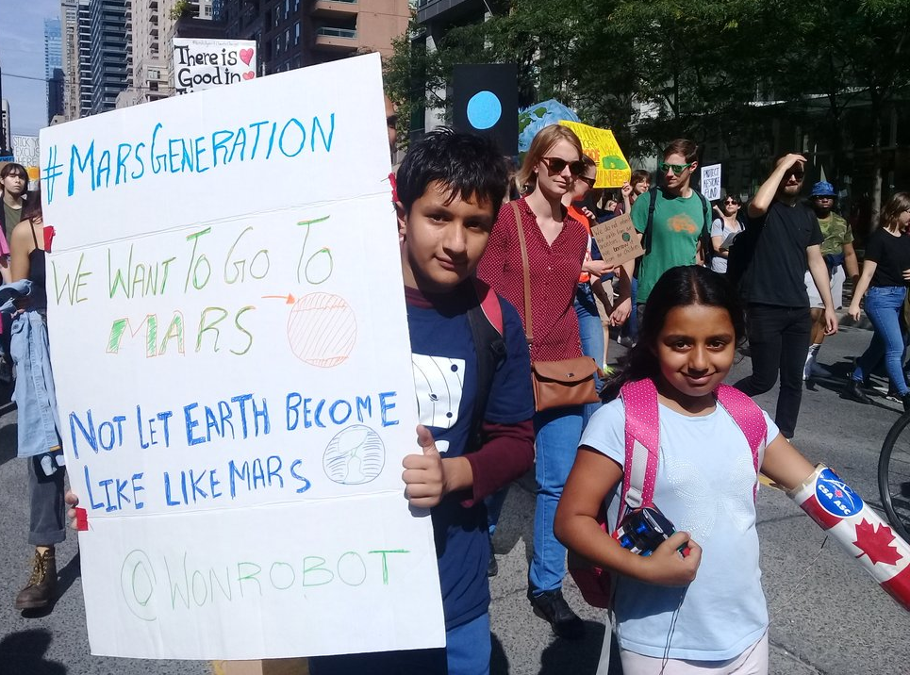
School Strikes Globally Against Climate Change
Toronto, 27 September 2019
Global Climate Goals through Small Simple Solutions
From School Strikes to School S.N.A.C.K

Slide 3
My SpaceApps Challenge: Smash your SDG.
SDG 11 (Sustainable Cities and Communities)
Use Earth Data from Satellites to address the UN Sustainable Development Goals
Use local measurements to support environmental concerns
Use information generated by crowd-sourcing

Slide 4
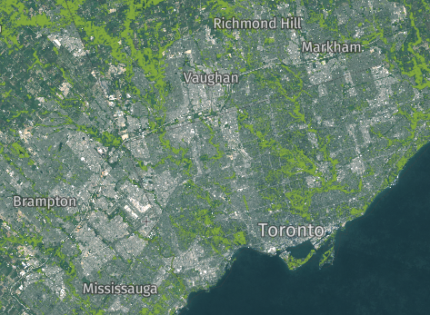
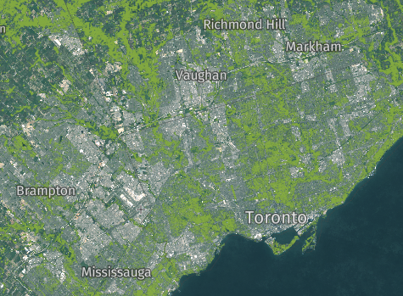
Toronto and Neighbourhoods Green Cover
Mapping Areas of Tree Density > 25%
Mapping Areas of Tree Density > 15%
Source: Landsat 8 data. 2017, NASA LandSat Science https://landsat.gsfc.nasa.gov

Slide 5
Satellite Data I used for S.N.A.C.K
LandSat 8
Sentinel 2A
Planet Lab Data
I used that satellite image which was more clear and had less clouds in it.
Source: NASA LandSat Science. https://landsat.gsfc.nasa.gov

Slide 6
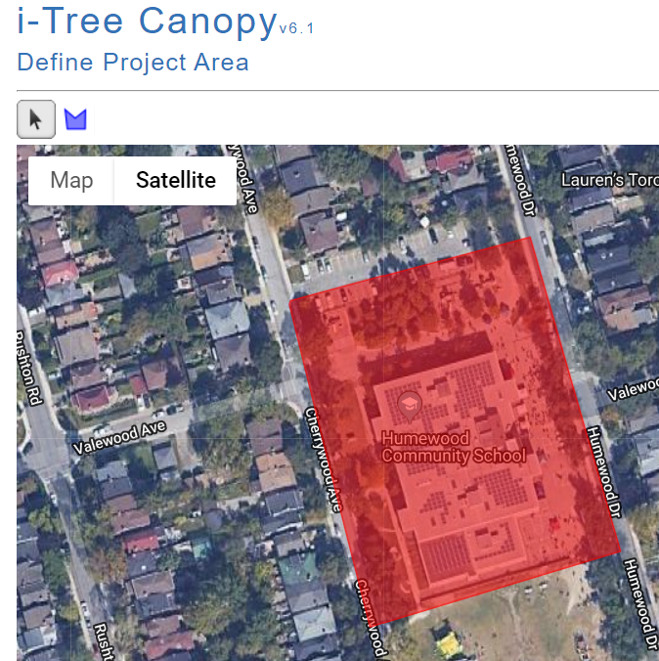
Used i-Tree Canopy Tool to measure Tree Density in Schools (French Board)

Slide 7
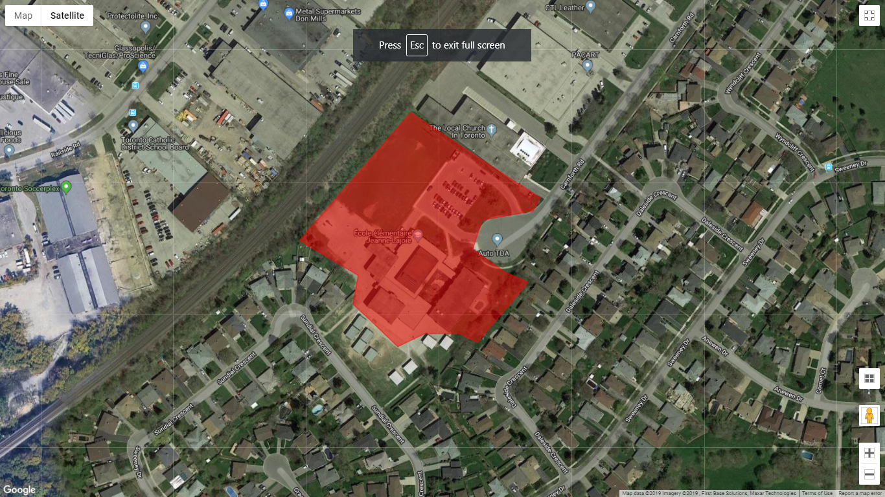
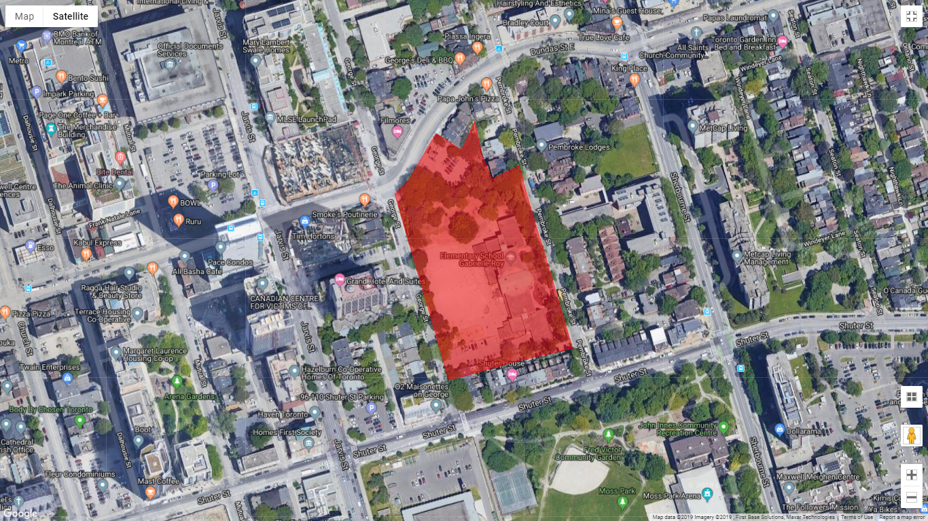
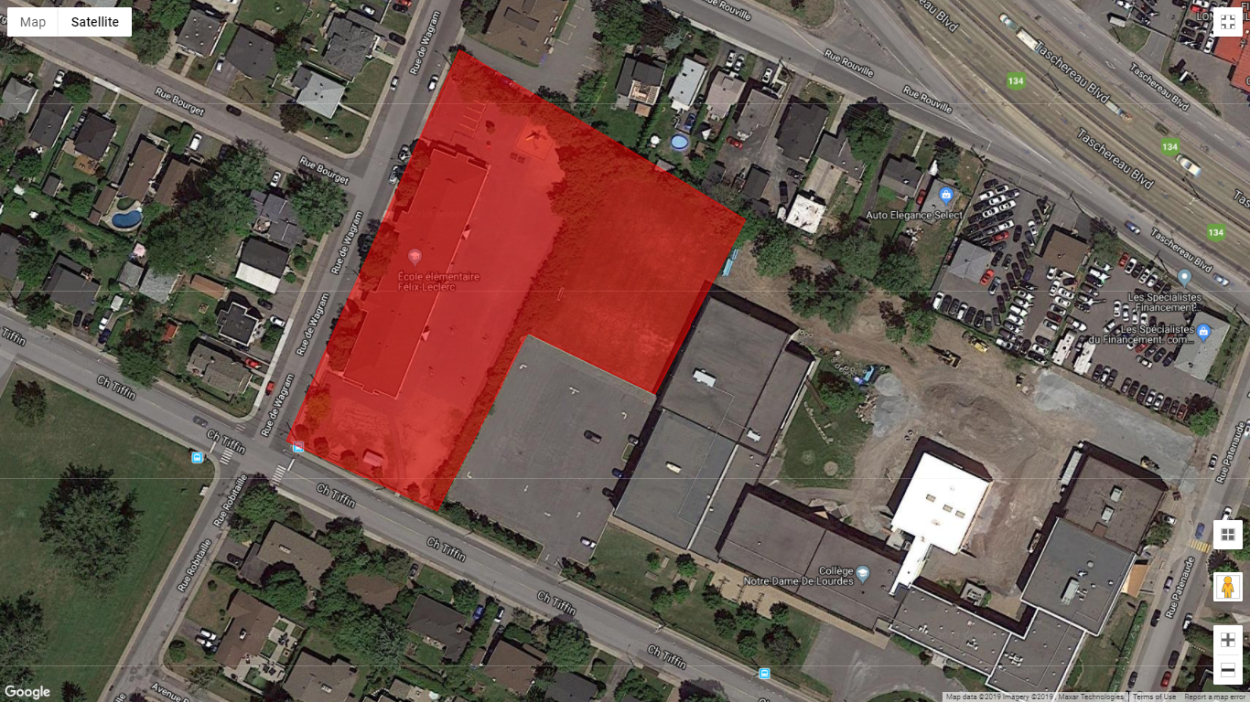
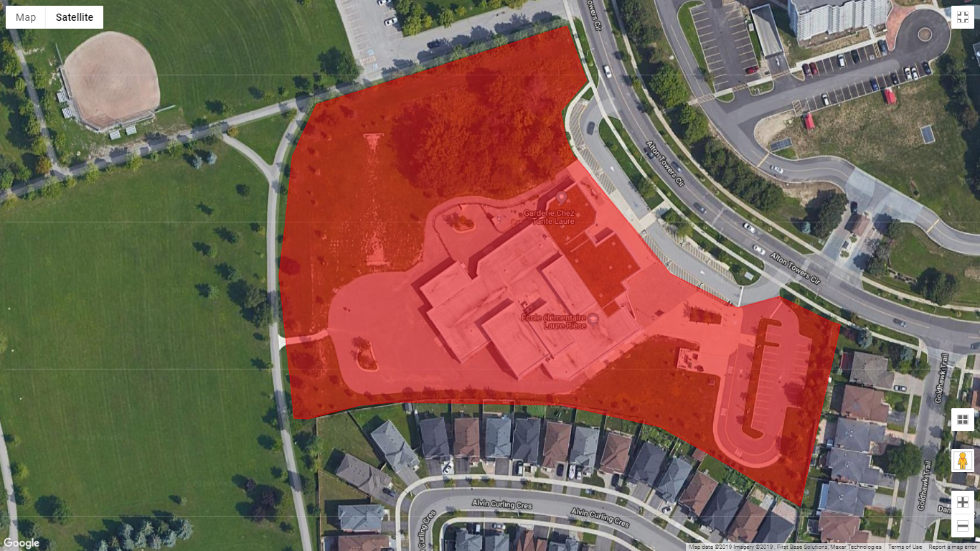
Using iTool for Measuring School Tree Density of 12 School Playgrounds
École élémentaire Jeanne-Lajoie
École élémentaire Gabrielle-Roy
École élémentaire Félix-Leclerc
École élémentaire Laure-Rièse

Slide 8
School Playground Tree Density Ranking
(Top 5)
École élémentaire Gabrielle-Roy 41%
Académie Alexandre-Dumas 25%
École élémentaire Félix-Leclerc 23%
École élémentaire Laure-Rièse 21%
École élémentaire Charles-Sauriol 16%
All schools should aim to become like École élémentaire Gabrielle-Roy !

Slide 9
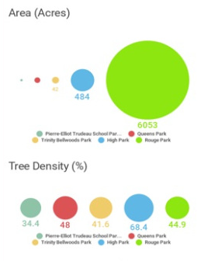
SCHOOL PARKS ARE IMPORTANT
We need big parks such as High Park and Rogue Park.
But also focus on school parks and neighbourhood parks and increase their density.
City parks improve health of children and increase biodiversity within cities.

Slide 10
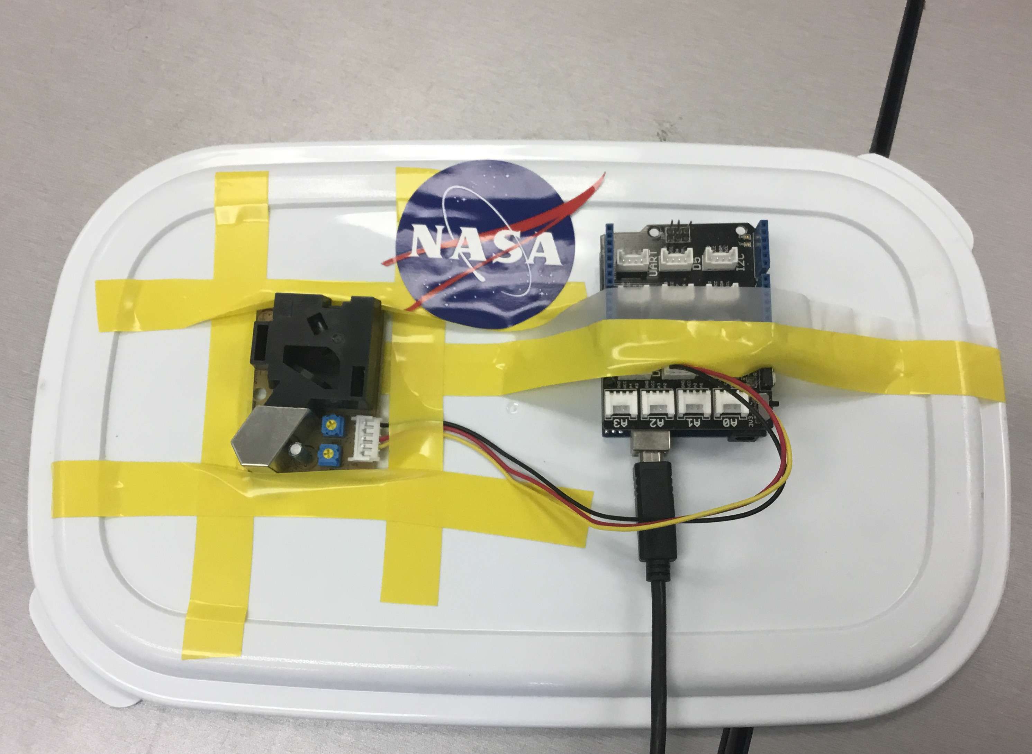
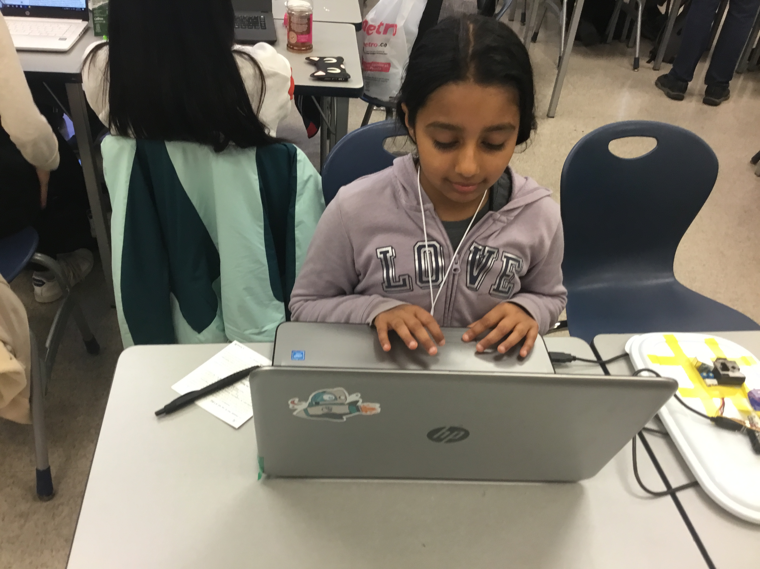
Made by Air Quality Measurement Device
Uses Arduino and Particle Sensor
Programming it

Slide 11
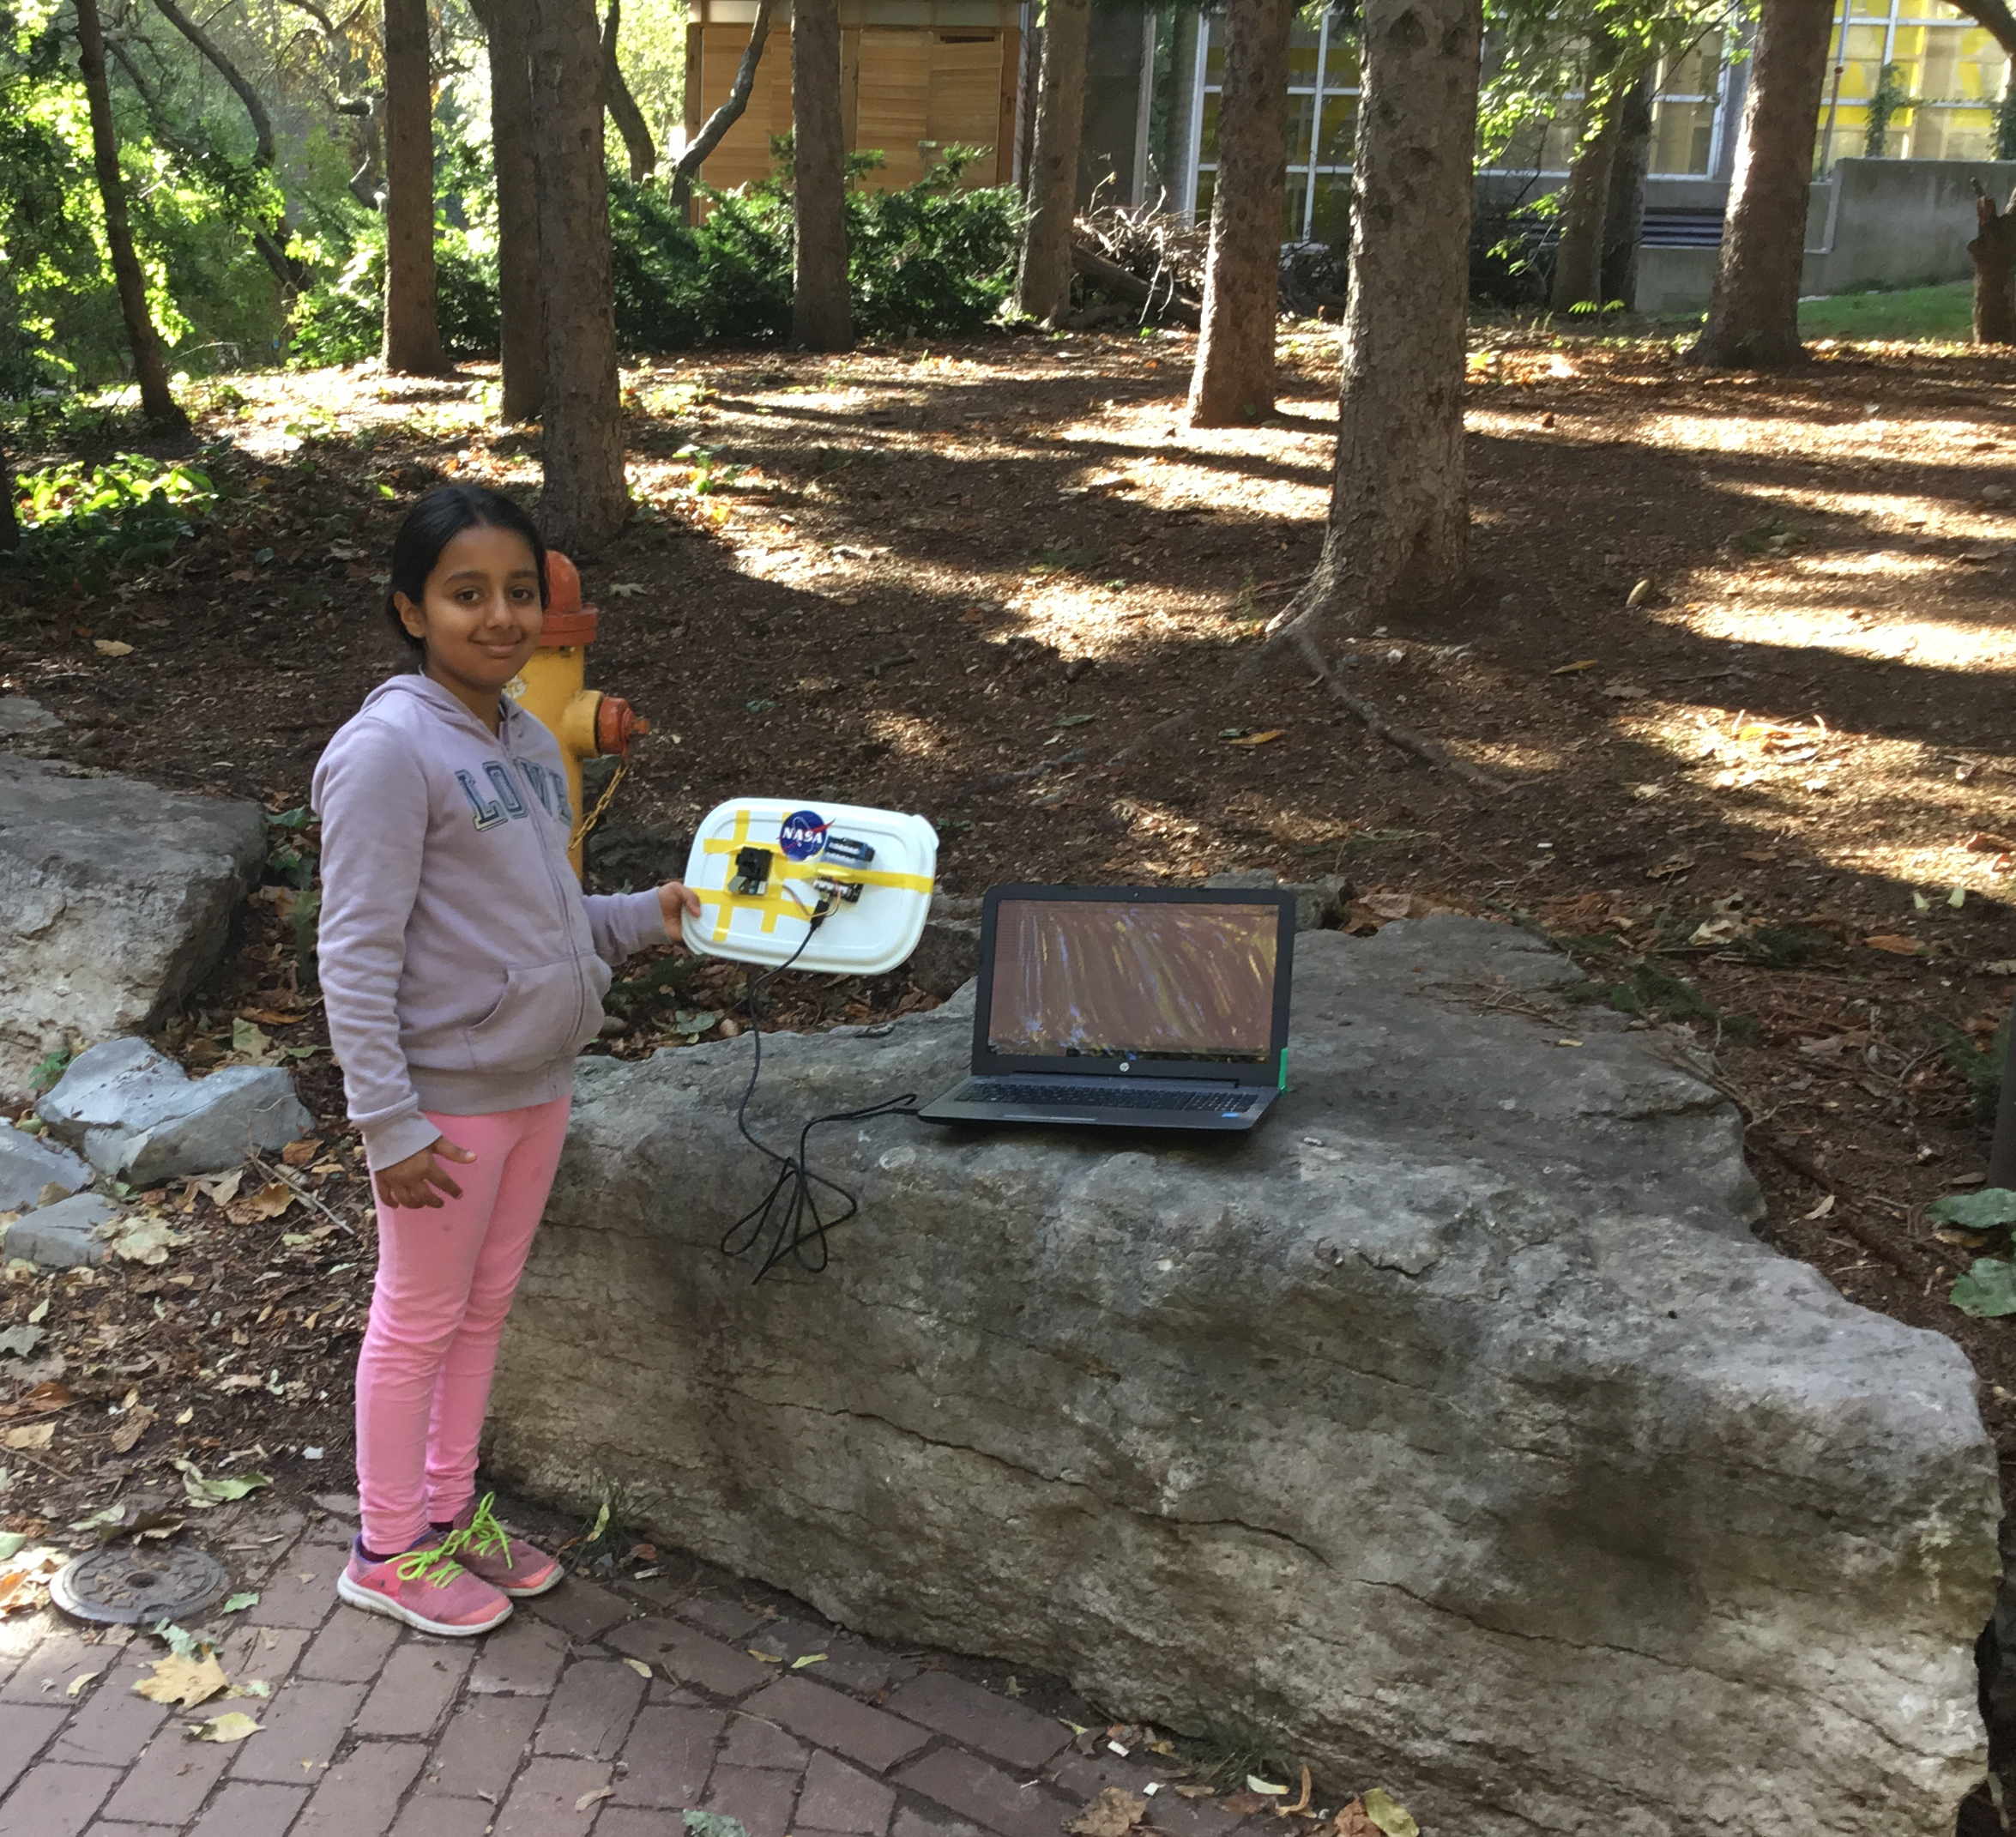
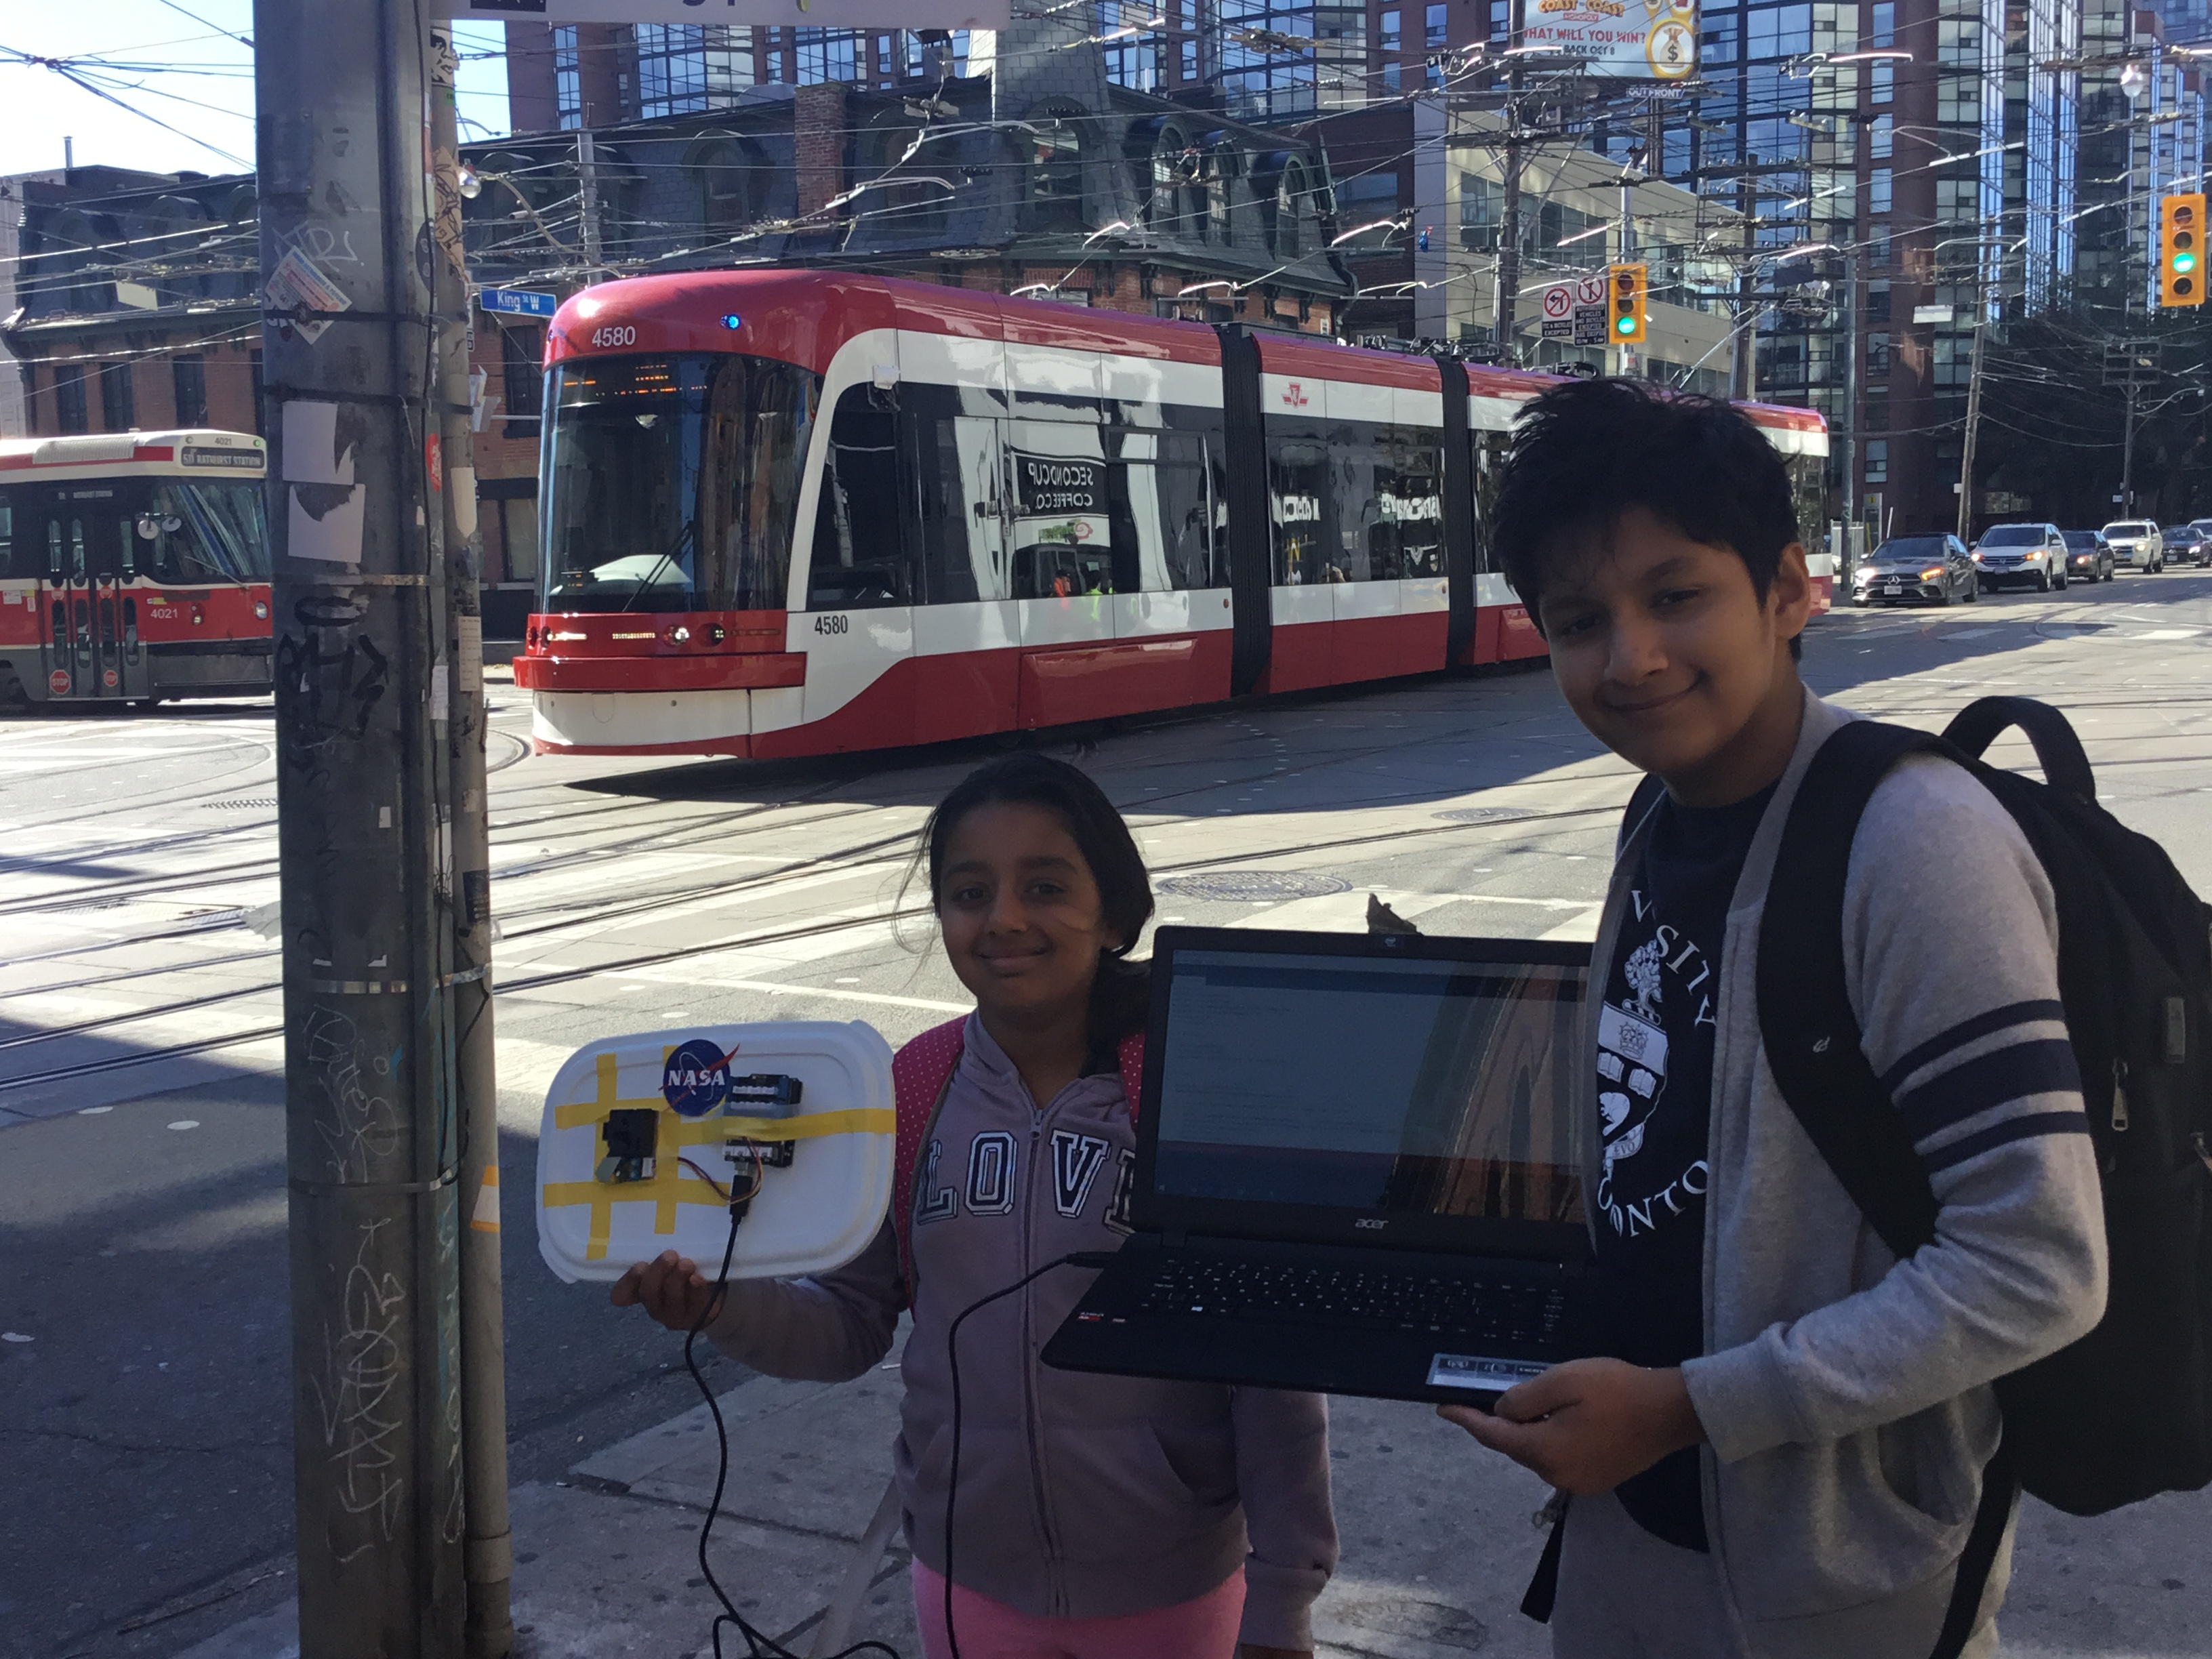
I Measured the Air Quality
School Parks
Toronto City Intersections

Slide 12
Air Quality Readings :
School Tree Areas vs
City Intersections
2172996,21.73,20792.64
1046867,10.47,6289.90
1971991,19.72,17212.68
1587905,15.88,11703.77
1769715,17.70,14109.83
1272449,12.72,8268.37
1424493,14.24,9816.50
886930,8.87,5081.20
1715670,17.16,13358.69
1650009,16.50,12487.52
1098070,10.98,6708.80
School Playground Average: 5968.03
Better quality
1587905,15.88,11703.77
1769715,17.70,14109.83
1272449,12.72,8268.37
1424493,14.24,9816.50
886930,8.87,5081.20
1715670,17.16,13358.69
1650009,16.50,12487.52
1098070,10.98,6708.80
436433,4.36,2289.13
544012,5.44,2894.12
479725,4.80,2529.18
City Intersections Average: 11990.57
Poor quality

Slide 13
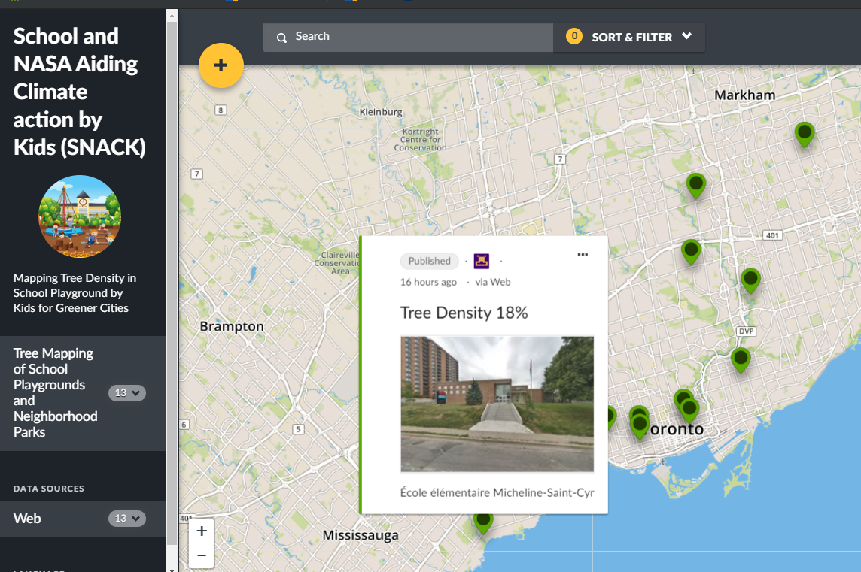
Created Crowd Mapping App for School Tree Density.
Kids can add data of their playgrounds!
https://snack.ushahidi.io

Slide 14
Schools and NASA Aiding Climate action by Kids (S.N.A.C.K)
Arushi Nath
HotPopRobot twitter @wonrobot
Toronto, 20 October 2019

