Slide 1
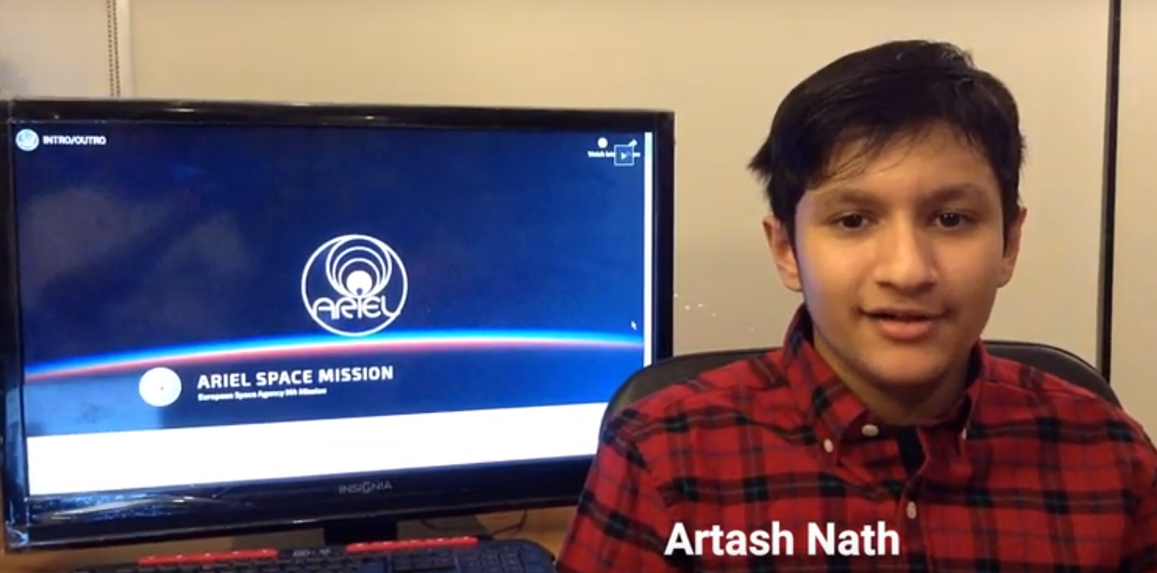
Hybrid Machine Learning Model to Remove Noise from Exoplanet Observations
Using Simulated Data from the ARIEL Space Telescope
Artash Nath
Grade 8 Student
Toronto, Canada
Space, Robotics, Machine Learning
Twitter: @wonrobot
www.HotPopRobot.com
artash.nath@gmail.com
ARIEL: SCIENCE, MISSION & COMMUNITY 2020 CONFERENCE
ESA/ESTEC
Noordwijk, The Netherlands

Slide 2
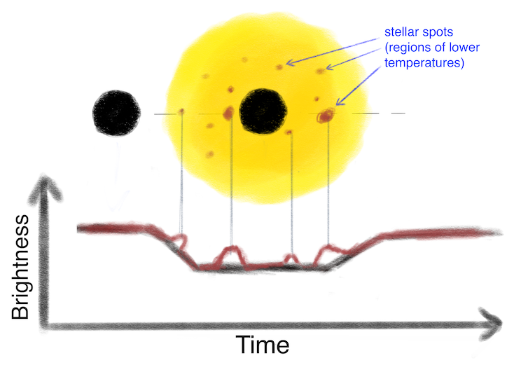
ARIEL Challenge: Light Curves, Wavelengths, Star Spots
The ARIEL Space mission is a European Space Agency mission to be launched in 2028 to analyse the atmospheres and chemistry of 1000 extrasolar planets.
Challenge:
Use Machine Learning to identify and correct the effects of stellar spots in noisy transiting light curves of exoplanets.
Outcome:
Will allow accurate measurement of radius of the exoplanets and eventually the chemistry of their atmospheres.

Slide 3
ARIEL Simulated Data Set
Datapoints
(300 Time Steps)
3D Array
TEST DATASET
Wavelengths
(55)
Observations
(146800)
Planet - Star Radius Ratio (55)
Observations
(62900)
6 Stellar Parameters
Observations
(146800)
Planet - Star Radius
Ratio (55)
TEST DATA
Observations
(146800)
TRAINING DATA

Slide 4
Selection of Machine Learning Model
Data Type: Sequential (or Time-Series) Data and Numerical Data
Sequential Data | Numerical Data
Light Curve Time Series Data Points | Star : Temperature | Log | Radius | Mass | Magnitude | Period
Long Short Term Memory (LSTM) Model Can classify, process and make predictions on complex time-series data. | Feed Forward Neural Network Perform classification and regression on non-sequential data.

Slide 5
ML Model 1: Long Short-Term Memory (LSTM) Network
LAYER 1
LAYER 2
LAYER 3
Output
Datapoints
(300 Time Steps)
LSTM
256
LSTM
256
LSTM
256
Dense
Layer
(55)
Planet - Star
Radius Ratio (55)
Planet - Star
Radius Ratio (55)
3D Array
Wavelengths
(55)
Observations
(146800)
Observations
(146800)
Each Layer encodes deeper and more complex information from the Input Sequence
Weights are applied and rearranged on the Sequence Data
Cells in each layer learn what to remember and what to forget
The Dense layer brings together all the information to produce the output

Slide 6
ML Model 2: Merging Long Short-Term Memory + Feed Forward Network
Output
LSTM
Layer 1
256
LSTM
Layer 2
256
SEQUENTIAL DATA
Concatenate
Merge Sequential and Numerical Data
Dense
Layer
64
Dense Layer
55
Planet - Star
Radius Ratio (55)
3D Array
Long Short-Term Memory (LSTM)
Observations
(146800)
NUMERICAL DATA
Dense
Layer 1
32
Dense
Layer 2
32
Merger of Machine Learning Models
Stellar Parameters
Feed Forward Network

Slide 7
Setting up the Machine Learning Model
4 Steps
Set number of Layers
Set Neurons in each layer
Set Learning Rate
Epochs

Slide 8
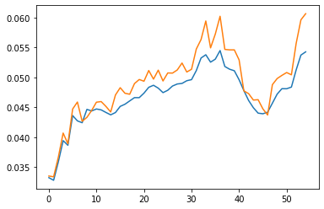
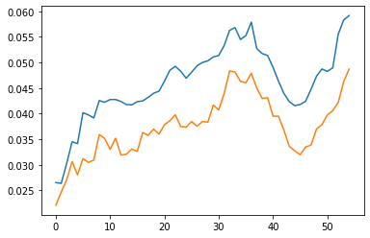
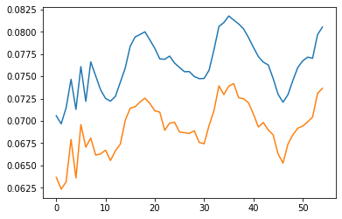
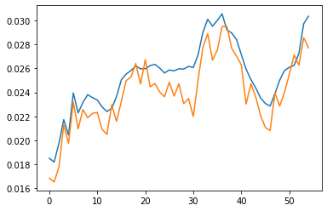
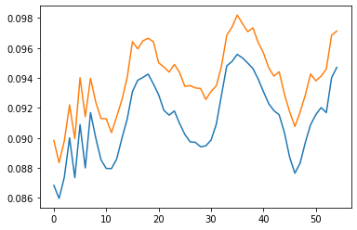
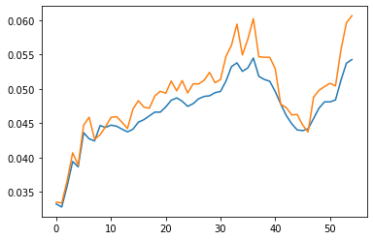
SAMPLE RESULTS (on Testing Dataset)
Ground Truth
Predicted Results
Planet - Star Radius Ratio
Over 55 Wavelengths

Slide 9
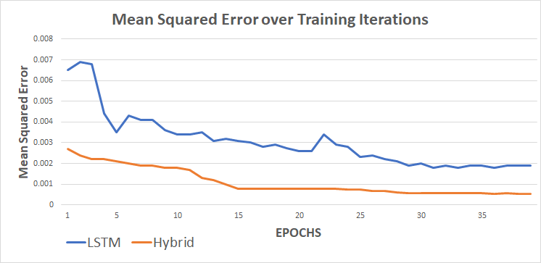
Hybrid Model Outperforms the LSTM Model
Hybrid Model
Train MSE: 0.00053
Test MSE: 0.001
The Hybrid Model reaches a lower Mean Squared Error (MSE). The trend is smoother and the MSE is always decreasing.
Training time: 3 hours. Single GPU Machine

Slide 10
Conclusion:
My Machine Learning model was effective in reducing noise from Exoplanetary Observations. It achieved a Mean Squared Error (MSE) of 0.001 on the Test dataset.
The Model works on different data types: Sequential and Numerical.
The model can be expanded to include new sequential and numerical data. It can work even when some data is missing.

Slide 11
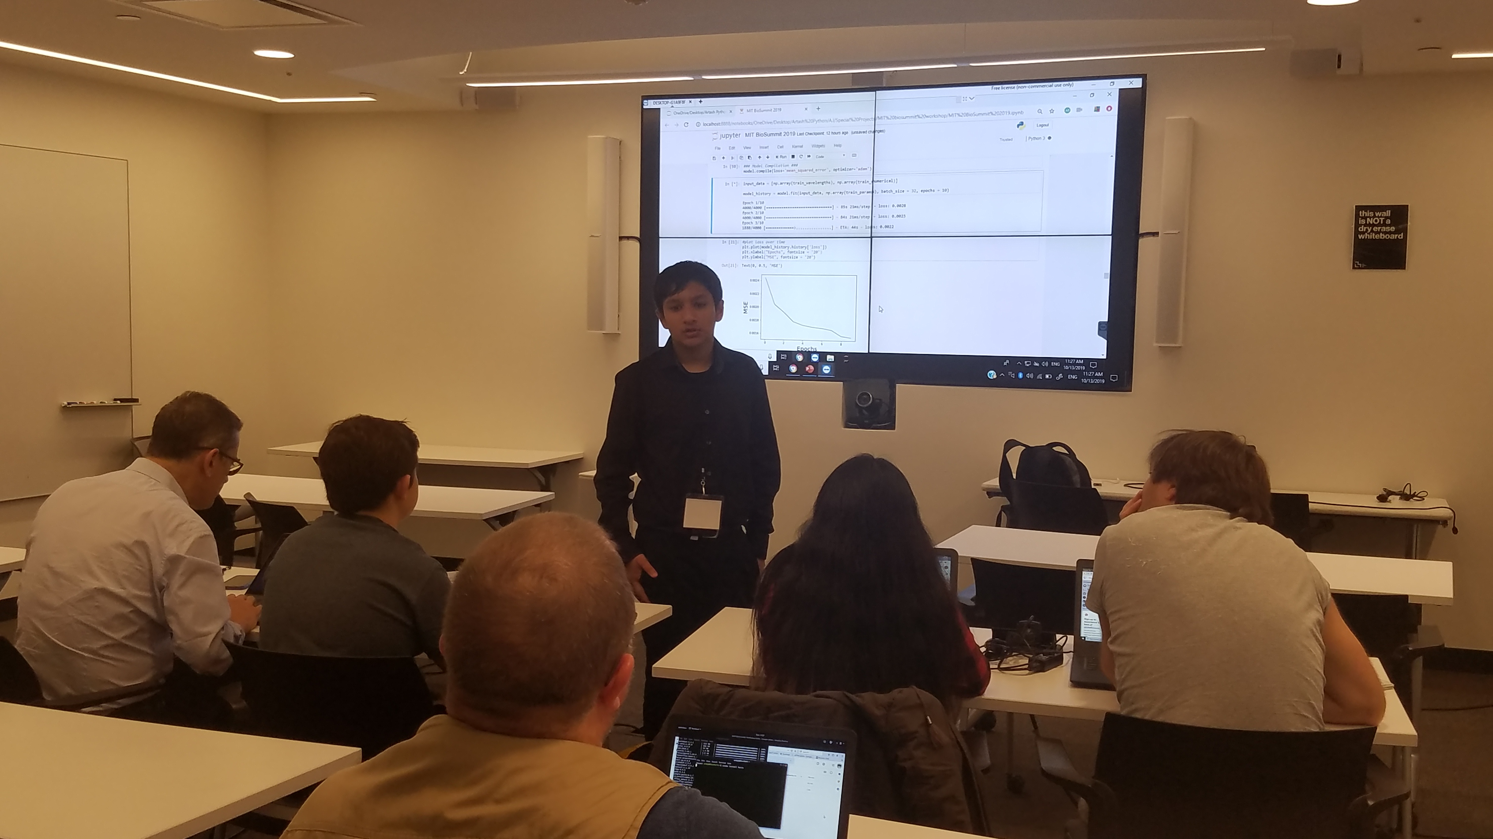
Created free online Tutorial on Jupyter Notebook for beginners to use Machine Learning on ARIEL data.
Can be taken online or delivered in classrooms.
Takes 3 hours to complete! Several people have completed it.
I will be happy to conduct a workshop for your organization.
Available at my GitHub: www.github.com/Artash-N twitter: @wonrobot
Artash.Nath@gmail.com
Expanding the ARIEL Data Community
Online Course and Training:
Learn & Build your own Machine Learning model
13 October 2019, MIT Media Lab, USA
3 hours training workshop for participants of Global Bio Summit on creating Machine Learning Models using ARIEL Data.

