Slide 1
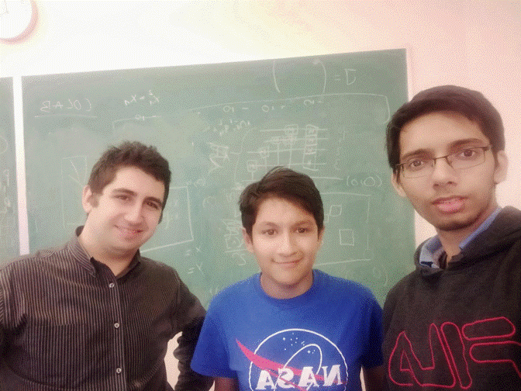
QUANTUM MAZE RUNNER
Artash Nath @wonrobot
Amardeep Singh @Amardeep2212
Christopher Joly @ChrisJoly93

Slide 2
Presentation Structure
Introduction
Pseudo Random Number Generators (PRNGs)
Quantum Randomization And Circuits
Labyrinth Creation With Random Scatter Points
Results And DEMO

Slide 3
Pseudo Random Number Generators (PRNG)
Not Truly Random
Needs predefined ‘seed’ therefore can be recreated
Current RNGs use mathematical algorithms to generate random numbers. Initializes algorithm with seed
Notes:
Are not truly random
There needs to be a seed to for the algorithm to run
There are other methods to create RNGs, but are not mentioned here. Hardware RNGs are considered true RNGs. Quantum theoretically is a true RNG as well due to the random nature of qubits. No seed is needed.

Slide 4
Example of PRNGs
Notes:
First one

Slide 5
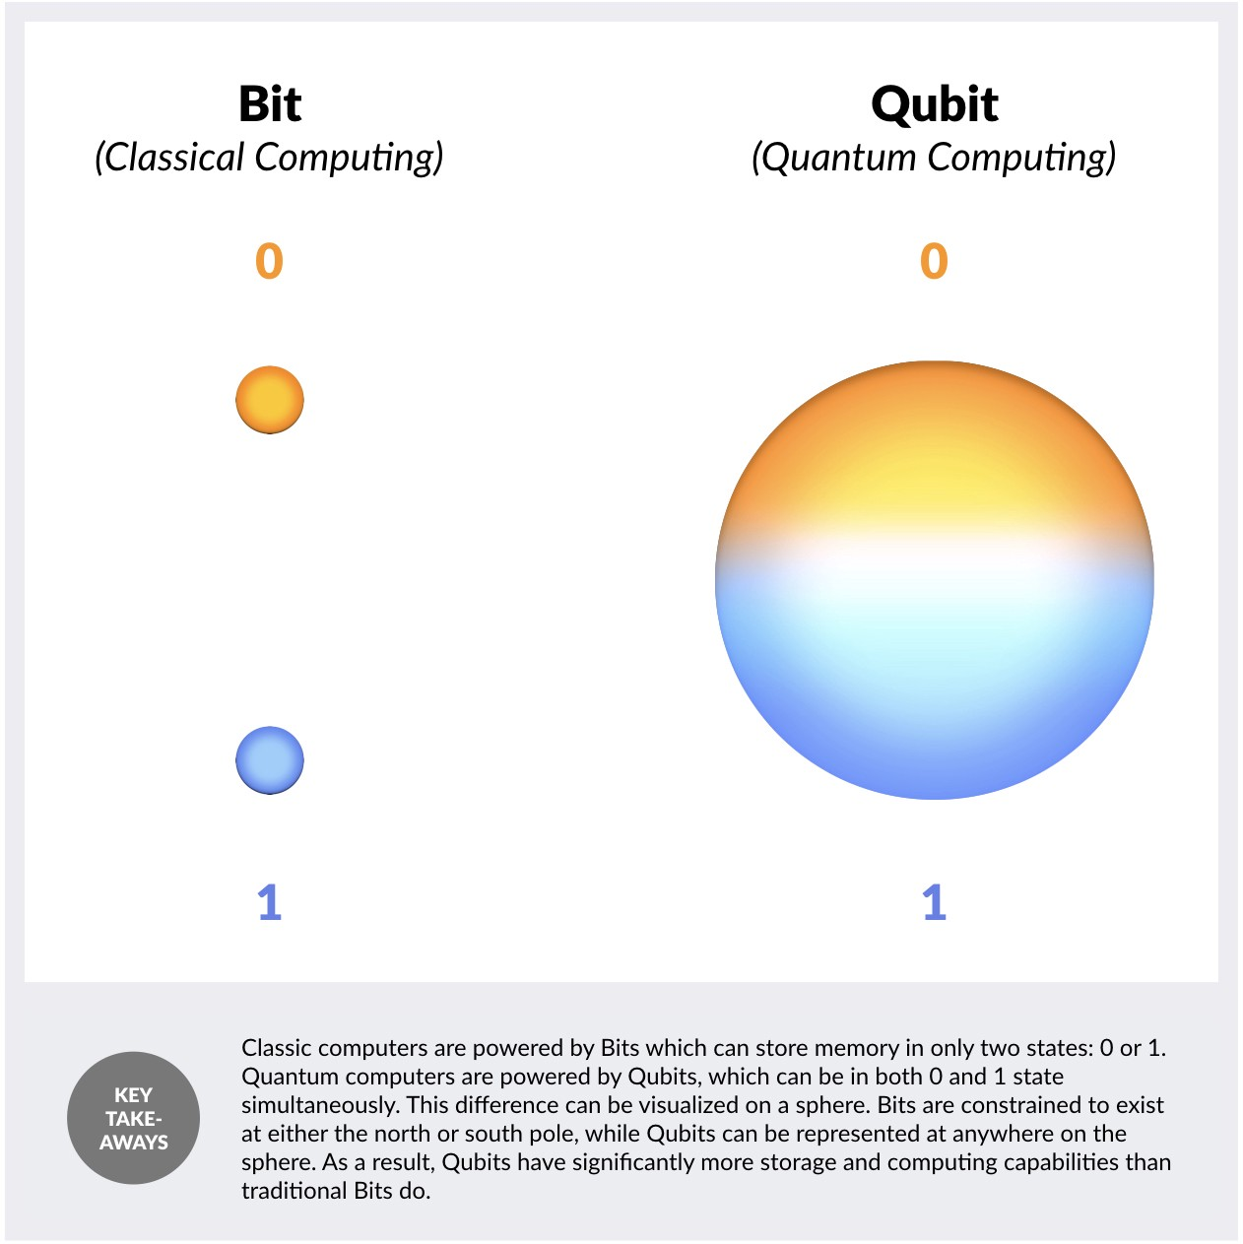
Quantum Randomization
Qubits in superposition produce random numbers
It is between 0 and 1 at any point in time, but collapses into either when measured

Slide 6
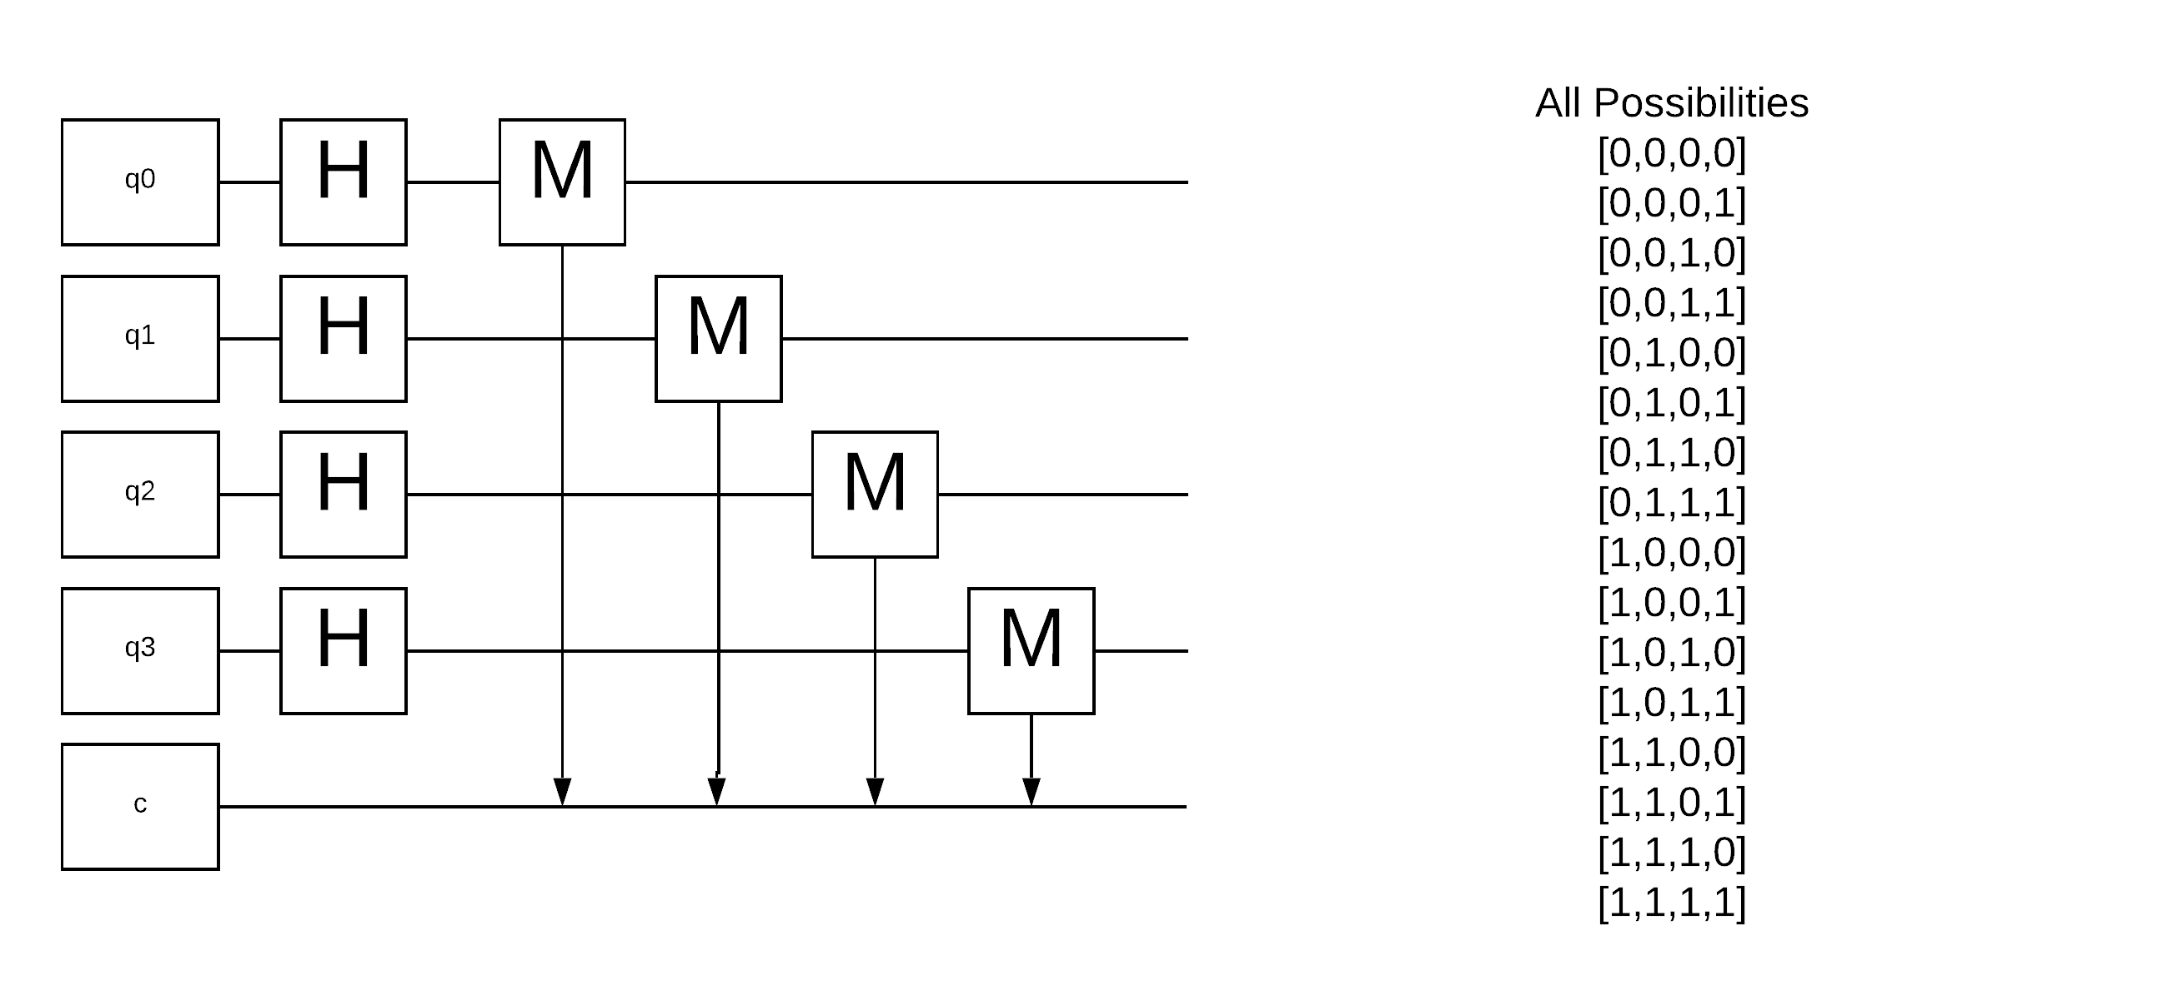
Quantum Circuit

Slide 7
Quantum Randomization
4 Qubits are in superposition, and the chances of each qubit at measurement becoming 0 or 1 is 50%.
The chance for each combination is random

Slide 8
From Binary to Random Numbers
Quantum Circuit provides us an array of 20 binary numbers from collapsed qubits
In a nested for loop, we multiply each value in the array by 2^{-n}
This process is repeated through out the whole array of 20 binary digits
Final random number between 1 and 0 will be composed by a combination of all the binary digits

Slide 9
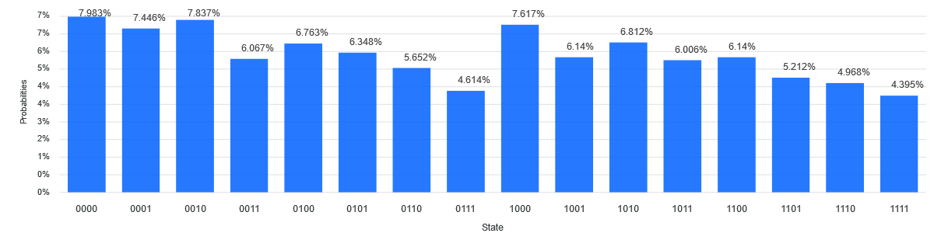
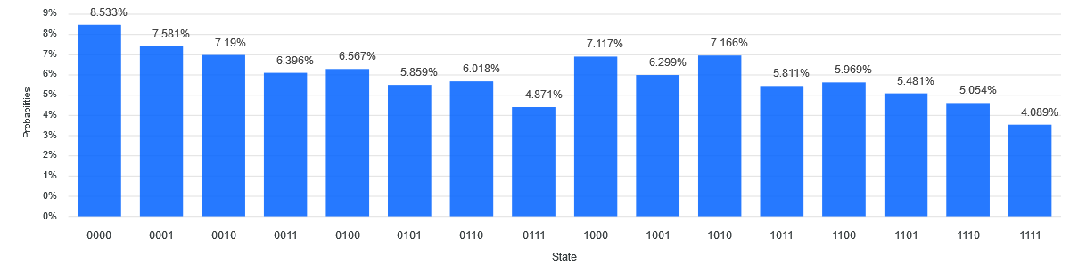
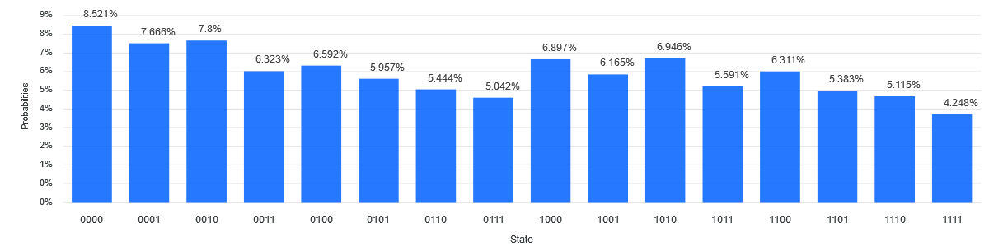
Quantum Results using 14 Qubit Computer ibmq_16_melbourne

Slide 10
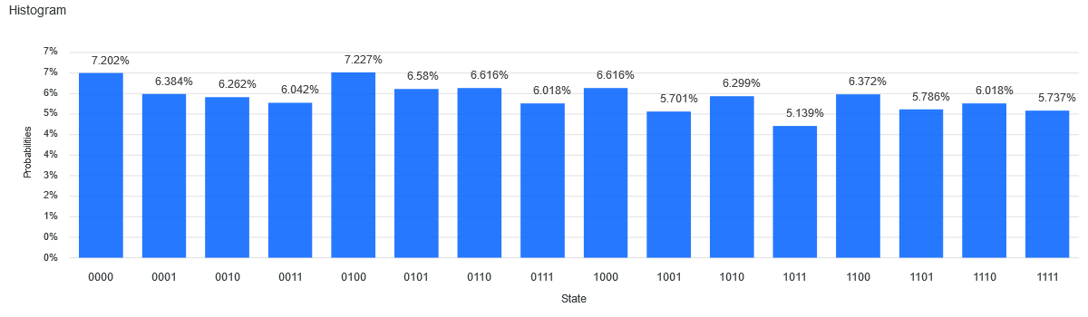
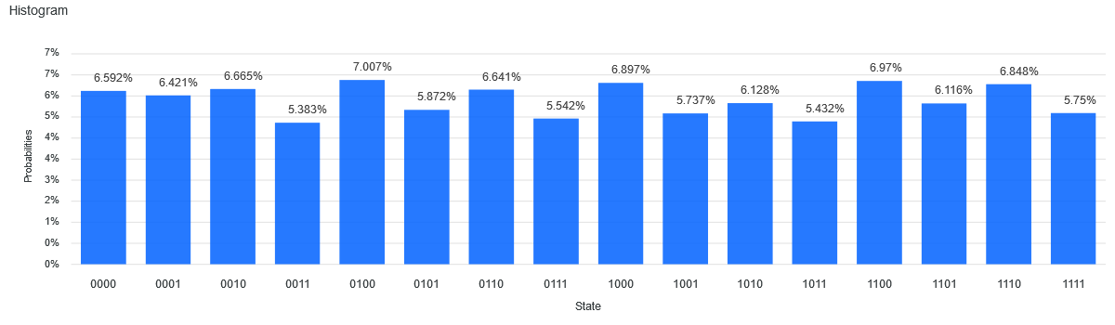
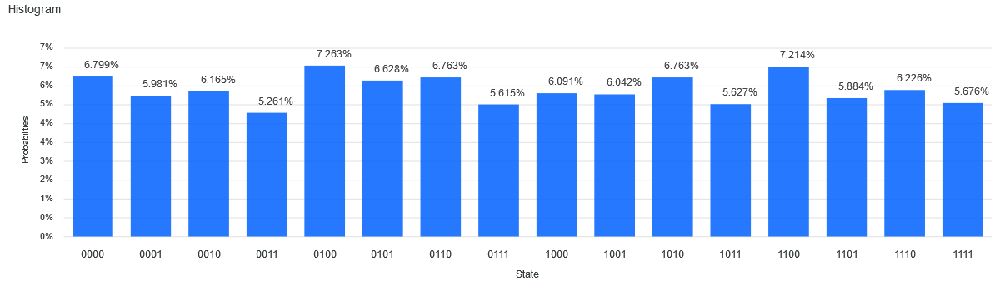
Quantum Results using 4 Qubit Quantum computer ibmq_vigo

Slide 11
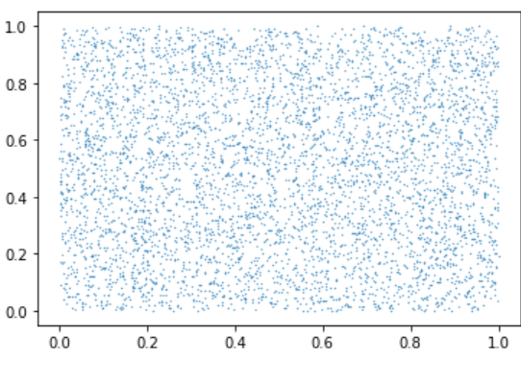
Randomly Generated Points
Notes:
These coordinates are generated from the array

Slide 12
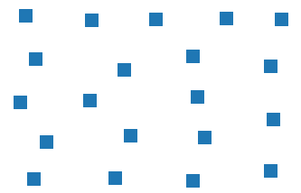
Adding K-means Clustering
Notes:
Adding K-mean clustering allows us to place larger squares in specific positions

Slide 13
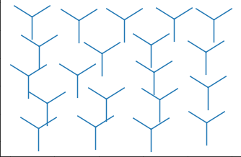
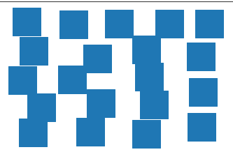
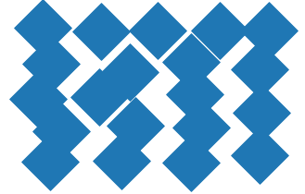
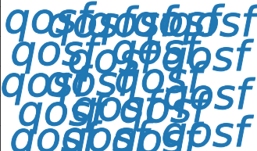
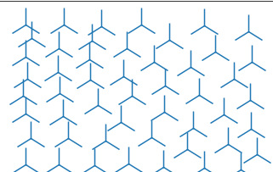
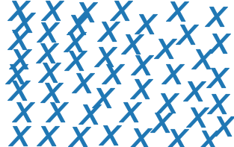
Possible Labyrinth Icons
Notes:
Possible designs for the Maze

Slide 14
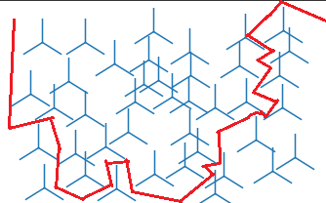
Example Labyrinth Solution

Slide 15
DEMO

