Slide 1
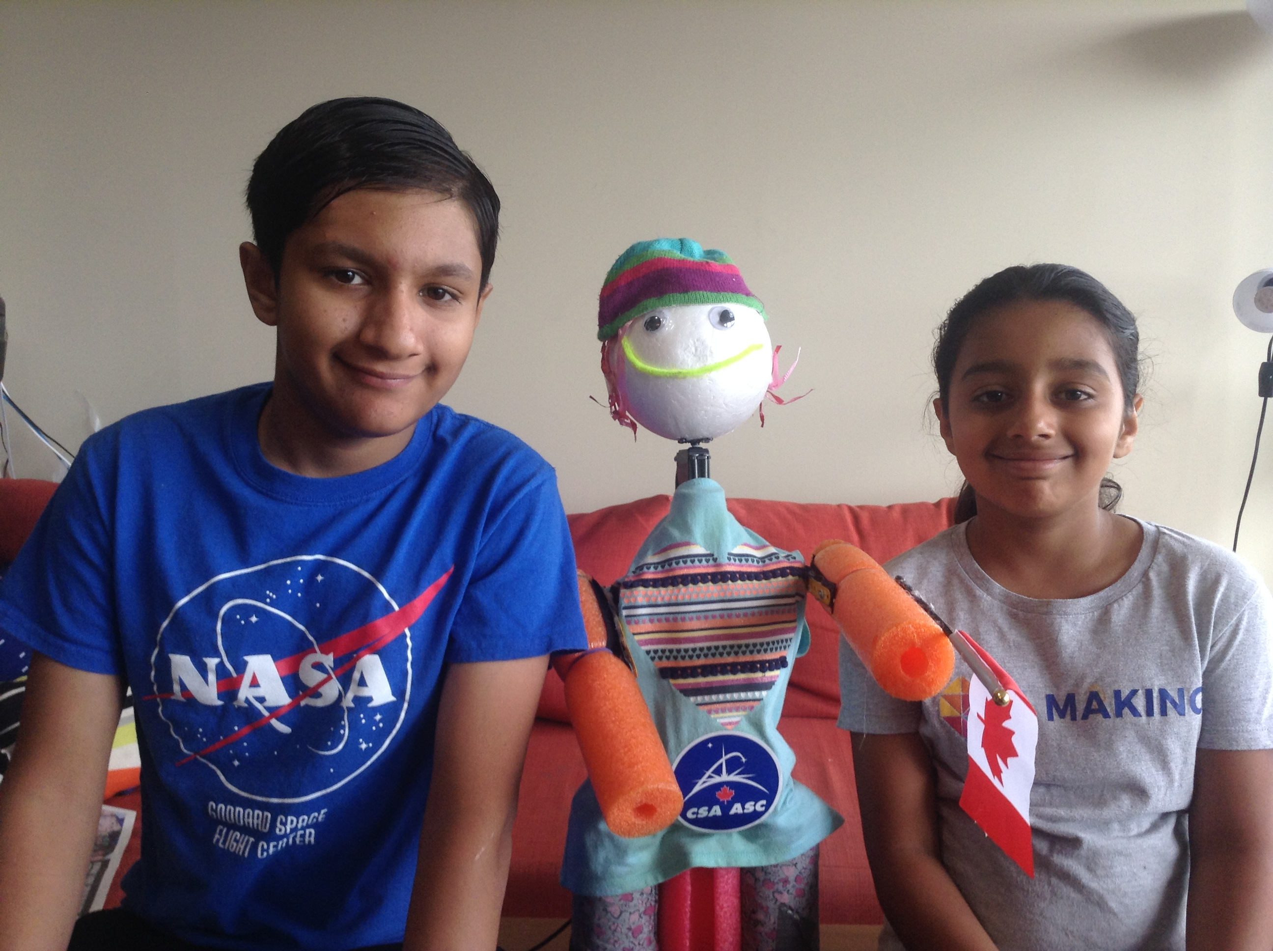
Using Machine Learning to Predict Facial Emotion
The MARS BOT
Artash Nath (Grade 8)
Arushi Nath (Grade 5)
Co-Founders
HotPopRobot.com
Twitter @wonrobot
Google GDG DevFest
Toronto. September 28, 2019

Slide 2
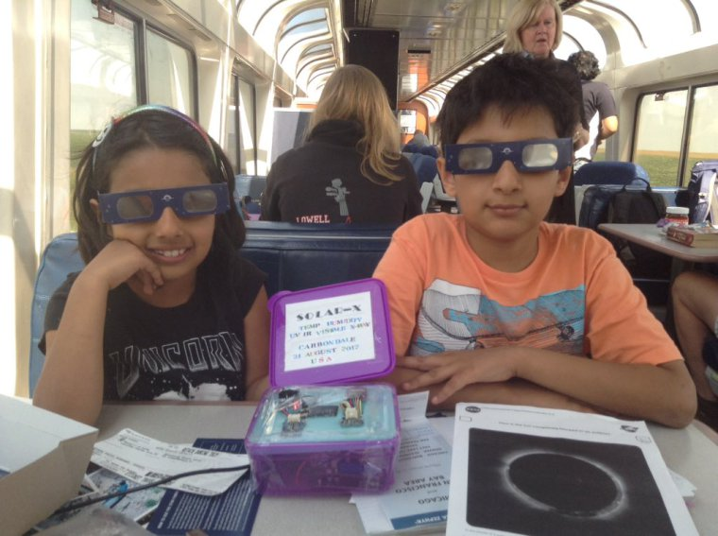
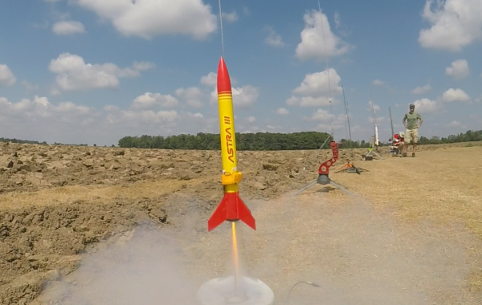
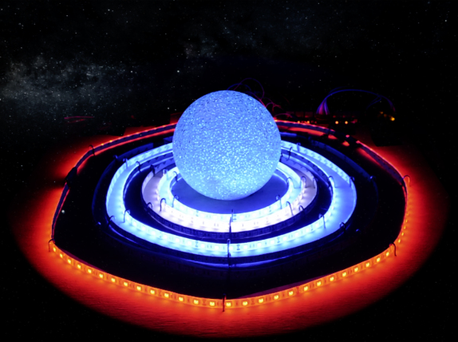
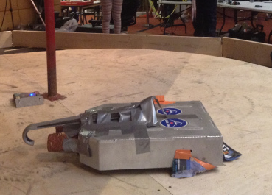
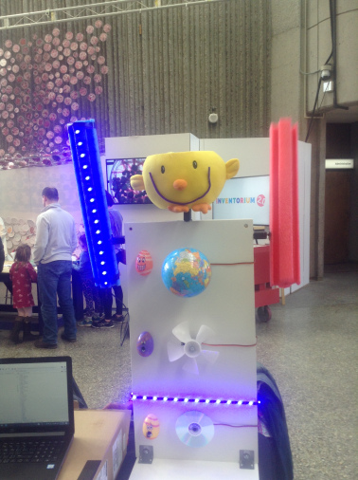
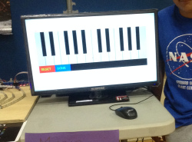
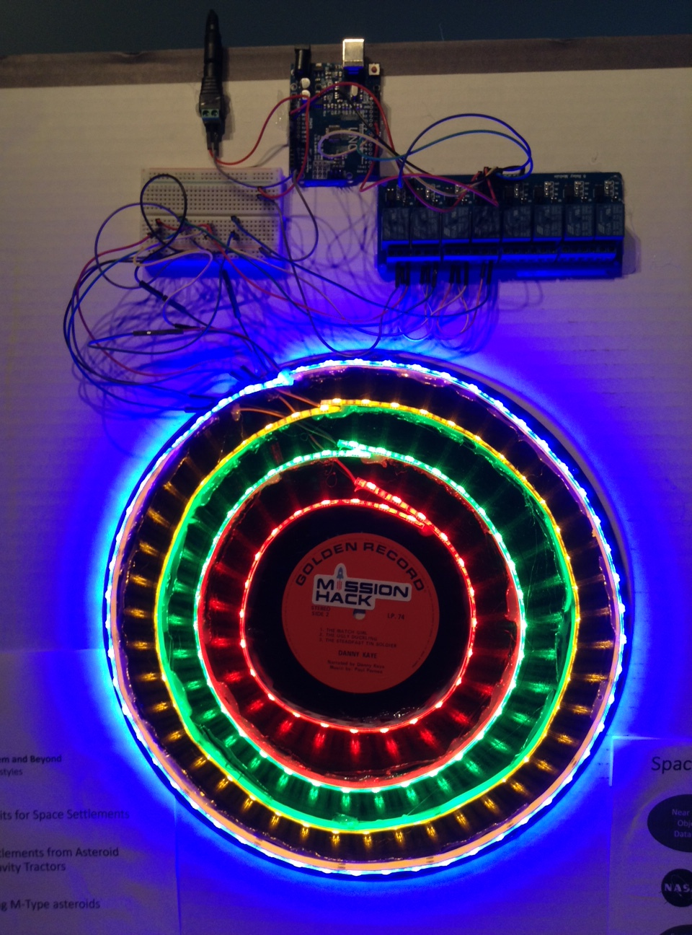
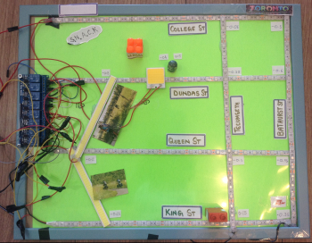
We are a Maker Family. Made over 25 Space, Robotics, Arts, Music, Artificial Intelligence related projects. www.HotPopRobot.com

Slide 3
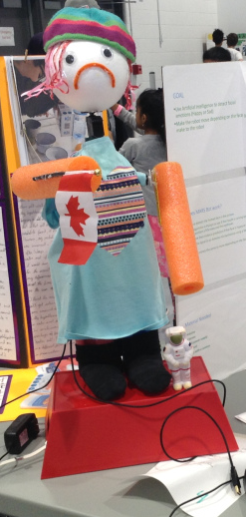
Three Steps to create Machine Learning based Robot that detects facial emotions
INPUT: Face Detection
PROCESSING: Emotion Evaluation using A.I Algorithm
OUTPUT: Robotics

Slide 4
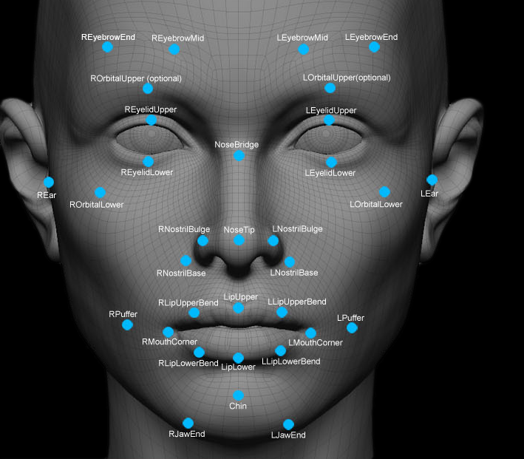
Face Detection
Uses Open CV algorithm based on Geometry to identify human face

Slide 5


Image Preparation
Robot takes 20 images of the face in 4 seconds
Images are cropped to the person’s face
Converted to grayscale

Slide 6






Multiple Images Increase Accuracy of Emotion Detection

Slide 7
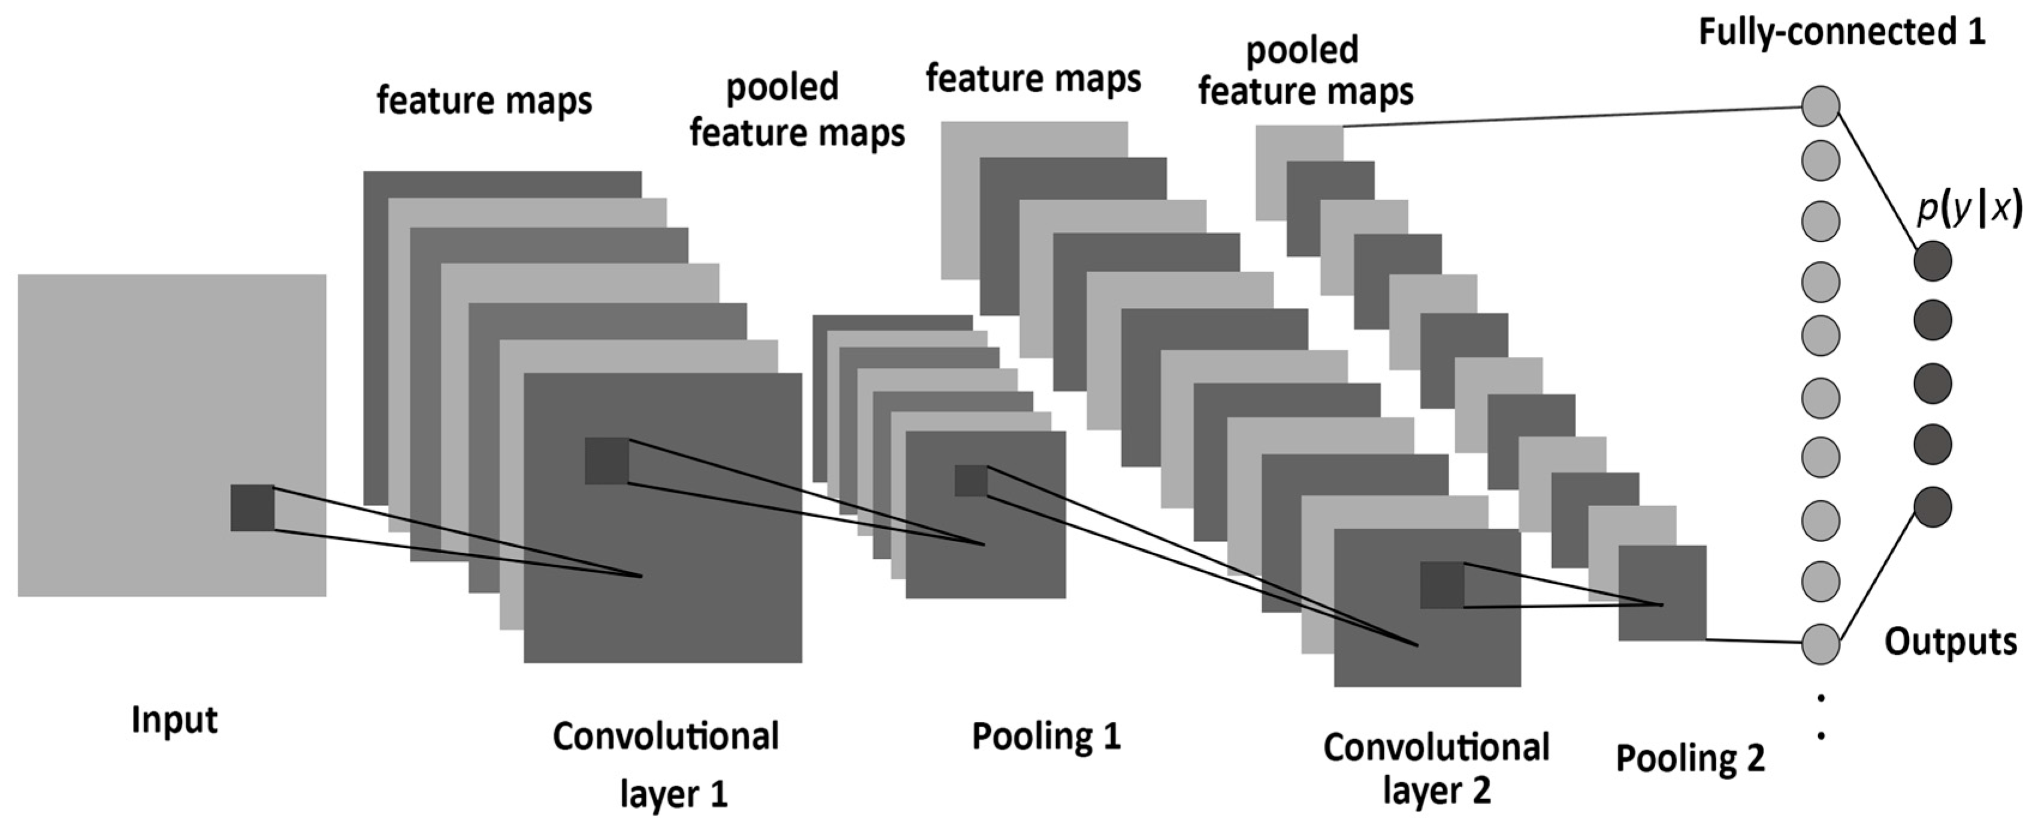
Supervised Machine Learning
Convolutional Neural Networks (CNNs)
Happy
Sad/Angry
Surprised
Neutral

Slide 8
How does Convolutional Neural Network (CNN) Work?
Important
(Higher weightage)
Not important
(Least Weightage)
Less important
(Less Weightage)
More Important
(Highest weightage)

Slide 9


Why is it a Supervised Learning?
TRAINING DATA
TESTING DATA

Slide 10
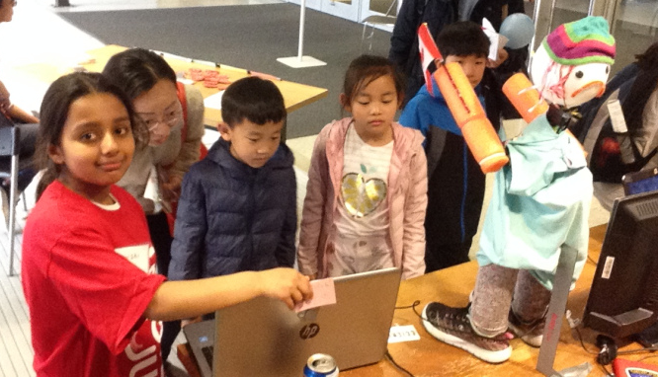
Emotion Recognition
Facial images are run through the CNN algorithm
Emotions from all the faces are obtained. MODE is taken to determine to the mostly likely emotion
3. Results are sent to the Robot using a Serial Bridge (Python to Arduino link)

Slide 11
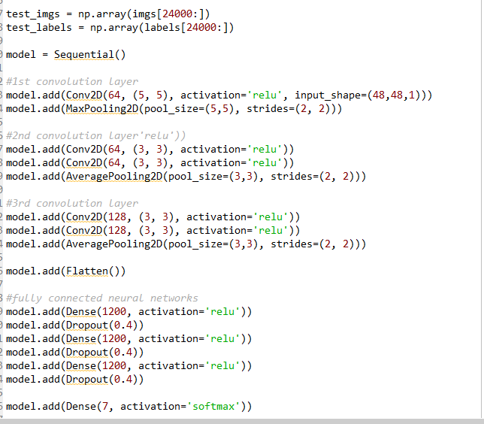
Selection of Code
Python
Google TensorFlow
Keras
Open Computer Vision
(Open CV)
Arduino

Slide 12
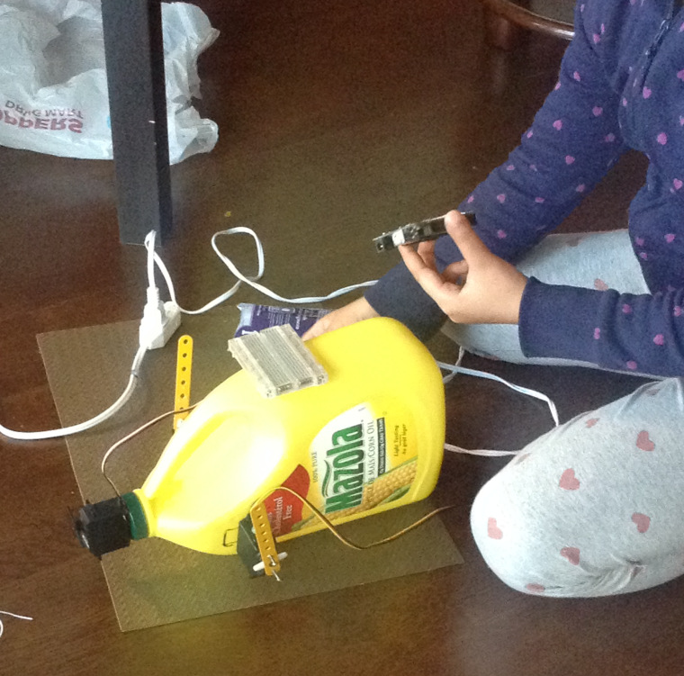
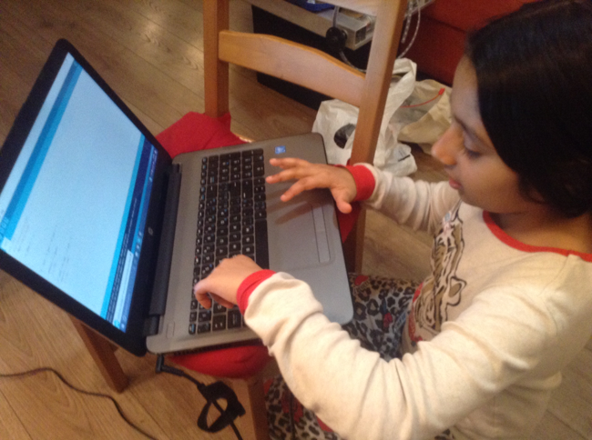
How I made the Robot?
Oil container
Pringles chips box
Pool noodles
Styrofoam ball
---------------
Arduino
3 Servos

Slide 13
DEMO

Slide 14
Using Machine Learning to Predict Facial Emotion
The MARS BOT
Artash Nath (Grade 8)
Arushi Nath (Grade 5)
Co-Founders
HotPopRobot.com
Twitter @wonrobot
Google GDG DevFest
Toronto. September 28, 2019

