Slide 1
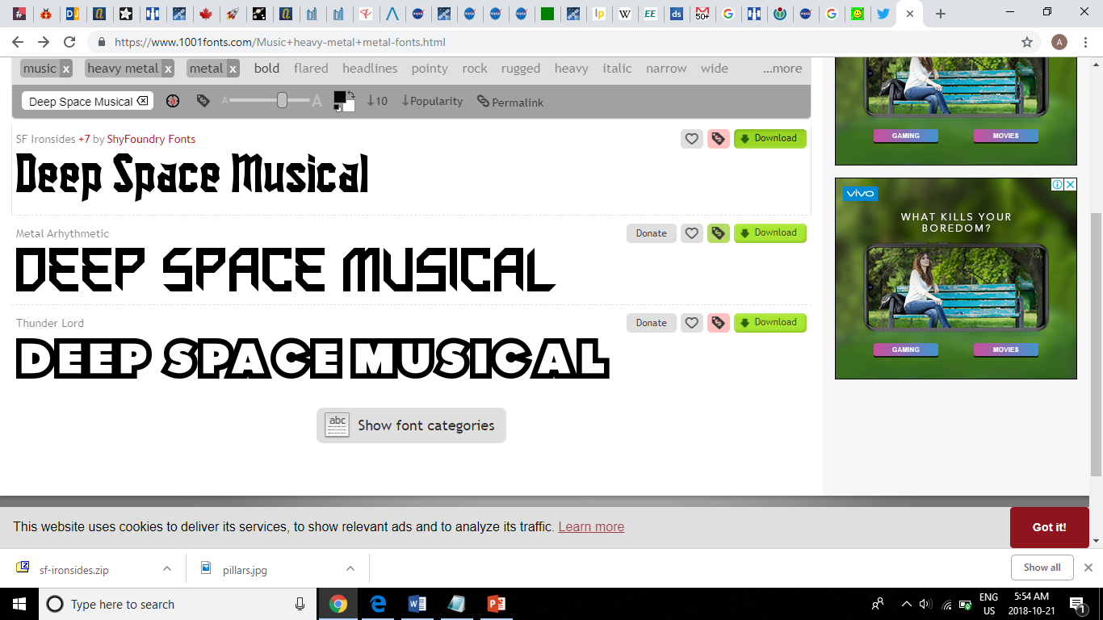
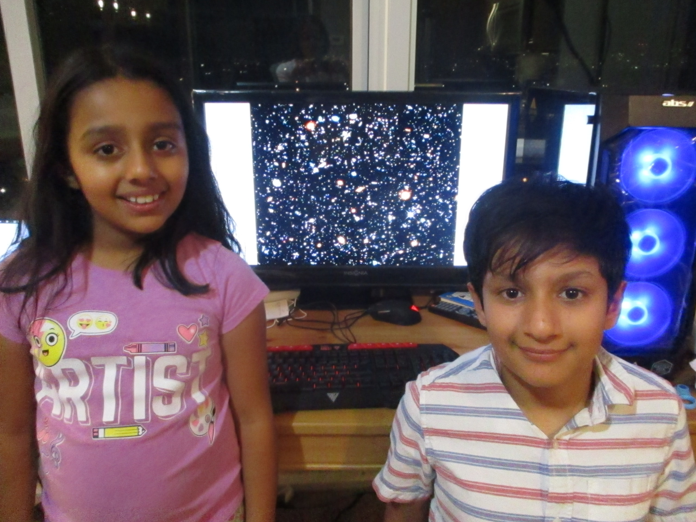

Artash Nath (Grade 7)
Arushi Nath (Grade 3)
Vikas Nath
HotPopRobot.com
Follow us @wonrobot
7 November 2018

Slide 2
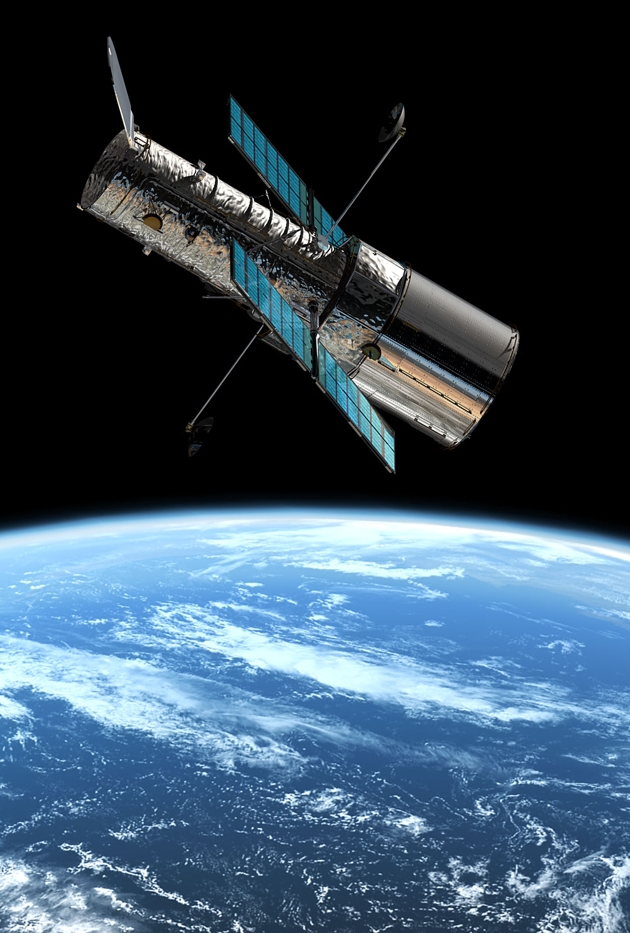
Hubble has been orbiting the earth for over 25 years and has taken over 1.3 million observations
Transforms images taken by the Hubble Space Telescope into a Musical.
Allows beauty of Universe to be experienced by all, including people who are visually impaired.

Slide 3
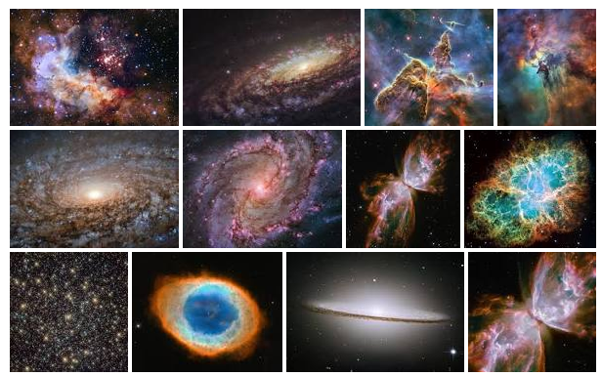
Hubble Telescope has made over
1.3 million observations
We converted some of them to Music!

Slide 4
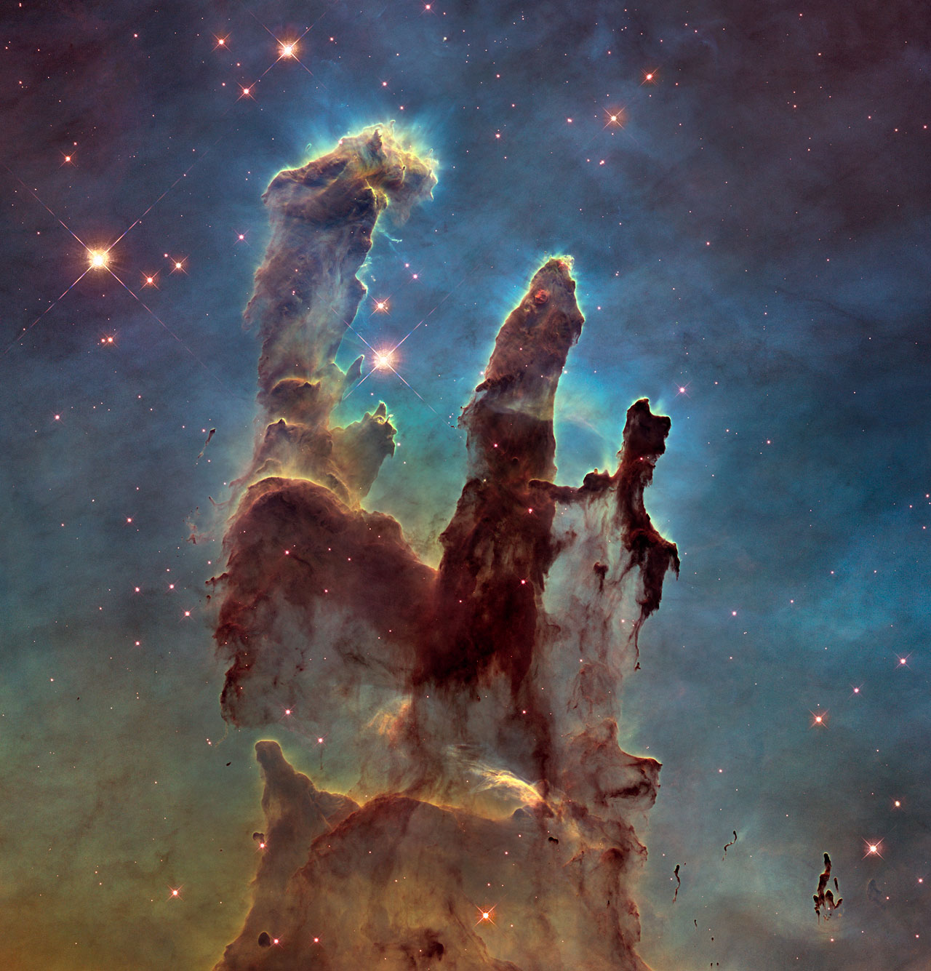
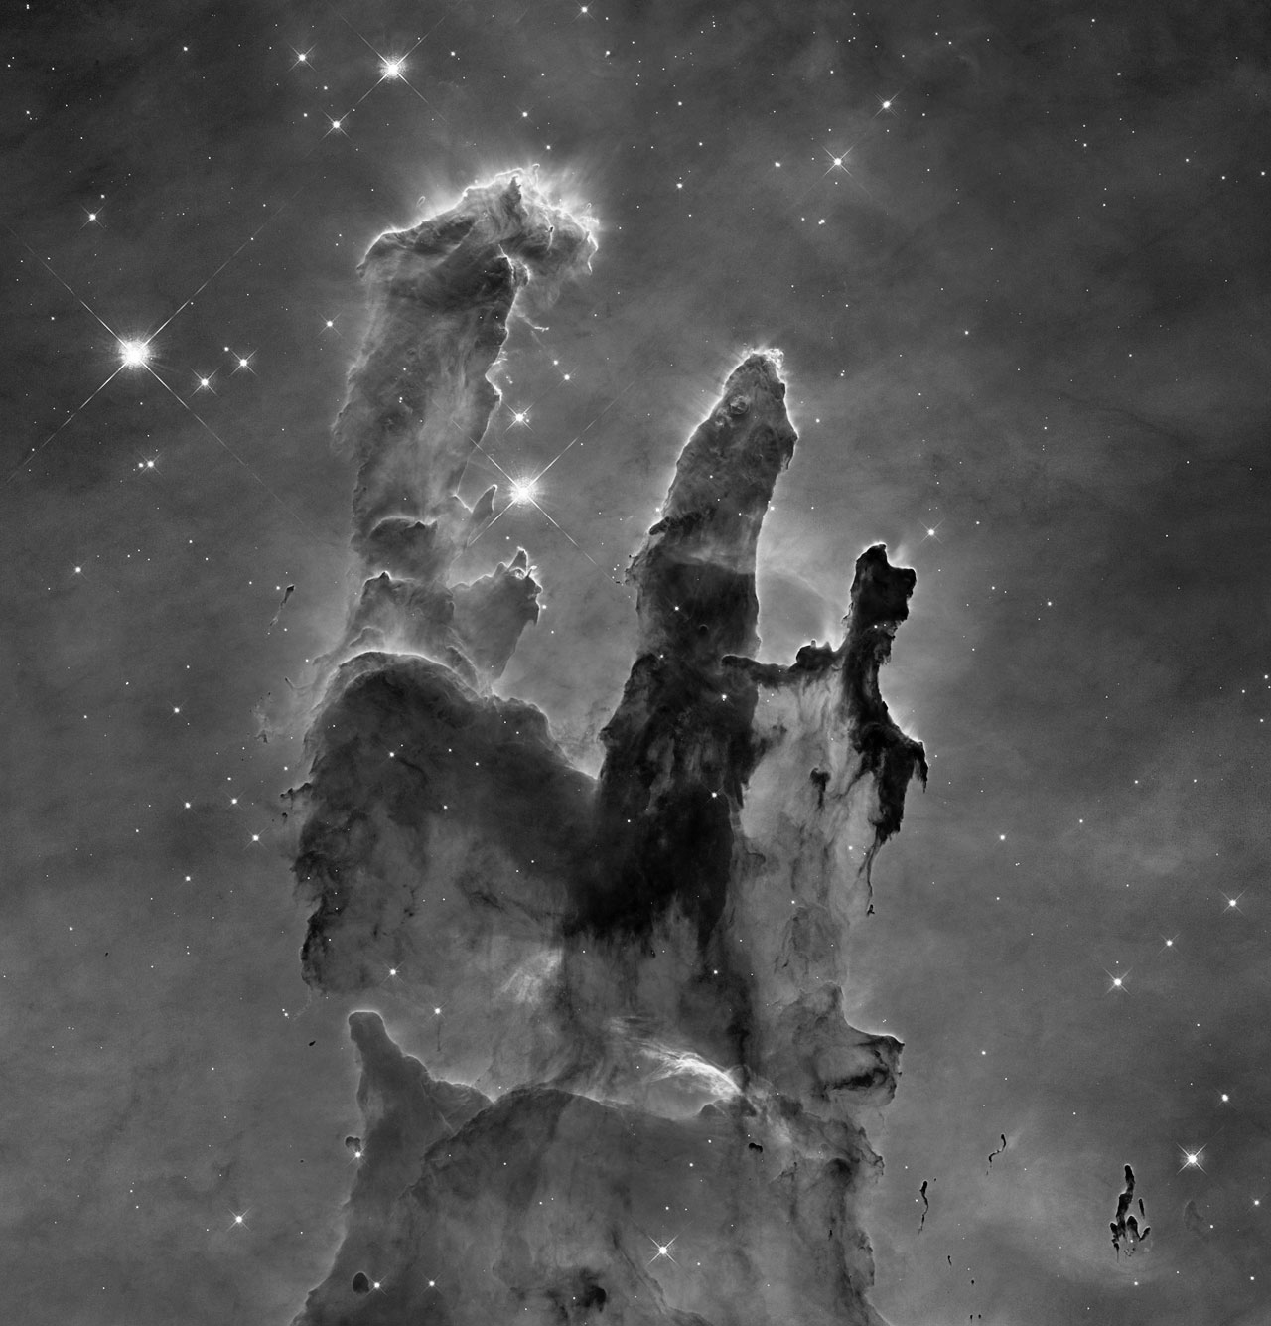
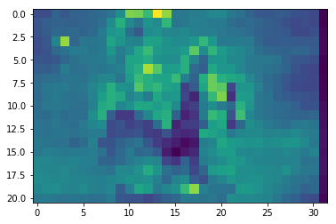
RGB (Red Green Blue) → Gray Scale → Pooling
HOW?
Actual Hubble Image

Slide 5
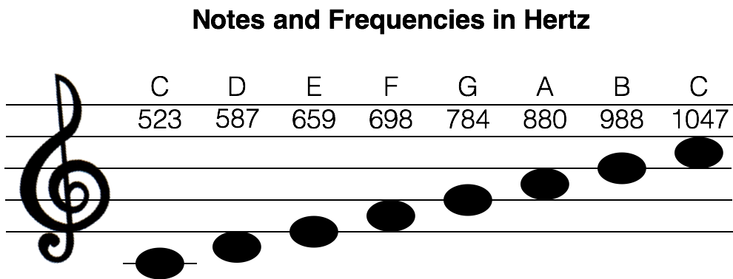
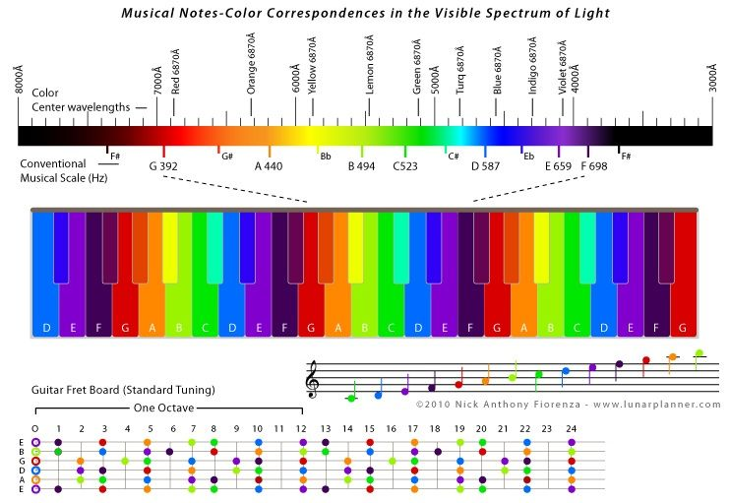
Transformed Pixel Values into Frequencies and Notes!
Every pixel of Hubble Color Image is associated with a musical note

Slide 6
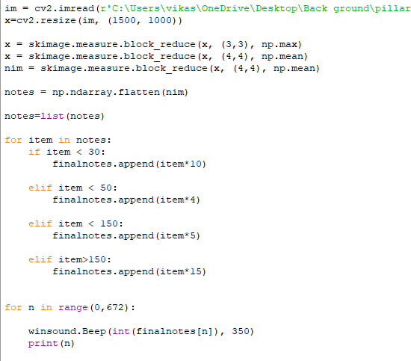
Peek into Python Code

Slide 7
DEMO: Listen to the Musical

Slide 8

Musical Part 1:
Birth of Stars
The Pillars of Creation
Eagle Nebula
7000 light years
Hubble Images: 5 Jan 2015
Pillars Of Creation Musical

Slide 9
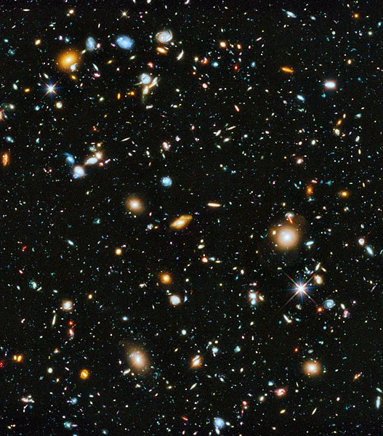
Musical Part 2:
Galaxies of Stars
Hubble Ultra Deep Field (HUDF) Photograph
Fornax Constellation
13 billion light years
Hubble Images:
Sep 2003 – Jan 2004
HUDF Music

Slide 10
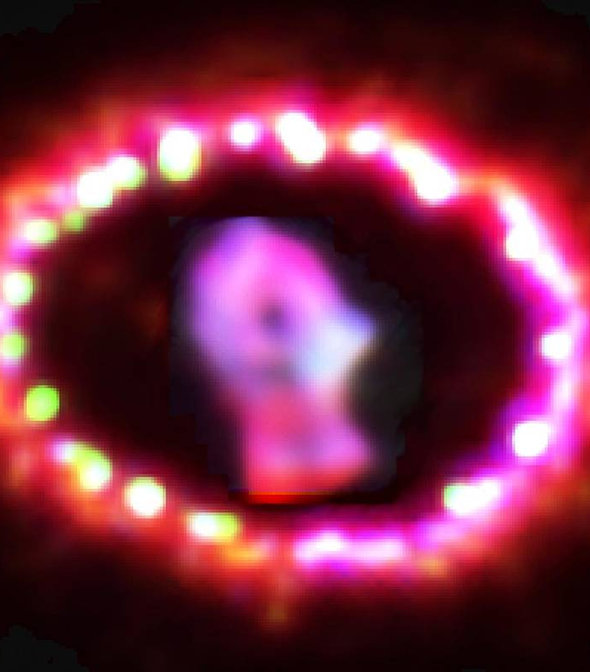
Musical Part 3:
Star Death
Supernova 1987A
Large Magellanic Cloud
168,000 light years
Hubble Images 1994 - 2003
Super Nova Music

Slide 11
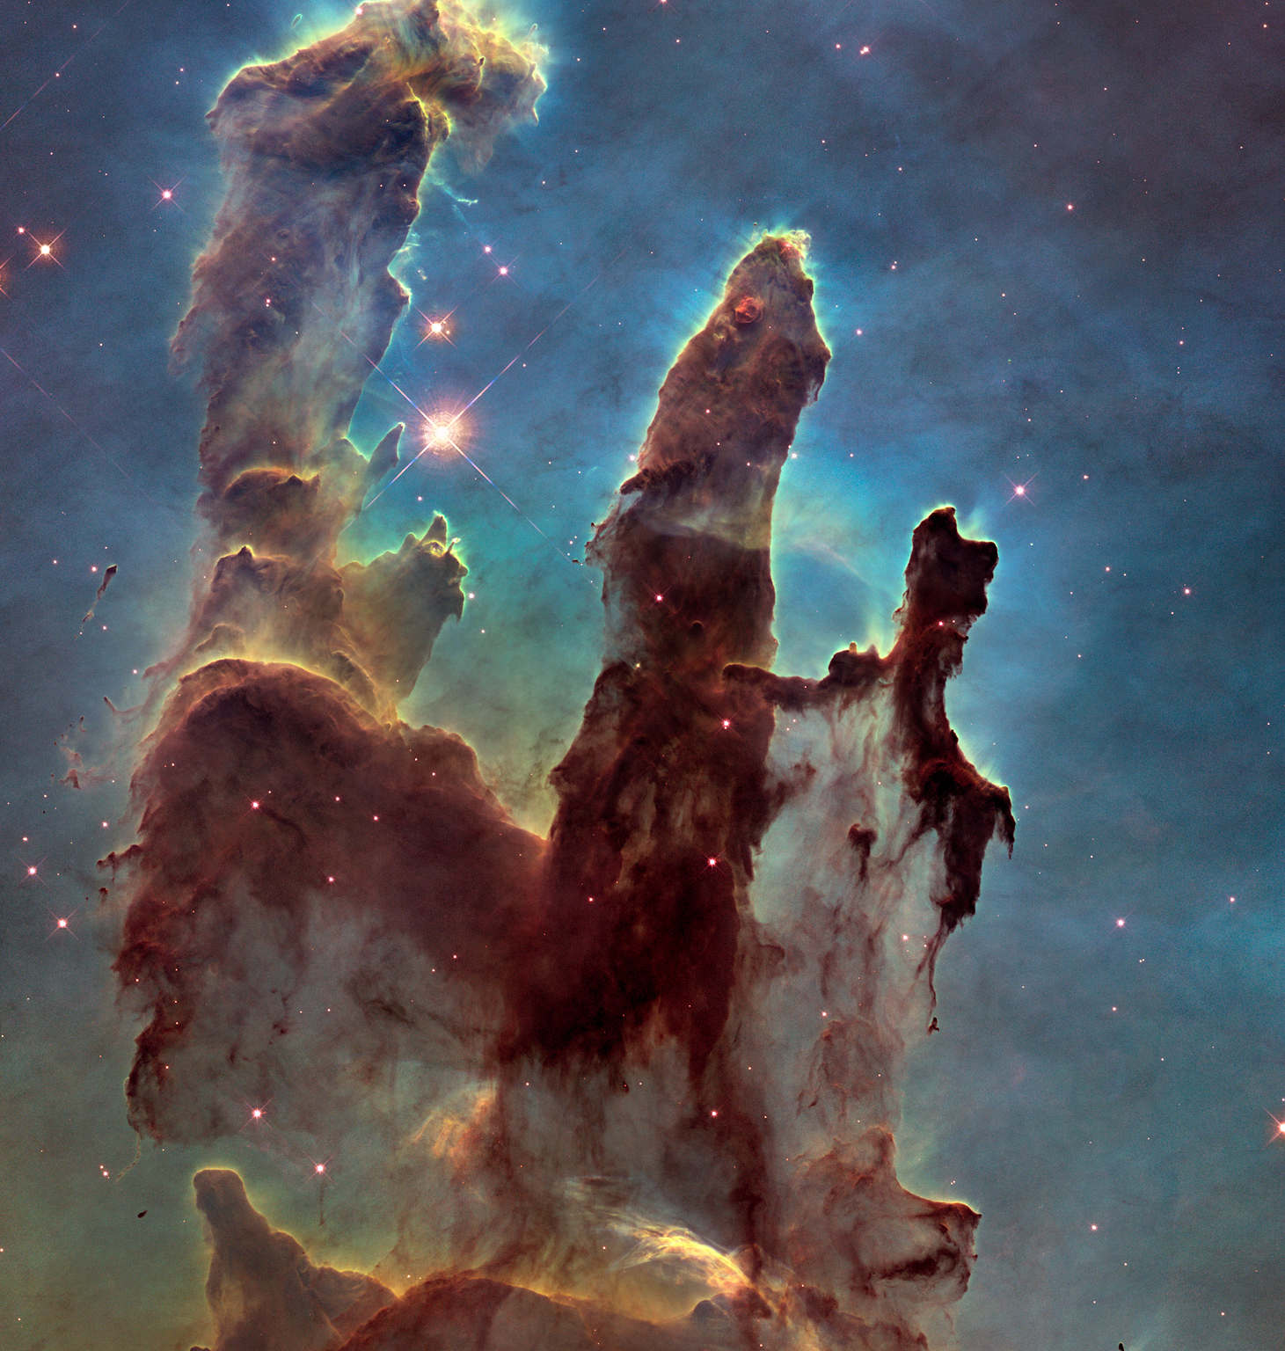
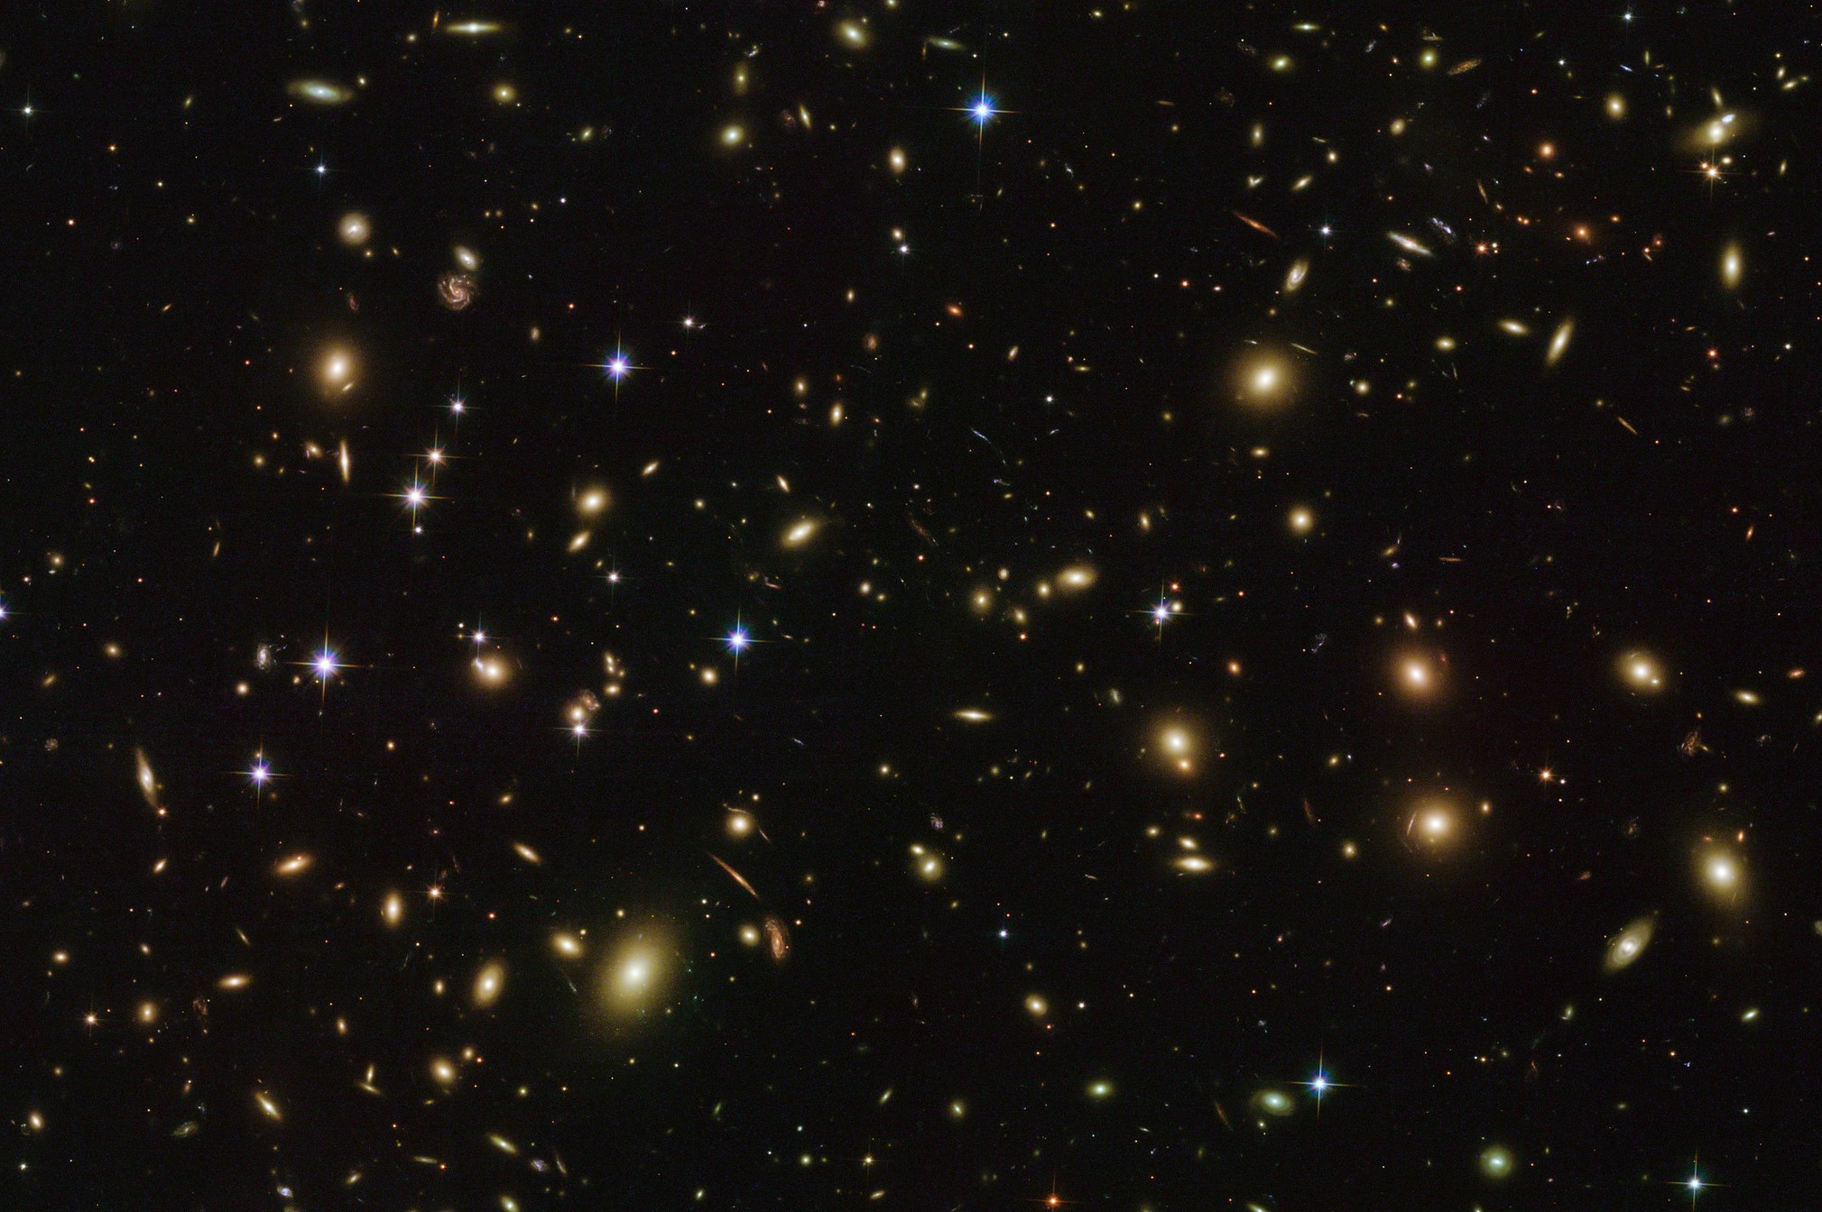
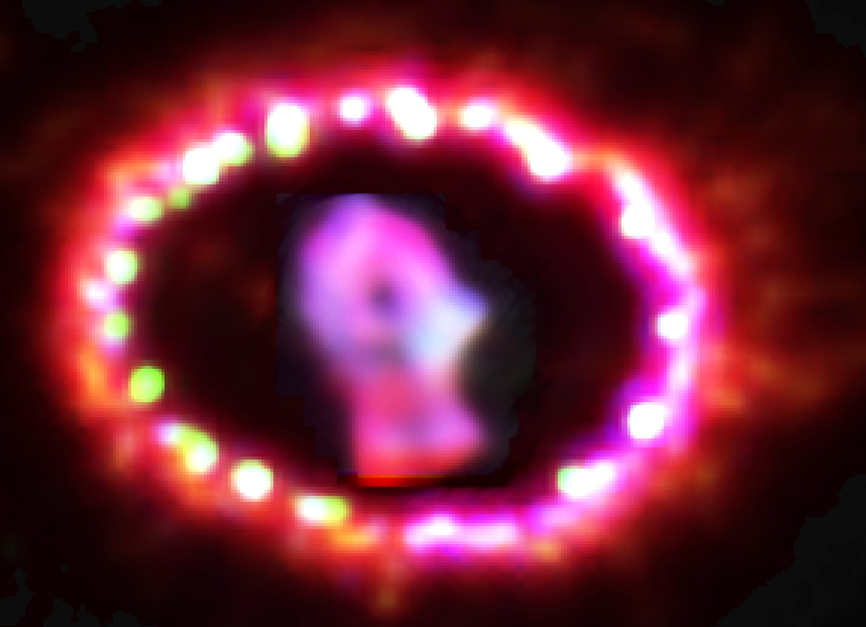
Now Listen to the complete Musical!

Slide 12

Artash Nath (Grade 7)
Arushi Nath (Grade 4)
Vikas Nath
Team: HotPopRobot.com
Follow us @wonrobot
21 October 2018

