Slide 1
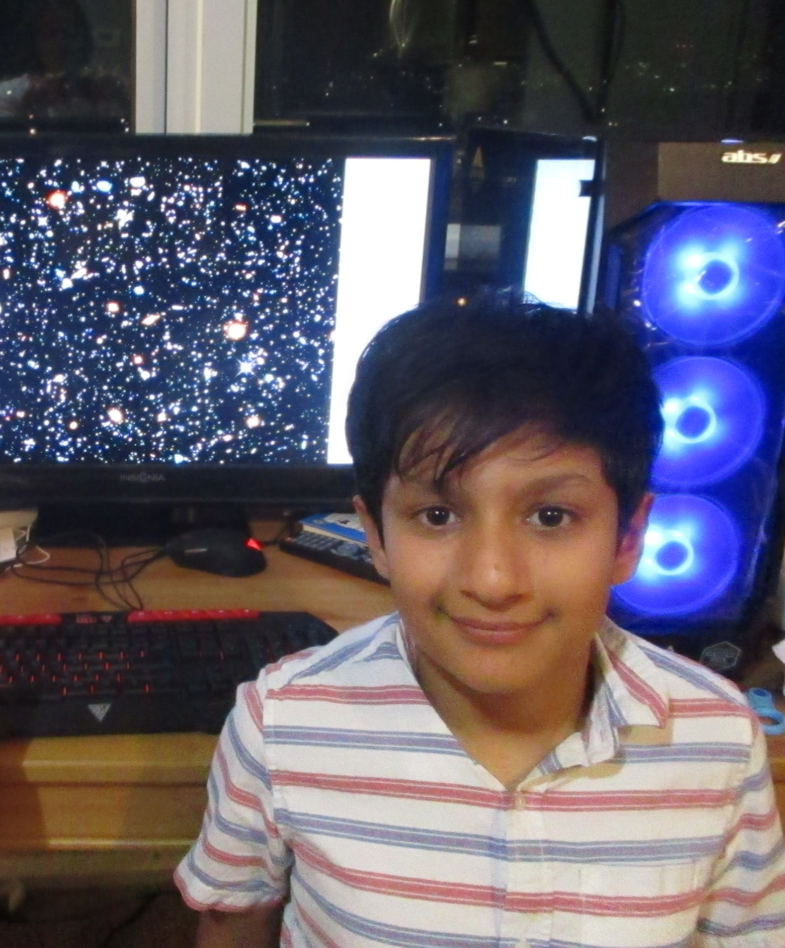
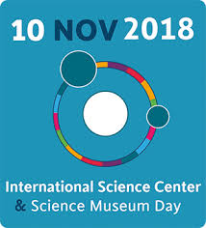
Science a Human Right: Dream Big and Every Kid Should have Access to Science
Artash Nath (Grade 7)
Co-Founder
HotPopRobot.com
Follow us @wonrobot
Ontario Science Centre
10 November 2018

Slide 2
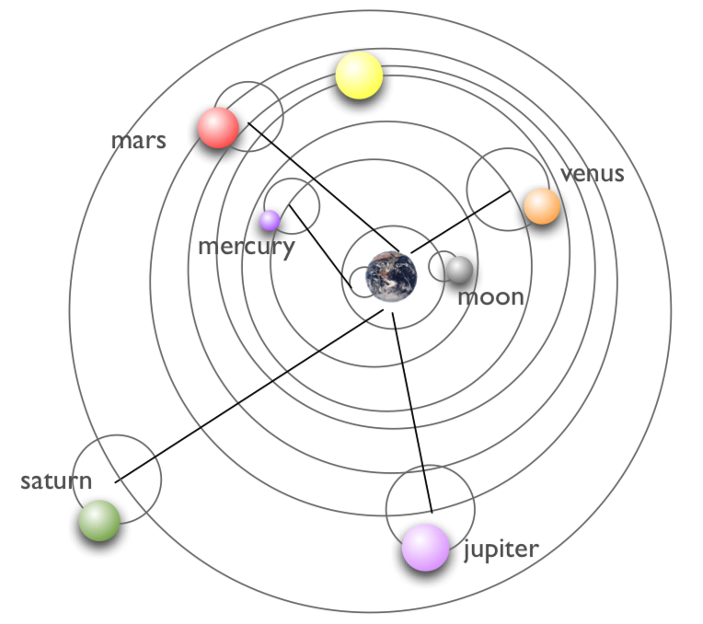
100 AD: The Ptolemaic Model of our Universe
The Earth is stationary and at the Centre.
The Sun and the other planets revolved around the Earth
The model remained unchallenged for 1400 years even when Observations did not match the Predictions by the Model!
Why?
Earth has a special place in the Universe
The Model was believed by so many people that it was difficult to accept anything different!

Slide 3
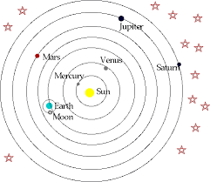
1500 AD: Copernicus and Galileo Model
The Sun is at the Centre and other planets revolve around the Earth
The model met Resistance.
Why?
Earth has NO special place in the Universe
The Model was not accepted by People .
Galileo was convicted of a “strong suspicion of heresy” - for challenging popular views!
Science was not always a Human Right!

Slide 4
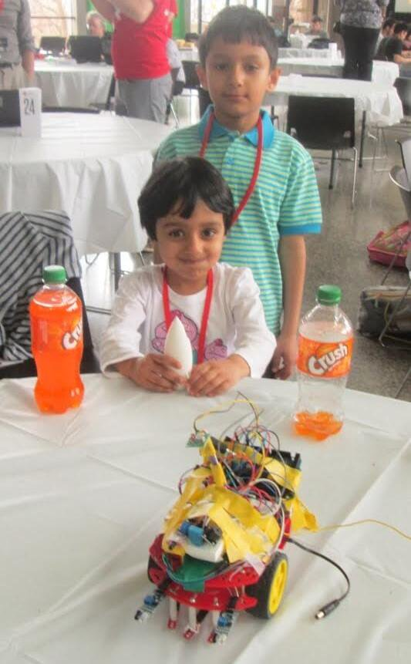
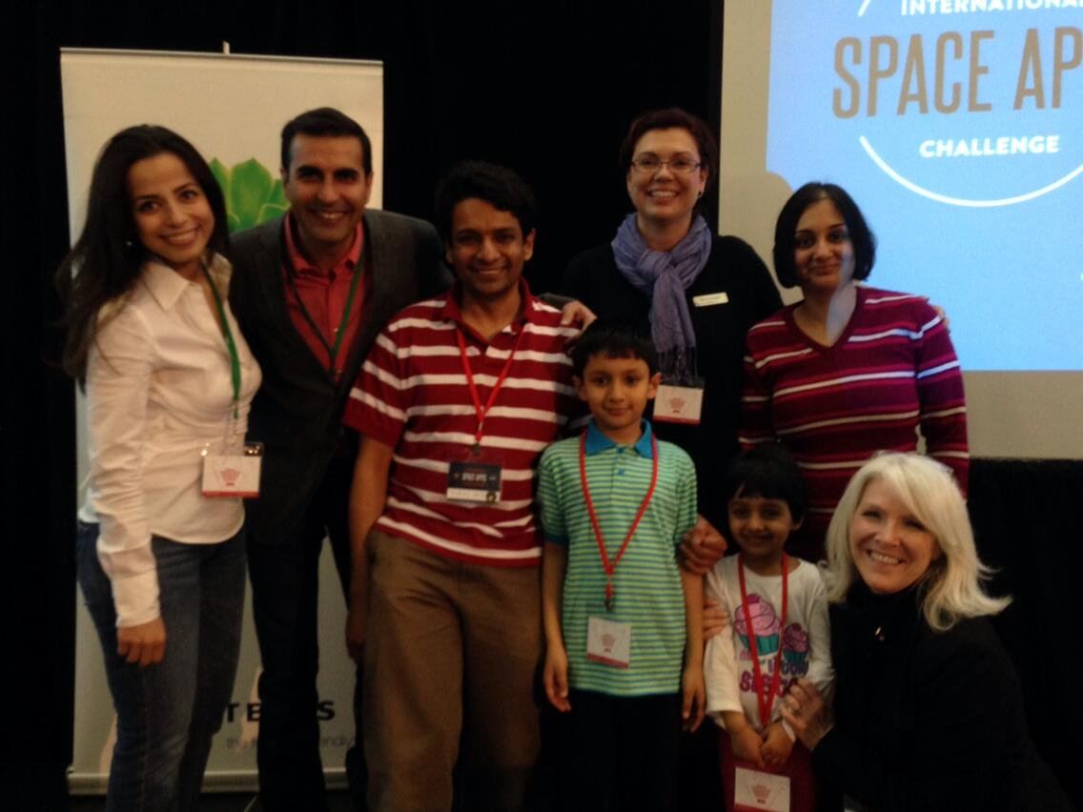
2014: My First Space Event
NASA SpaceApps Challenge at the Ontario Science Centre
Building CuriousBot Rover:
detects obstacles
Winning my First NASA Space Apps Challenge at the Ontario Science Centre

Slide 5
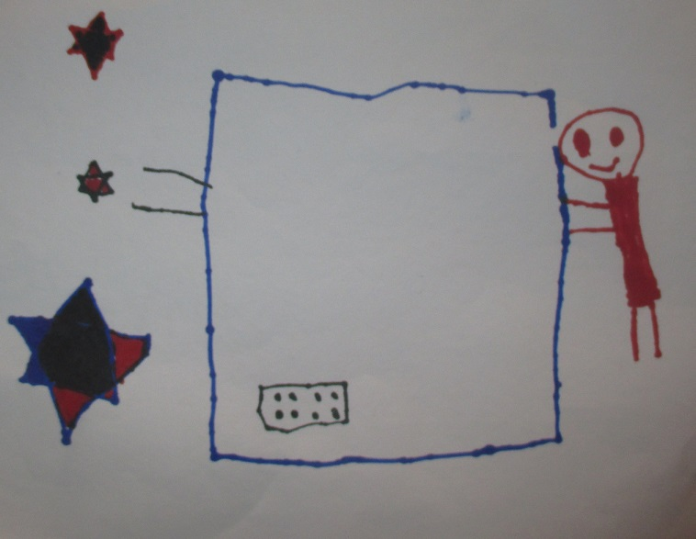
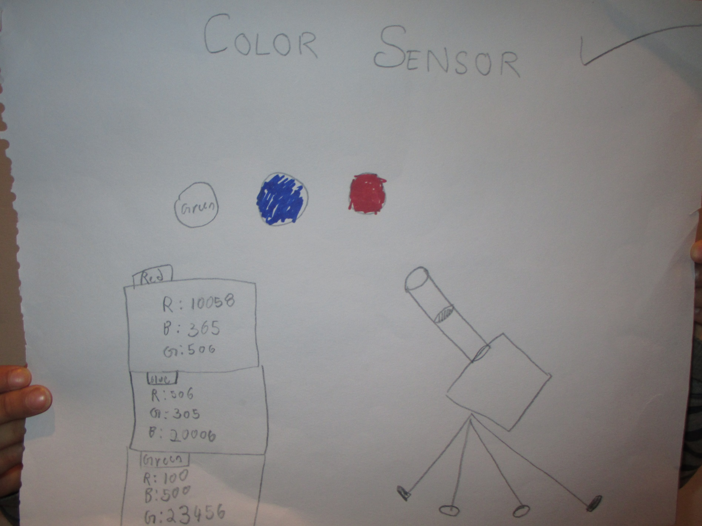
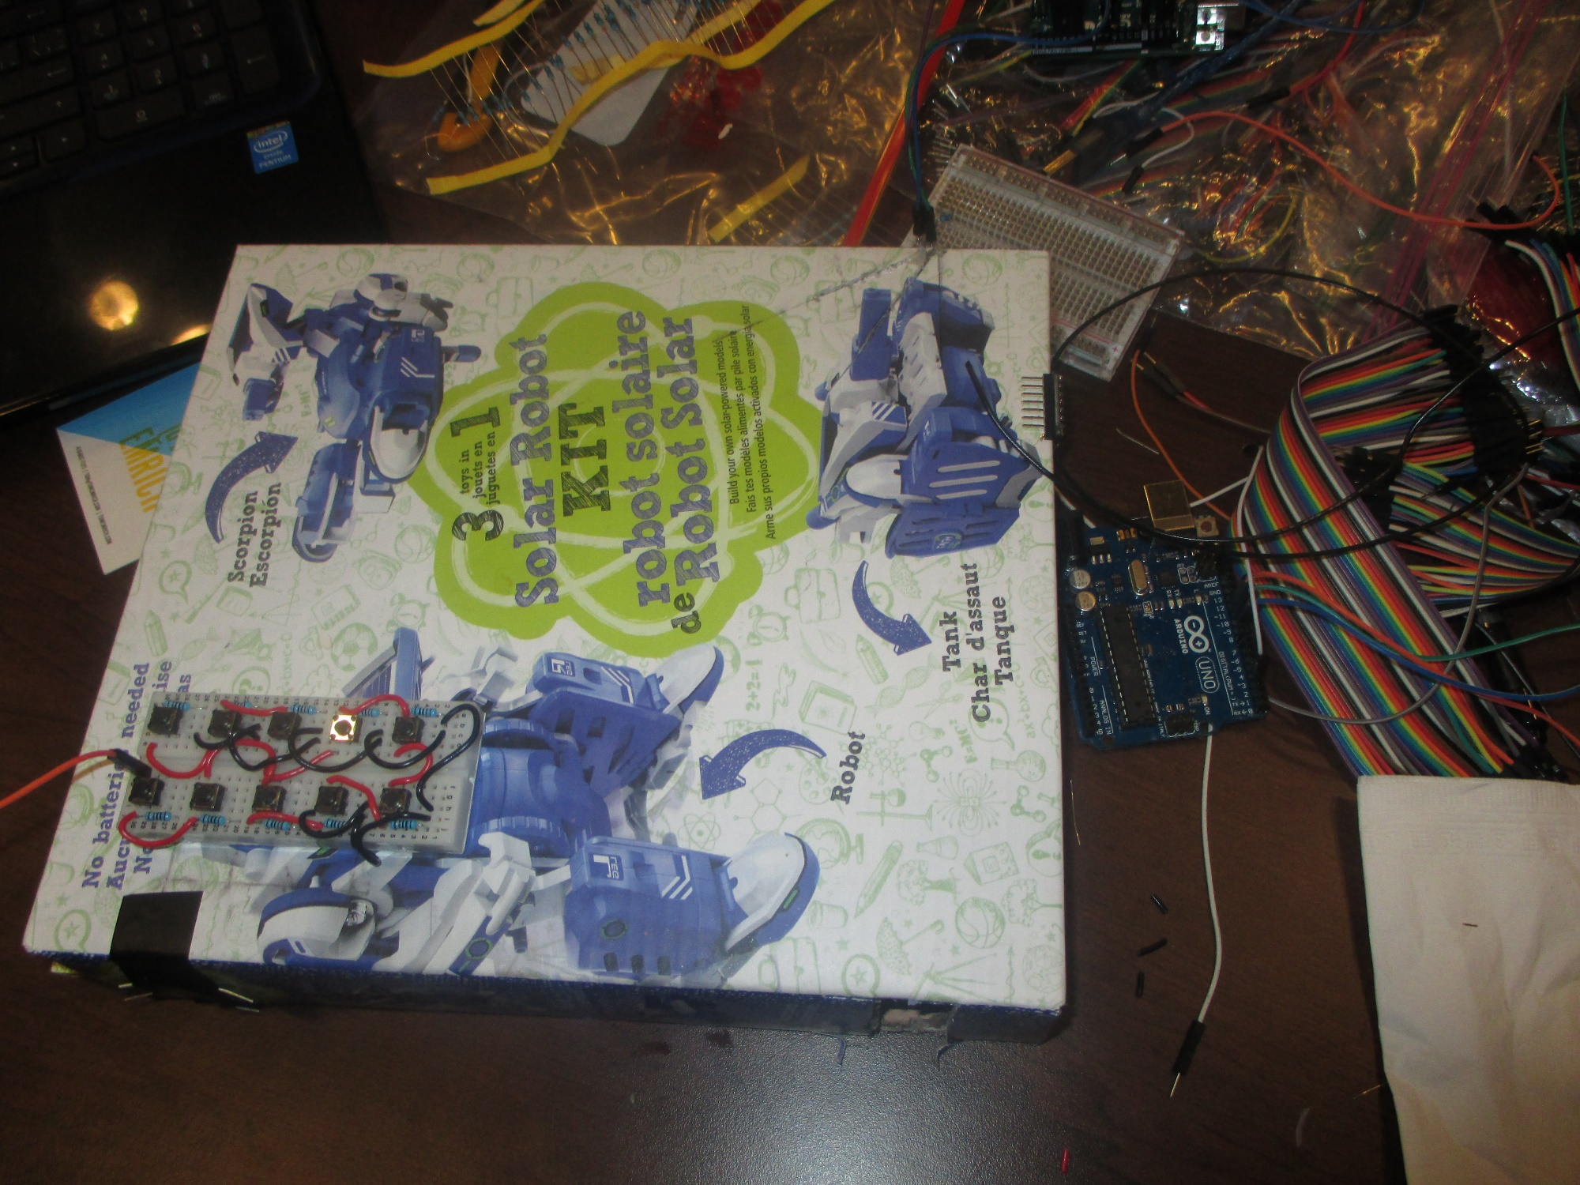
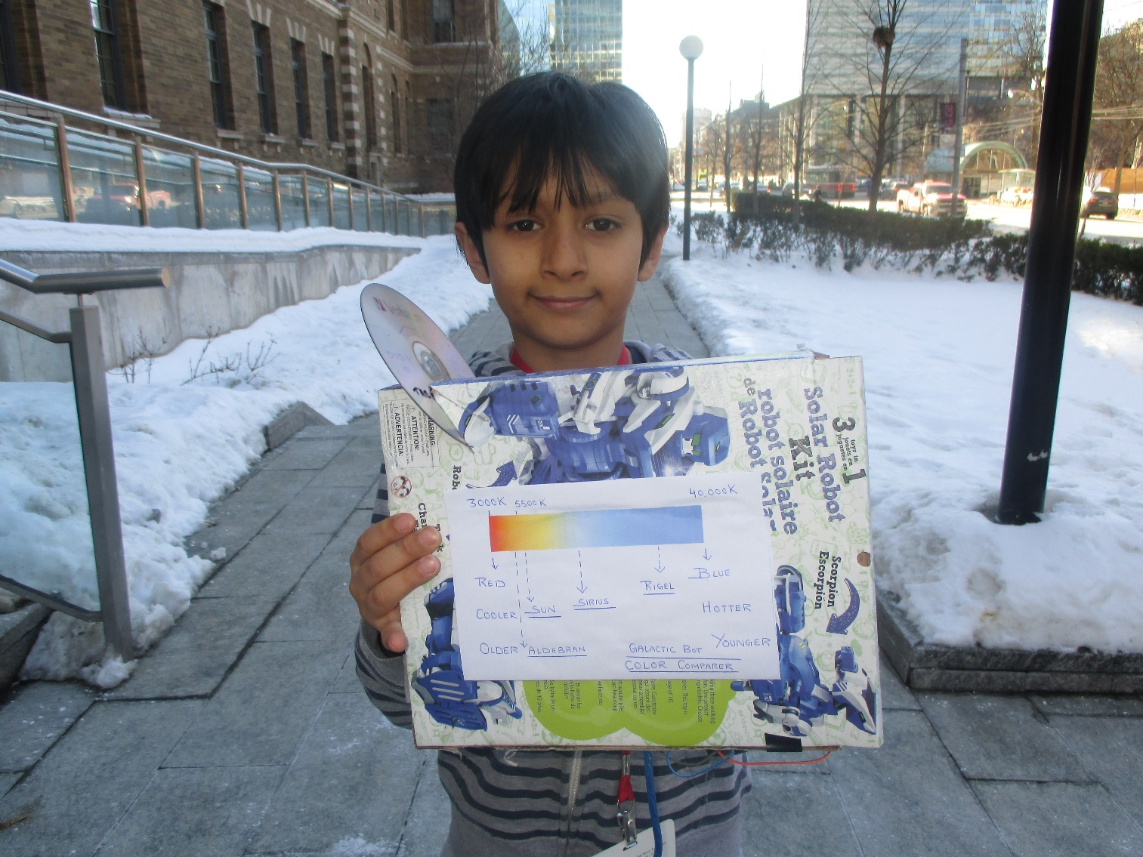
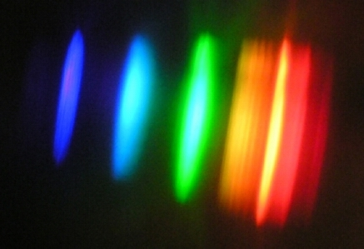
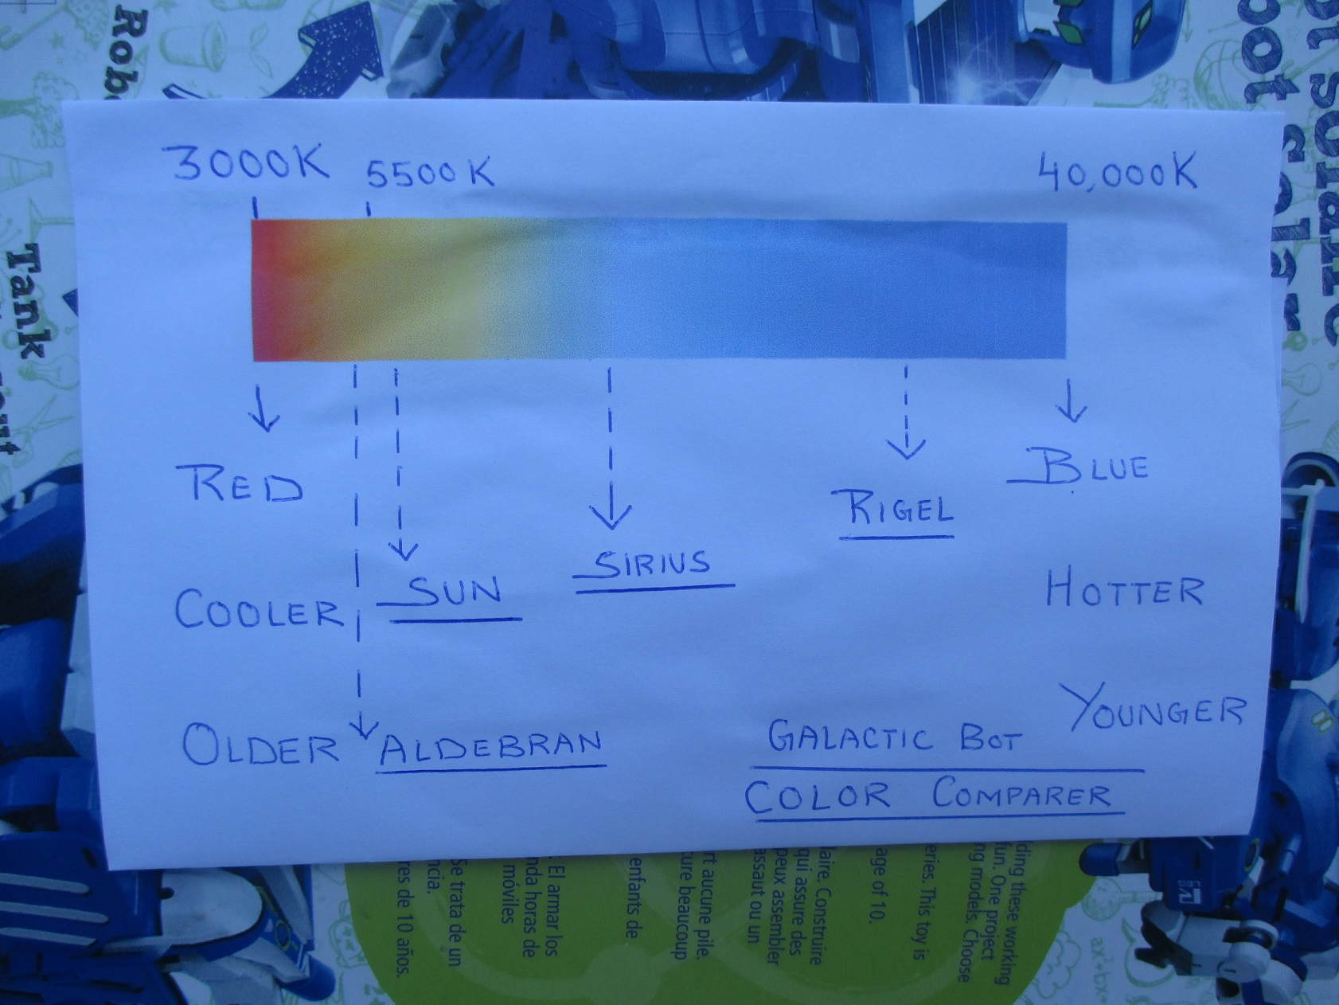
Dreaming of Stars… to learn more about them!

Slide 6
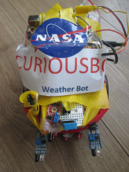
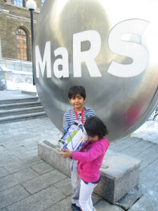
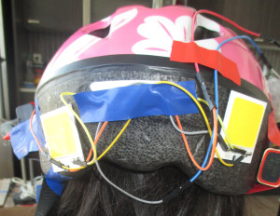

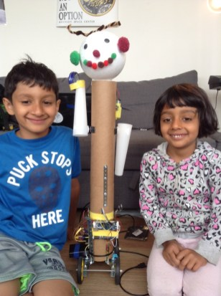
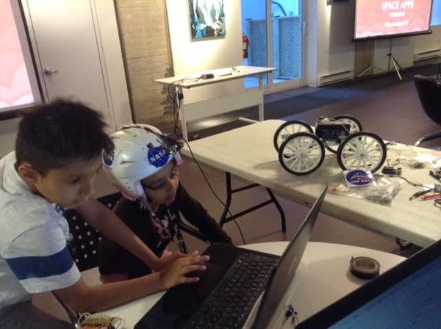
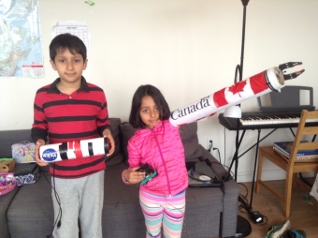
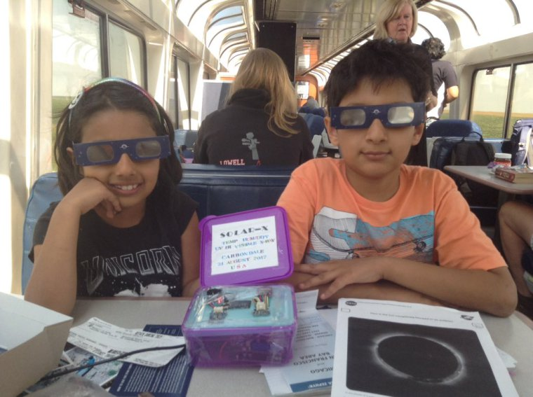
I am a Maker. Making Space Projects since I was 5 years
Astro Gesture Sensing Helmet 2015
Saturn V Rocket 2015
Curious Bot 2014
Galactic Bot 2015
Astro Health 2015
MARS Rover 2016
Canada Arm 2017
Solar-X 2017

Slide 7
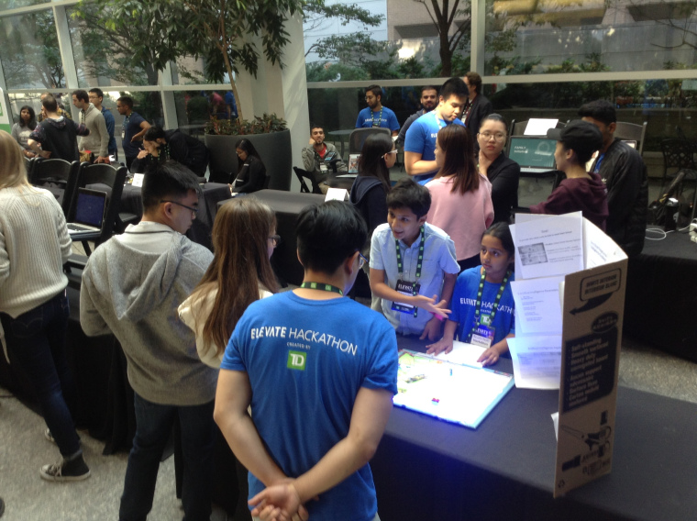
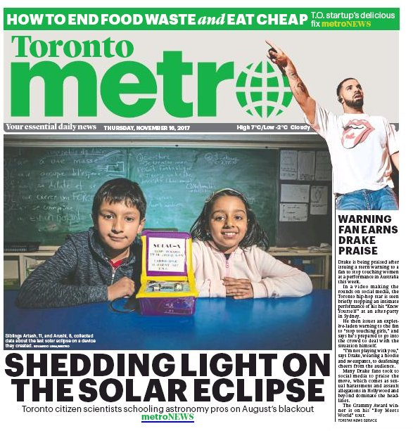
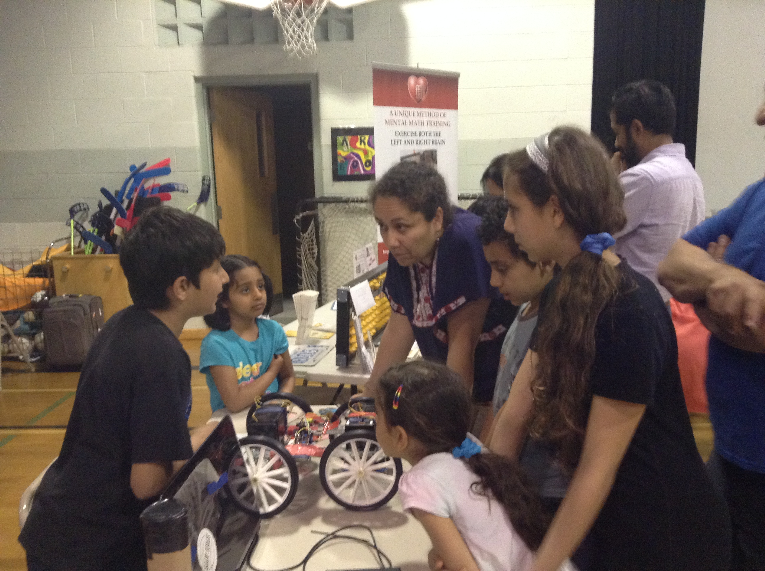
Presenting and Giving Demo of my Science Projects
Giving a demonstration of my project in community events
Love sharing my experiences with other kids and parents
Front page coverage of the
Solar-X project

Slide 8
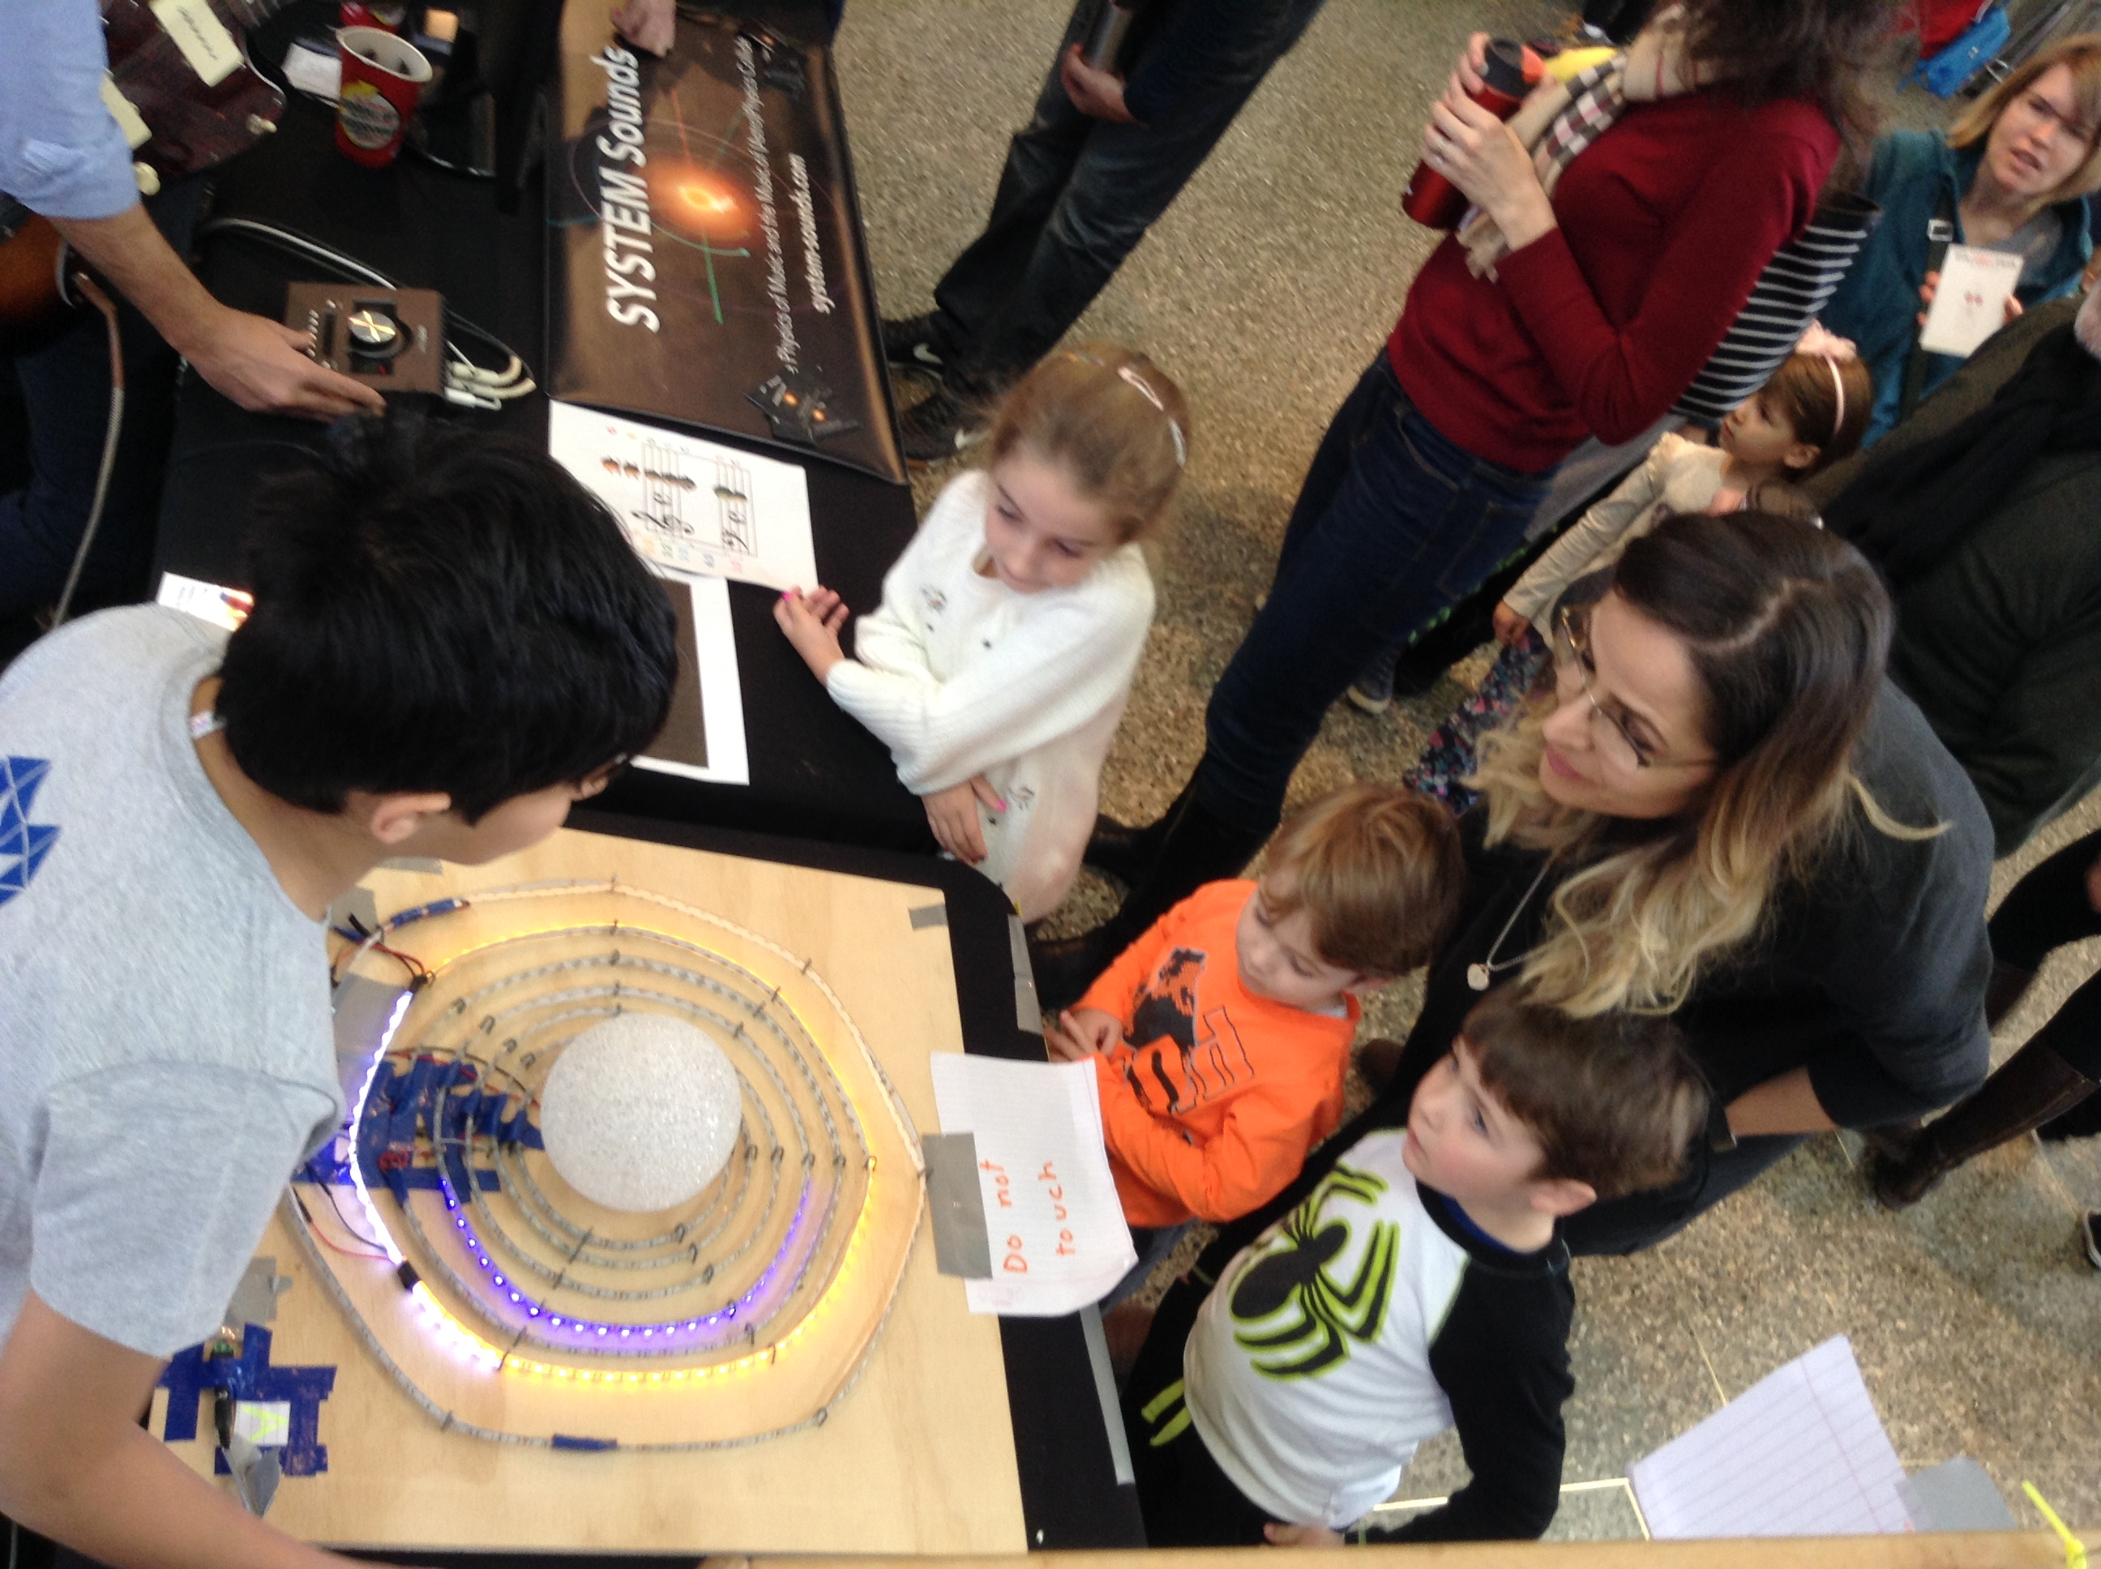
Join a local Science Club, Museum or Organisation
Organisations in Toronto from where I
learned about Space, Satellites and Coding, and to keep dreaming and doing!
Ontario Science Centre
Royal Astronomical Society of Canada
Kids Code Jeunesse
Coderdojo
Students for the Exploration and Development of Space (SEDS Canada)

Slide 9
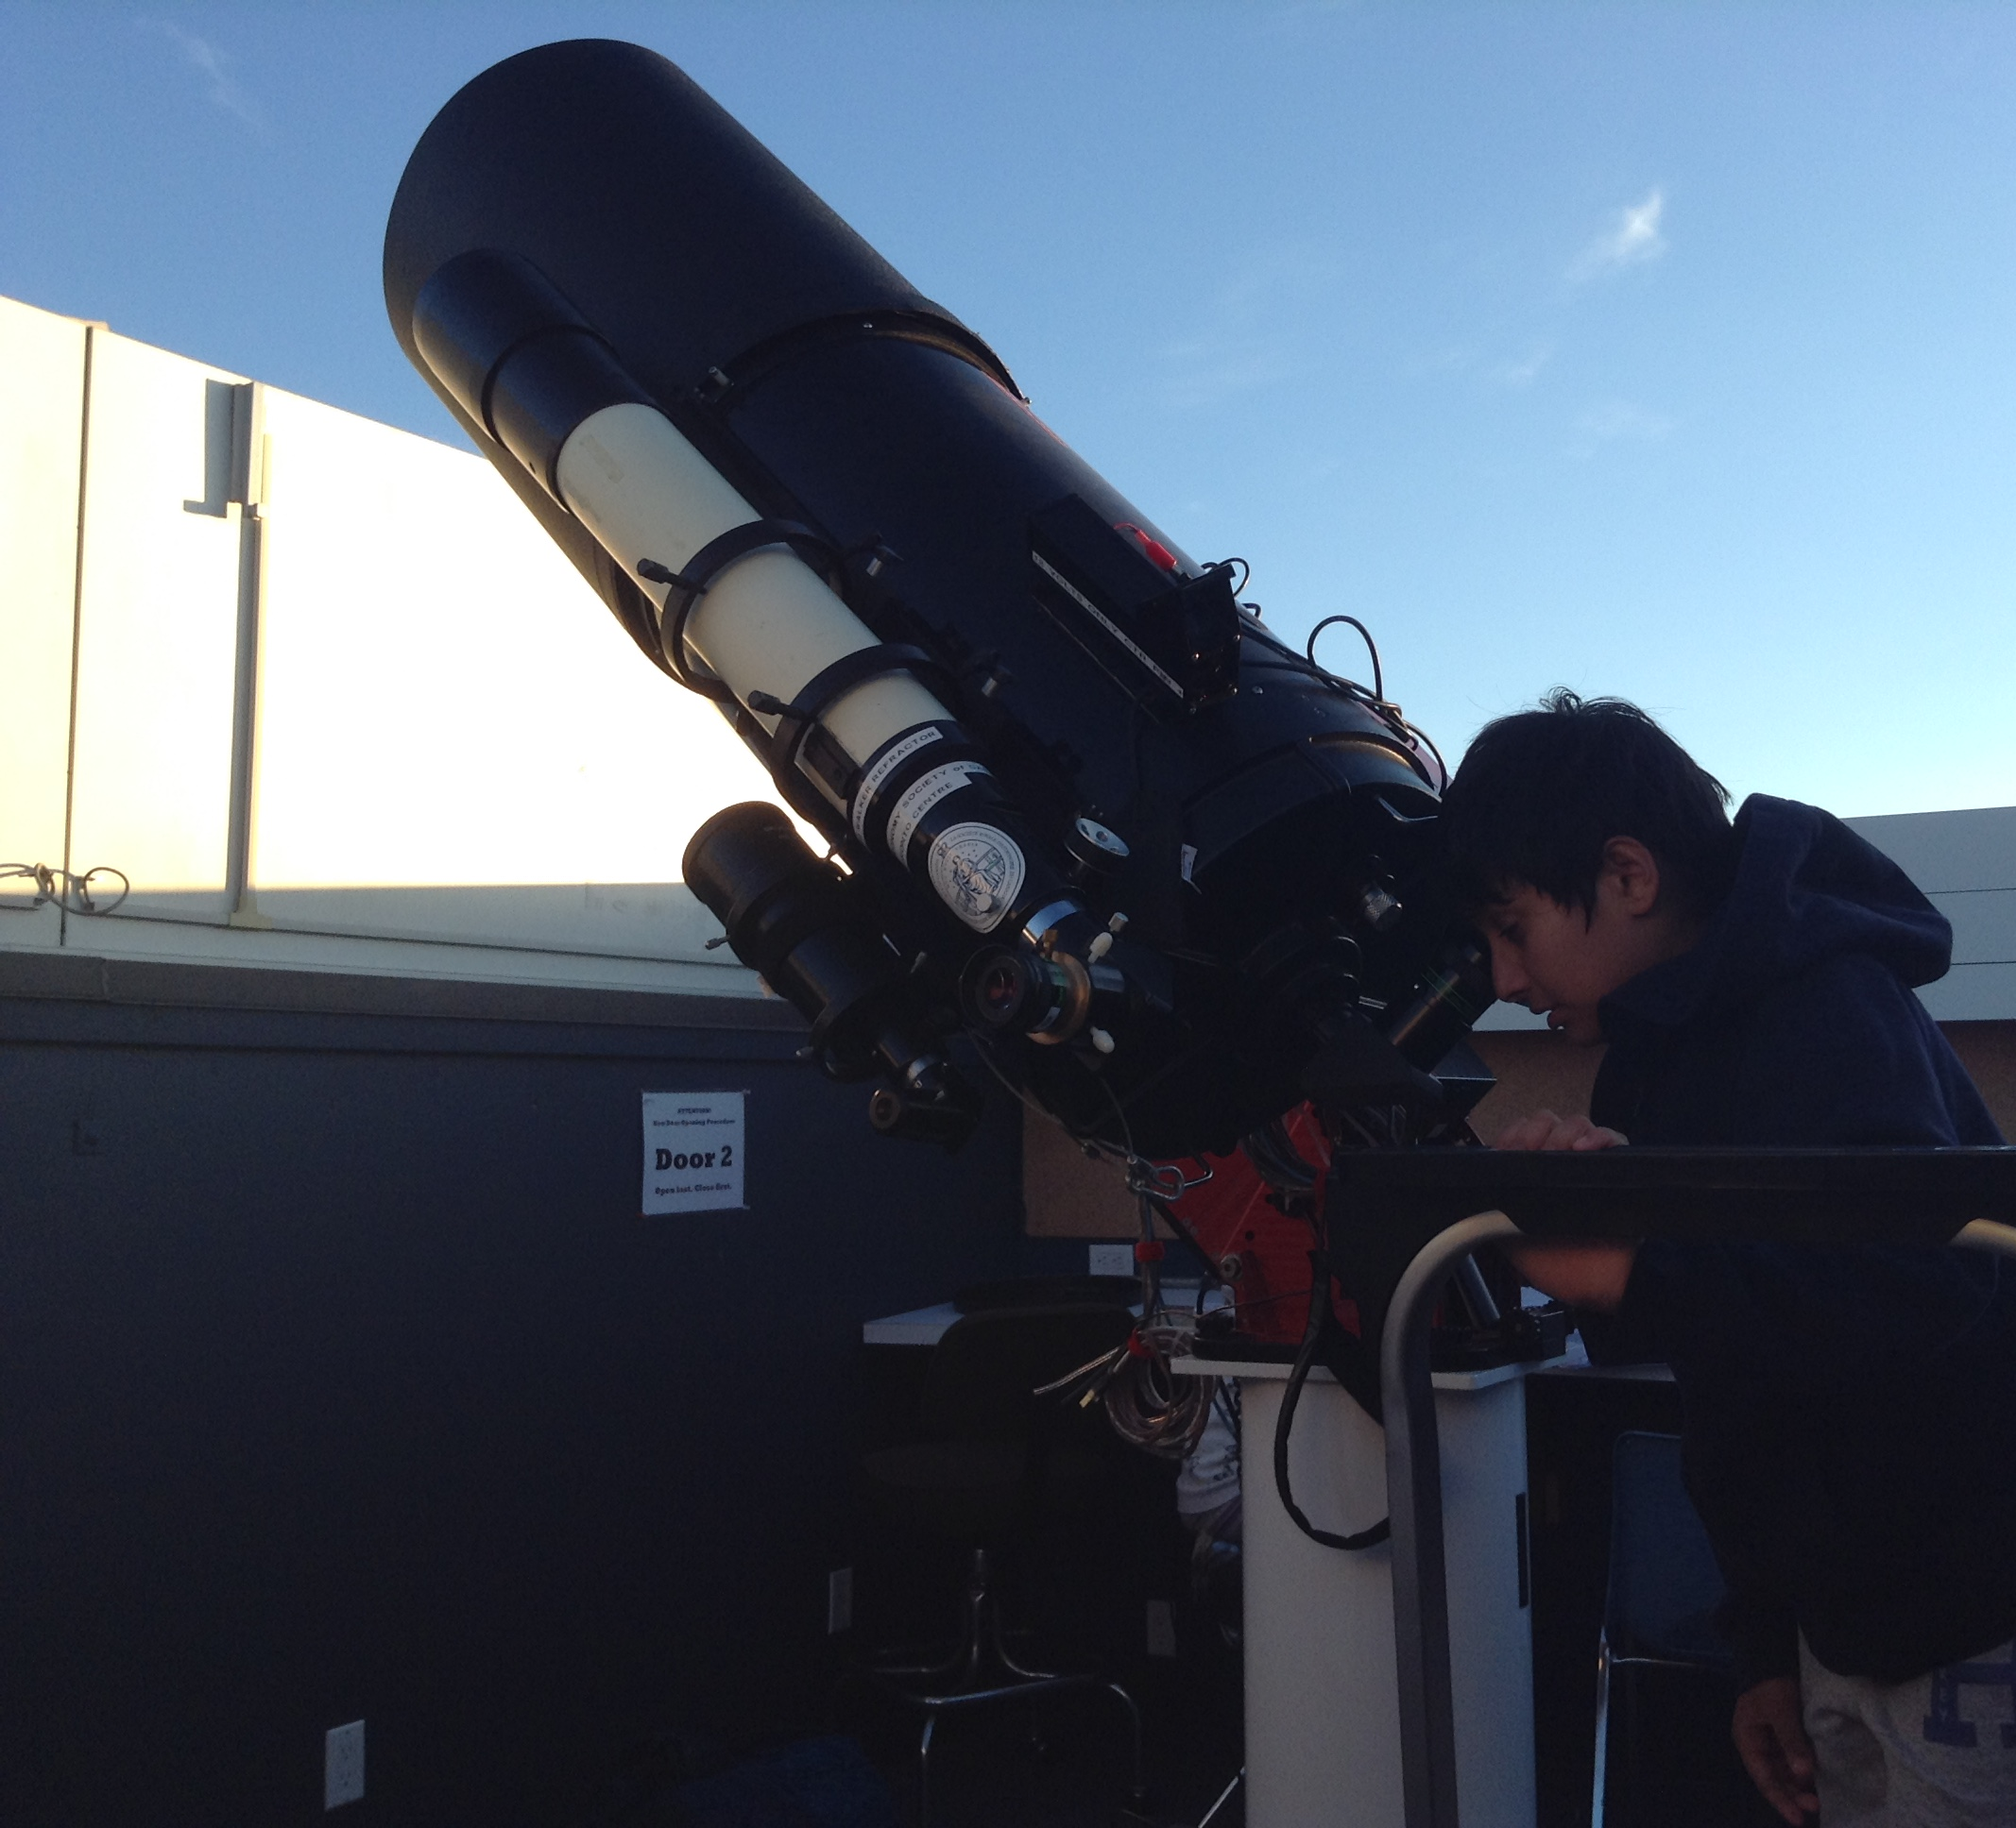
How to make Science a Human Right?
Encourage asking Questions- WHY?
Provide scientific tools to conduct experiments to ask questions
Customise Learning to children’s interest and passion
Have a Vision where children can become creators and scientists and not just consumers
Think Big! Solve Challenges
Artash looking at Planets using the Telescope at Carr Astronomical Observatory, RASC Toronto

Slide 10
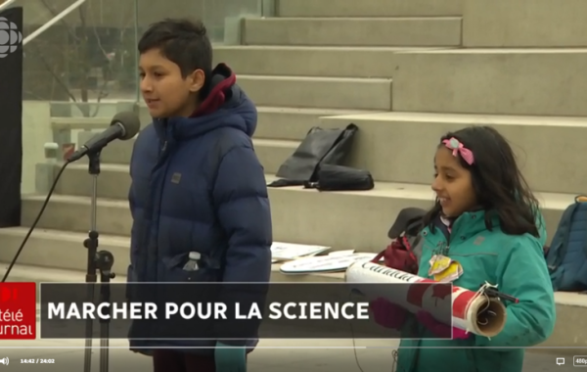
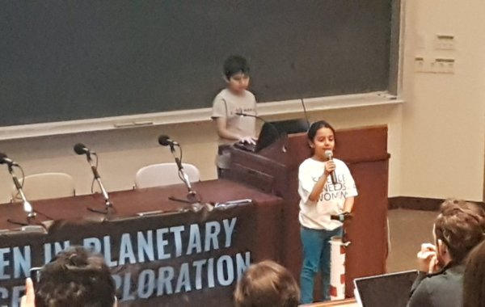
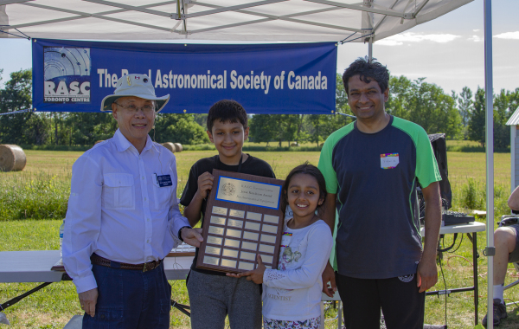
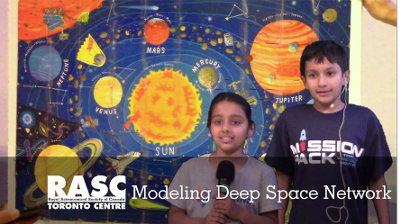
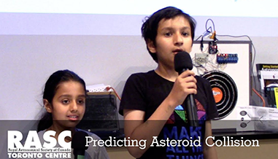
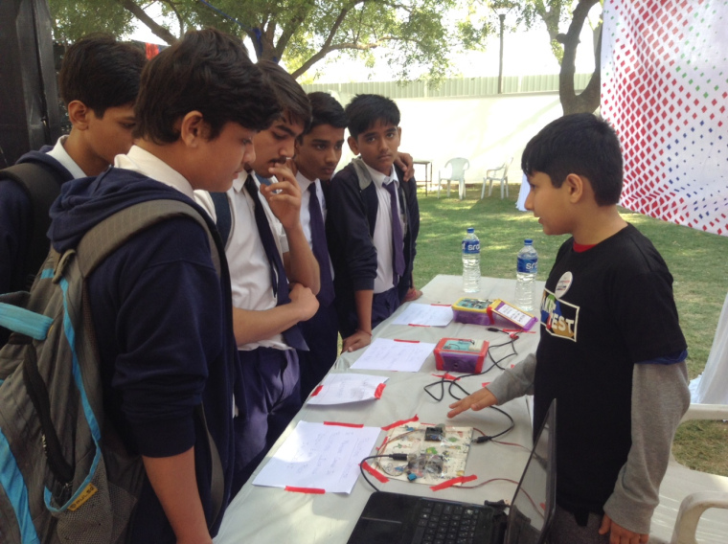
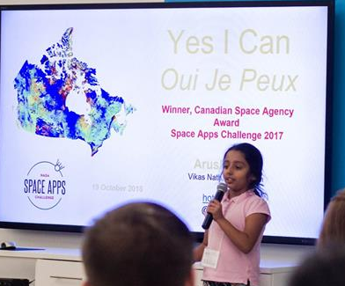
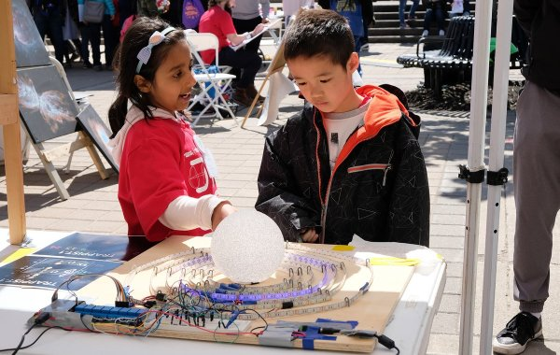
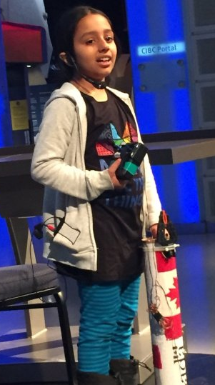
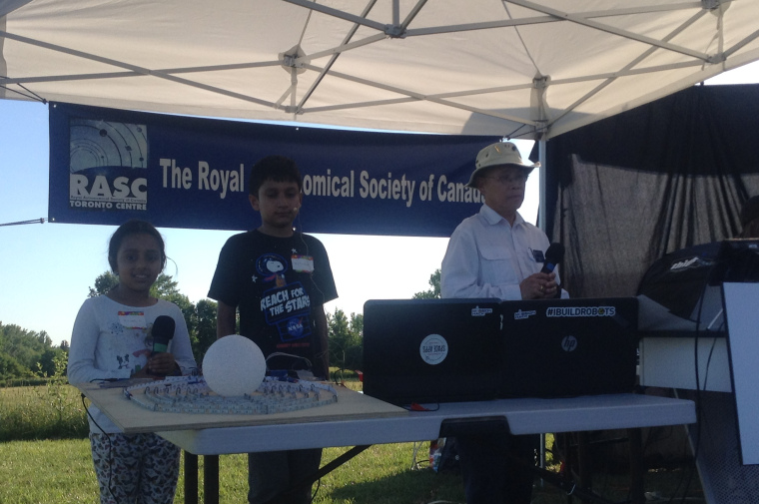
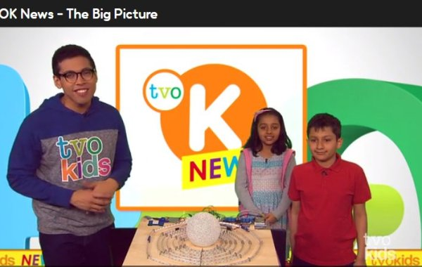
2018: Glimpse of our Sciene Journey
Speaker, Science March Toronto, Nathan Philips Square
Guest Speaker – Women in Planetary Science, Uof T.
RAN 1: Deep Space Network
RASC Toronto Jesse Ketchum Award
Opening Presentation,
SpaceApps Toronto
RAN 2: Predicting Asteroid Collision using AI
Maker Festival India
Speaker, International Day for Girls in Science, Ontario Science Centre
Science Odyssey Grand Prize for
Science Outreach
Awards Day Presentation on
TRAPPIST-1 CARR Observatory
TVO Kids- TRAPPIST 1 Model

Slide 11
Science a Human Right: Dream Big and Every Kid Should have Access to Science
Artash Nath (Grade 7)
Co-Founder
HotPopRobot.com
Follow us @wonrobot
Ontario Science Centre
10 November 2018

