Slide 1
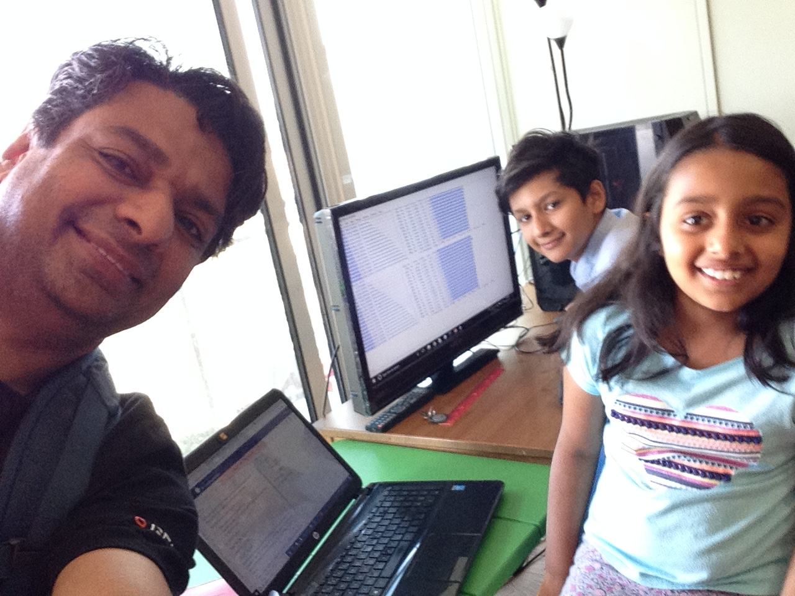

A.B.Cs (Artificial intelligence for Better Customer Service)
Toronto, 14 October 2018
Artash Nath, Arushi, Vikas
www.HotPopRobot.com @wonrobot

Slide 2
Goal:
Predict Customer Satisfaction Ratings for new products based on reviews and comments shared online
Artificial Intelligence Training Data:
Keras Online Forum Reviews

Slide 3
Data Flow for A.B.Cs
Good
Visual Interpretation
Rating>0.5
Higher Rating: Better Review
Lower Rating: Worse Review
Product Reviews
Artificial Intelligence Decision
(0.0 – 1.0)
Bad
Rating<0.5

Slide 4
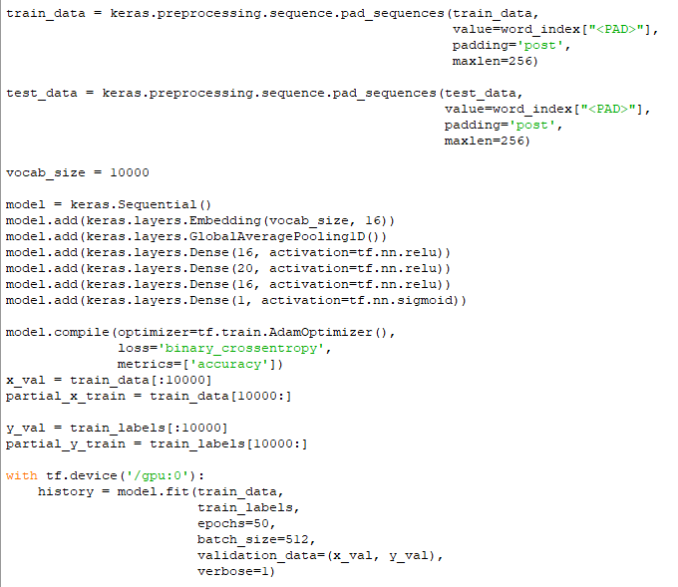
Peek into Neural Network Code

Slide 5
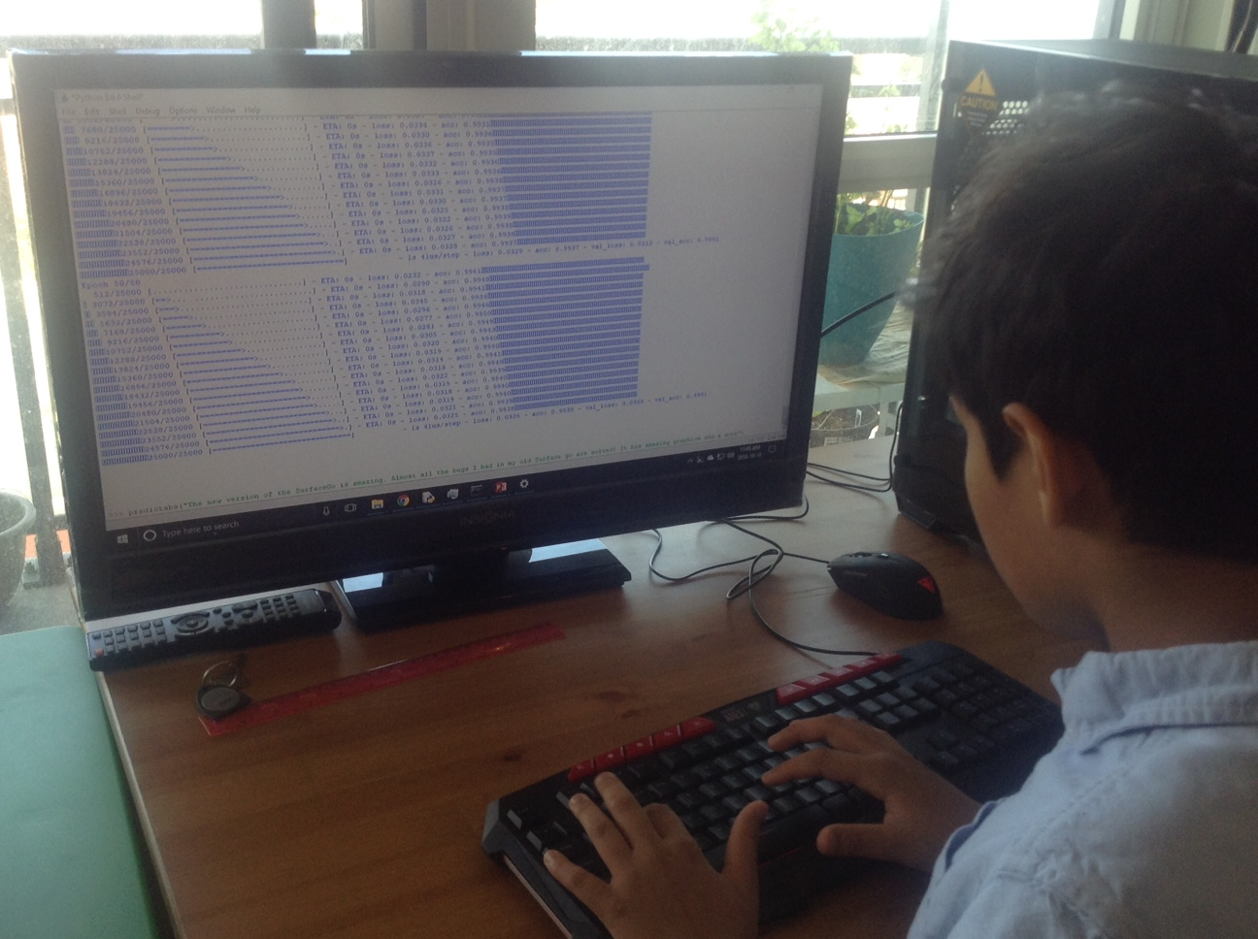
Coding Neural Network with TensorFlow
Lots of Training and Testing
Several training epochs

Slide 6
DEMO

Slide 7
A.B.Cs (Artificial intelligence for Better Customer Service)
Toronto, 14 October 2018
Artash Nath, Arushi, Vikas
www.HotPopRobot.com @wonrobot

