Slide 1
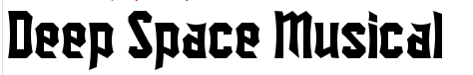
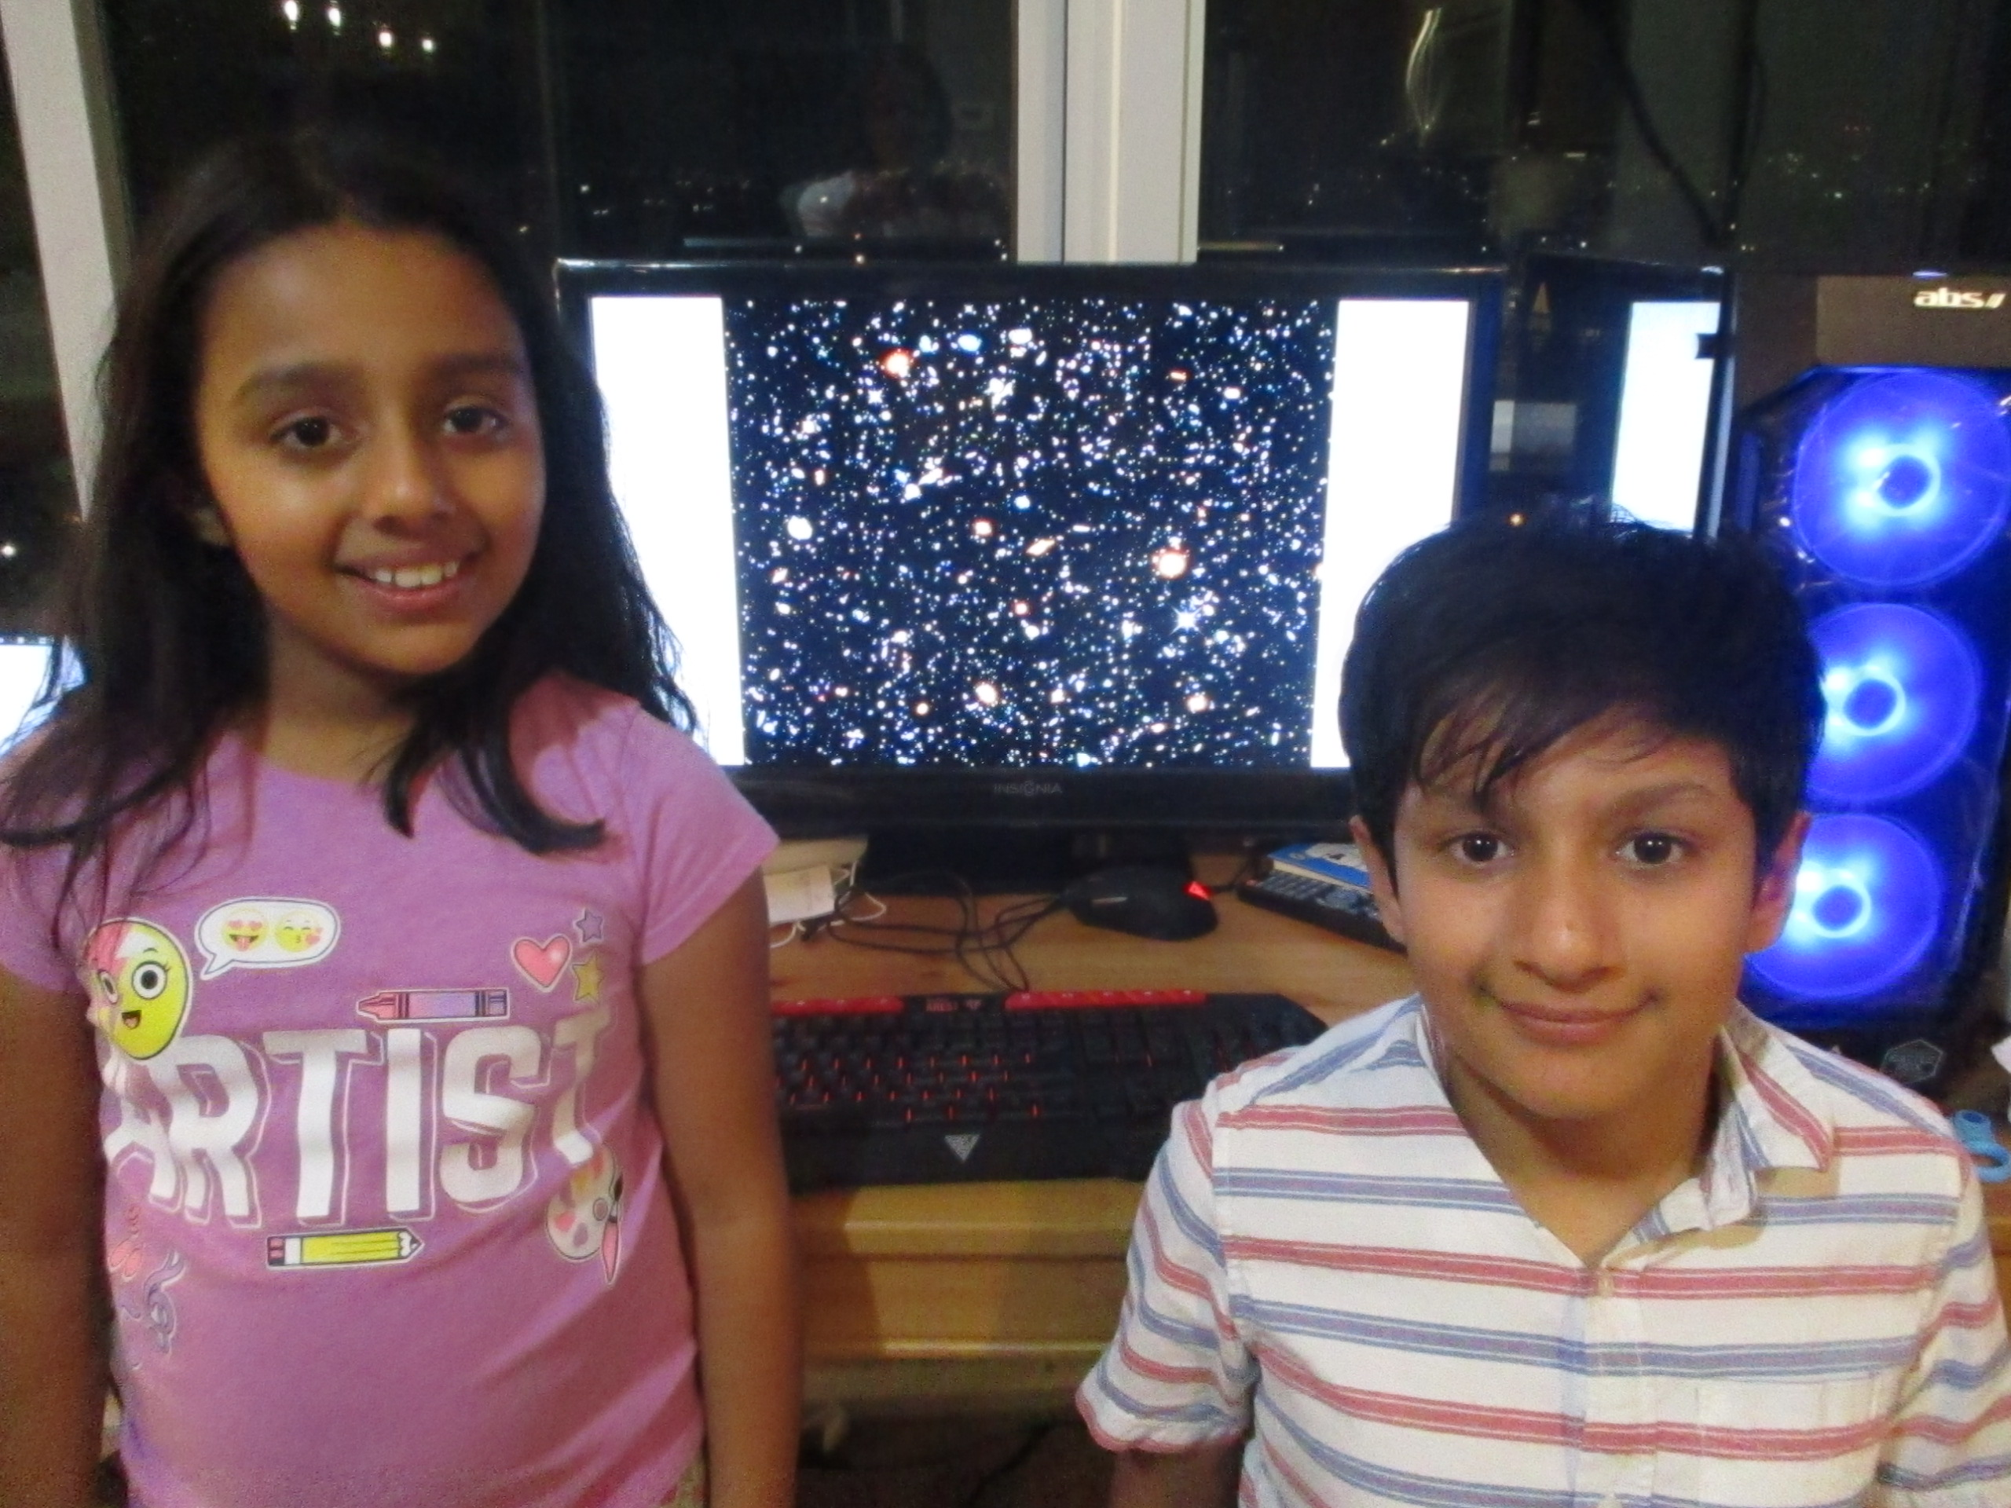
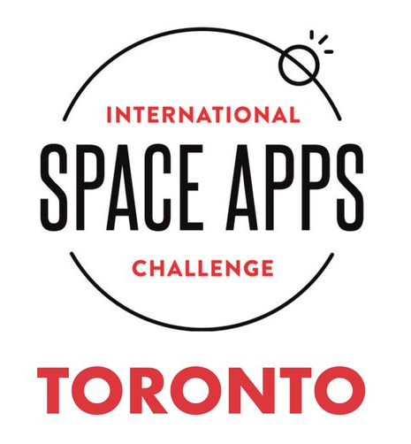
Artash Nath (Grade 7)
Arushi Nath (Grade 4)
Vikas Nath
Team: HotPopRobot.com
Follow us @wonrobot
21 October 2018

Slide 2
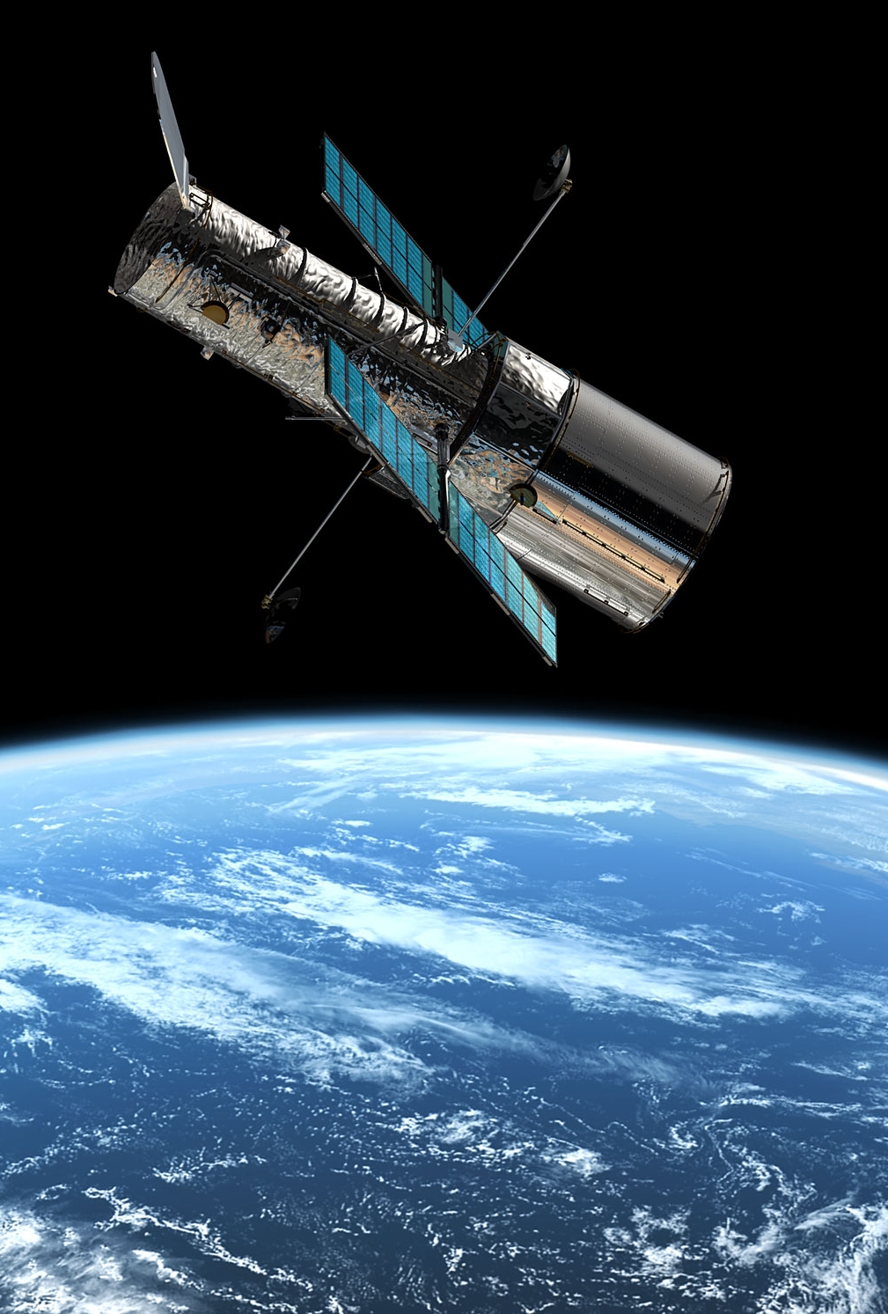


SpaceApps Challenge:
On the Shoulder of Giants
(Hubble Space Telescope Imagery)
Transforms images taken by the Hubble Space Telescope into a Musical.
Allows beauty of Universe to be experienced by all, including those who are blind.

Slide 3
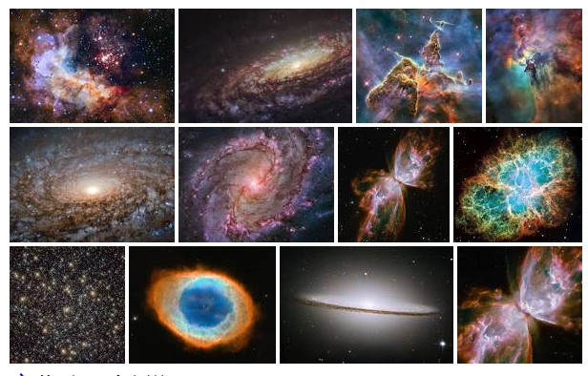
Hubble Telescope has made over
1.3 million observations
We converted some of them to Music!

Slide 4
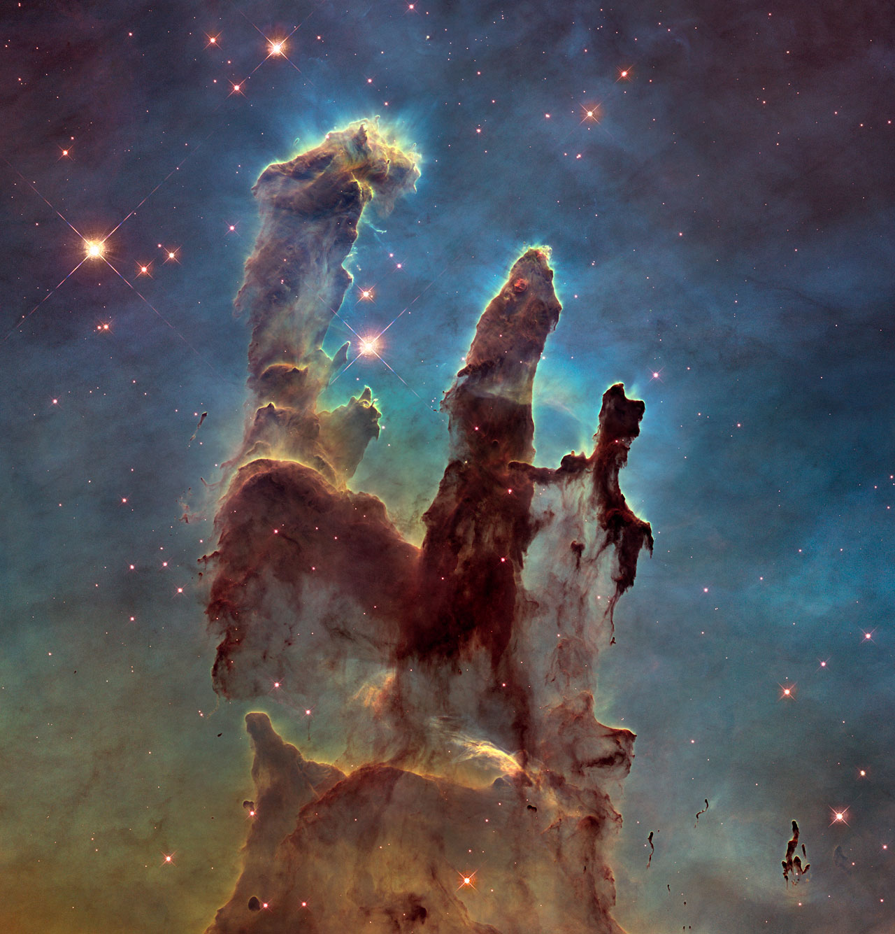
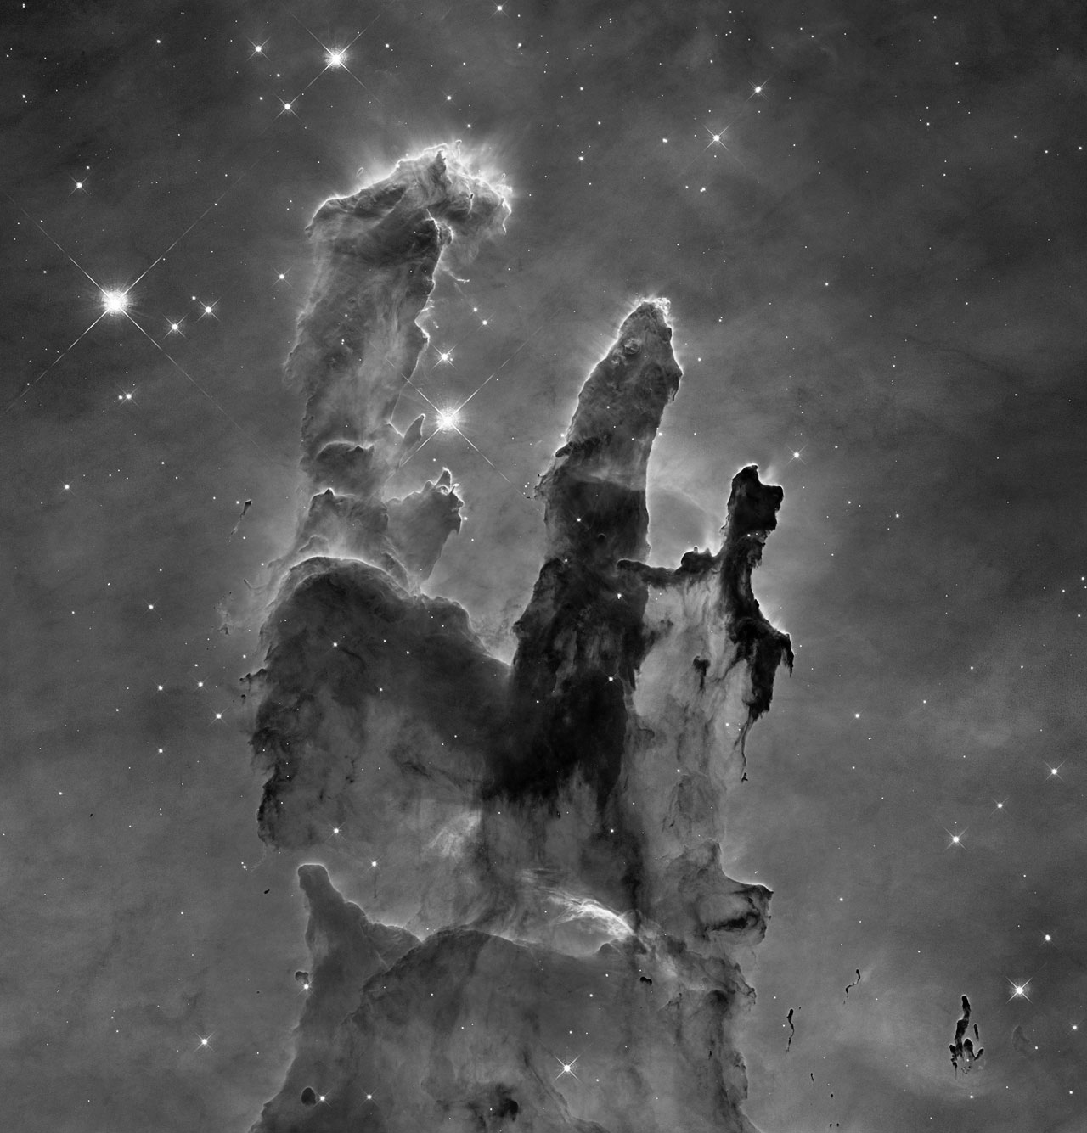
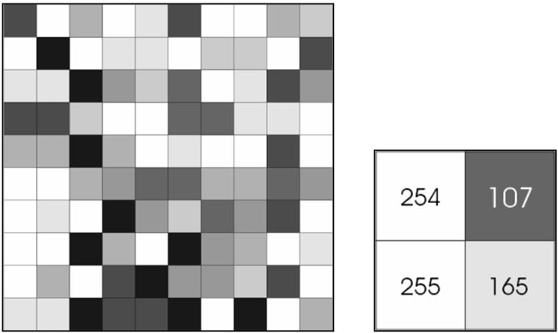
RGB (Red Green Blue) → Gray Scale → Pixel Matrix
HOW?
Actual Hubble Image

Slide 5
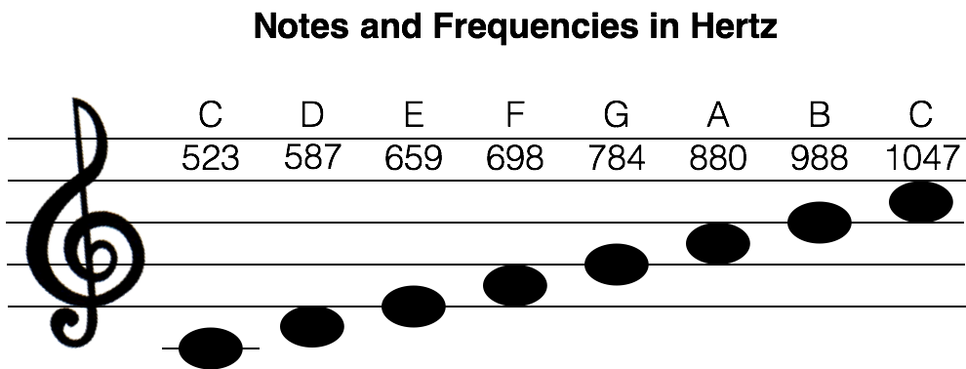
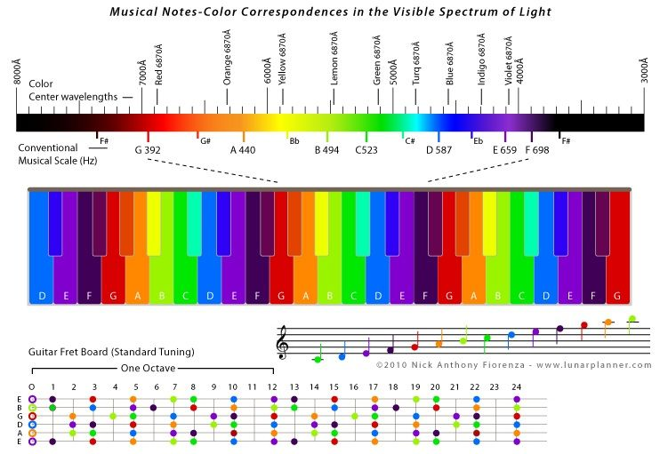
Transformed Pixel Values into Frequencies and Notes!
Every pixel of Hubble Color Image is associated with a musical note

Slide 6
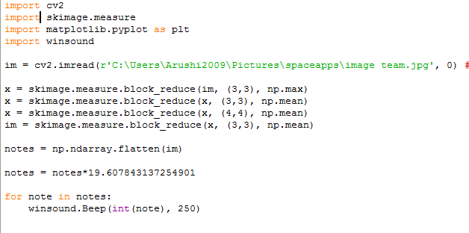
Peek into Python Code

Slide 7
DEMO: Listen to the Musical

Slide 8

Musical Part 1:
Birth of Stars
The Pillars of Creation
Eagle Nebula
7000 light years
Hubble Images: 5 Jan 2015
Pillars Of Creation Music

Slide 9
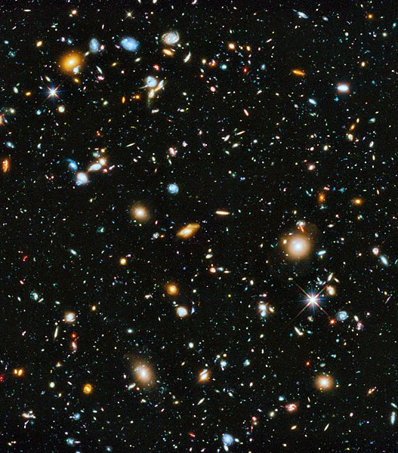
Musical Part 2:
Galaxies of Stars
Hubble Ultra Deep Field (HUDF) Photograph
Fornax Constellation
13 billion light years
Hubble Images:
Sep 2003 – Jan 2004
HUDF Music

Slide 10
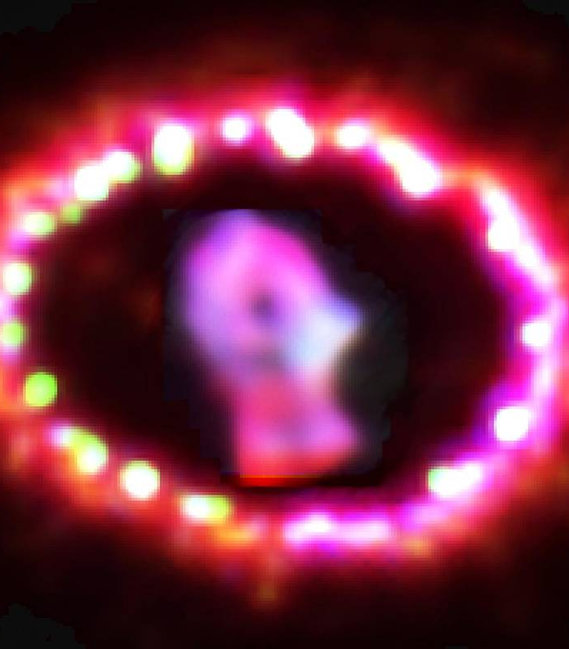
Musical Part 3:
Star Death
Supernova 1987A
Large Magellanic Cloud
168,000 light years
Hubble Images 1994 - 2003
SuperNova Music

Slide 11
Artash Nath (Grade 7)
Arushi Nath (Grade 4)
Vikas Nath
Team: HotPopRobot.com
Follow us @wonrobot
21 October 2018

