Slide 1
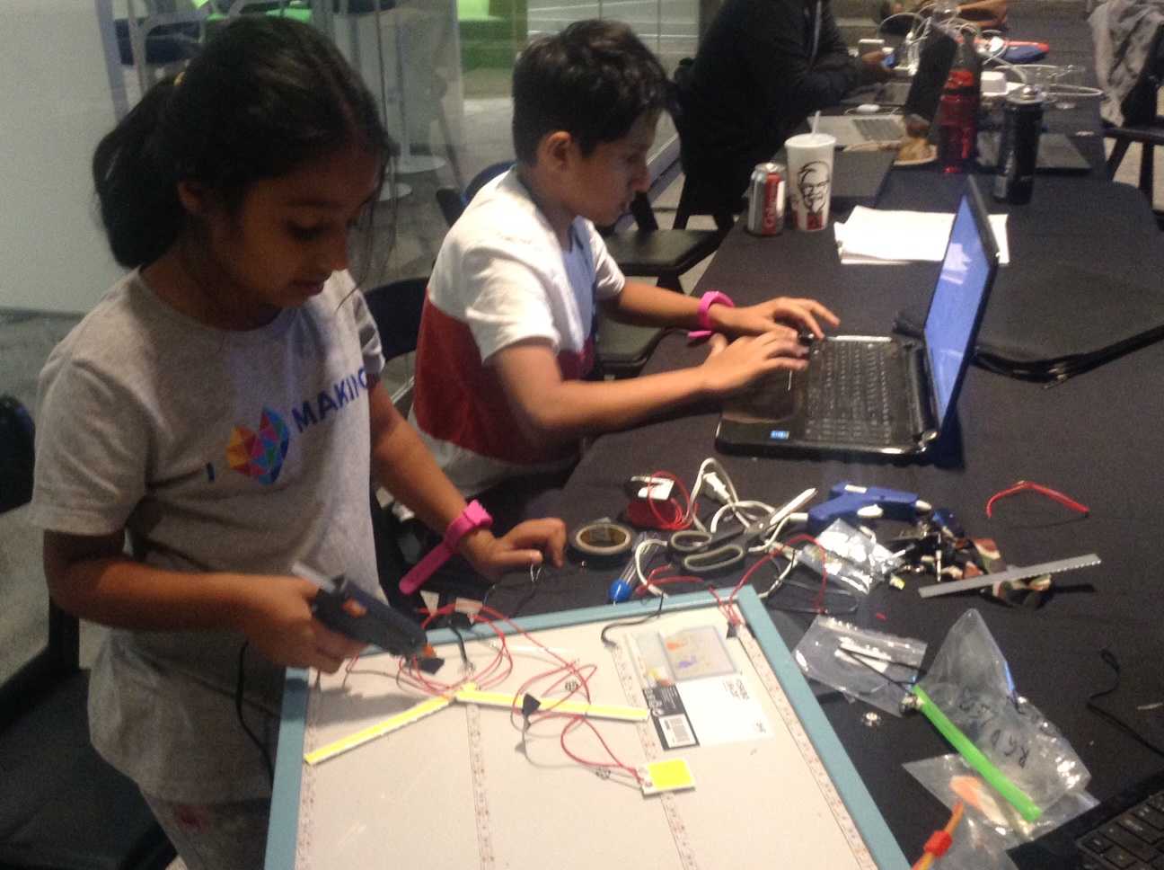

Smart Street Navigation Using Artificial Intelligence for City Kids (SNACK)
Toronto, 26 September
Family Team HotPopRobot
Artash, Arushi, Vikas
www.HotPopRobot.com @wonrobot

Slide 2
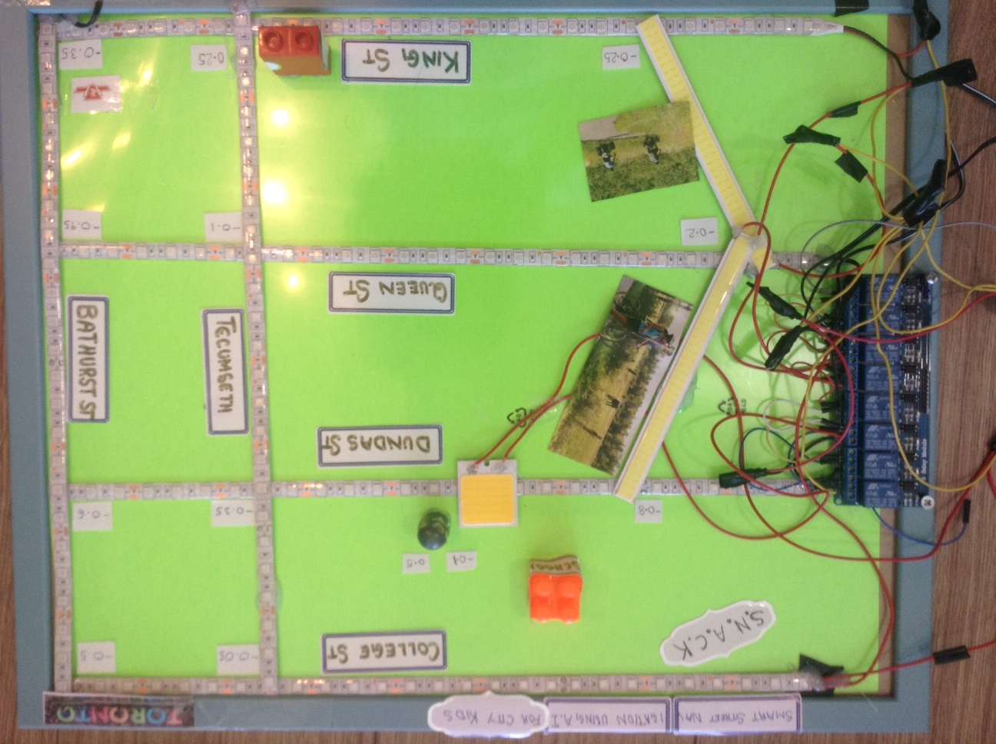
Goal:
To provide the safest route to kids to reach their School
Predict: Safest Street Routes Options
Protect: Kids from traffic, unsafe intersections everyday – day and night.
Impact: Includes voices of children in Safe City and transit planning

Slide 3
5 Artificial Intelligence Parameters and Data Sources
Bike Lanes
Open Data Toronto
2. Enhanced Signaling Intersections
Open Data Toronto
3. Schools and Parks
Open Data Toronto
4. School Guards:
Toronto Police Services
5.Fatalities and Accidents:
Vision Zero Documents

Slide 4
Artificial Intelligence Inputs
TRAINING AND TESTING DATABASE | DESCRIPTION | DATA POINTS
Bike Lanes Enhanced Signalling Intersections School and Parks School Guards | Uses Higher Fatalities rate as index for higher risks | 500 (Downtown Area: Bathurst – Shaw)
DEPLOYMENT | DESCRIPTION | DATA POINTS
All intersections of Toronto | Uses Results from Training Database to generate city wide Intersections Index | 3000

Slide 5
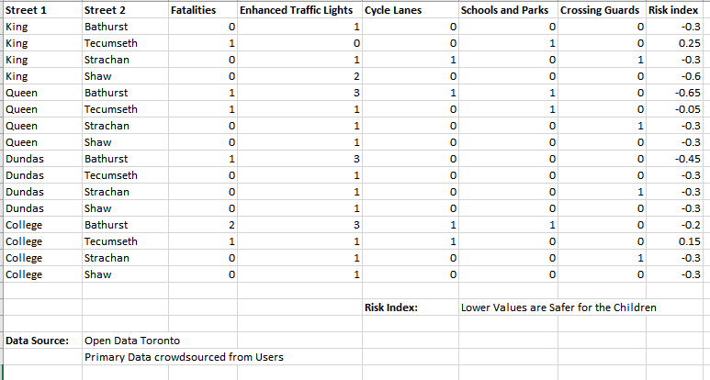
Generating Risk Index of Intersections Using Artificial Intelligence

Slide 6
SNACK Data Flow
Visual Interpretation
SAFEST ROUTE
OPEN DATA
Toronto
Higher Index: Higher Risk
Lower Index: Lower Risk
Artificial Intelligence Decision
Trinity Bellwood Park : -0.5
King and Tecumseth: 0.25
Intersections with Crossing Guards : -0.1
Intersections without Crossing Guards: 0.5
DATA FROM THE USERS
Different Index
(Day, Nights, Weekends)

Slide 8
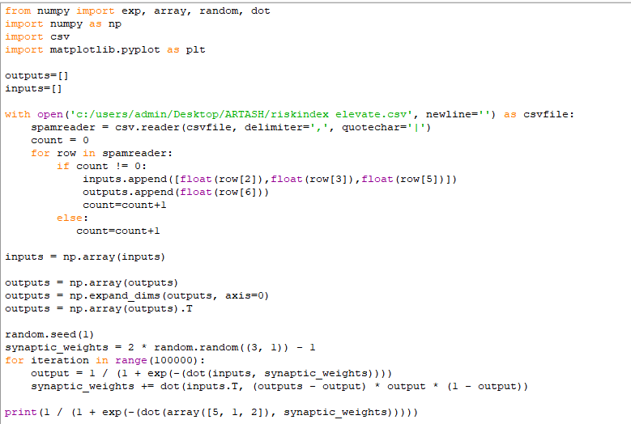
Peek into SNACK’s Neural Network Code

Slide 9
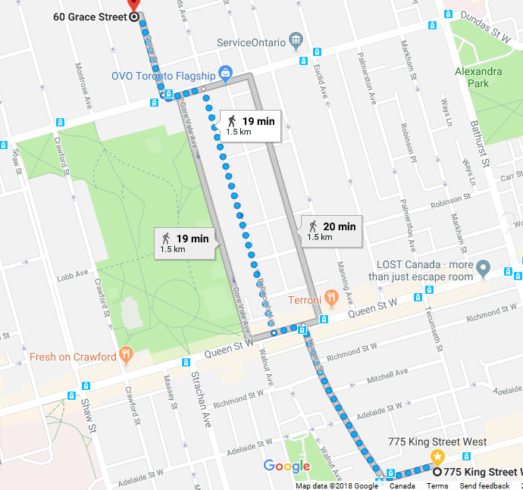
Google Map vs SNACK Map
Time Taken: 26 Minutes Risk Index: -1.35
Time Taken: 20 Minutes Risk Index: -0.6

Slide 10
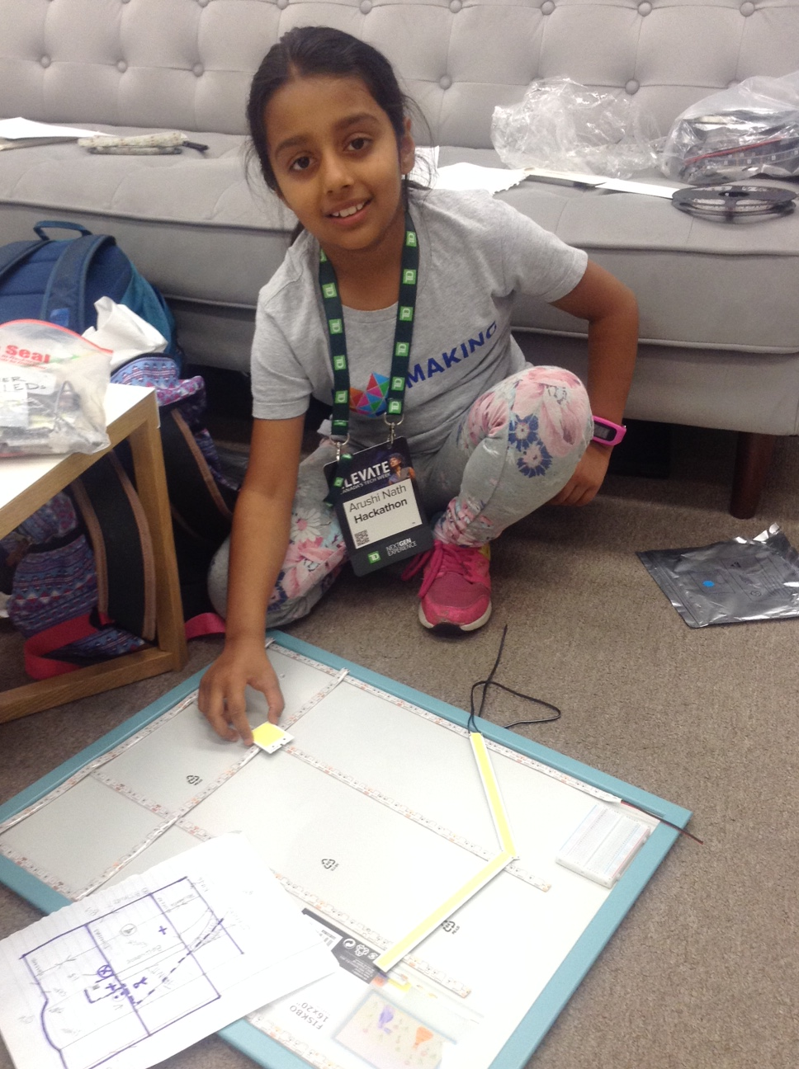
Sketches, Making, Coding

Slide 11
Smart Street Navigation Using Artificial Intelligence for City Kids (SNACK)
Toronto, 26 September
Family Team HotPopRobot
Artash, Arushi, Vikas
www.HotPopRobot.com @wonrobot

