Slide 1
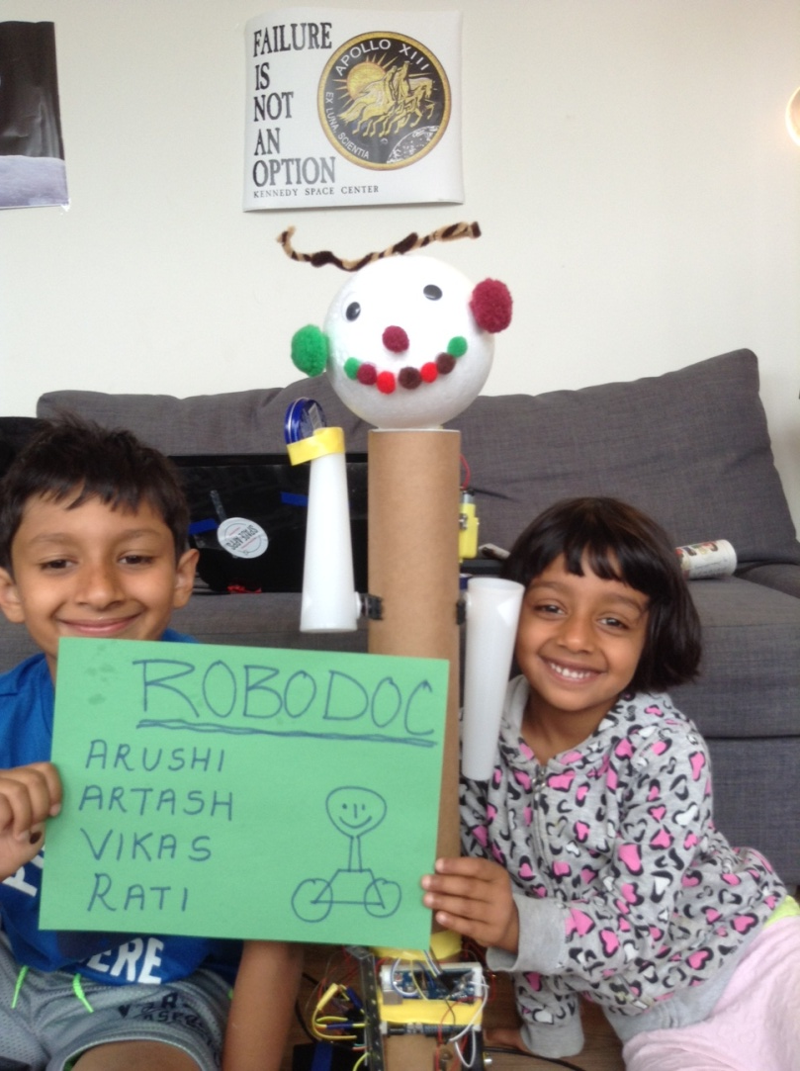
RoboDOC
Team
Arushi Nath
Artash Nath
Vikas Nath
Rati Mehrotra
www.HotPopRobot.com
Twitter: @wonrobot

Slide 2
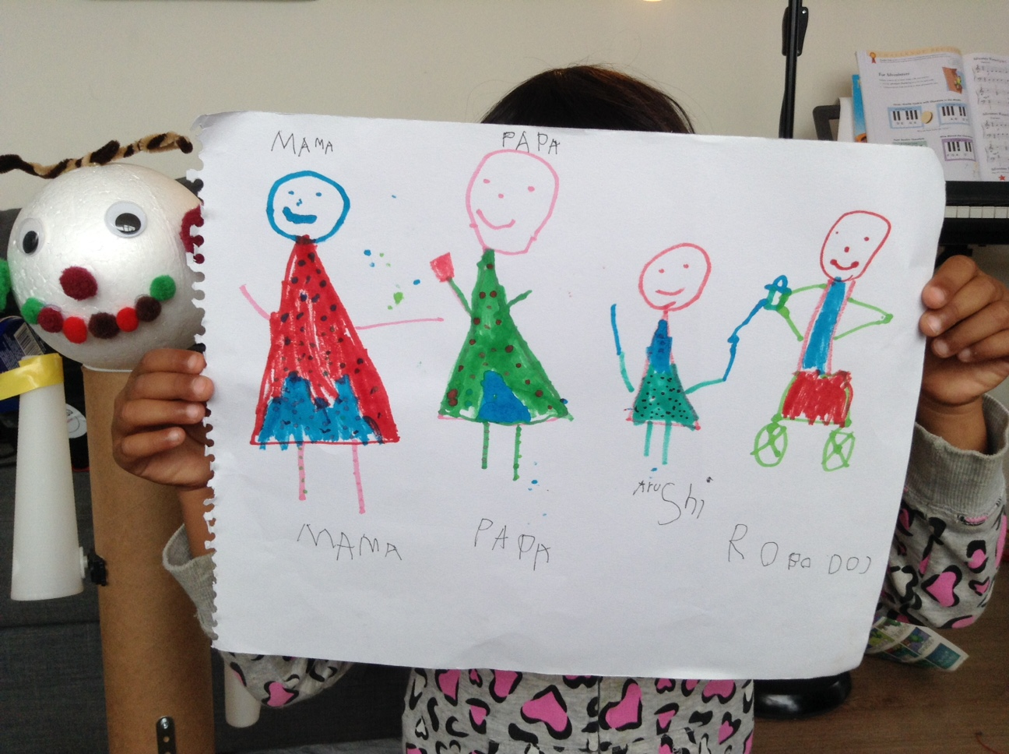
What we Imagined!

Slide 3
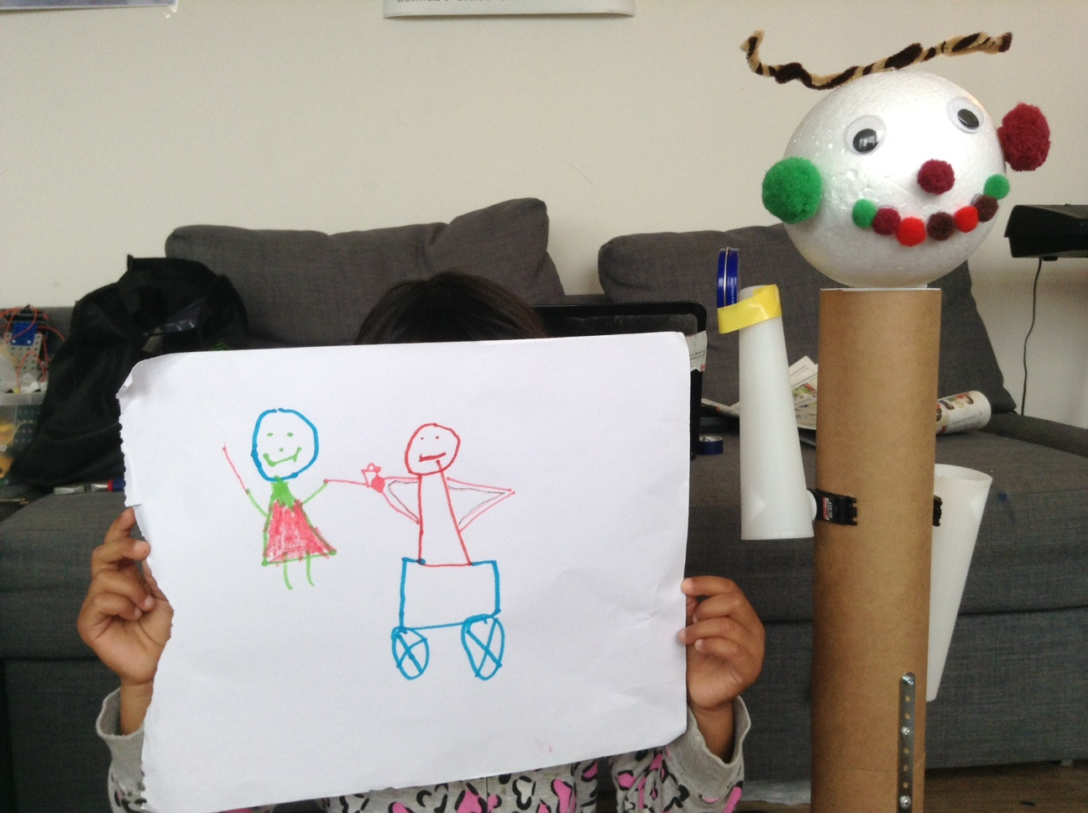
RoboDOC Gives Medicine every 2 hours!

Slide 4
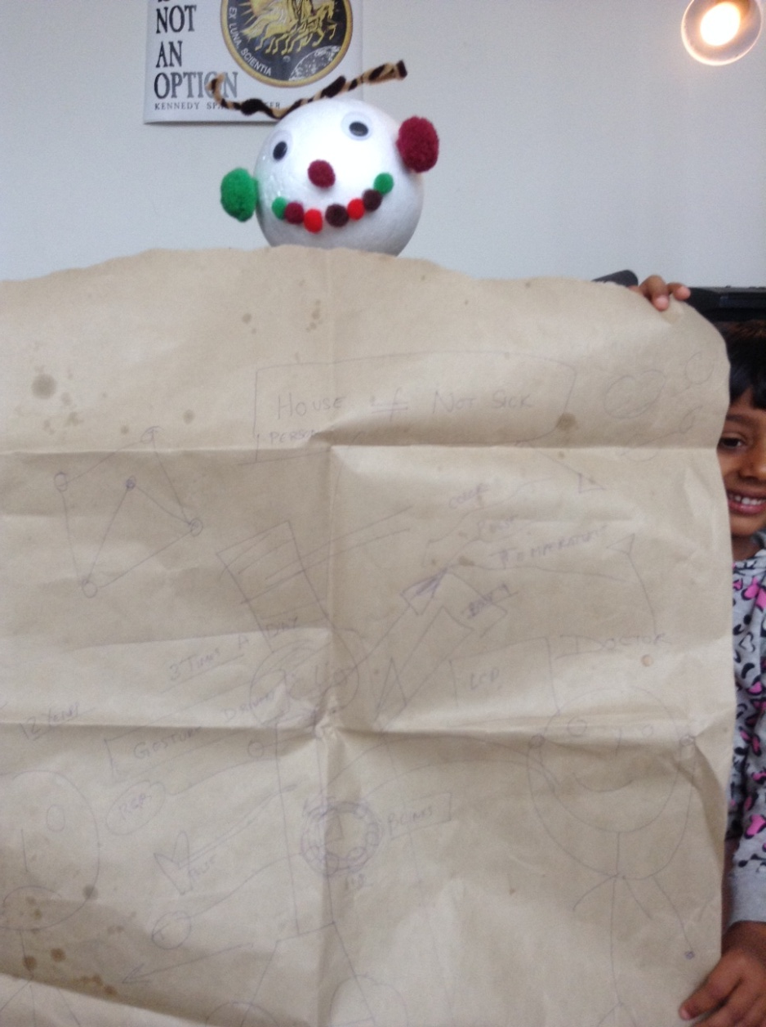
Lots of BrainStorming and Sketching!

Slide 5
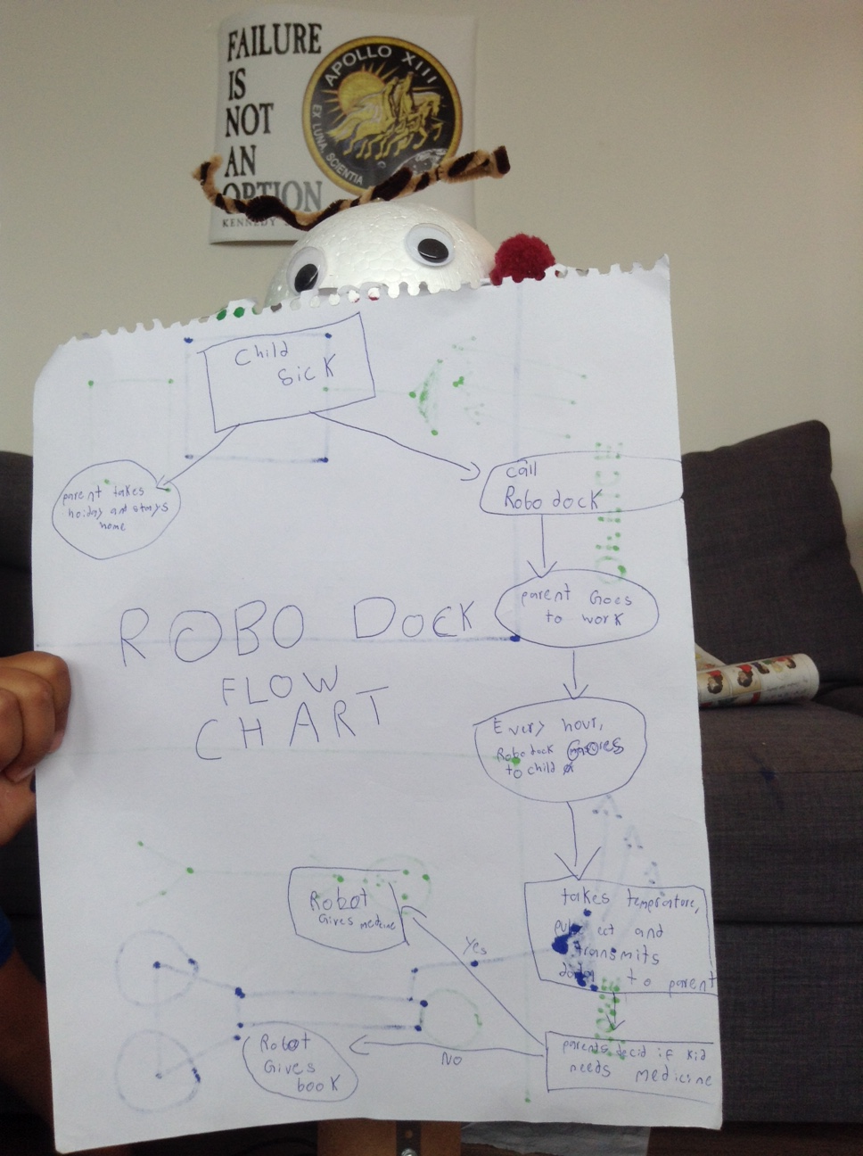
Programming
Flow Charts

Slide 6
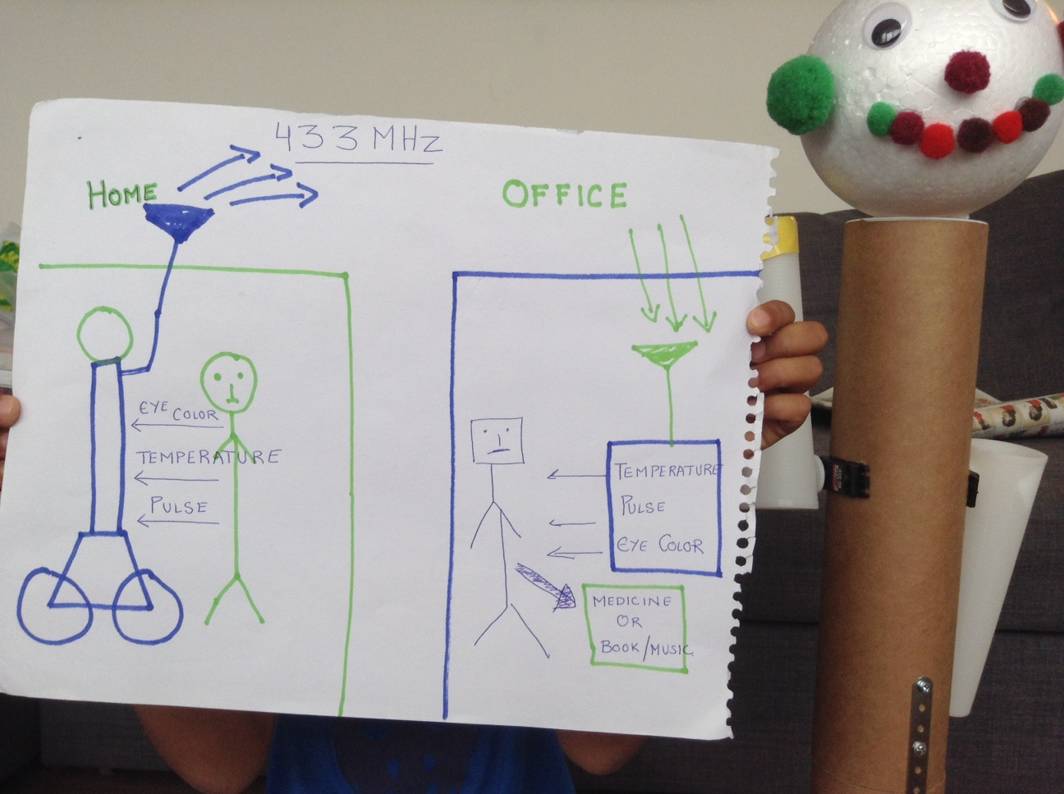
Wireless Transmission : Works without mobile phone or WiFi!

Slide 7
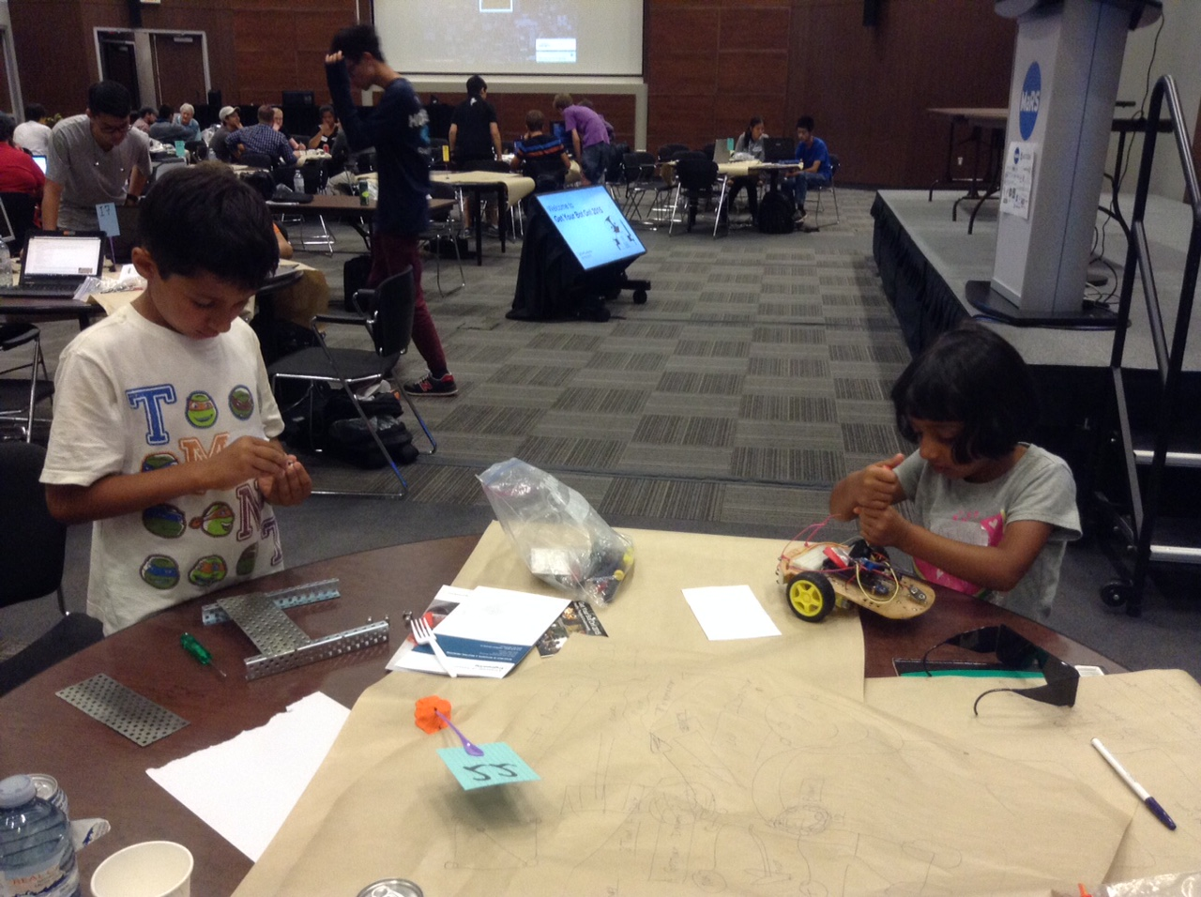
MAKING RoboDOC!

Slide 8
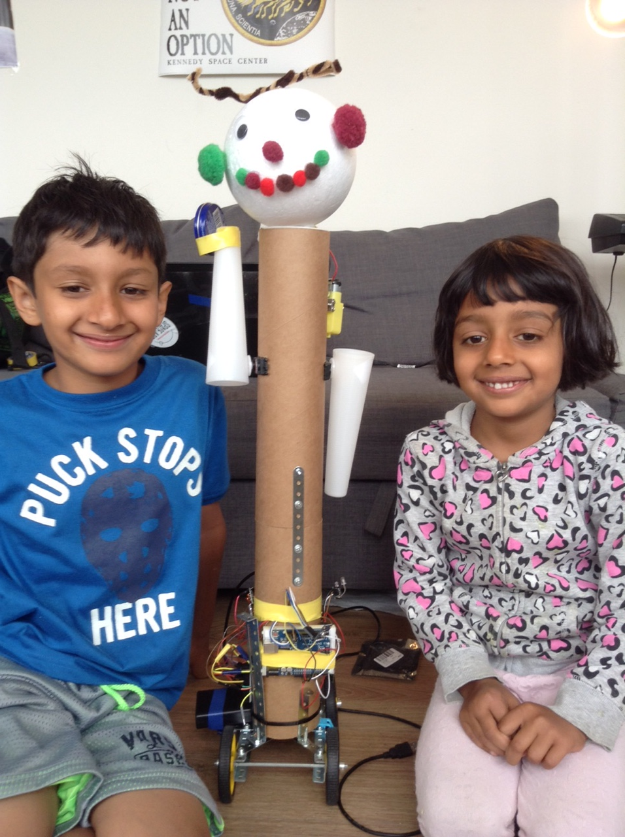
We need RoboDOC in every home!
Arushi Nath
Artash Nath
Vikas Nath
Rati Mehrotra
www.HotPopRobot.com
Twitter: @wonrobot

