Slide 1

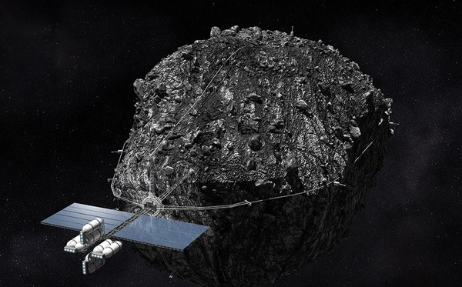

Space-REX
Predicting Risk Index of Asteroid Collision using Artificial Intelligence and displaying the results musically!
Presenting at the Ontario Science Center on June 20th 2018
Artash Nath, Grade 6
Arushi Nath, Grade 3
www.HotPopRobot.com @wonrobot

Slide 2
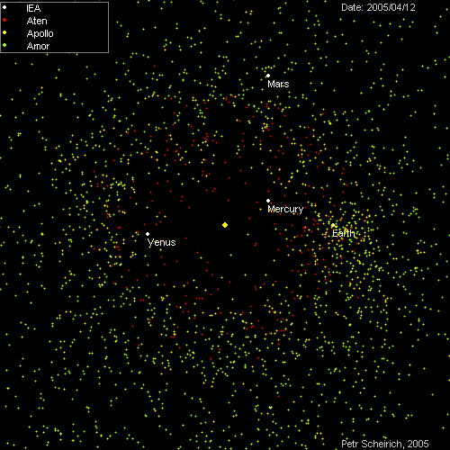
Space-Rex Goal:
Present Goal
Predict: Risk of Collision of Earth with Near Earth Objects (NEOs)
Future Goals
Protect: Space Settlements from Asteroid collisions
Profit: From mining M-Type asteroids

Slide 3
What are Near Earth Objects (NEOs)?
Asteroids and Comets in our solar system whose closest approach to the Sun is less than 1.3 astronomical units (AU).
Near Earth Asteroids are far more than Near Earth Comets.

Slide 4
When do NEOs become Potentially Hazardous?
When they intersect Earth’s Orbit at a distance of 0.05 AU or less!
(In comparison, Earth – Moon distance is 0.00257 AU).
Thus objects less than 20 times the distance of Earth-Moon are considered Potentially Hazardous!

Slide 5
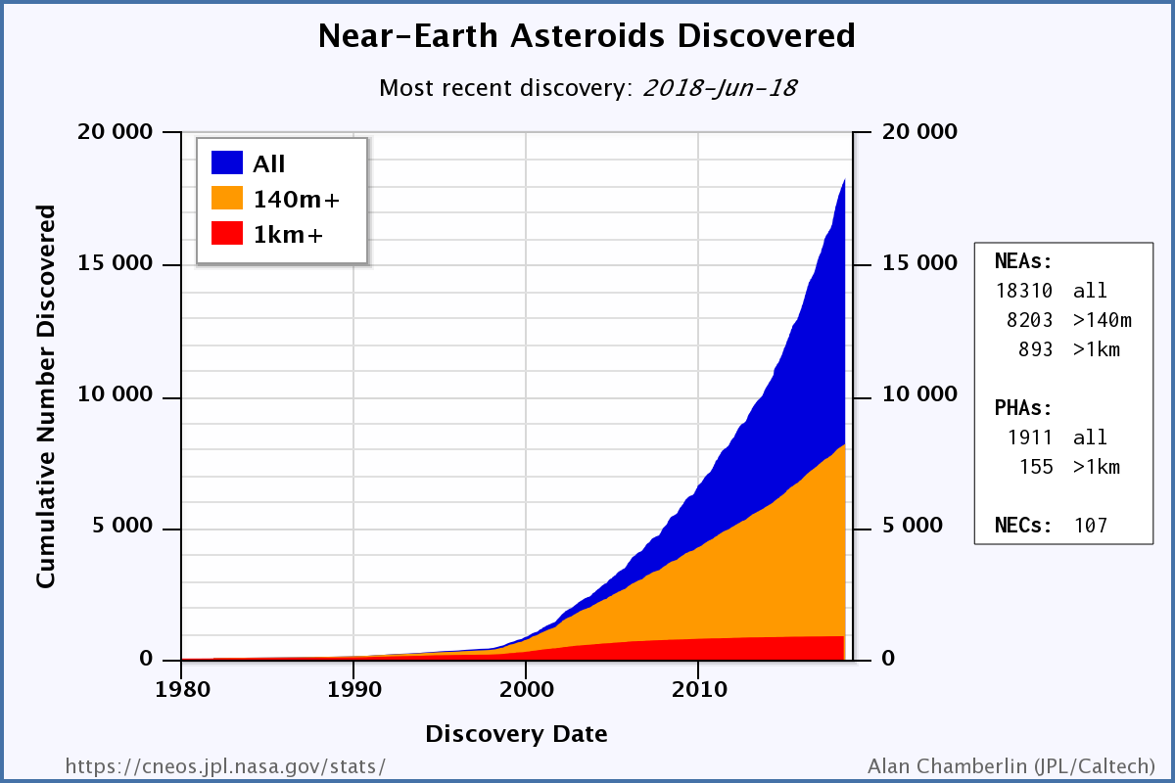
Data until 20 June 2018
Near Earth Asteroids > 18310
Near Earth Comets > 107
Potentially Hazardous Asteroids > 1911

Slide 6
Predicting Asteroid Collision Risk is complex
Orbits of asteroids are not precisely known
Sizes of asteroid varies
Velocity of asteroid varies
90% of the NEOs larger than one kilometer are already discovered.
Current focus is on finding NEO population larger than 140 meters.

Slide 7
How Artificial Intelligence Can Help?
AI Algorithms are used to identify patterns in large datasets
2 types of dataset are used as Inputs:
Training database: To find patterns
Testing database: To validate the patterns and improve prediction
The AI Algorithm inputs data from the datasets, passes them through hidden layers (neural network) and sends predictive values to the output layer

Slide 8
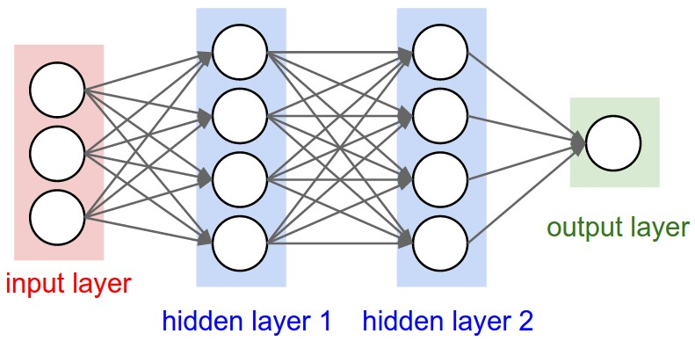

Slide 9
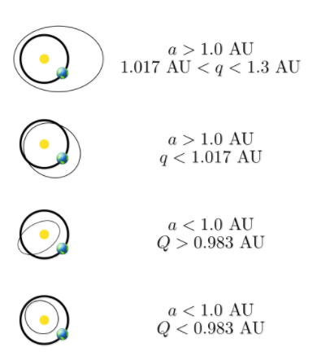
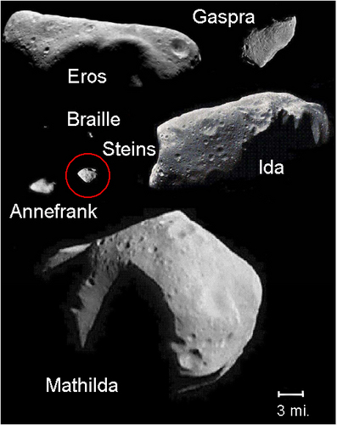
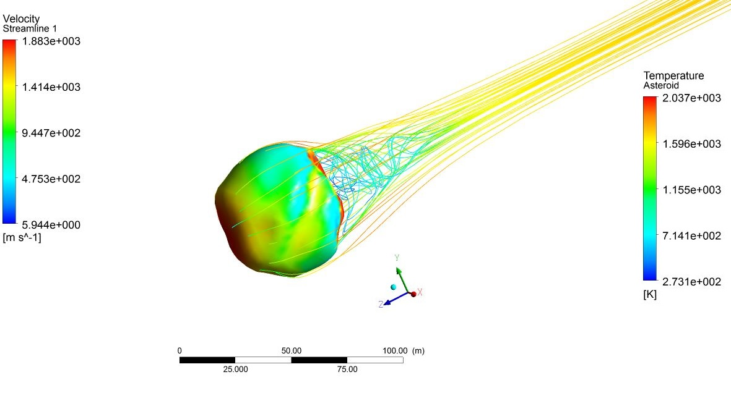
Input Layer: Asteroid Characteristics
1. Earth - Asteroid Distance
2. Asteroid Diameter
3. Asteroid Velocity

Slide 10
Output Layer: The Palermo Index
(Risk of Asteroid Collision)
Palermo Index:
-2 > No Likely Consequence
Between -2 and 0 Merit Careful Monitoring
> 0 Merit Some Level Of Concern
These scales are Logarithmic, so each number represents a risk of ten times more than the previous number

Slide 11
How Artificial Intelligence Can Help?
AI Algorithms are used to identify patterns in large datasets
2 types of dataset are used as Inputs:
Training database: To find patterns
Testing database: To validate the patterns and improve prediction
The AI Algorithm inputs data from the datasets, passes them through hidden layers (neural network) and sends predictive values to the output layer

Slide 12

Artificial Intelligence Inputs
TRAINING AND TESTING | DESCRIPTION | DATA POINTS
Sentry: Earth Impact Monitoring System | Events detected based on currently available observations | 263
DEPLOYMENT | DESCRIPTION | DATA POINTS
Near Earth Object (NEO) Close Approaches | Objects that come with 1.2 Lunar Distance of Earth | 831
Data Source: Center for Near Earth Object Studies, Jet Propulsion Laboratory (JPL), NASA

Slide 13
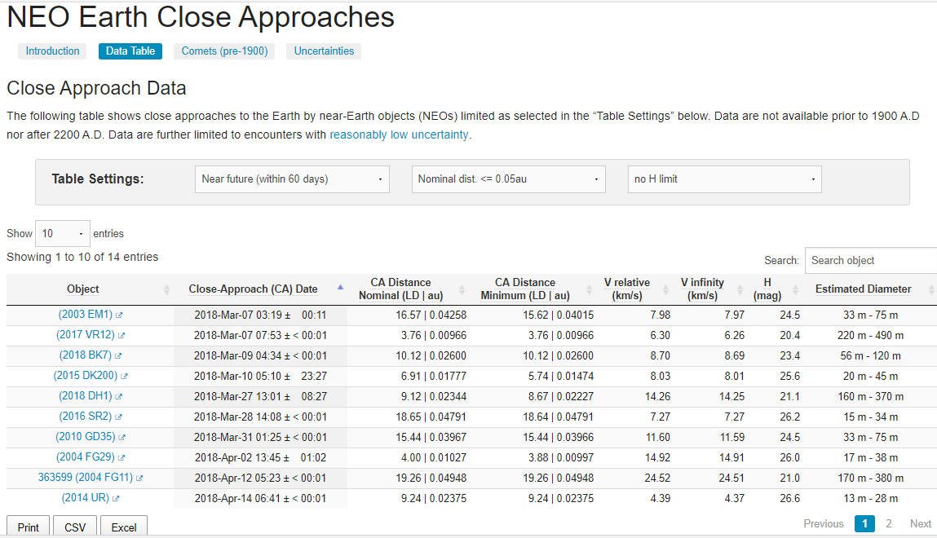
Artificial Intelligence Outputs :
HAZARDS INDEX
Predicted Palmero Index
- 2.113
- 2.285
- 2.124
- 1.977
- 1.968
- 2.152
- 2.157
- 2.149
- 2.1
-2.147

Slide 14
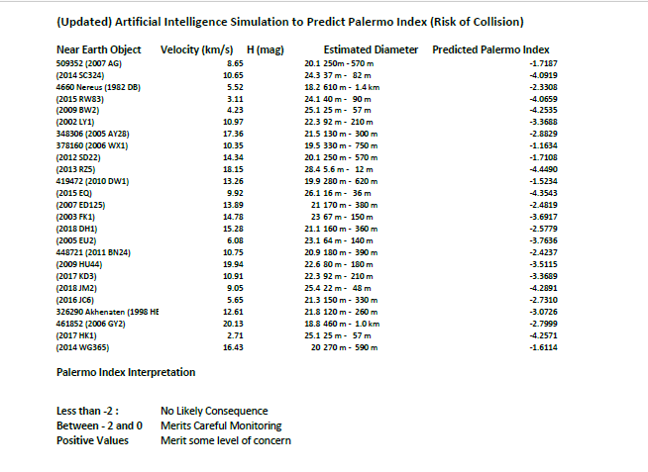

Slide 15
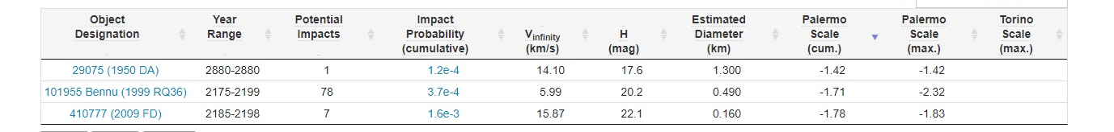
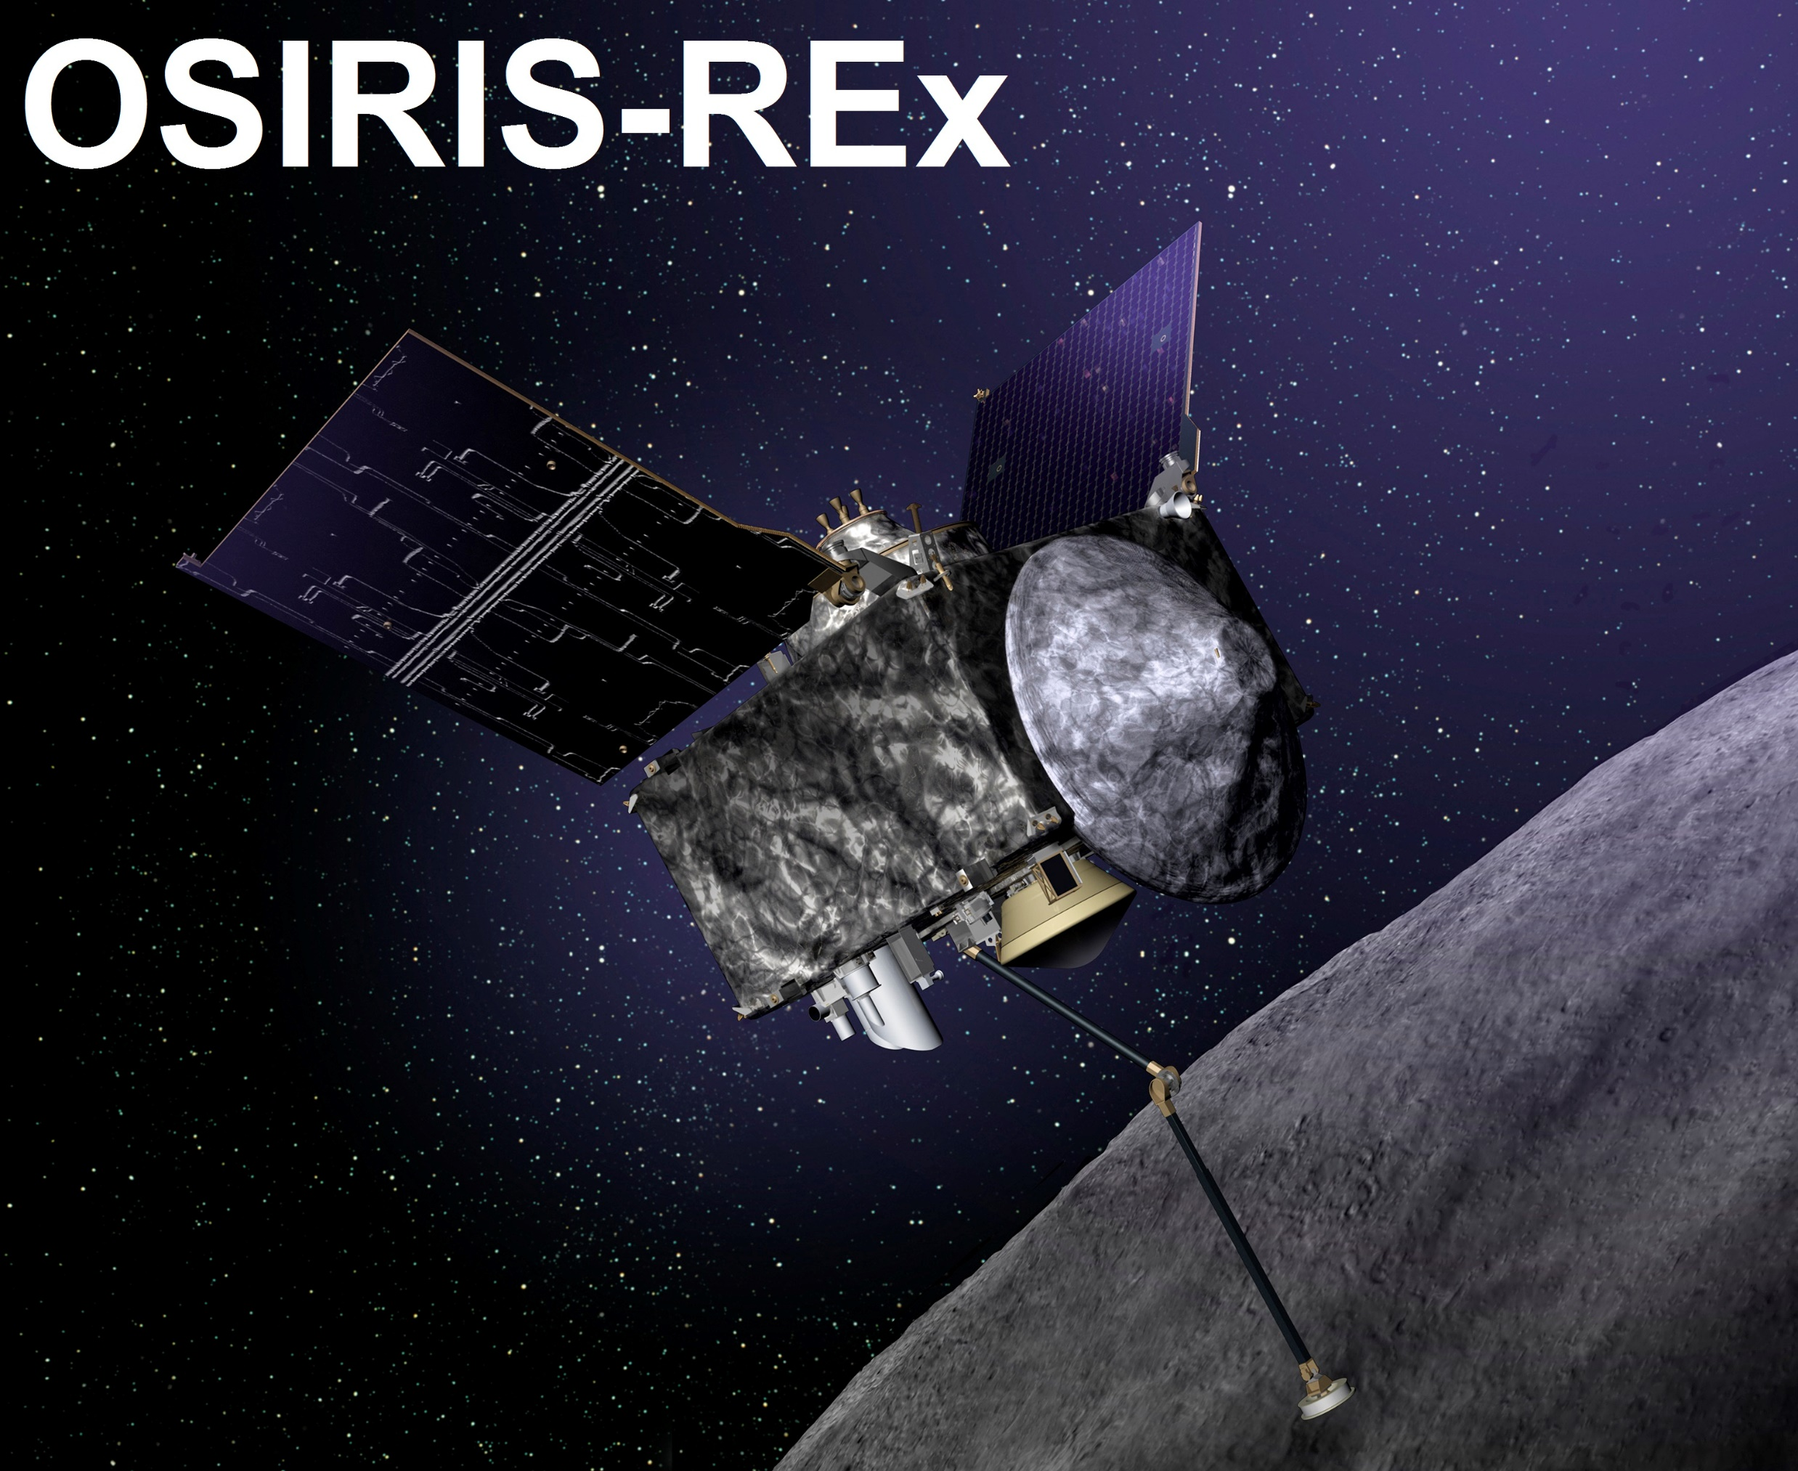
Top 3 Asteroids with highest Risk Index

Slide 16
Space-REX Data Flow (Future Scenario)
Visual Interpretation
Mining Module
Space Settlement Expands
Near Earth Objects Database
Orbit 1:
Decision-Making Orbit
Orbit 2:
Parking Orbit
Orbit 3:
Parking Orbit
Orbit 4:
Deflection Orbit
Artificial Intelligence Decision
Hazards Index:
-1 to -4
Hazards Index:
> 0
Sentry Earth Impact Monitoring System
Deflection Module
Space Settlement is Protected

Slide 17
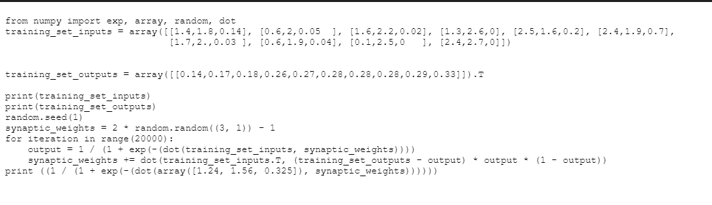
Peek into the Neural Network Code
while True:
q = int(input("what number?: "))
if q <= 269 and q >= 253:
print("C4")
if q <= 252 and q >= 239:
print("B3")
if q <= 238 and q >= 226:
print("A#3/Bb3")
if q <= 225 and q >= 213:
print("A3")
if q <= 212 and q >= 201:
print("G#3/Ab3")
if q <= 200 and q >= 189:
print("G3")
if q <= 188 and q >= 179:
print("F#3/Gb3")

Slide 18
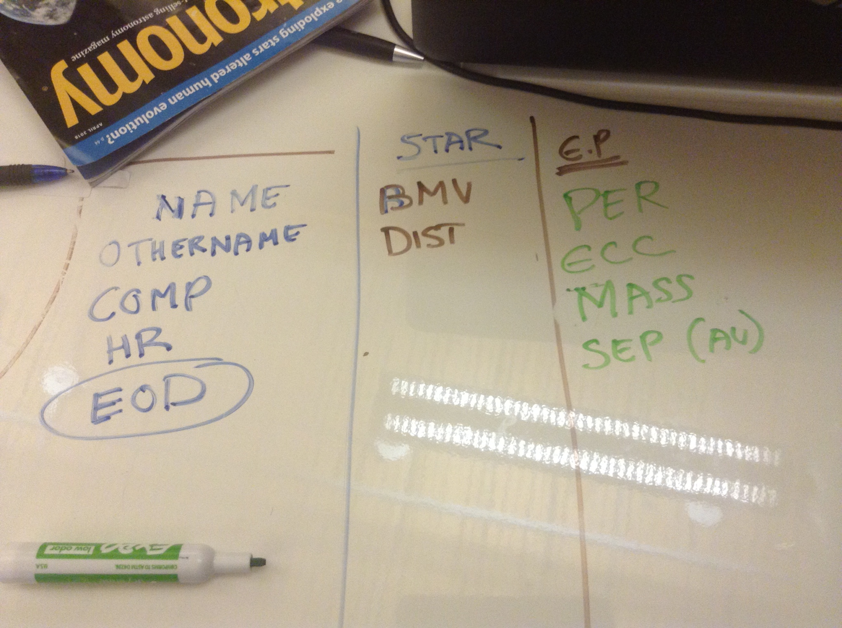
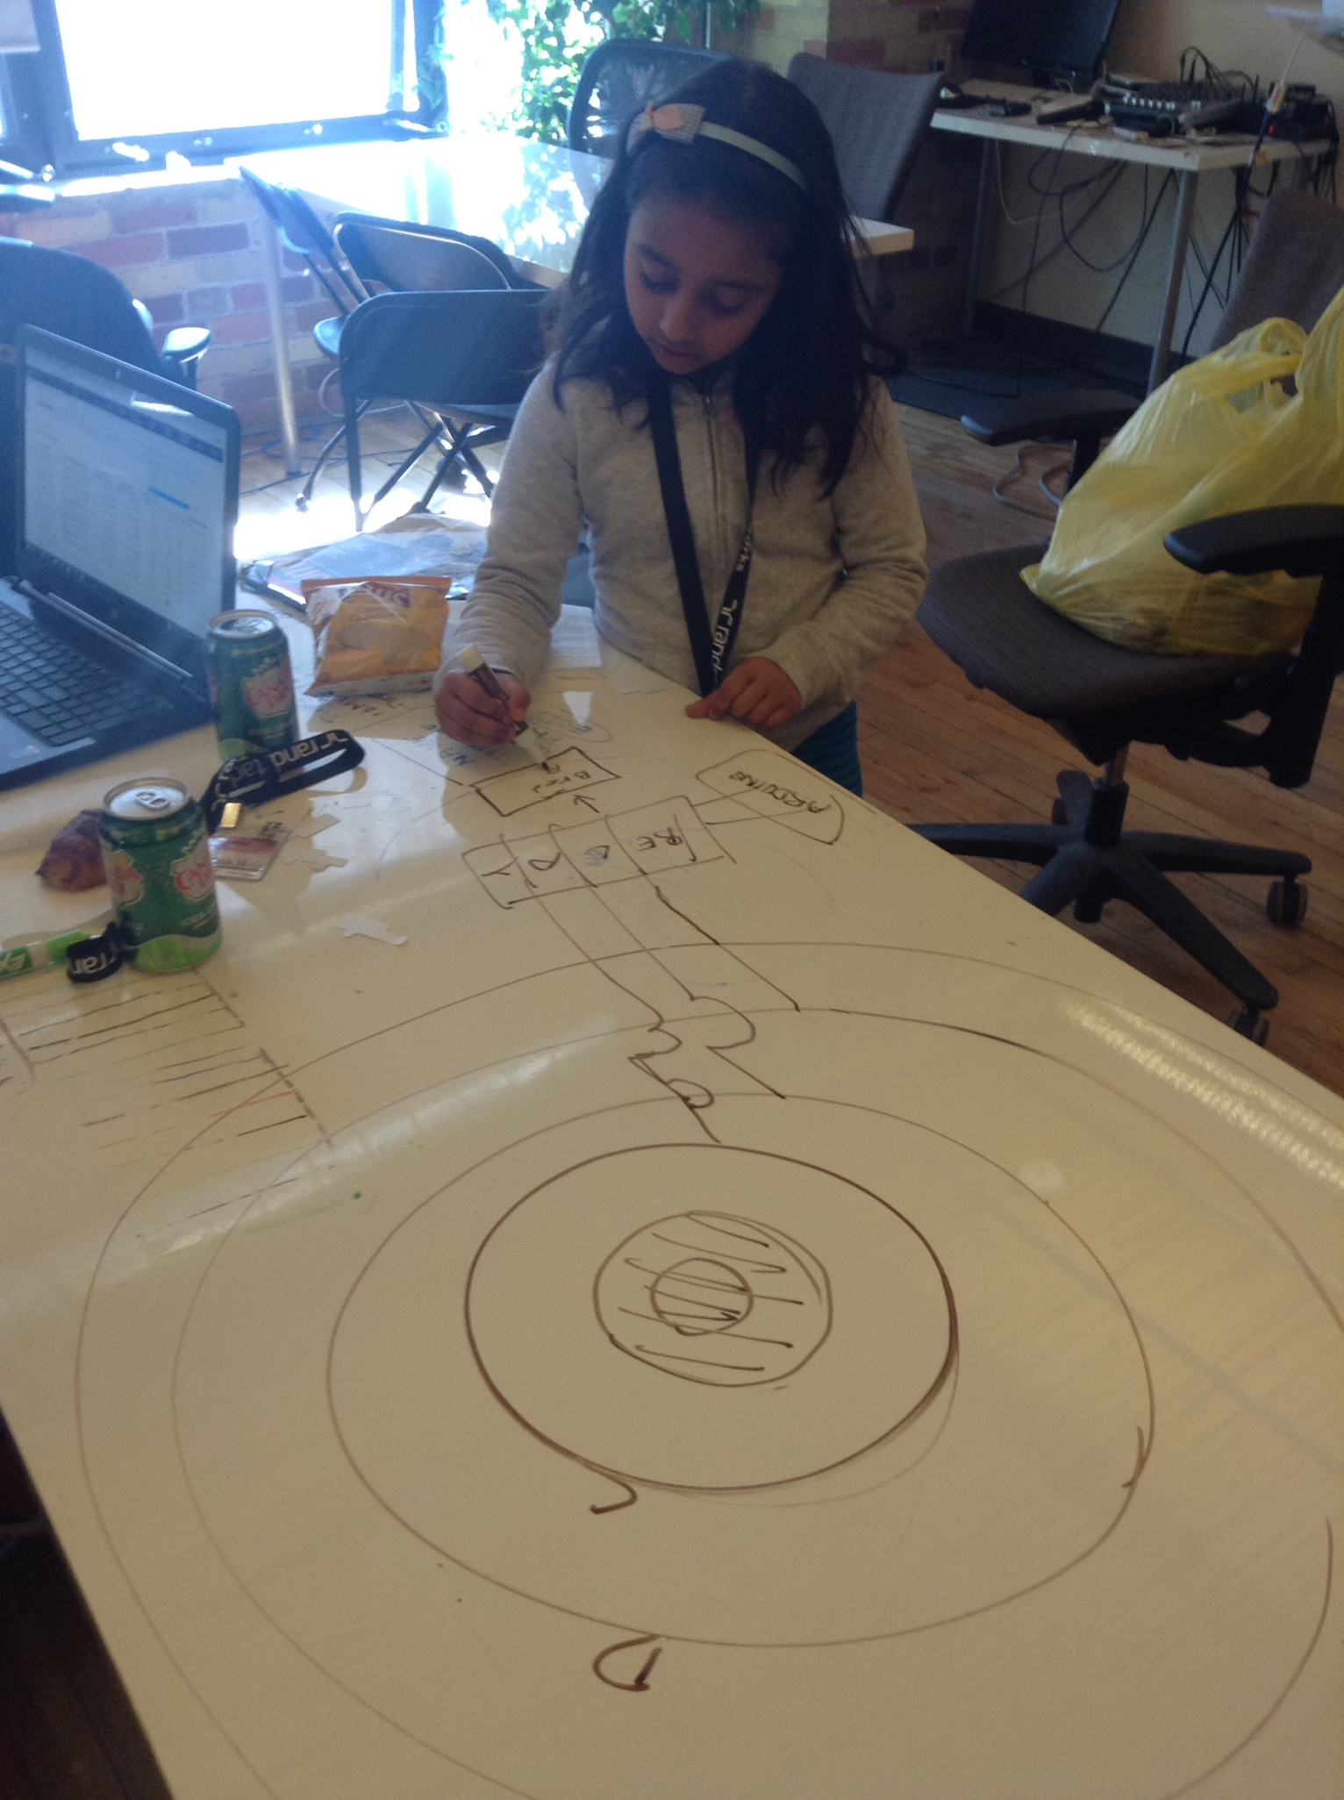
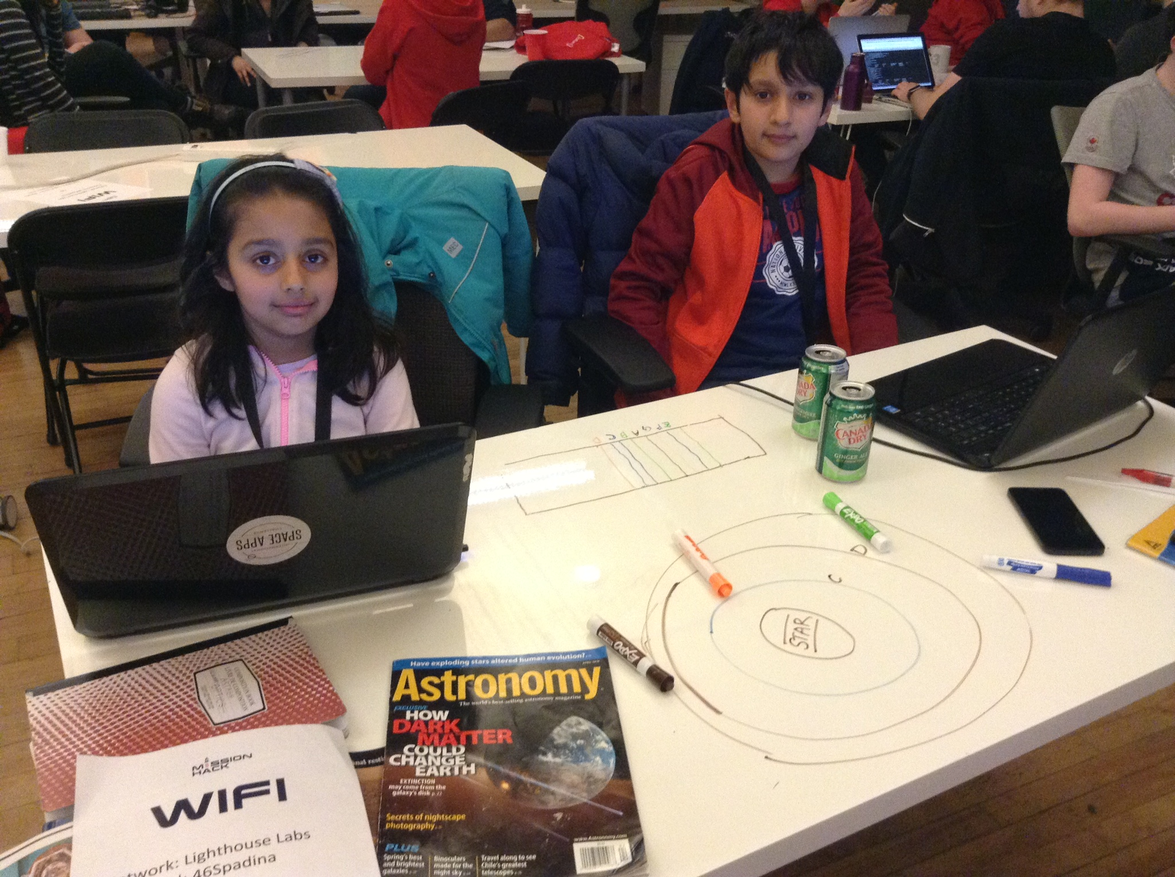
Sketches and Diagrams Stage
Planning, Reading and Background Research

Slide 19
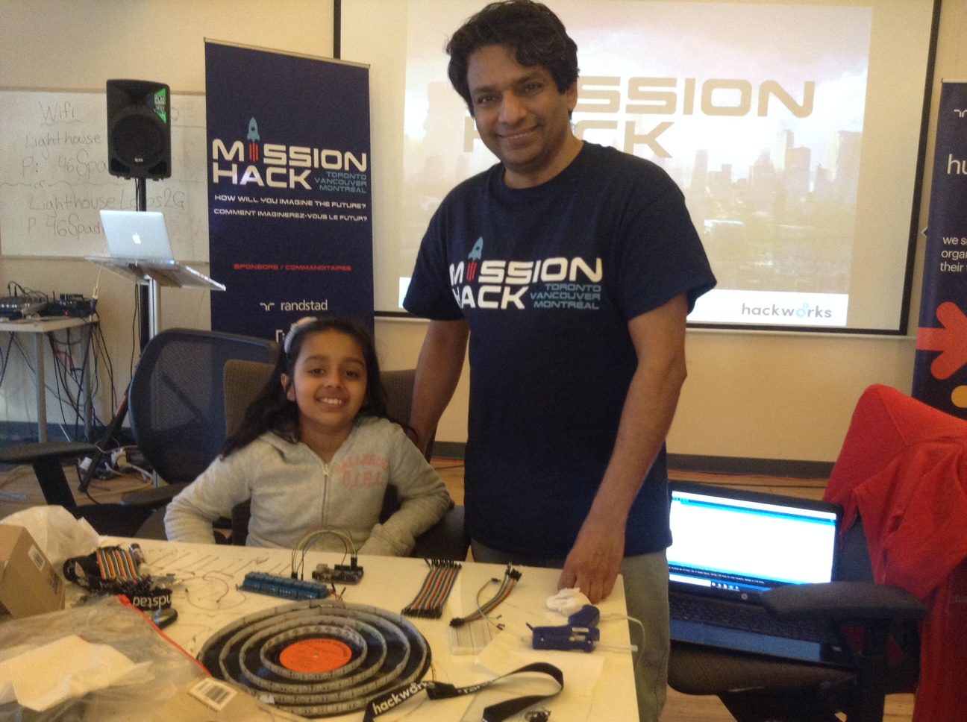
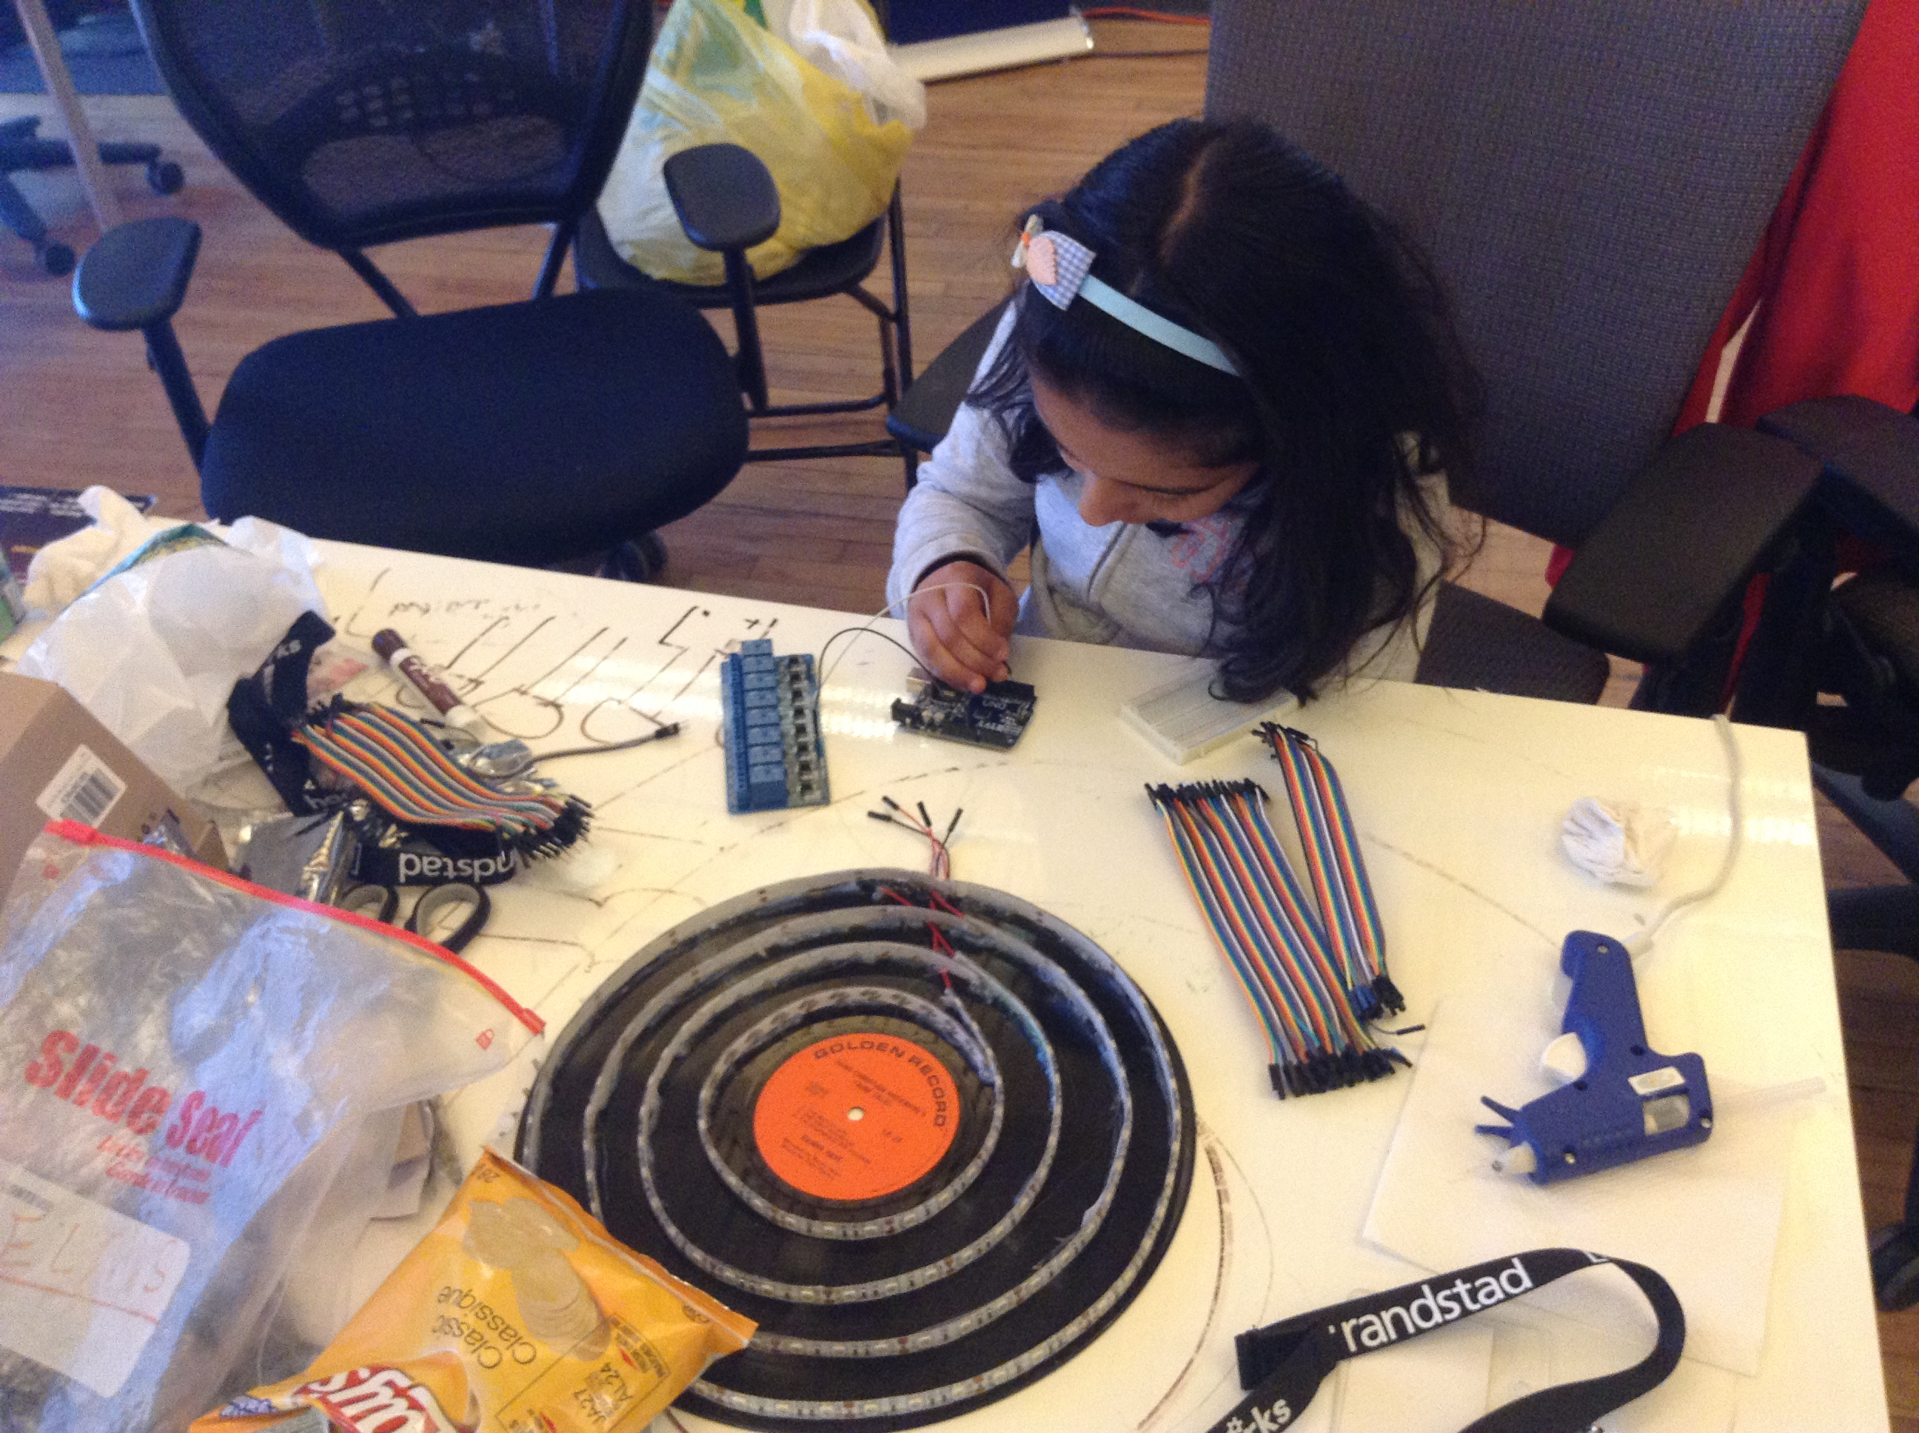
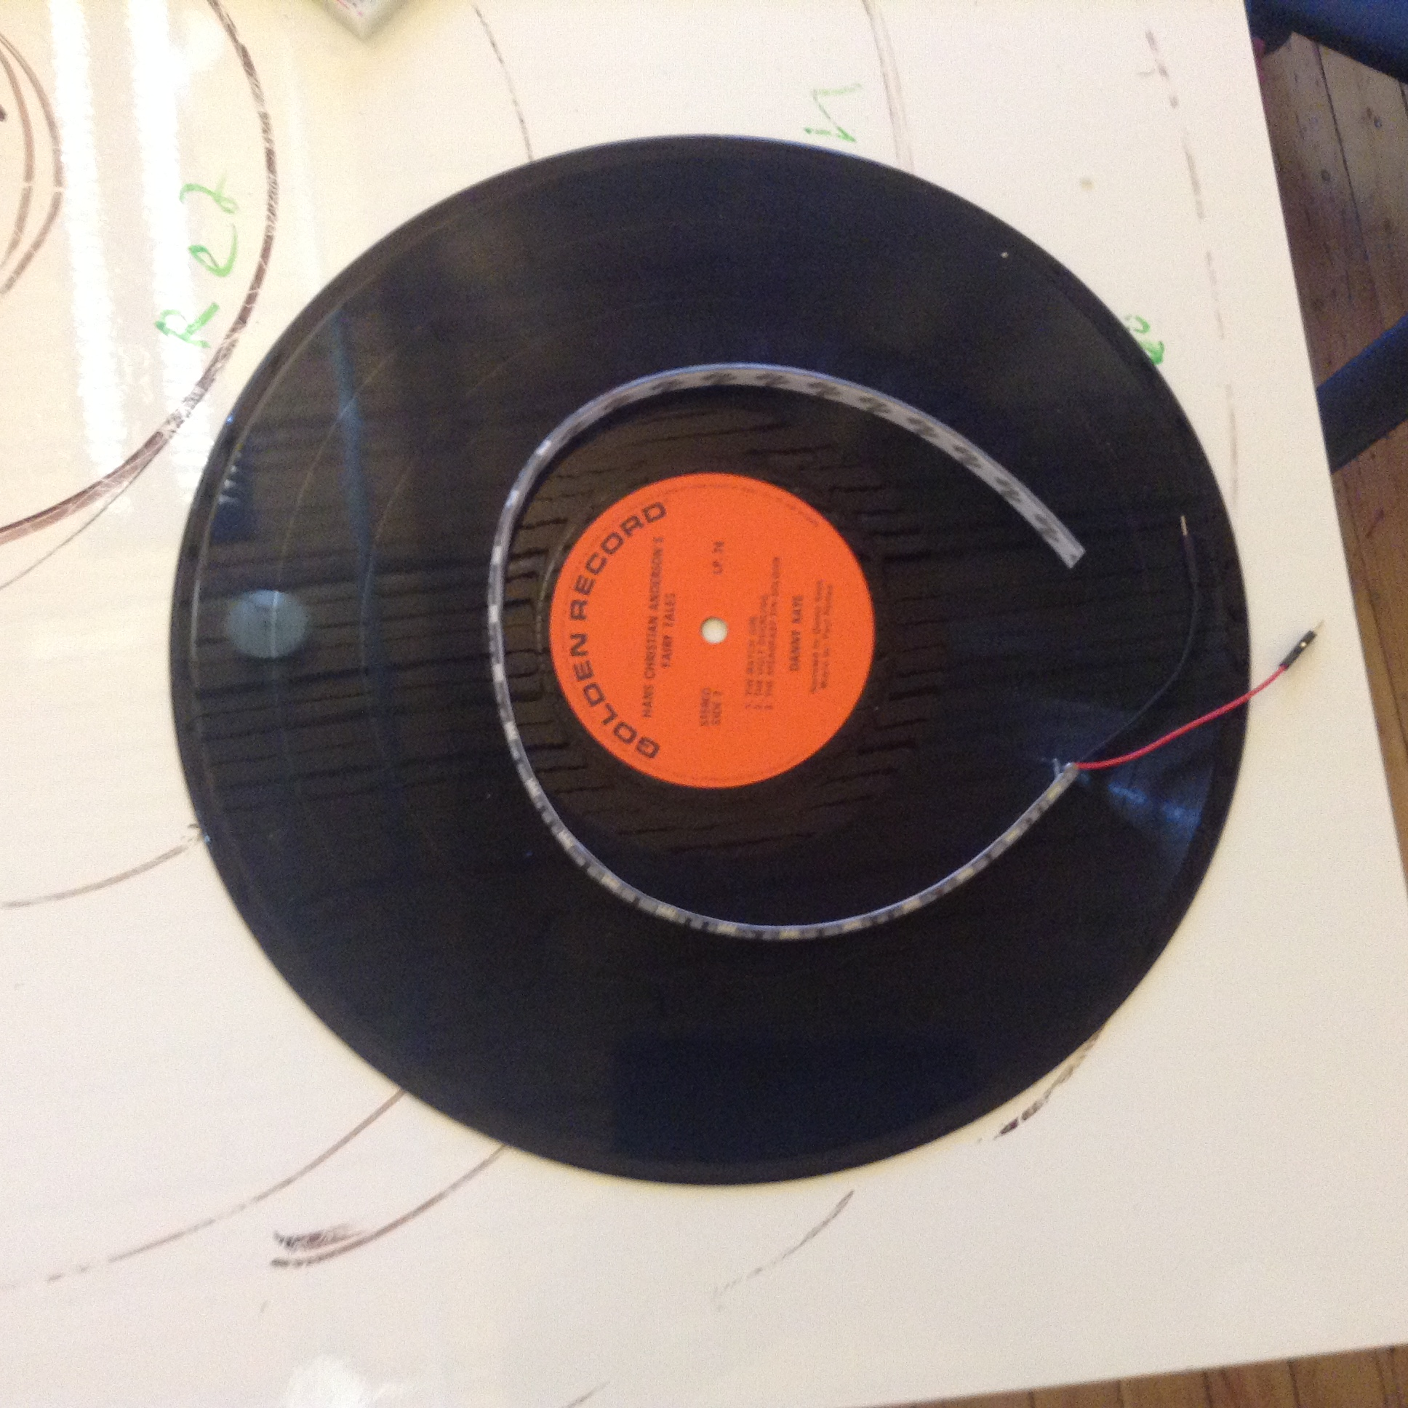
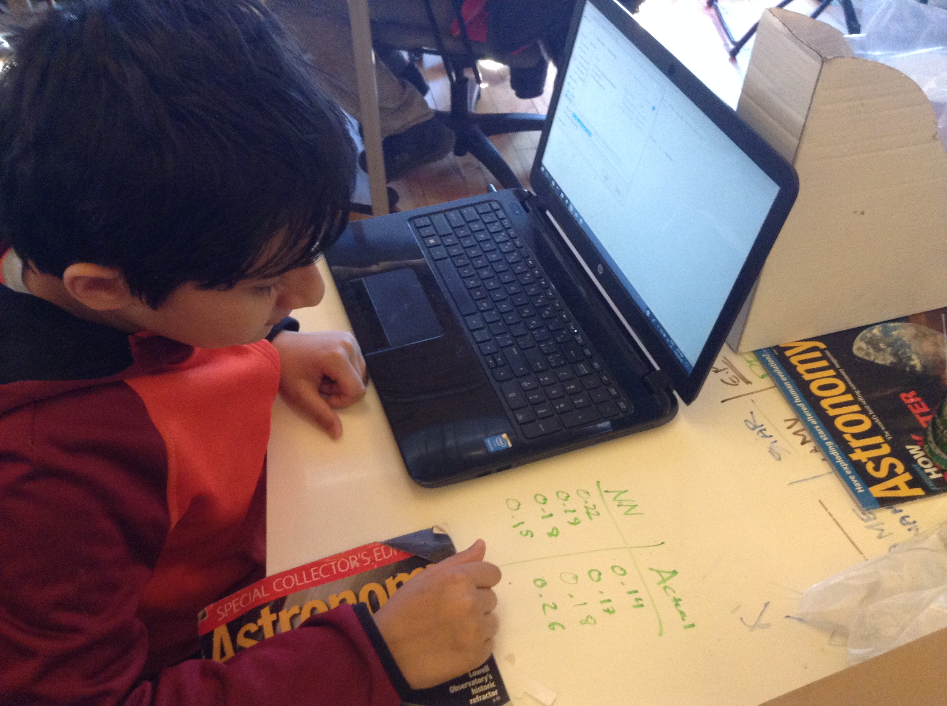
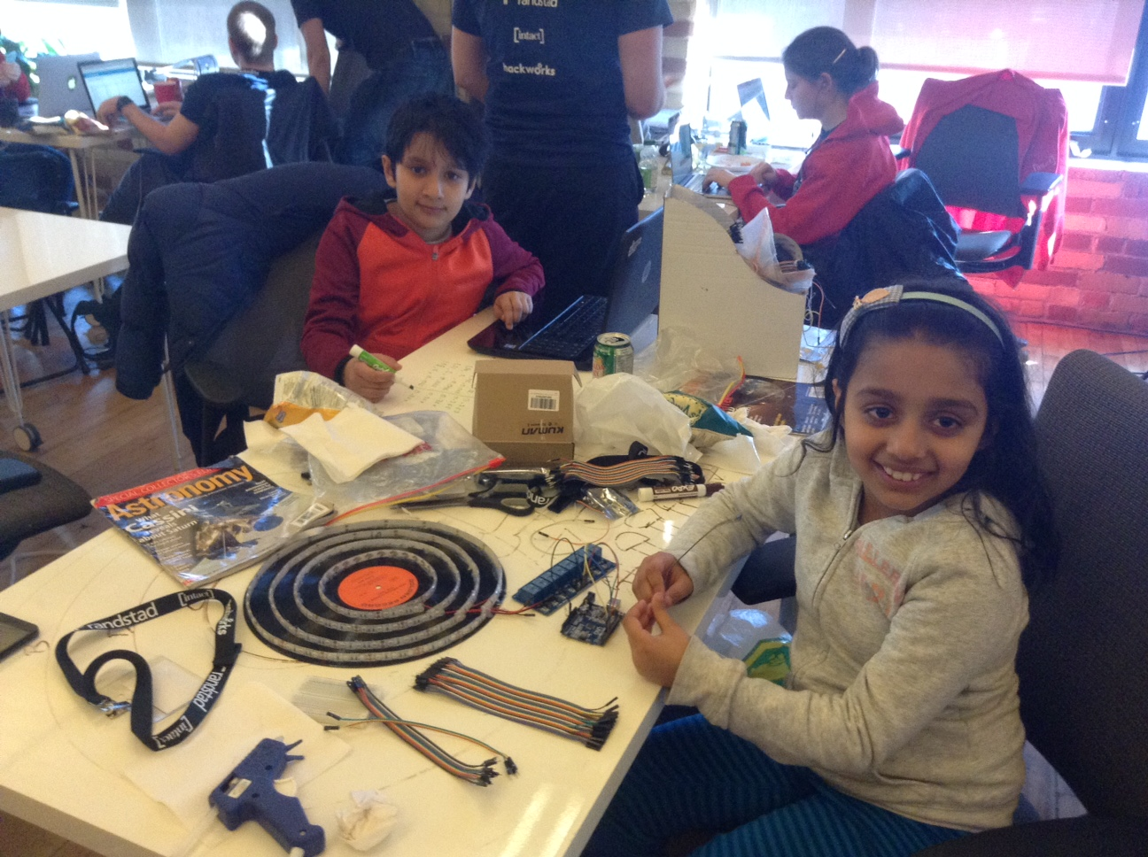
Actual Making, Coding and Testing

Slide 20
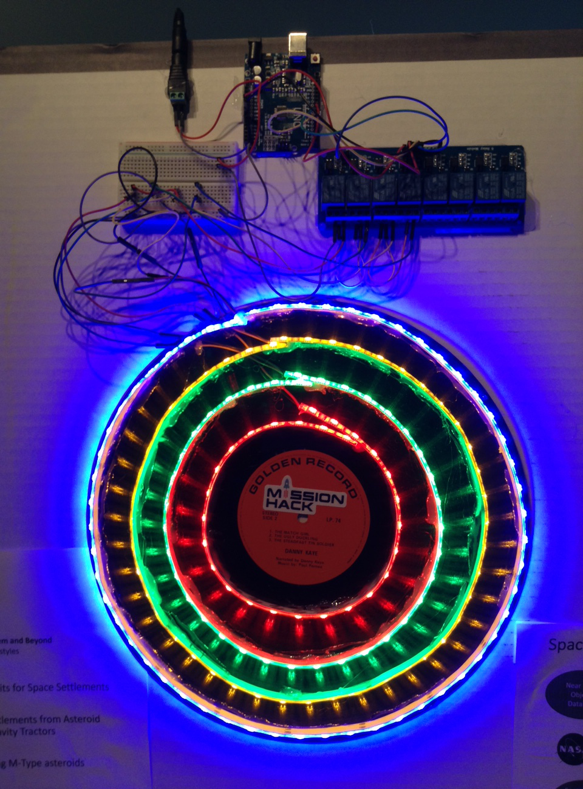
Demo

Slide 21
Real-time near-earth-Object Detection with Intelligent Neural-nets: R.O.D.I.N
Better Neural Networks using TensorFlow Framework
Live data and predictions
Suggestion for Asteroid Deflection methods
Use V.R technology to better understand the asteroids

Slide 22
Space-REX
Predicting Risk Index of Asteroid Collision using Artificial Intelligence and displaying the results musically!
Presenting at the Ontario Science Center on June 20th 2018
Artash Nath, Grade 6
Arushi Nath, Grade 3
www.HotPopRobot.com @wonrobot

