Slide 1
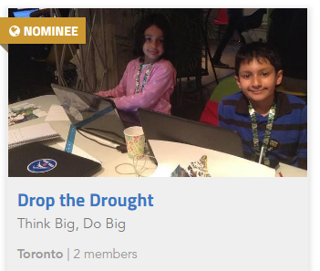
NASA Space Apps Toronto and
Canadian Space Apps Winners 2017
Drop the Drought Project
Artash Nath
Yes I Can
Arushi Nath
HotPopRobot.com
@wonrobot

Slide 2

Drop the Drought Project: using satellite imagery to predict droughts
2017 NASA Space Apps Winner, Toronto
Project Objective:
To predict droughts and possible migration patterns from space
Project Focus:
Agriculture, Human Settlements

Slide 3
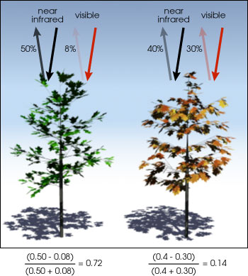
Science Behind Drop the Drought
Healthy vegetation absorbs most of the visible sunlight and reflects a large portion of the near-infrared light.
Unhealthy or sparse vegetation reflects more visible light and less near-infrared light.
NDVI Index:
0.4 - 1: Vegetation is healthy
< 0.4: Vegetation is under stress
Drought Conditions Trigger:
NDVI is below 70% of average.

Slide 4
Space Data Sets Used: 4
NASA Satellite Data:
Landsat 8 (Land Image)
Terra Modis (NDVI Index)
NASA Socio-Economic Data and Applications Center (SEDAC) Data
Population Density
Human Settlements

Slide 5
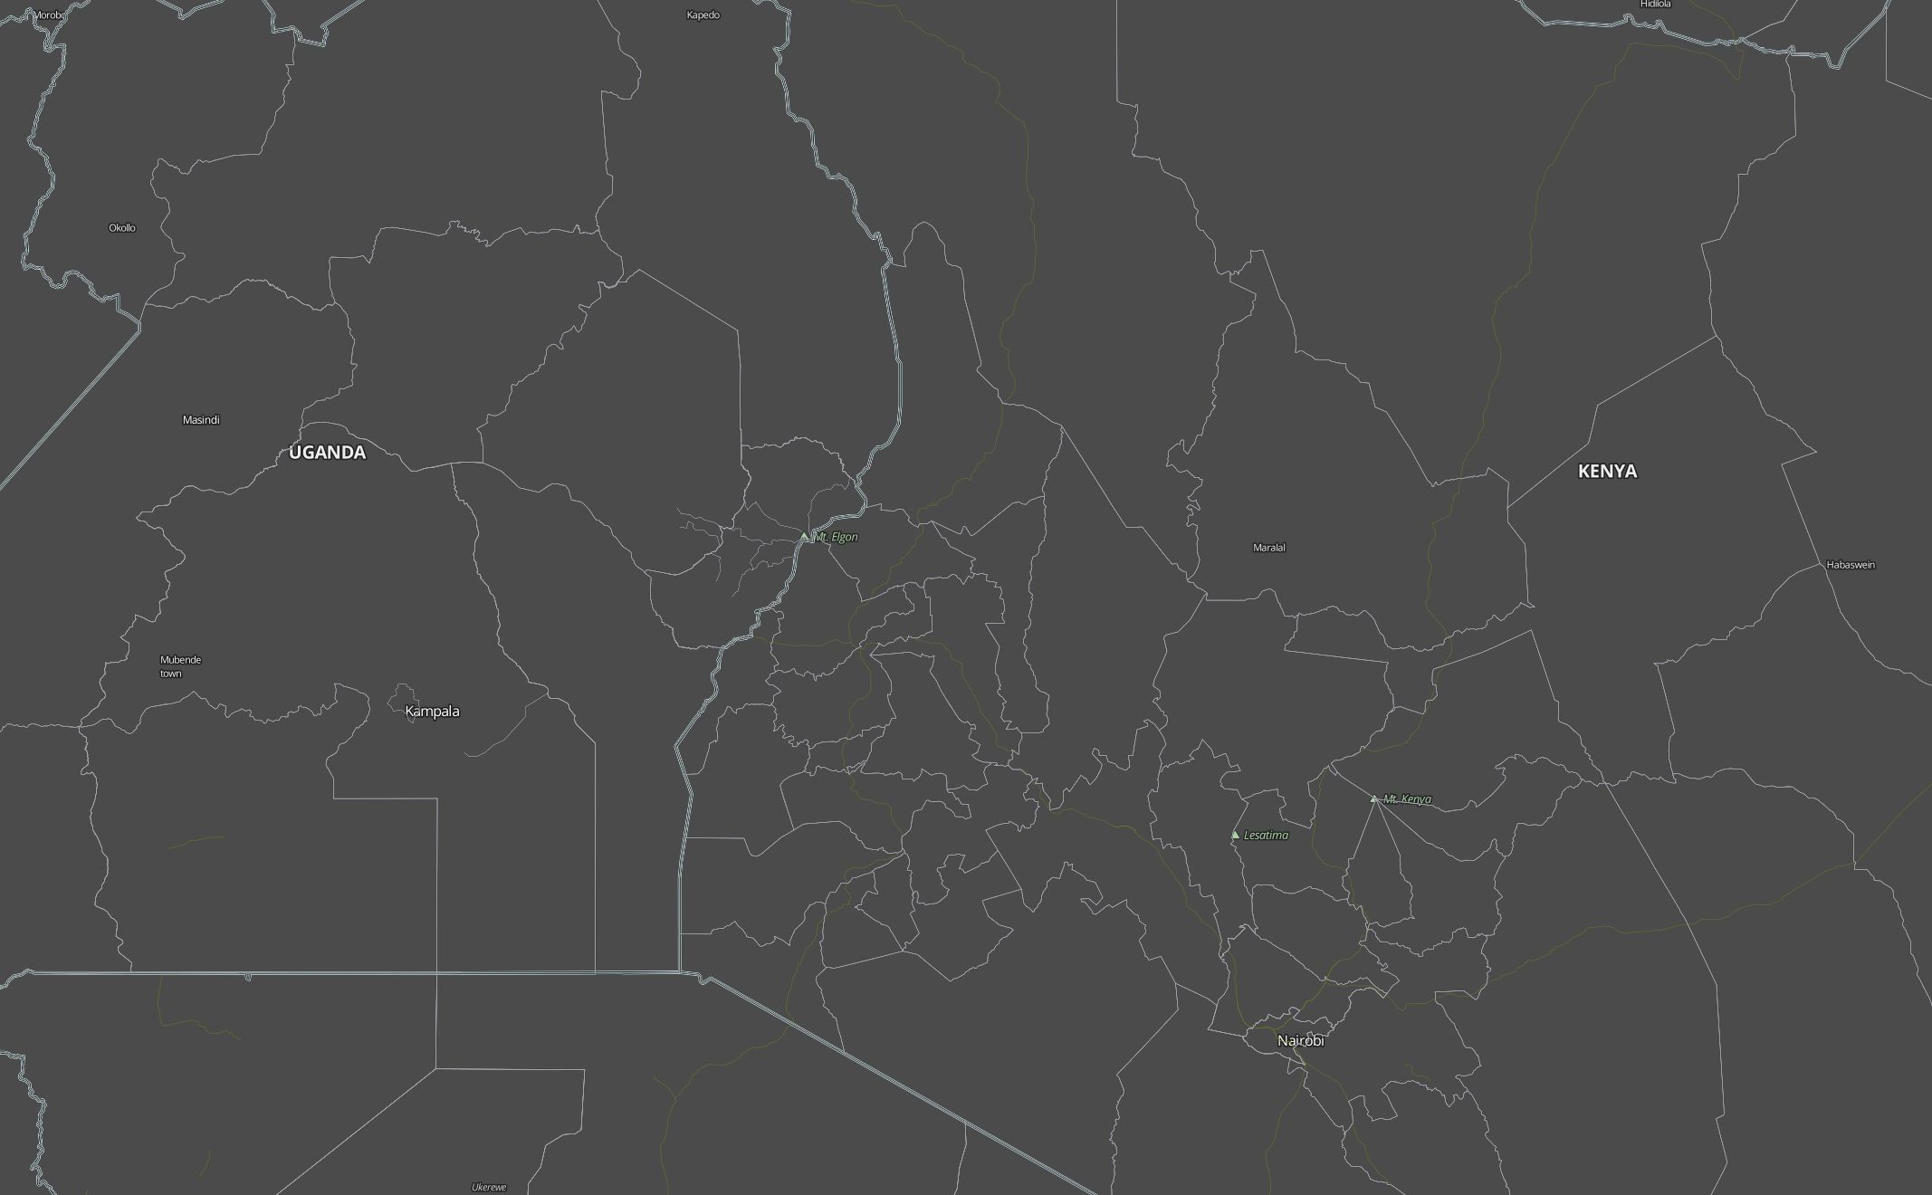
Narrowing our Geographical Area:
Kenya – Uganda Border
UGANDA
KENYA

Slide 6
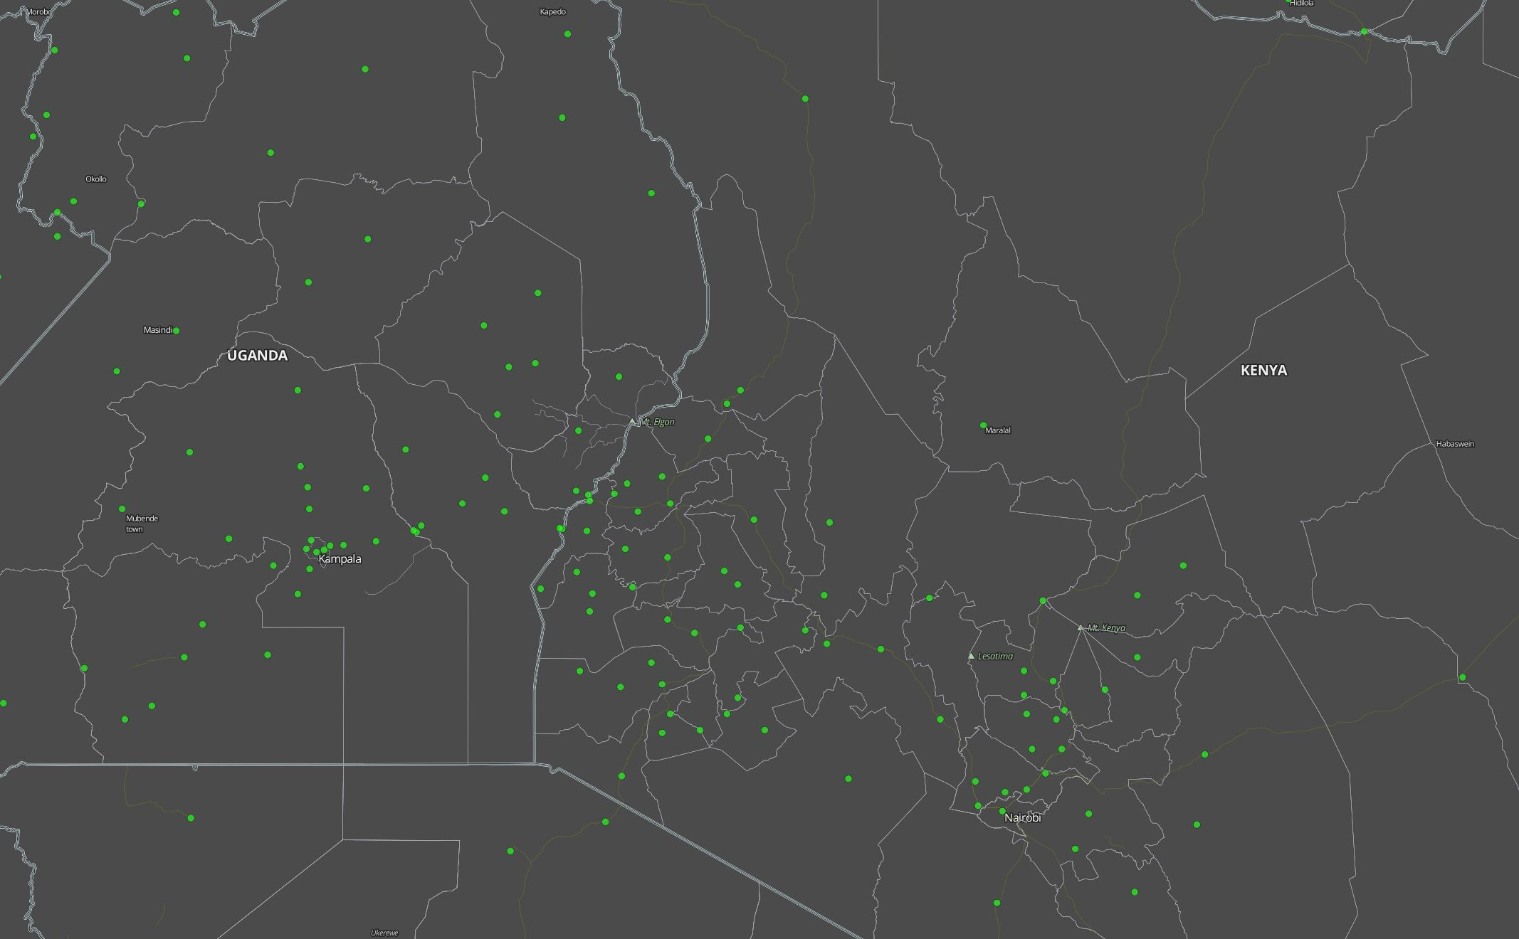
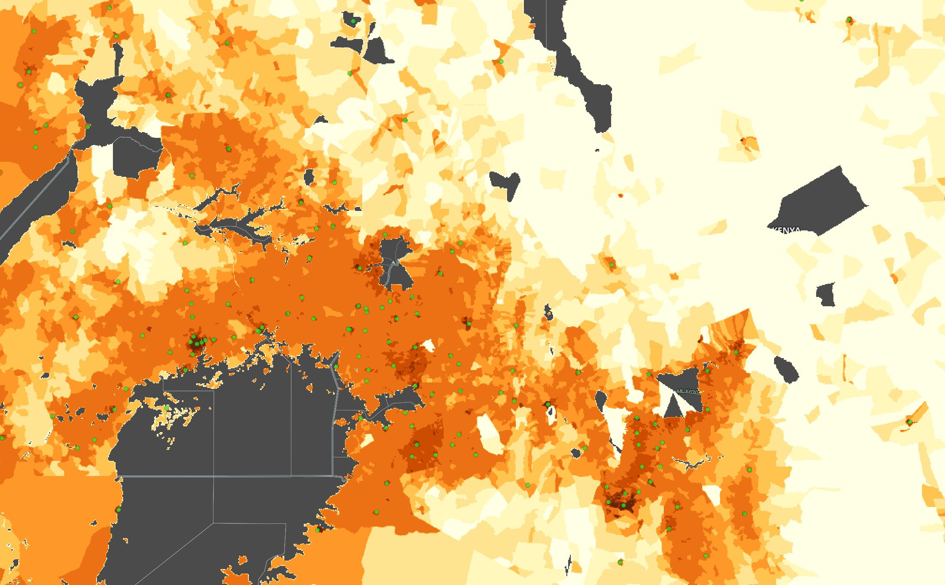
Layering of Data to make it more meaningful
Settlement and Population Density Data
Settlement Data
Population Density layer added

Slide 7
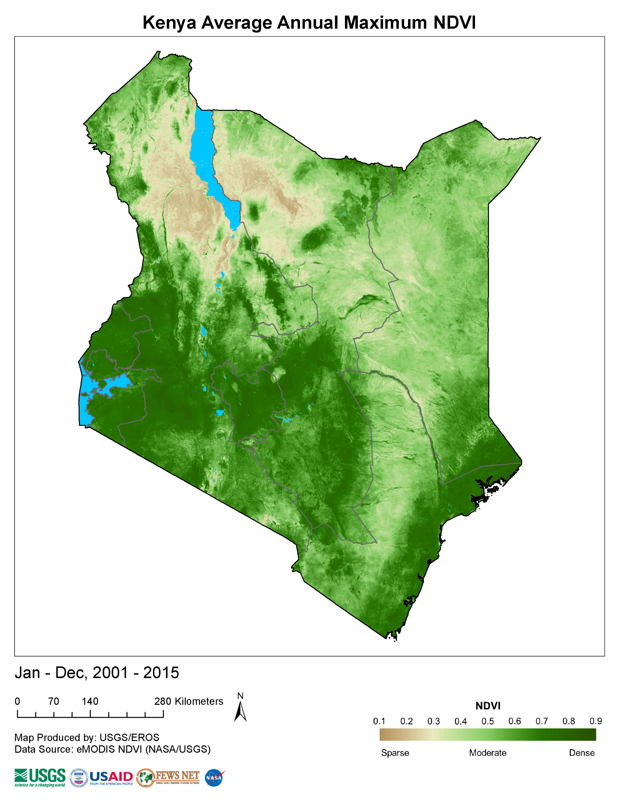
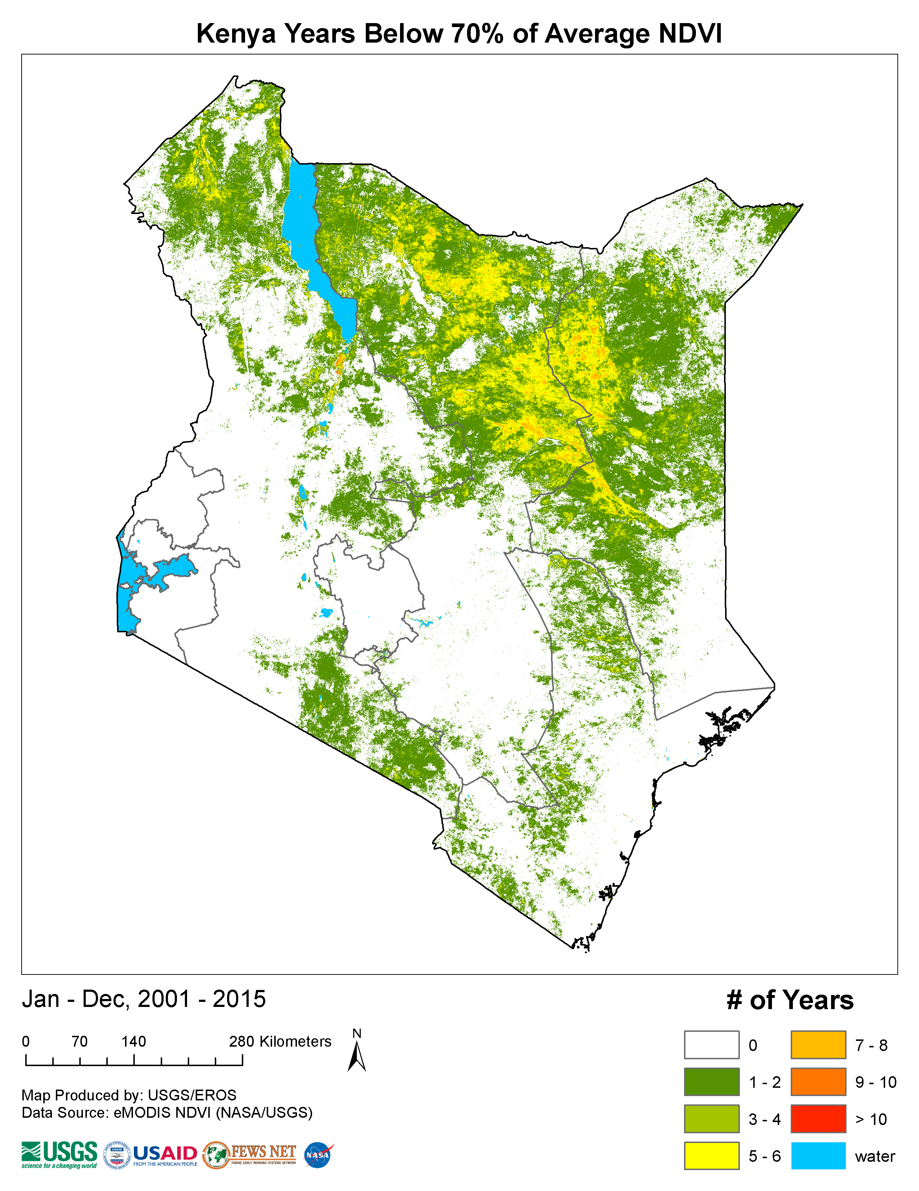
Getting Average Data of last 15 years:
Drought happens when NDVI falls below 70% of Average NDVI

Slide 8
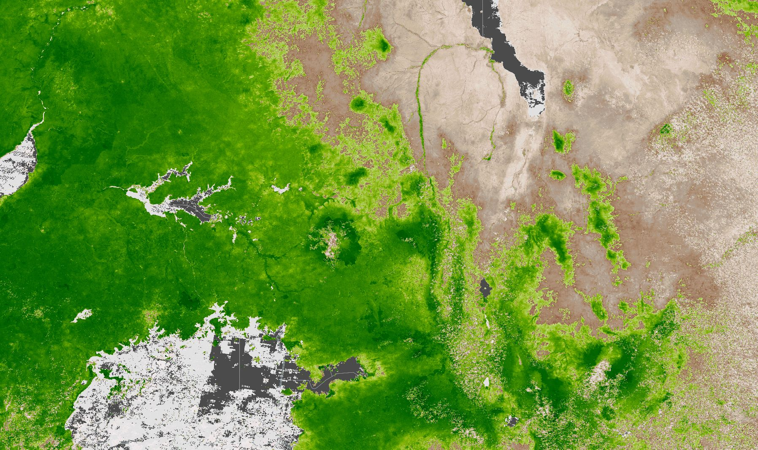
Layering the NDVI Values from Satellite Data starting from October 2016
October 2016
Uganda Average
NDVI value:0.77
Kenya
Average
NDVI value:0.61

Slide 9
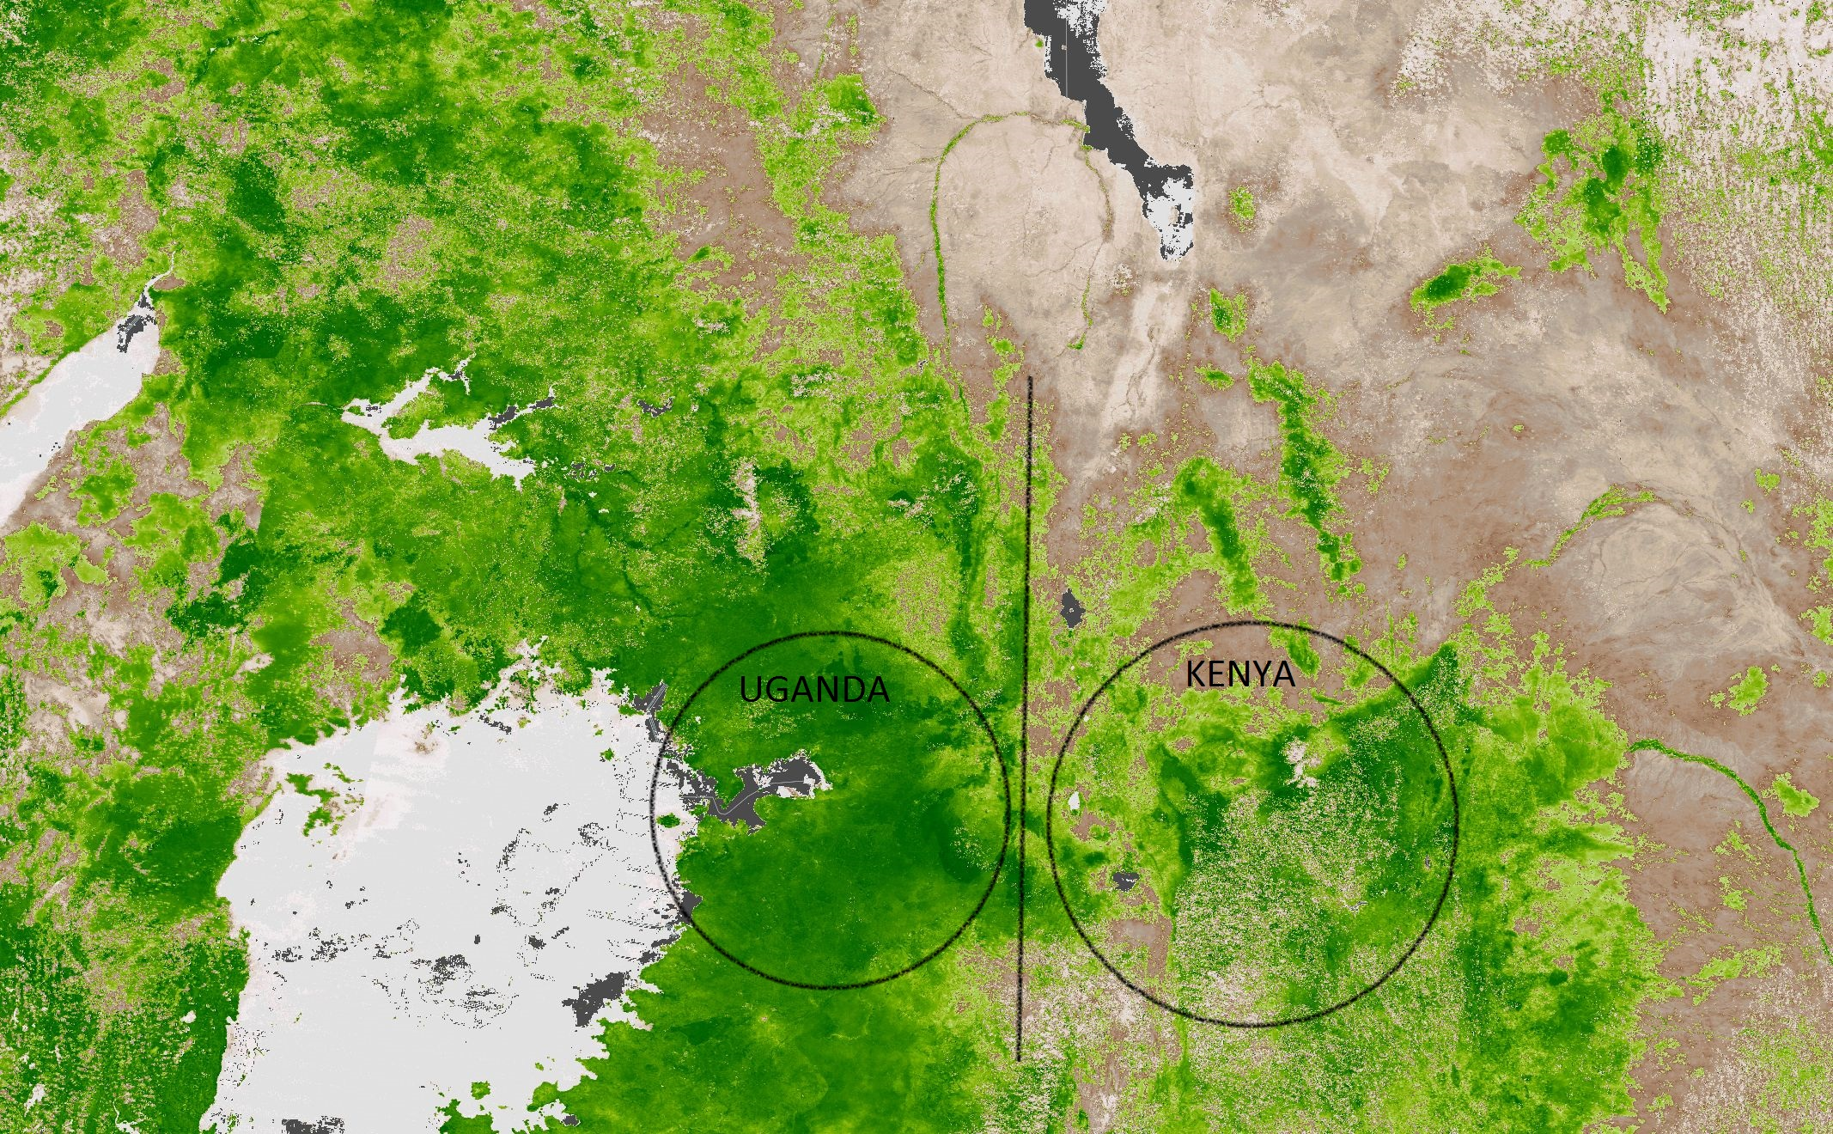
Analyzing and Interpreting the Data
Drought conditions could be predicted in January 2017
28 April 2017
POSSIBLE MIGRATION FROM KENYA TO UGANDA
Average
NDVI value:0.71
Average
NDVI value:0.30

Slide 10
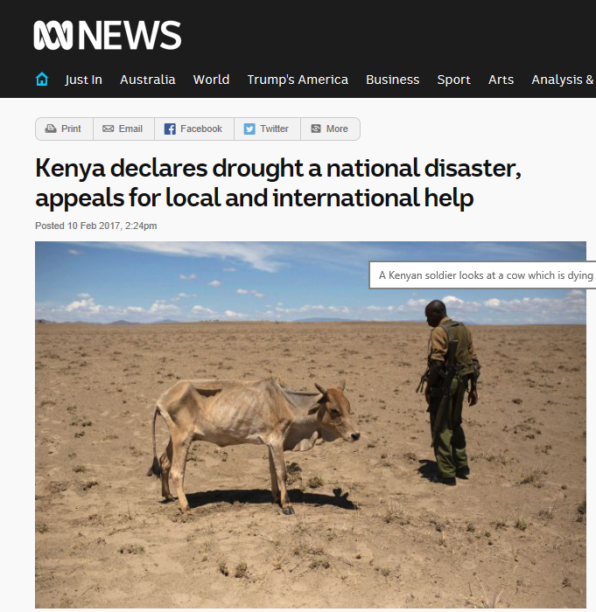
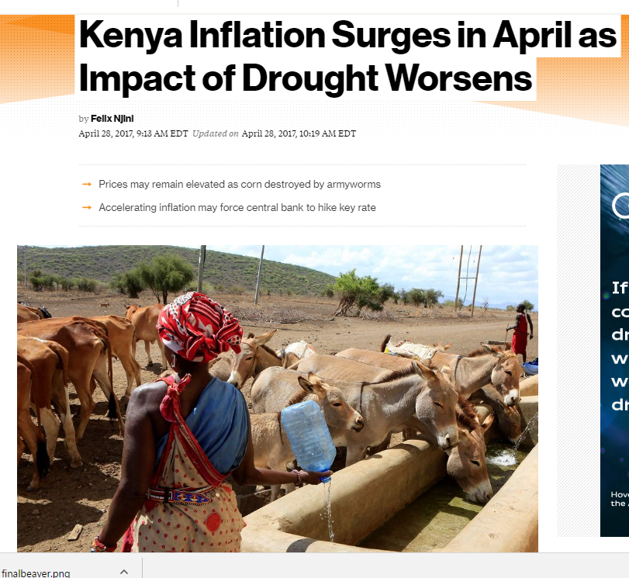
Stories which should not be in the Global News

Slide 11
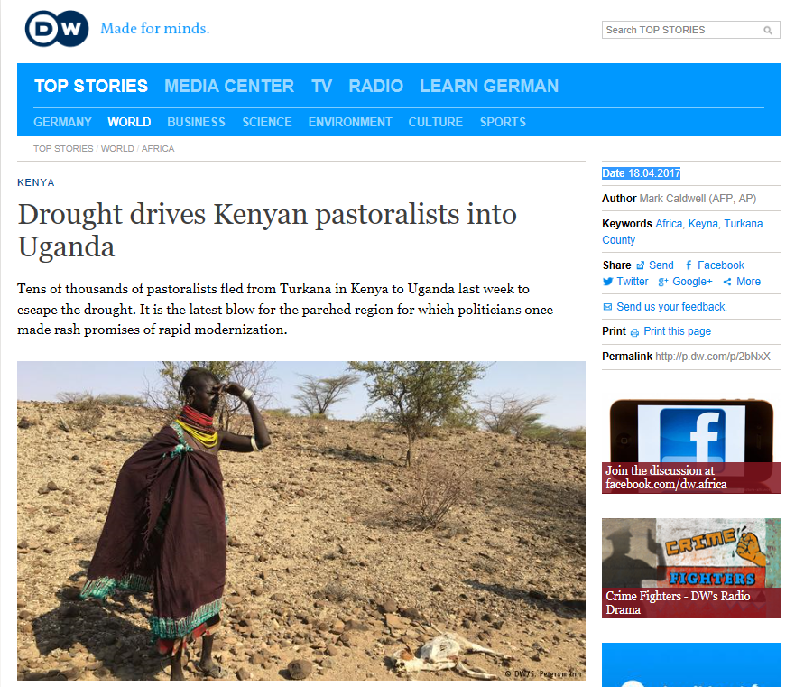
We could see from the Sky:
Migration could Happen …. and it Happened
14 April 2017

Slide 12
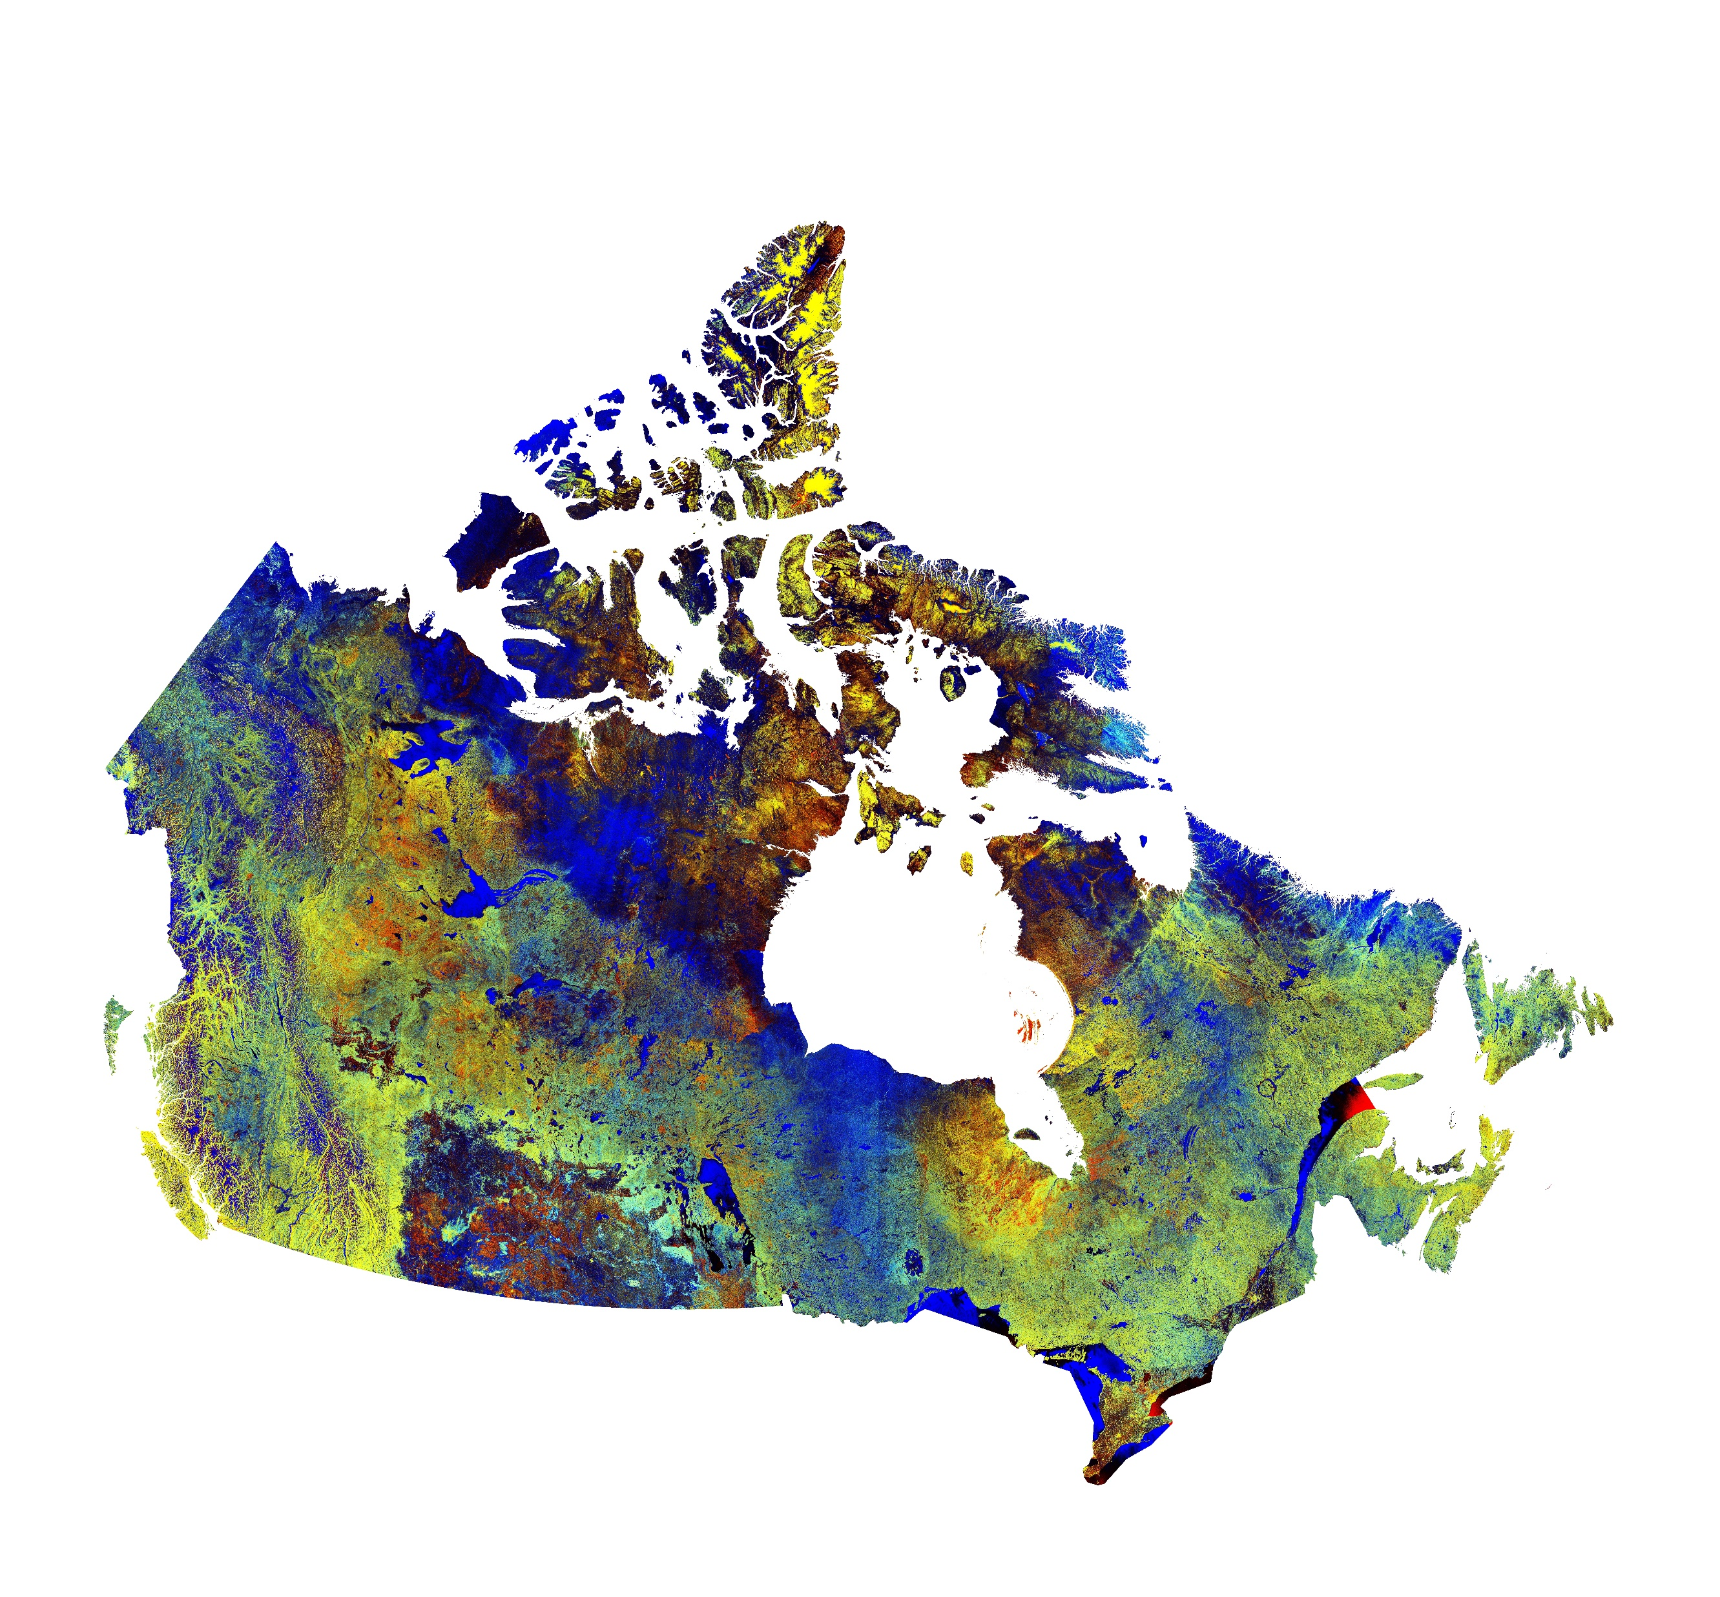
Yes I Can project:
Artistic Use of Satellite Data
2017 Canadian Space Apps Winner, Toronto
We took a large printout of data from Radar Sat 2.
And cut it into pieces……
RadarSat- 2 Image of Canada

Slide 13

Processing the Canadian Satellite RadarSat -2 Data

Slide 14


Making Mosaics from Cut-out pieces

Slide 15
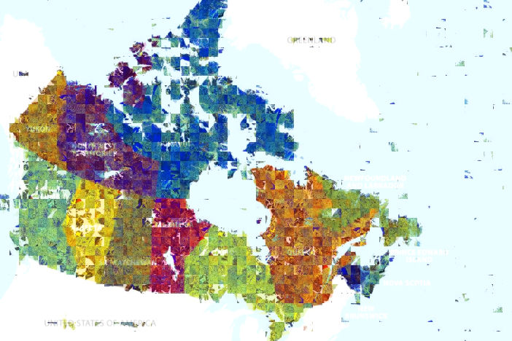
Recreating Canada Map from RadarSat-2 Images

Slide 16

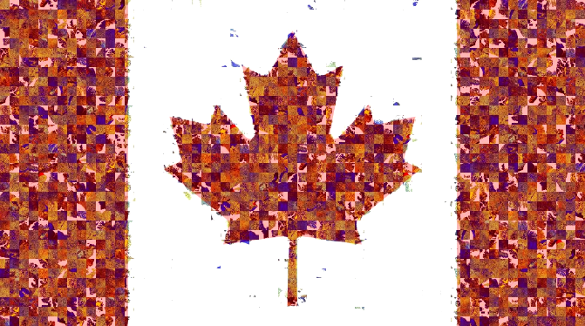

Slide 17

Making Sense of Data from Space
The Citizen Science Approach
THANK YOU
Artash Nath
Arushi Nath
Vikas Nath
HotPopRobot.com
@wonrobot
International Space Development Conference, St. Louis, USA, 25-29 May 2017

