Slide 1
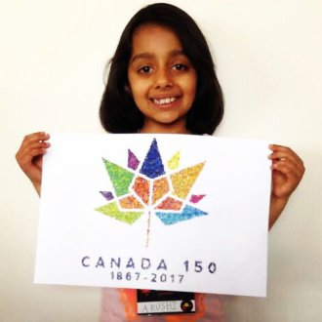

Space, Satellite and Code
Arushi Nath
Grade 3
Winner, Space Apps Award 2017
Canadian Space Agency
www.HotPopRobot.com
@wonrobot
11 February
Ontario Science Centre, Toronto

Slide 2
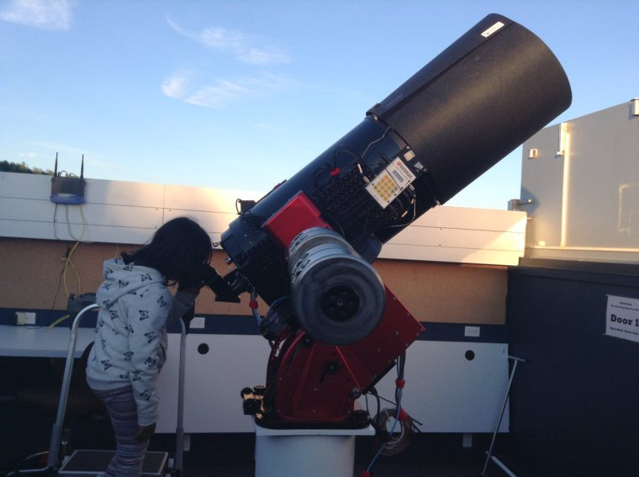
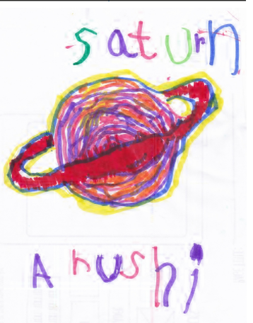
I love Space and watching the Night Sky!
Saturn is my favourite planet
Observing Saturn at the Collingwood Astronomical Observatory, Royal Astronomical Society of Canada

Slide 3
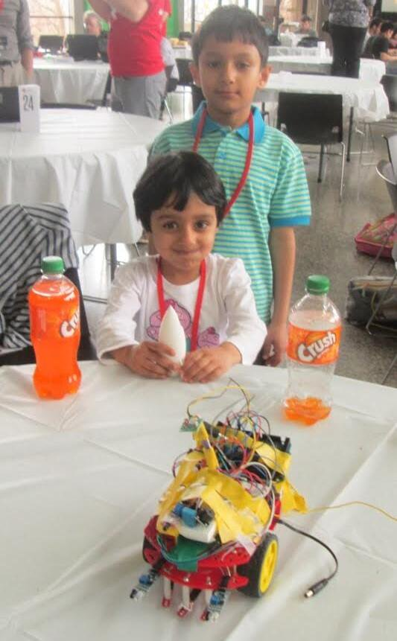
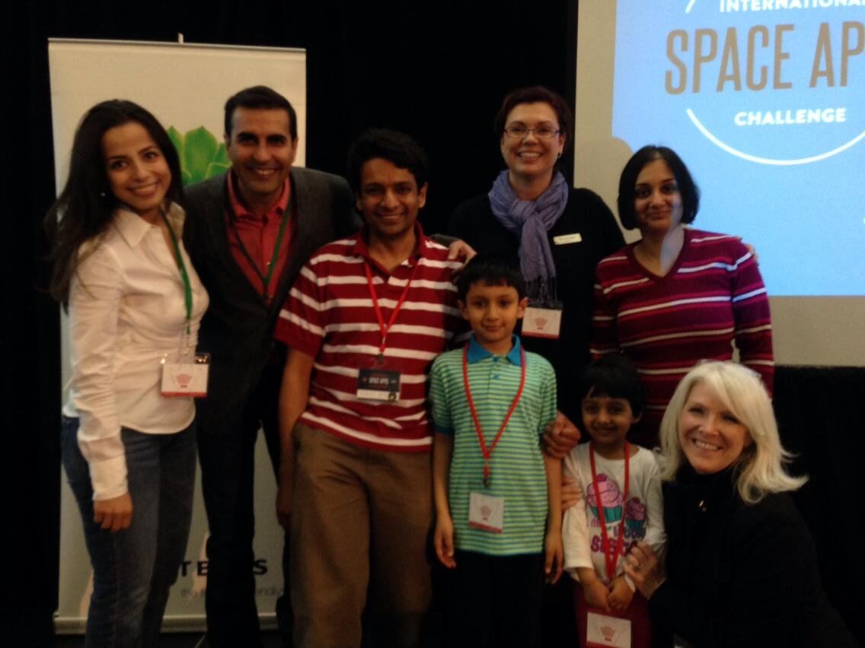
2014: My First Space Event
NASA SpaceApps Challenge at the Ontario Science Centre
Building Curious Bot Rover:
detects obstacles
Winning our First NASA Space Apps Challenge at the Ontario Science Centre

Slide 4
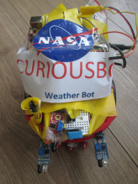
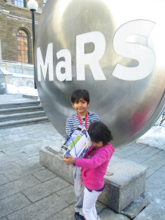
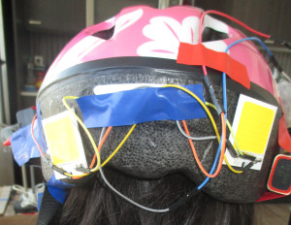

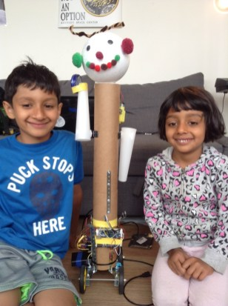
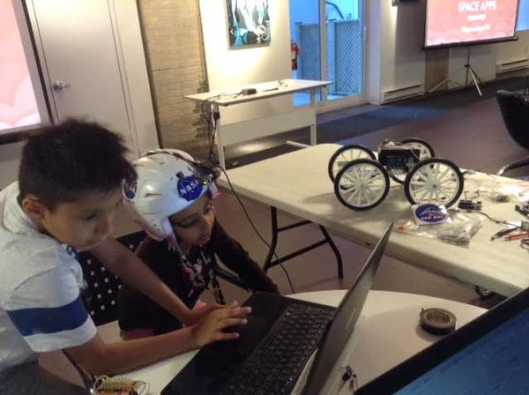
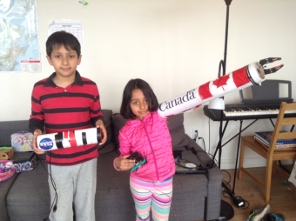
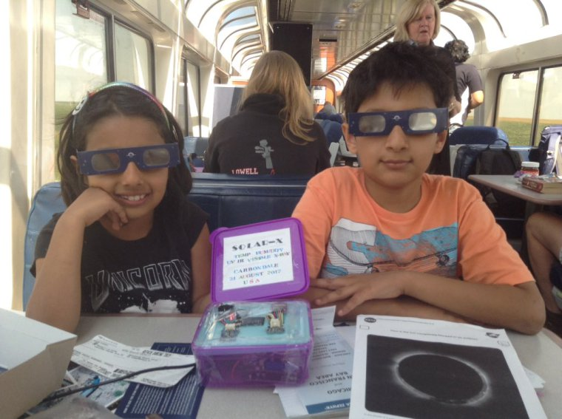
I am a Maker. Making Space Projects since I was 5 years
Astro Gesture Sensing Helmet 2015
Saturn V Rocket 2015
Curious Bot 2014
Galactic Bot 2015
Astro Health 2015
MARS Rover 2016
Canada Arm 2017
Solar-X 2017

Slide 5
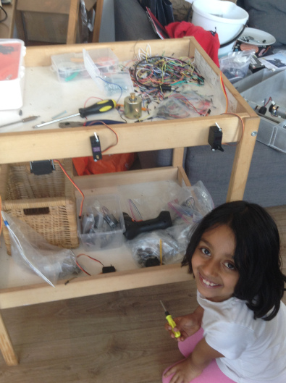
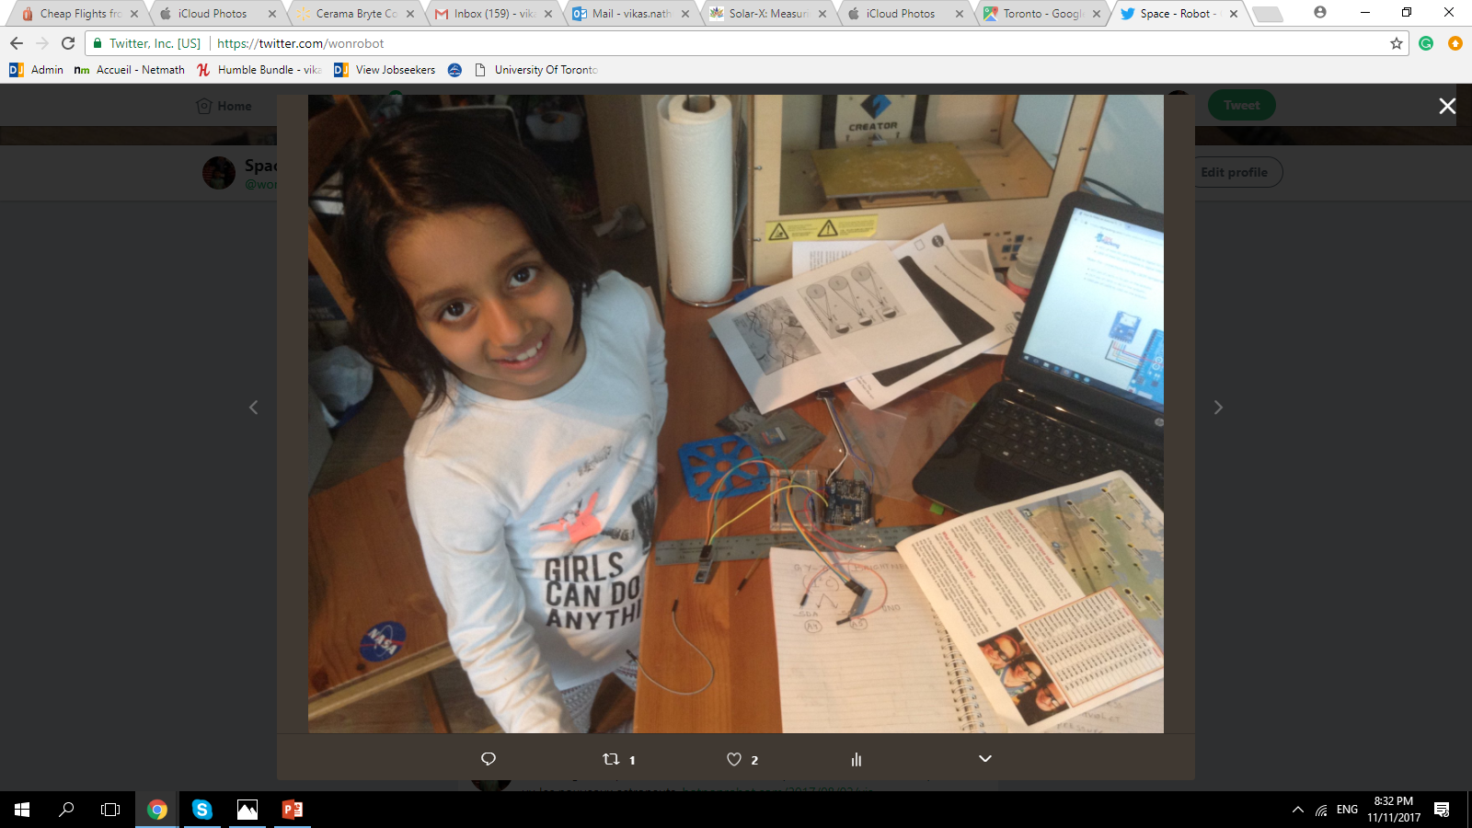
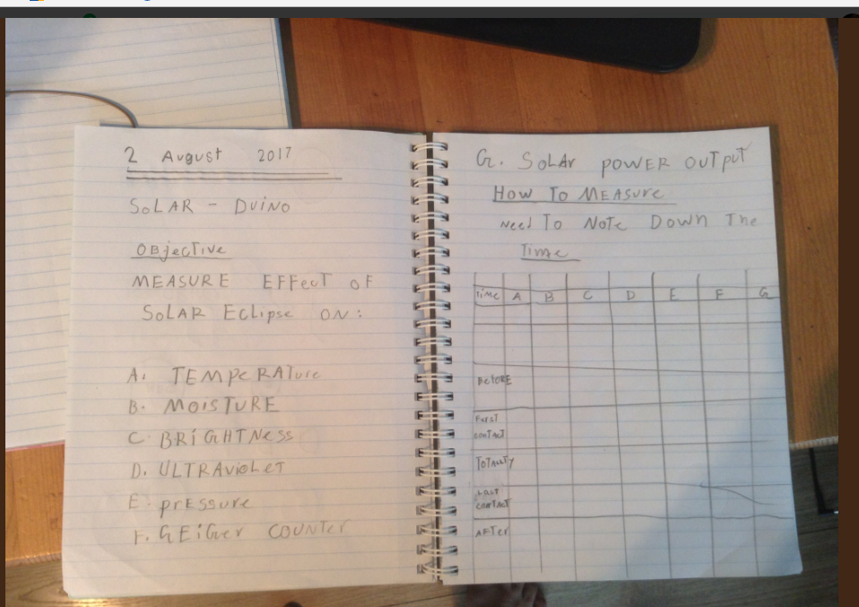
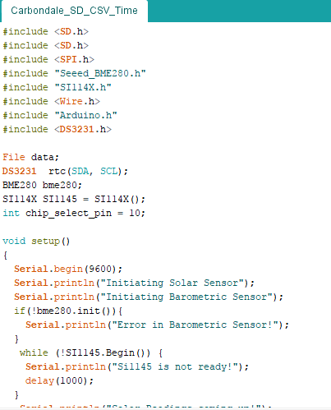
I have learned how to Code, Measure and Build!
All my projects start with Paper and Pencil
And Code!
Then I build

Slide 6

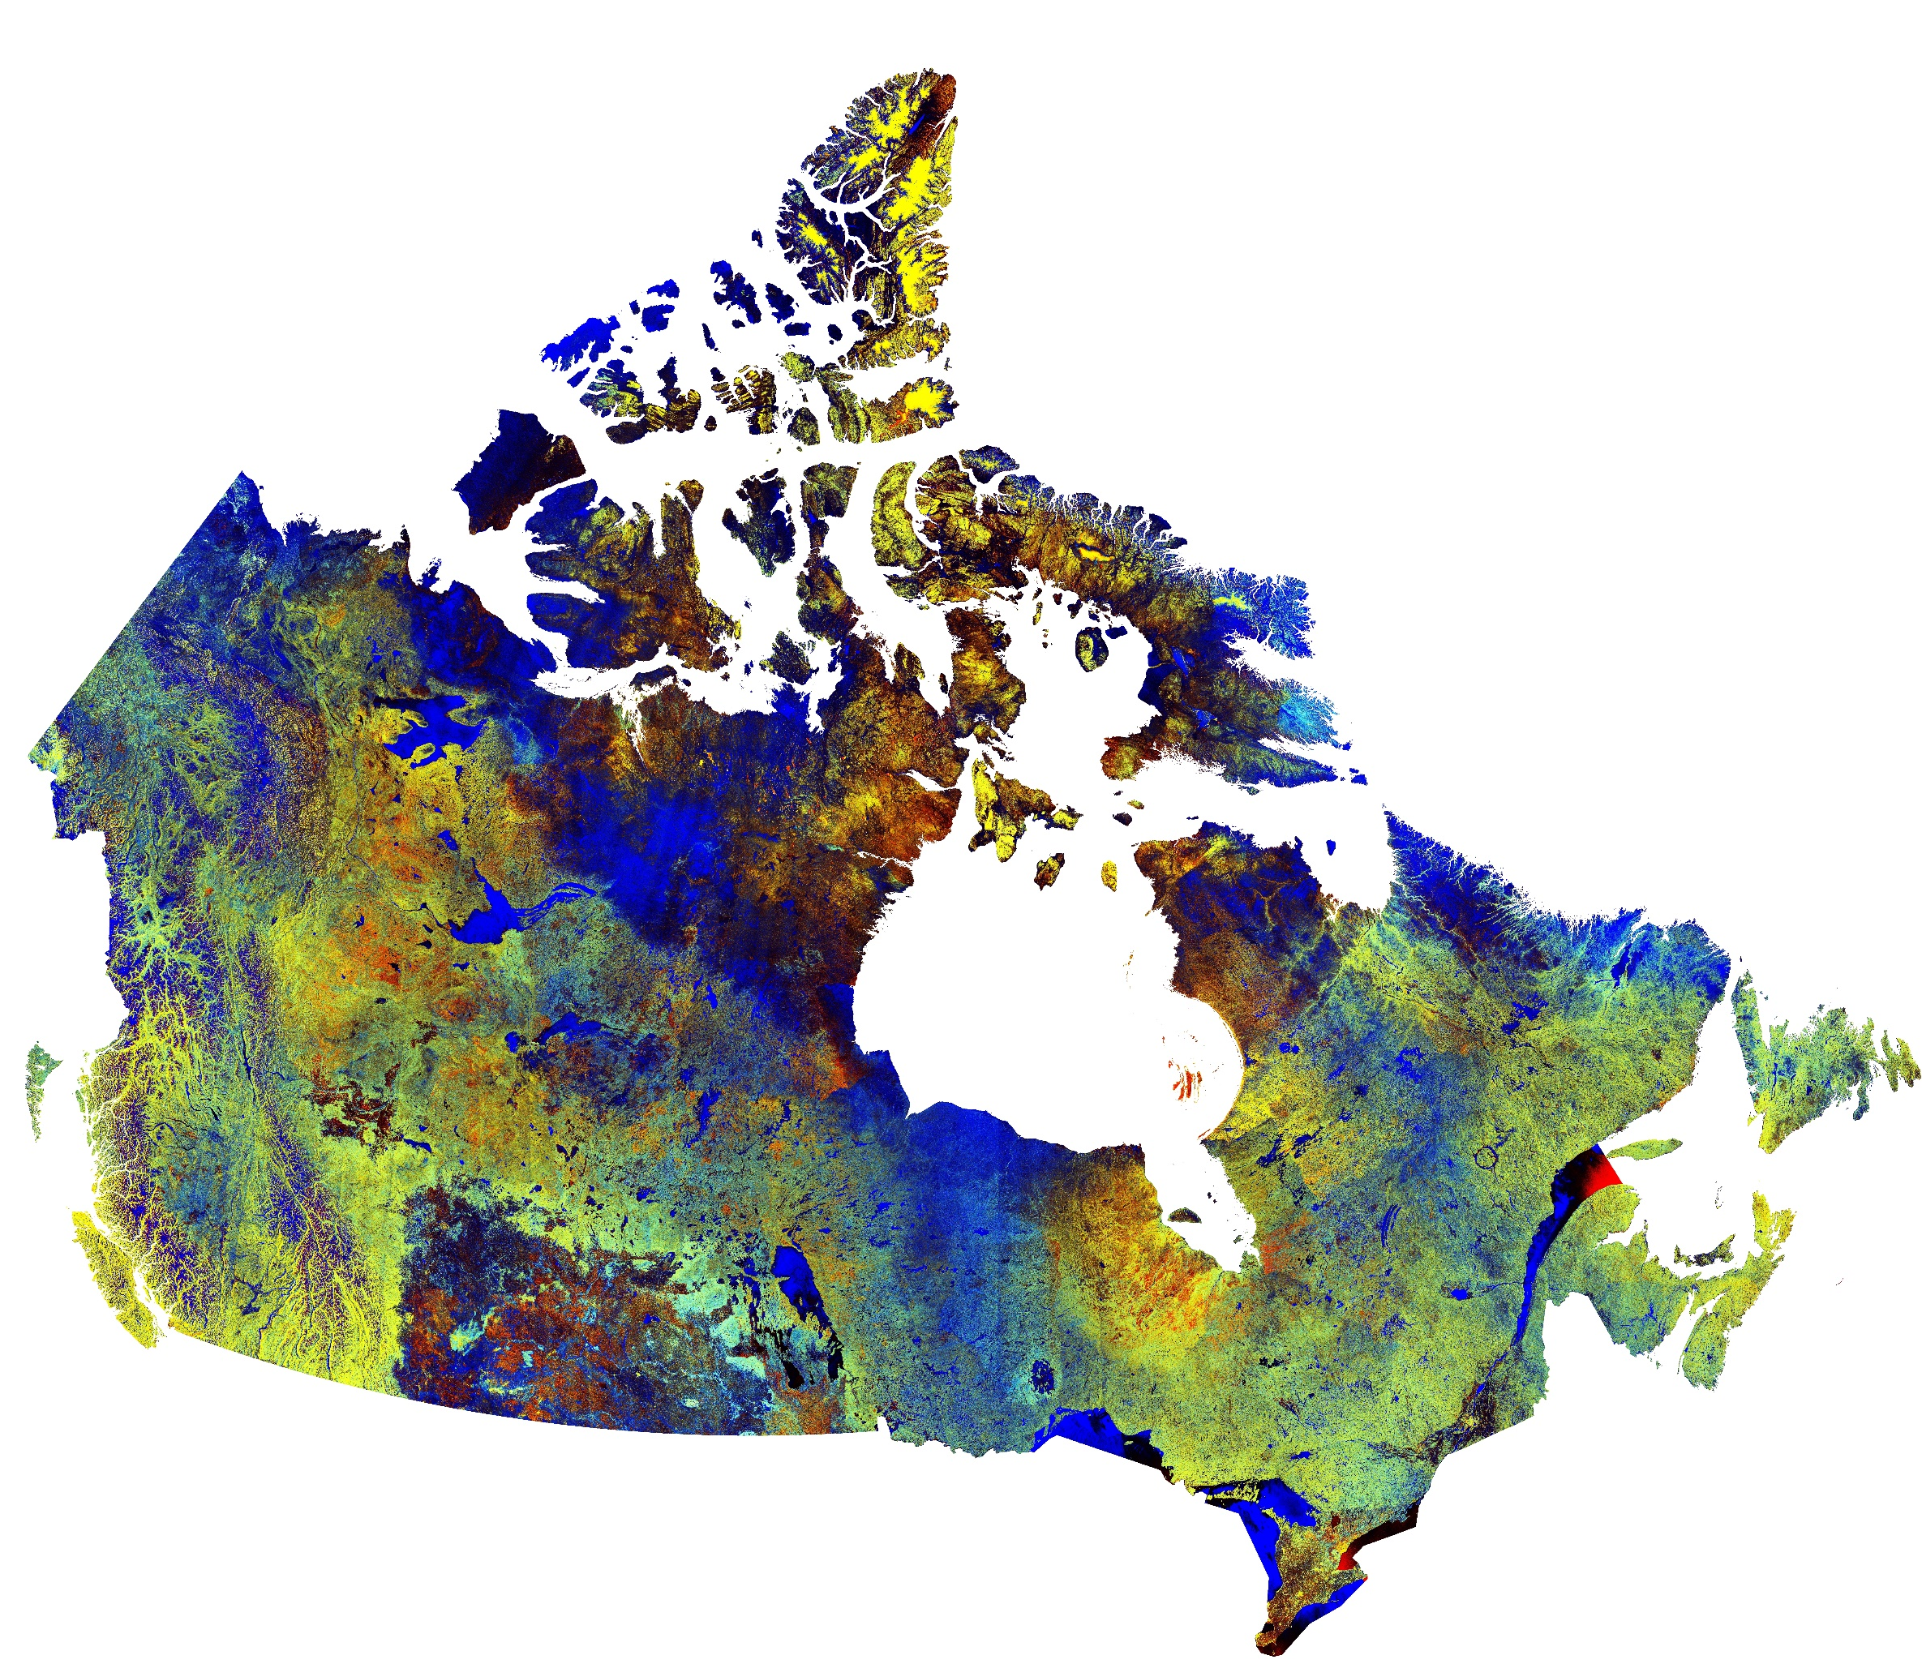

Yes I Can Oui Je Peux
I Won the
Canadian Space Apps Challenge 2017!!
I took Images from the Canadian Satellite RadarSat-2
And made the Canada 150 Logo using the Satellite Images

Slide 7
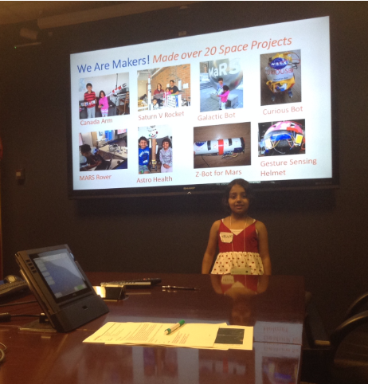
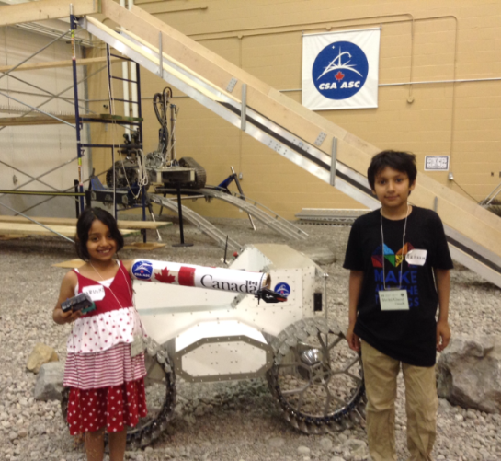
My Award Visit to the Canadian Space Agency
With the Moon Exploration Rover
Presenting my project at the Canadian Space Agency

Slide 8
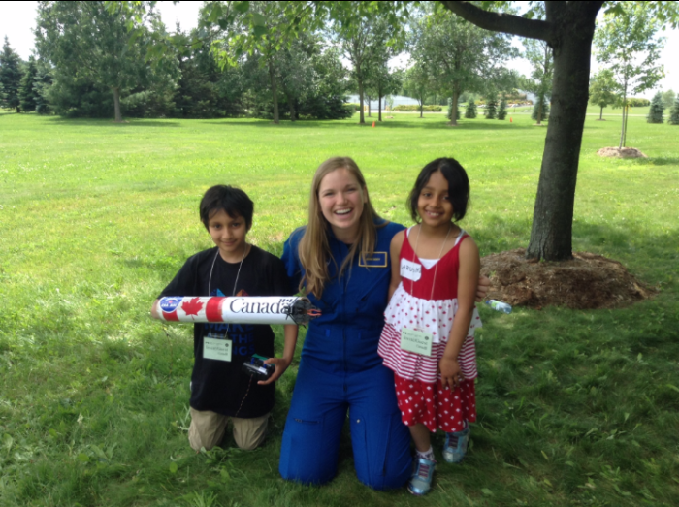
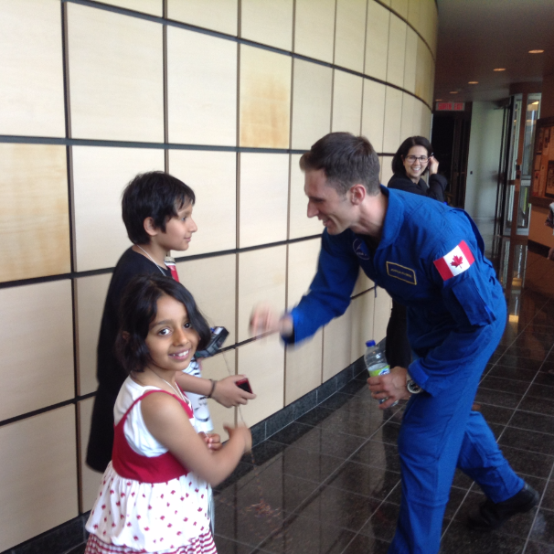
Meeting the New Canadian Astronauts!
Astronaut Jennifer Sidey
Astronaut Joshua Kurtyk

Slide 9
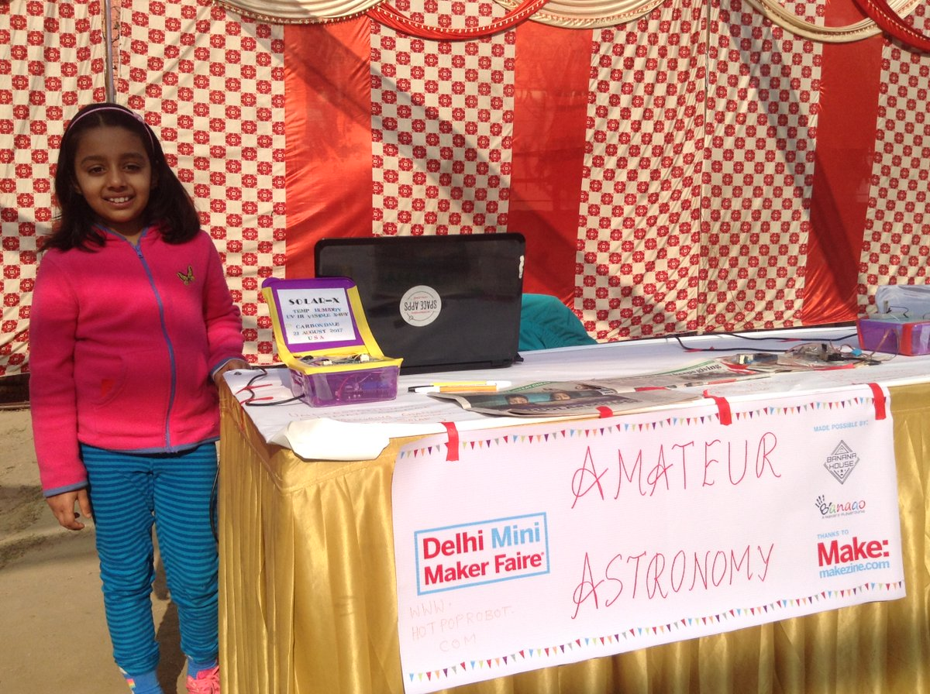
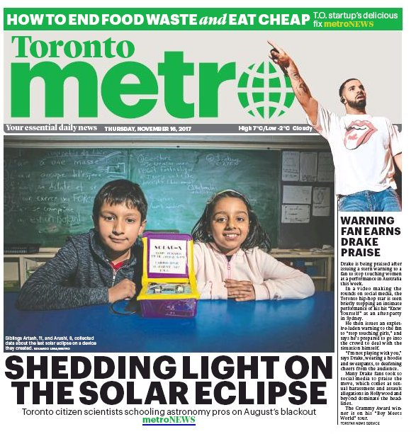
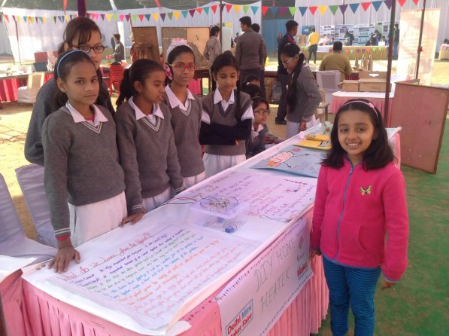
I Like Presenting My Science Projects
Giving a demonstration of our Space Projects
Loved sharing my experiences with other girls at the Maker Festival in India
Front page coverage of the
Solar-X project

Slide 10
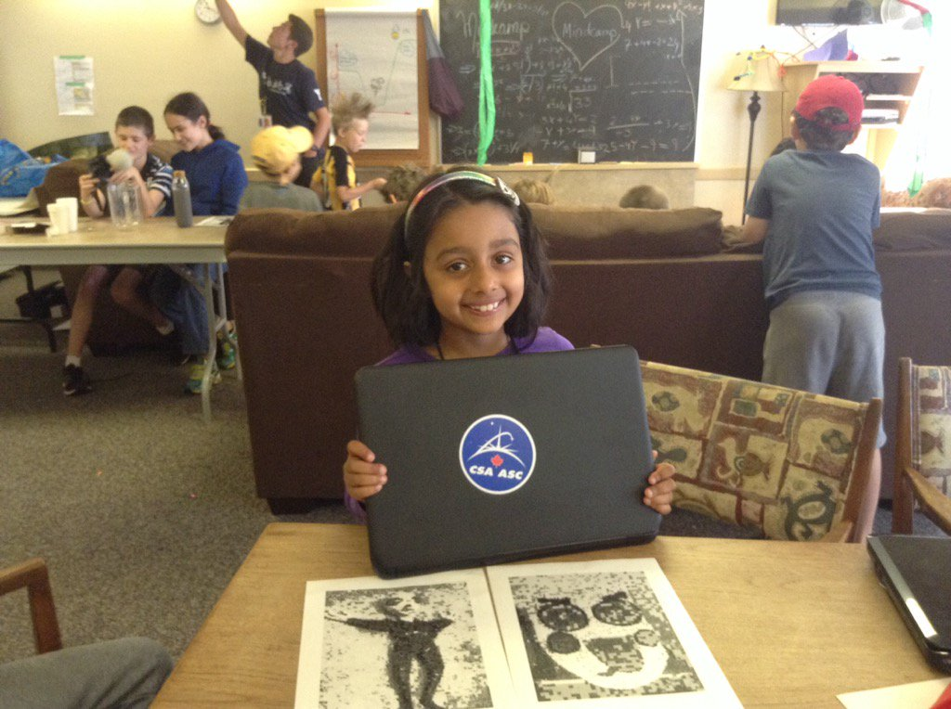
Thank You!
There are so many organisations in Toronto from where I have learned about Space, Satellites and Coding
Ontario Science Centre
Royal Astronomical Society of Canada
Coderdojo
Kids Code Jeunesse
Toronto International Film Festival
Arushi Nath
www.HotPopRobot.com
@wonrobot
Arushi giving training on Satellite Imagery and Arts to other kids at MindCamp, Orillia

