Slide 1
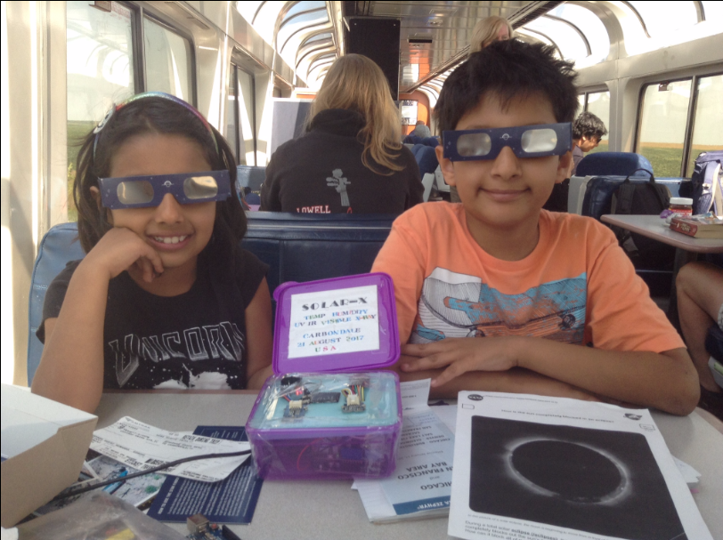
The Solar-X Project:
Changes in Solar Radiation during the
2017 Total Solar Eclipse
Artash Nath (11 years)
Arushi Nath (8 years)
Vikas Nath
www.HotPopRobot.com
@wonrobot
Vikas.nath@gmail.com
Our Pop-Up Outreach Station about Solar Eclipse on the Amtrak Train to Carbondale, USA

Slide 2
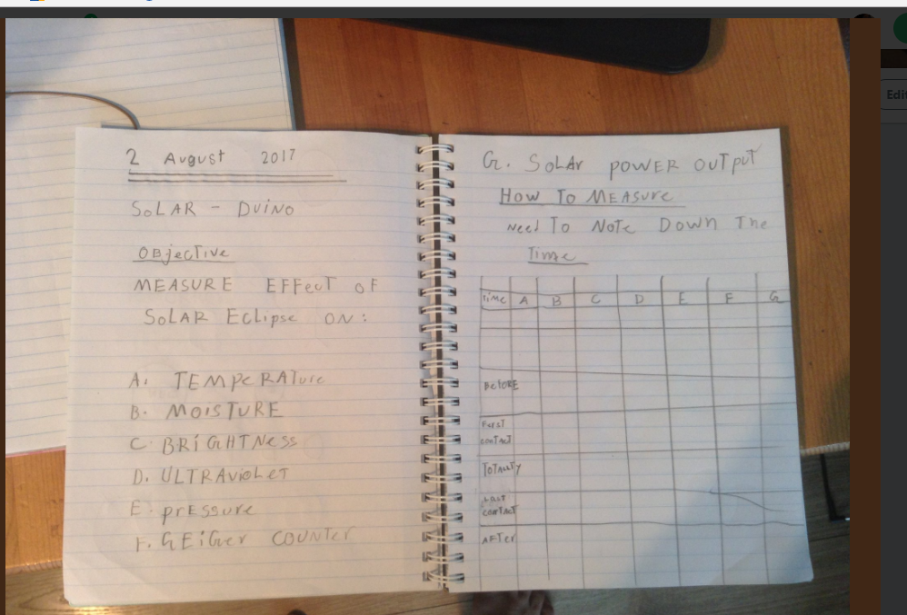
The Making of Solar-X:
All our ideas start with Paper and Pencil!
Some Questions in our Mind:
How dark will it get?
Will the temperature drop?
Will insects and birds behave differently?
Possible Uses:
Earth-based: To understand how quickly the Earth loses heat when sun light is blocked?
Solar-System based: Design spacesuits, spaceships and space settlements for deep space exploration that adapt to Eclipses.

Slide 3
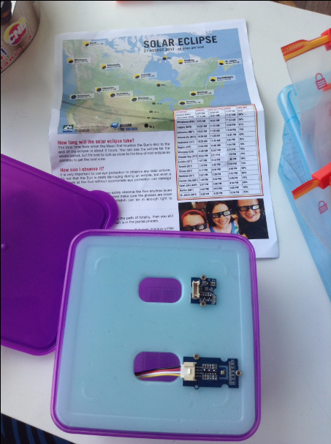
The Making Started with a Lunch Box!

Slide 4
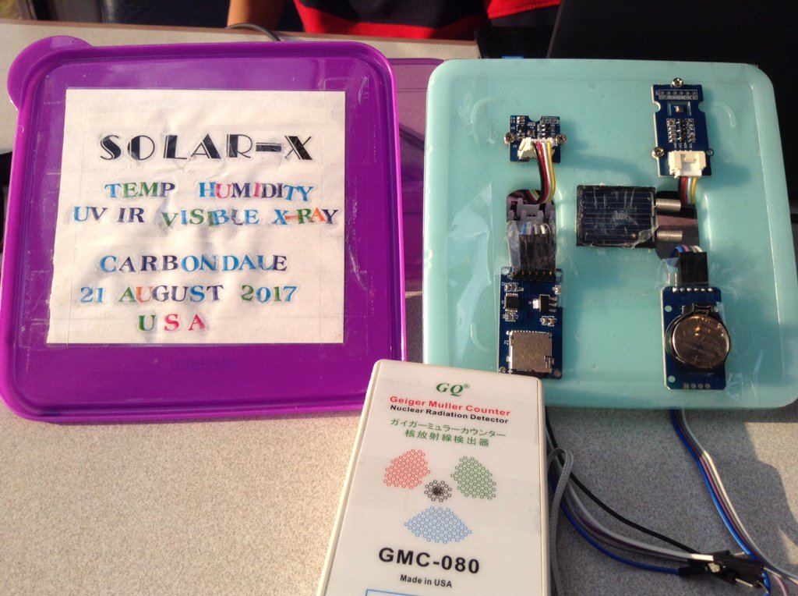
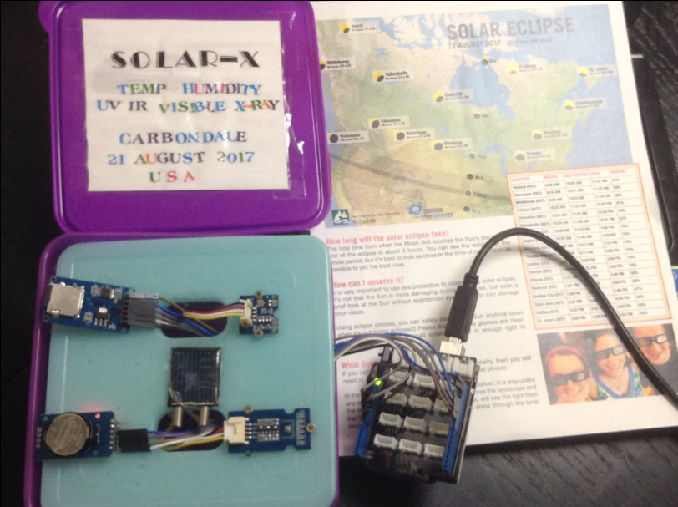
Added Sensors, Arduino, Timer and Data Storage Modules

Slide 5
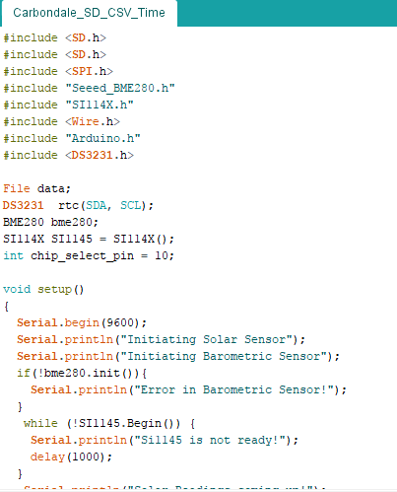
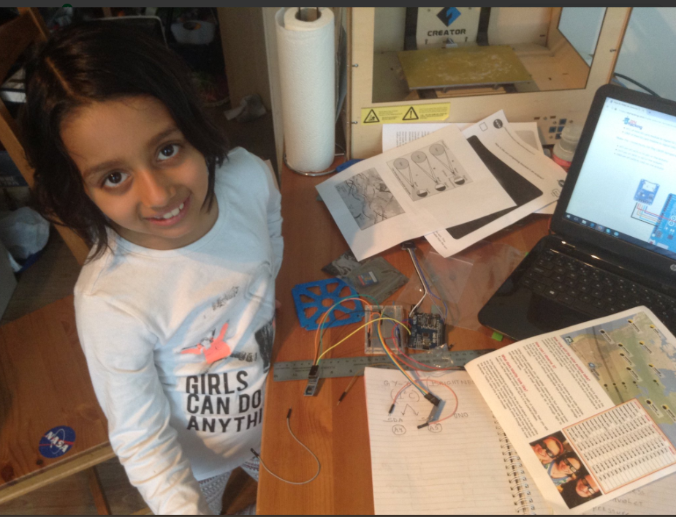
And coding…. Lots of it!
Sample of our code

Slide 6
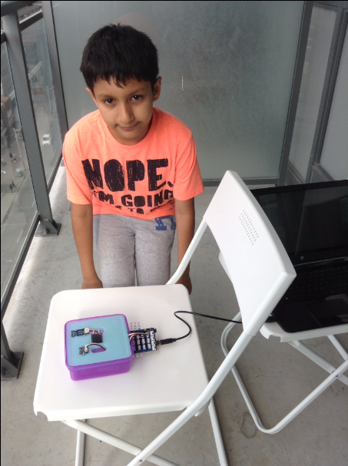
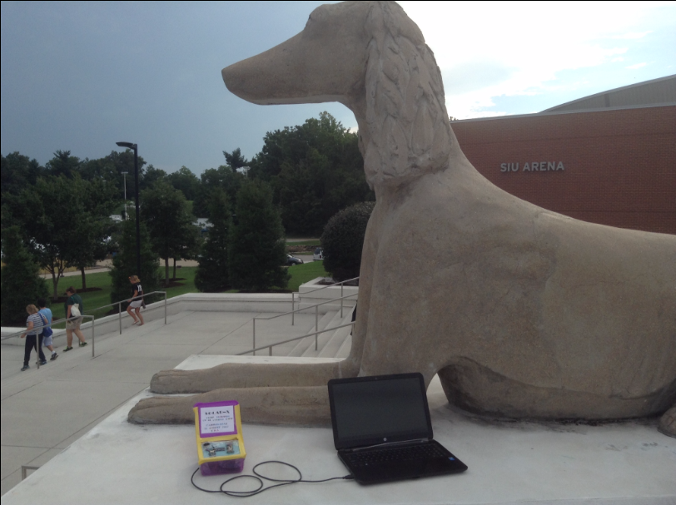
Followed by testing each Sensor, calibrating them…
At different locations!

Slide 7
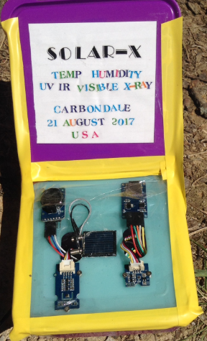
Solar – X Features
Measurements | Sensors | Units
Temperature | Grove IMU 10DOF | Centigrade
Humidity | Grove IMU 10DOF | Percentage
Pressure | Grove IMU 10DOF | Pascals
Visible Light | Si1145 | Lumens
Infrared | Si1145 | Lumens
Ultraviolet | Si1145 | UV-Index
Solar Output | Solar Cell | Volts
Data Storage | SD Card Module
Time Stamp | Real-Time Clock Module | seconds
Cost: Around $80

Slide 8
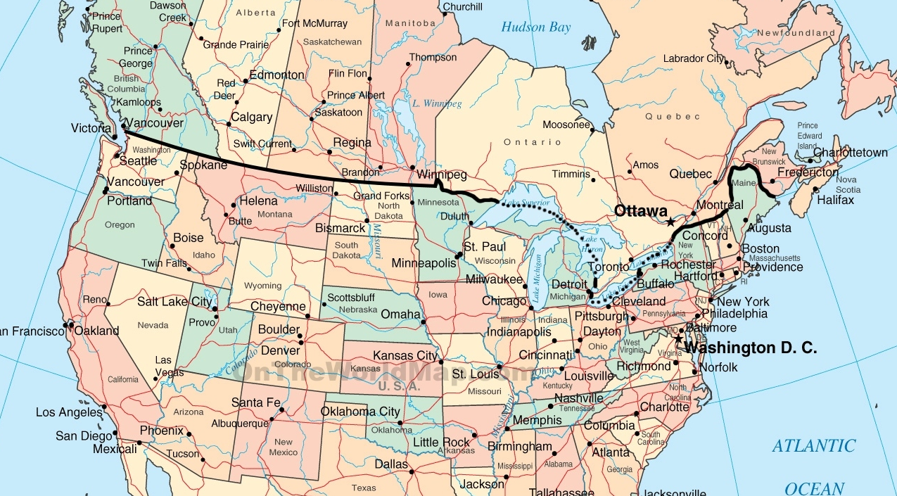
Toronto, Canada - Carbondale, Illinois (USA)
Direct Distance: 1300 Km.
We took a 8,000 km detour!
Victoria, BC
4400 km
Toronto, ON
Carbondale, IL
Sacramento, CA
9200 km
5800 km

Slide 9
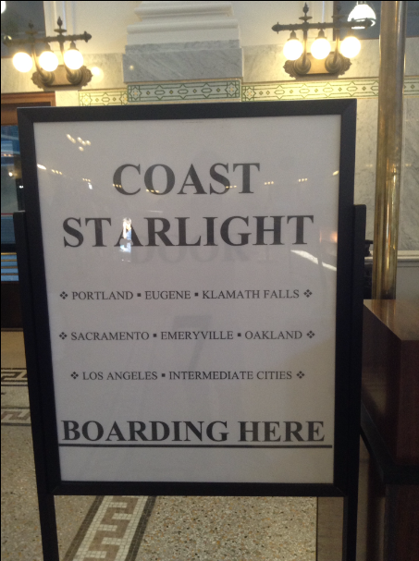
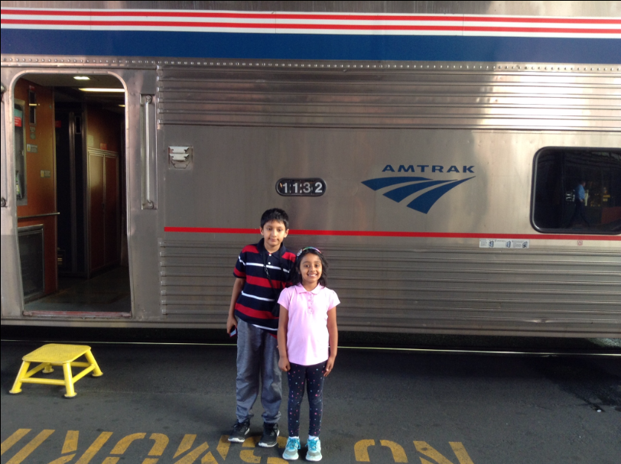
August 15, 2017: Started from Seattle on the Coast Starlight Amtrak Train to Sacramento!

Slide 10
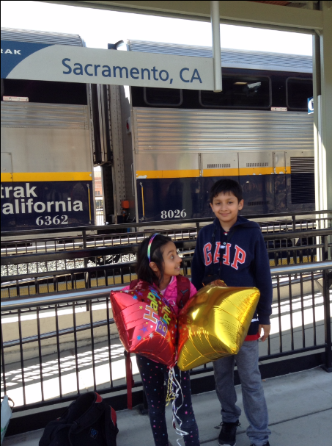
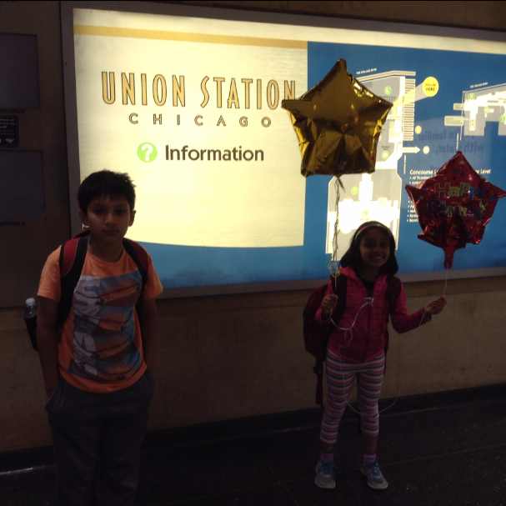
Then on California Zephyr Amtrak Train from
Sacramento to Chicago, and then to Carbondale!
The mystery of the balloons will get revealed!

Slide 11
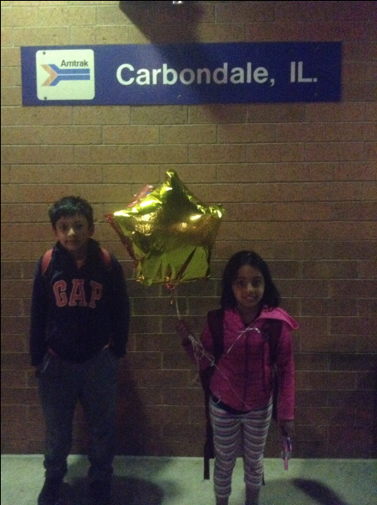
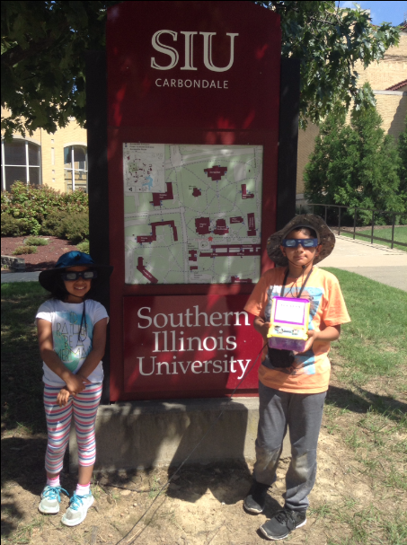
August 19, 2017: 9200 km and 4 days later. Reached Carbondale, Illinois, USA!

Slide 12
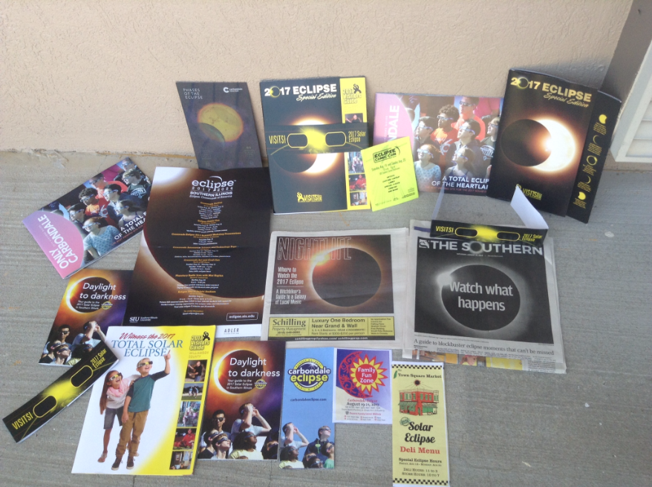
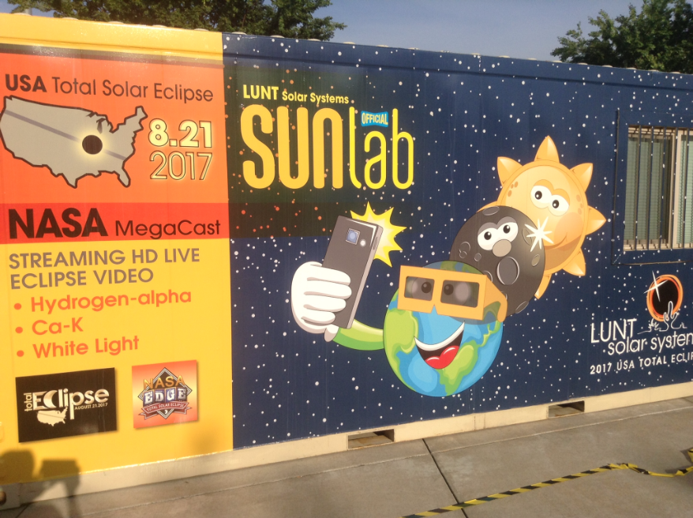
Carbondale: An Eclipse Town
Eclipse, Eclipse Everywhere

Slide 13
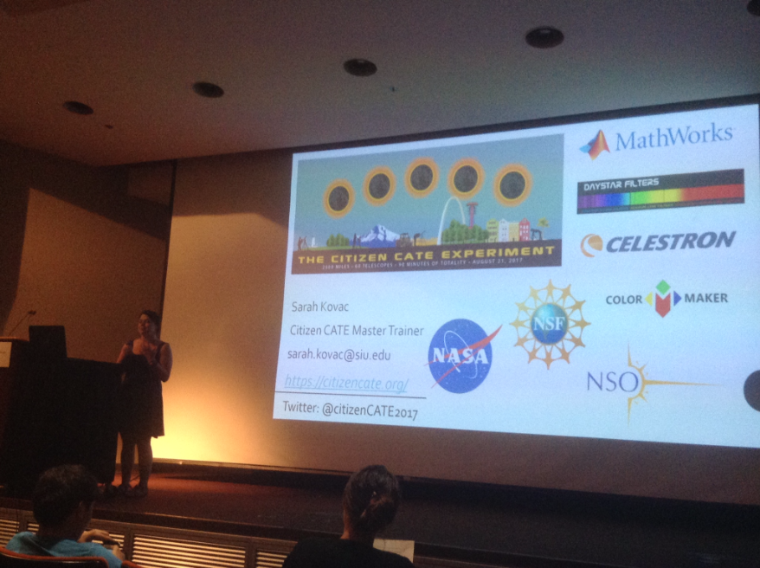
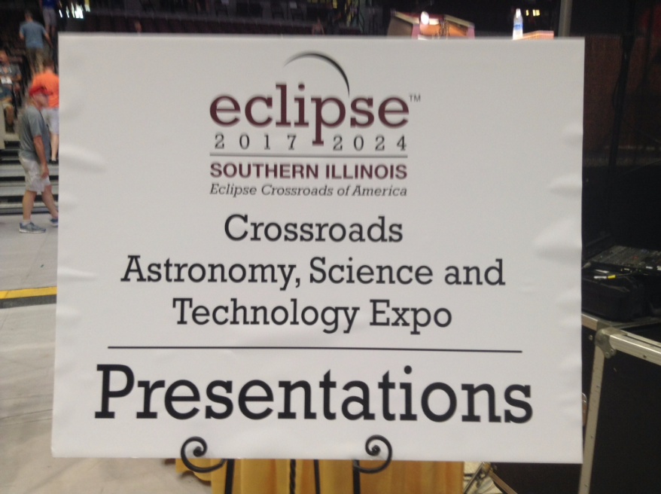
Attended Seminar about various Experiments happening during the Eclipse…..

Slide 14
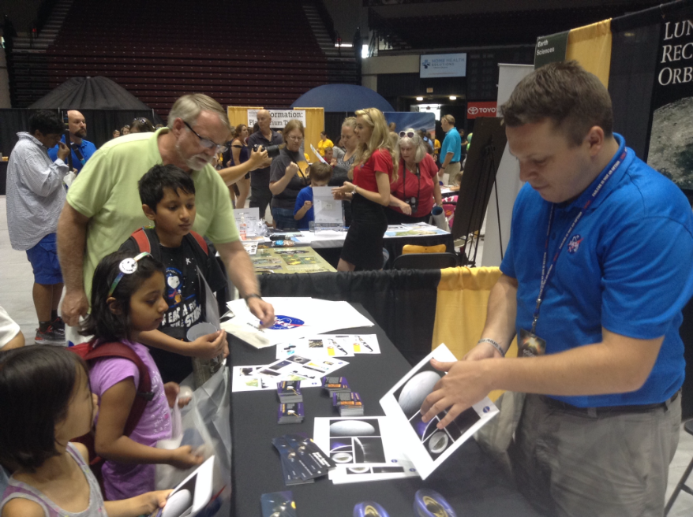
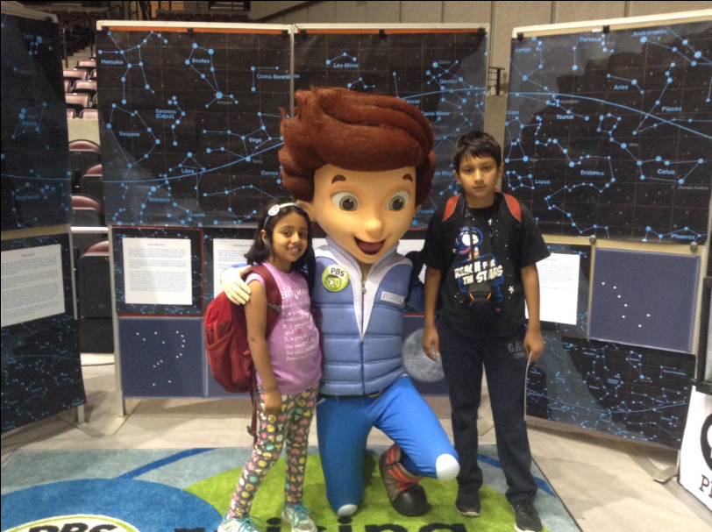
Spent lots of time at the Eclipse Expo organised by the Town at the University

Slide 15
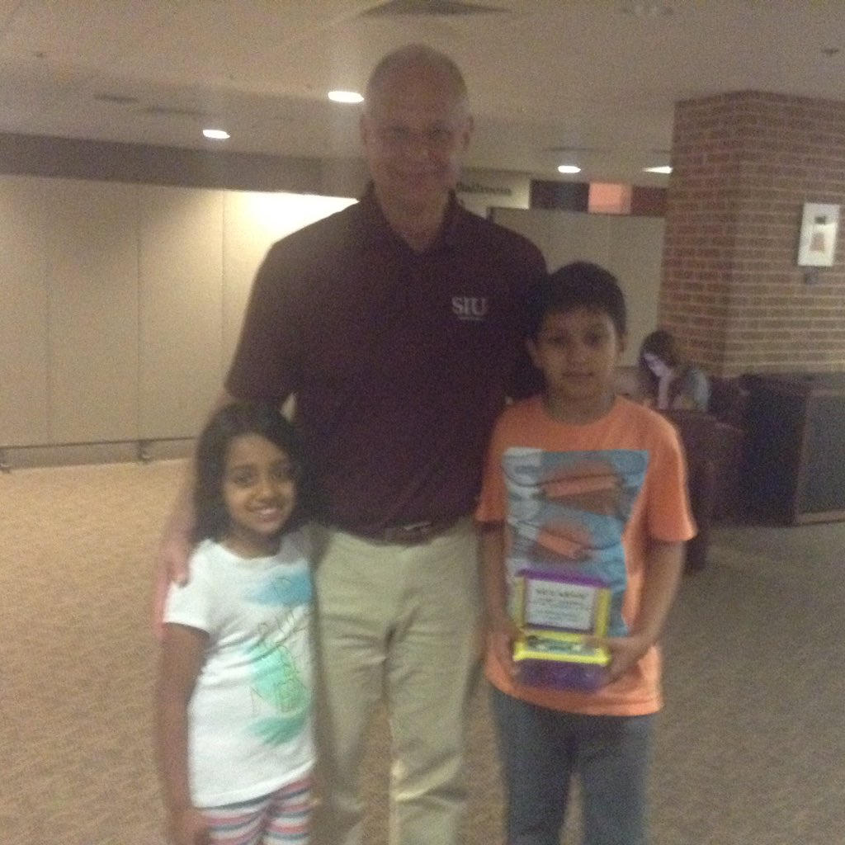
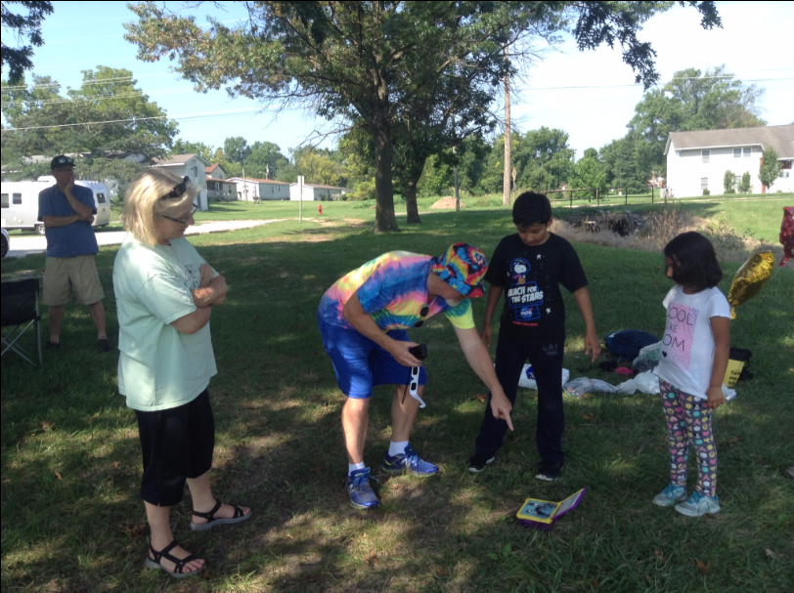
Outreach through Solar-X
With Dr. Carlo Montemagno, Chancellor of South Illinois University, Carbondale (A Canadian!)
At the site on the day of the Solar Eclipse

Slide 16
Baseline Data
Collected data through Solar-X on three days – Aug 19, Aug 20 and Aug 21 (the day of the Solar Eclipse)
Collected data one hour before the first contact until to one hour after the last contact.
Sampling Rate
Our sampling rate was every second.
All the 7 parameters (Temperature, Humidity, Pressure, Visible, UV, IR, Solar were measured every second)
We got around 22000 data lines, or 154,000 individual measurements!

Slide 17
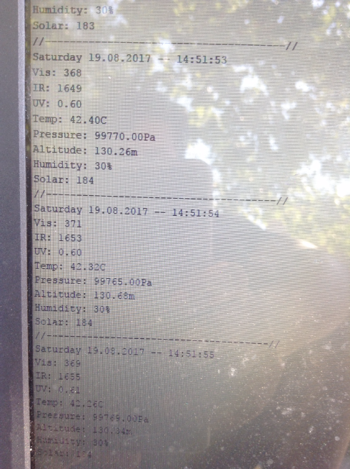
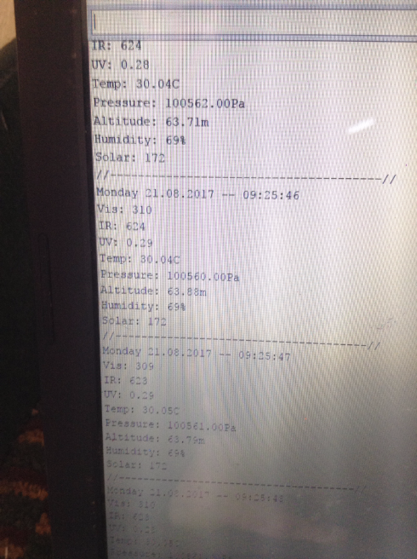
22,000 Lines of Data Collected!
Each line had data on 7 parameters = 154,000 data points!
2 Days before the Eclipse
On the Eclipse Day

Slide 18
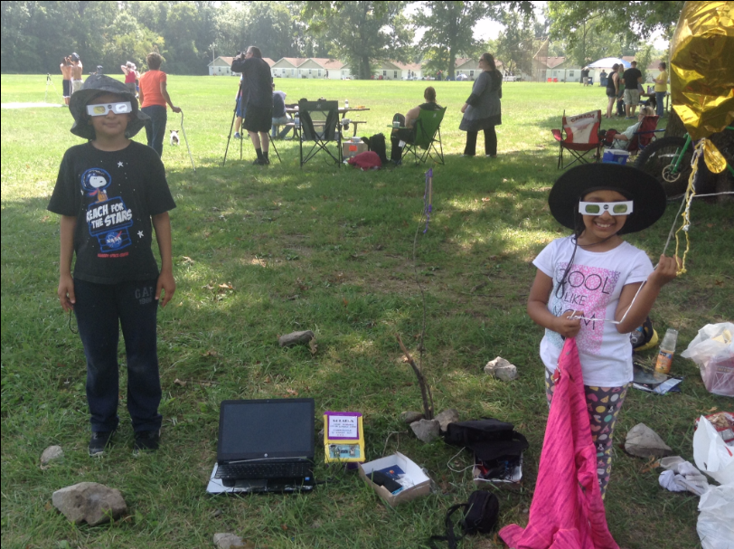
Ready for the Big Day: Away from the Big Crowds!

Slide 19
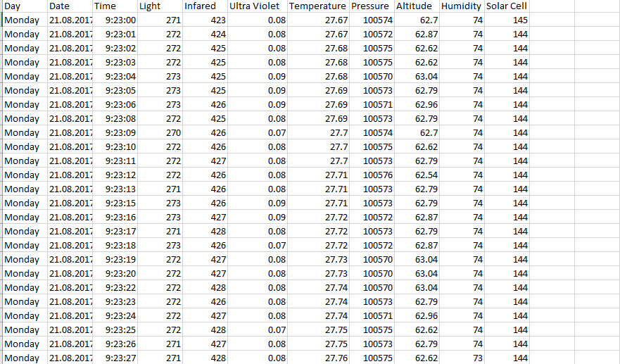
Snapshot of our Raw Data from Solar-X

Slide 20
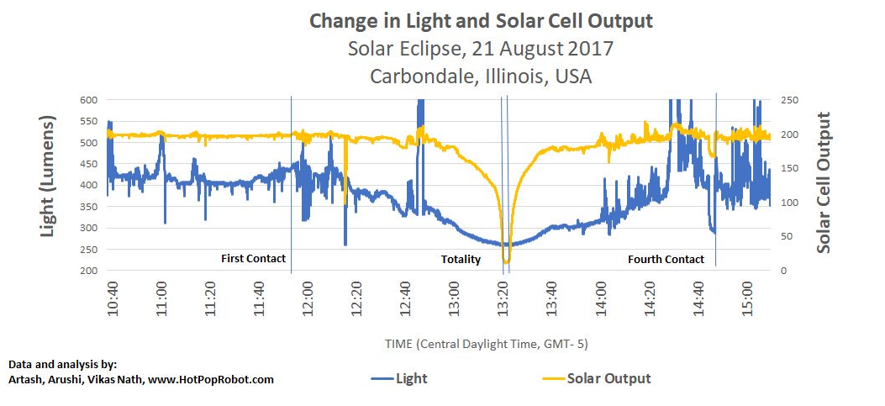
Visible Light dipped by 35% (400 lumens to 260 lumen)
Solar Output by 95% (from Solar Cell)

Slide 21
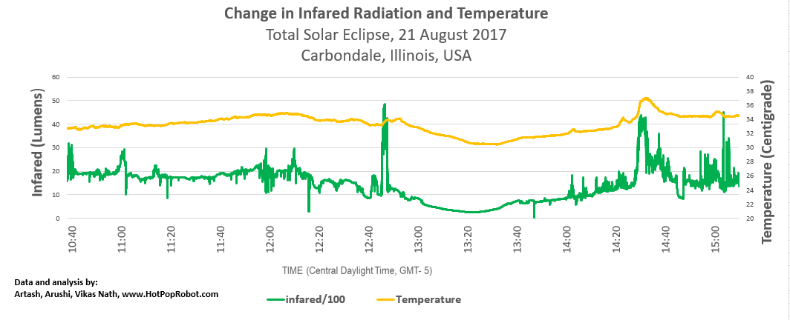
Temperature dropped from 34 degrees to 30.5 degrees (13%)
Infrared radiation by over 85%

Slide 22
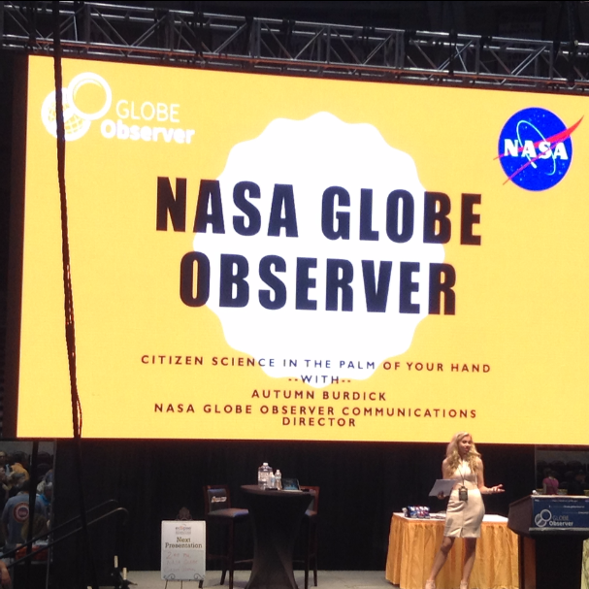
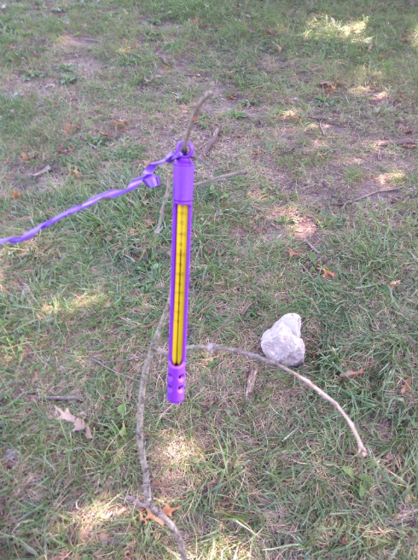
Data Gathered with the
NASA Globe App
Temperature Readings
(30 readings – every 10 minutes)
Cloud Cover
(15 readings, every 20 minutes)

Slide 23
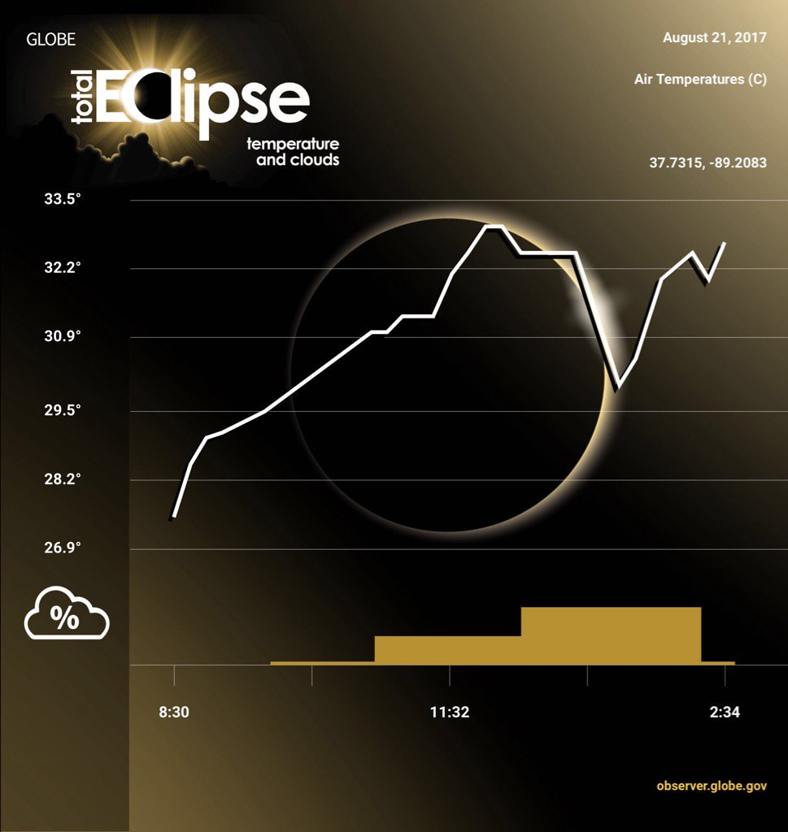
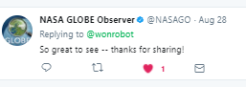
Graph of Data Submitted to the NASA Globe App

Slide 24
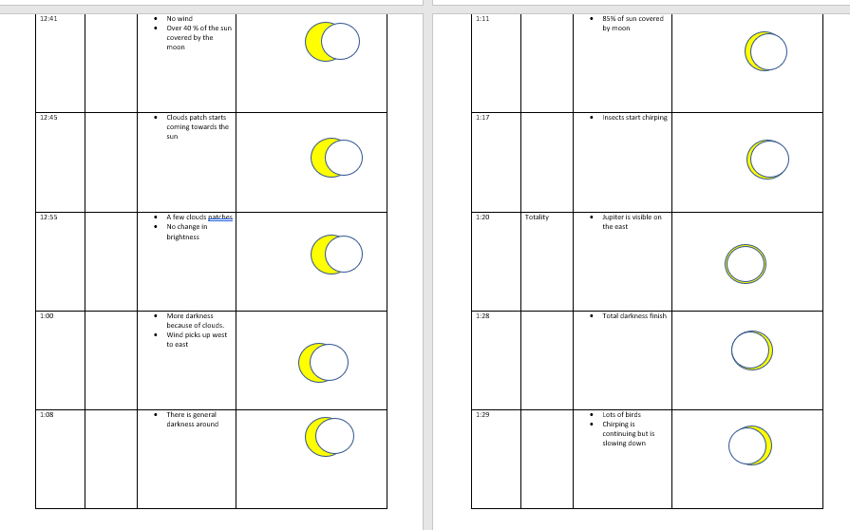
Visual Observations taken during the Eclipse

Slide 25
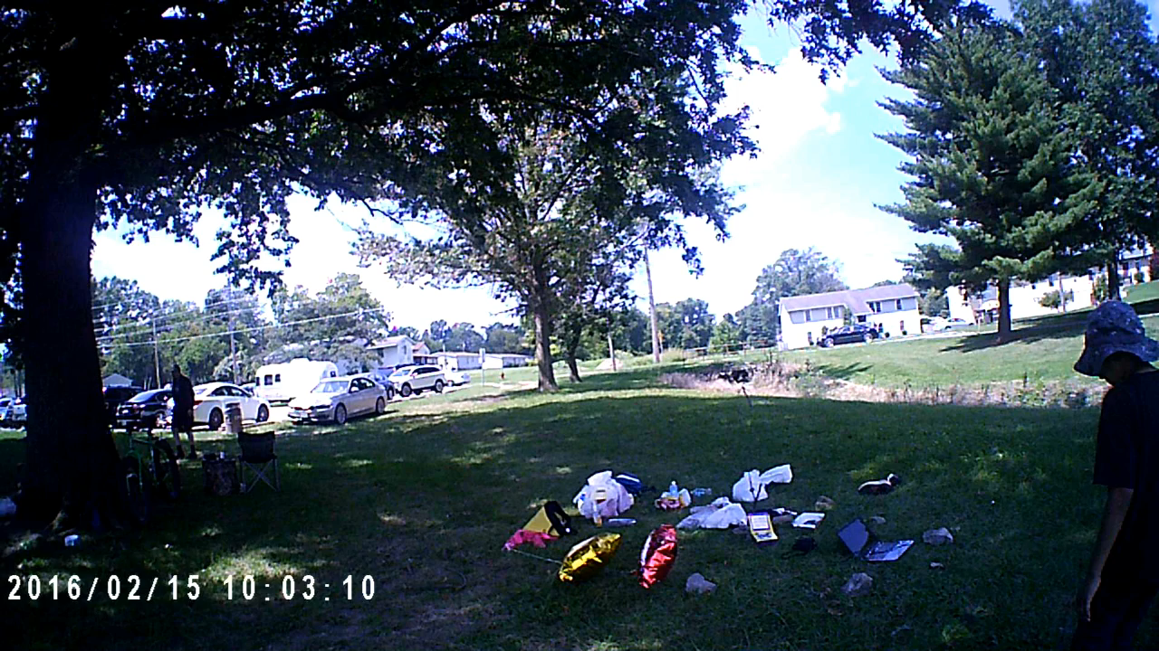
Video: Solar-X Deployment on day of the Solar Eclipse

Slide 26
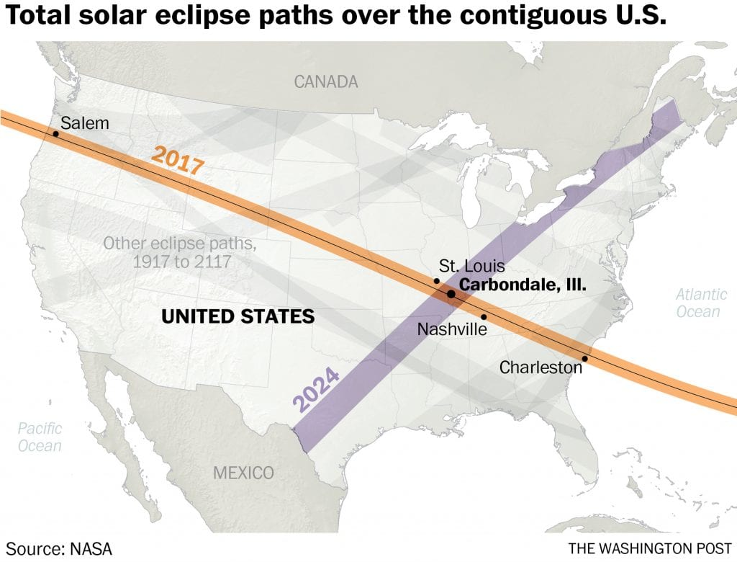
2024 Solar Eclipse: Will be Carbondale again!
April 8, 2024: Carbondale will experience more than 4 minutes of totality.

Slide 27
The Solar-X Project: Measuring Solar Radiation during the Total Solar Eclipse
Artash Nath
Arushi Nath
Vikas Nath
www.HotPopRobot.com
@wonrobot
Vikas.nath@gmail.com

