Slide 1
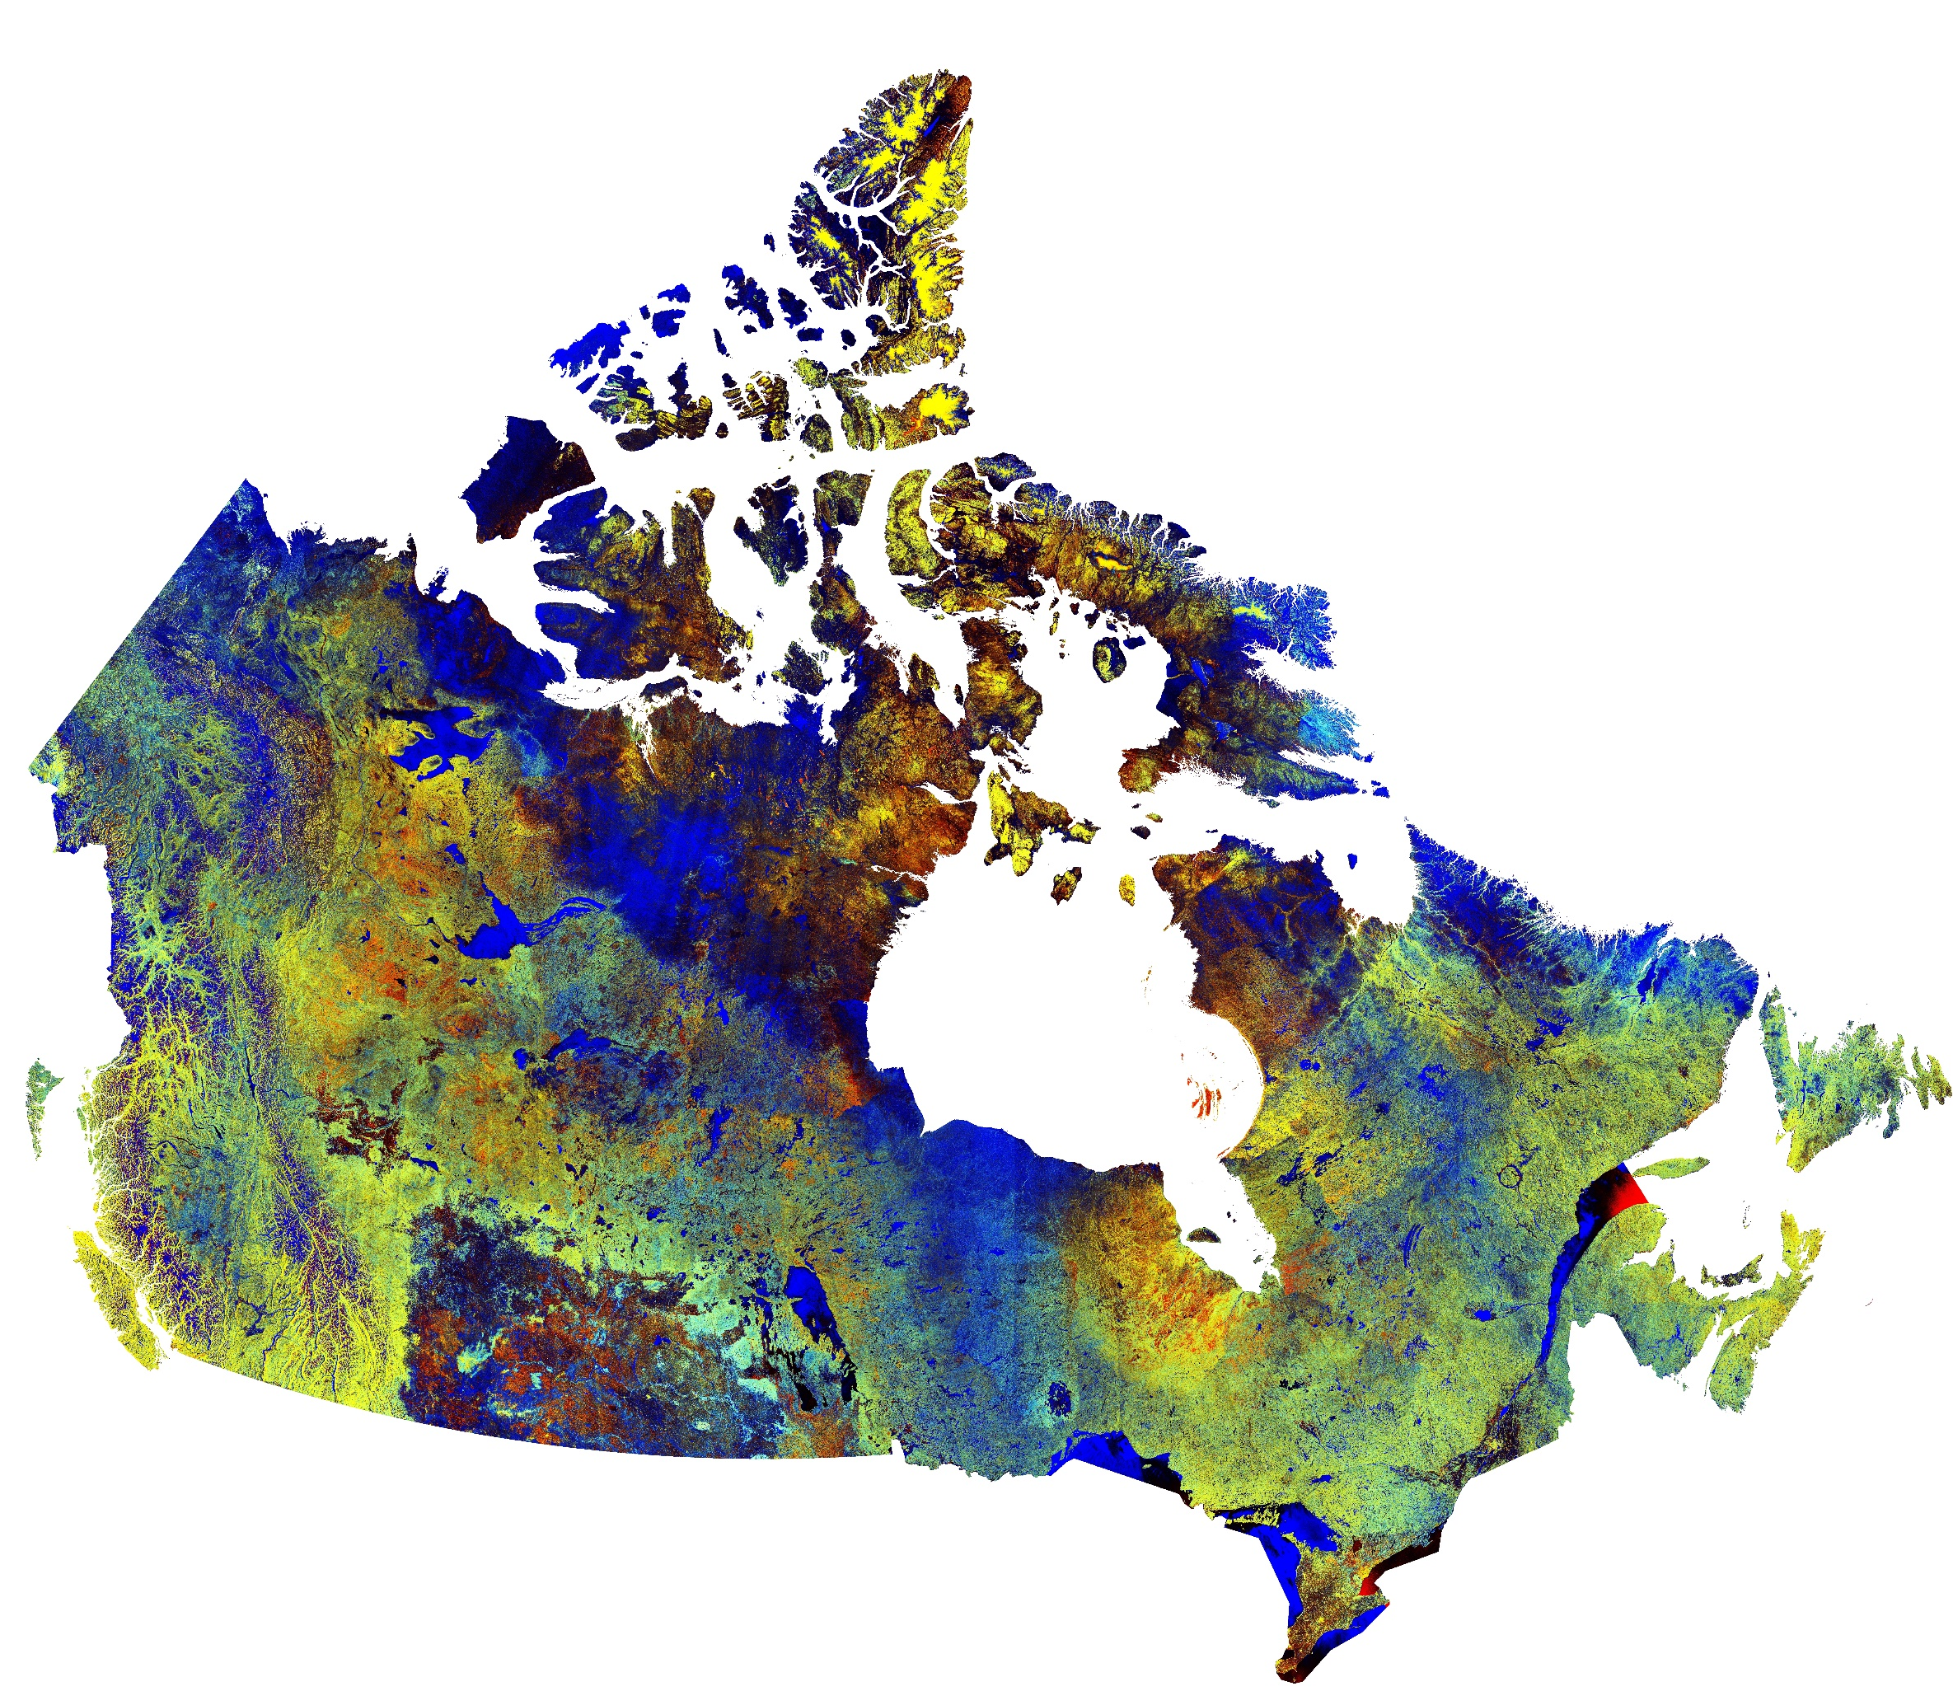

Yes I Can
Oui Je Peux
Winner, Canadian Space Agency Award
Space Apps Challenge 2017
Arushi Nath
Vikas Nath, Artash Nath
@wonrobot
Presenting at the Canadian Space Agency (CSA) Headquarters, 4 July 2017
John H. Chapman Space Centre, Saint-Hubert, Quebec

Slide 2
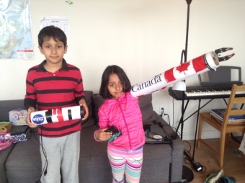

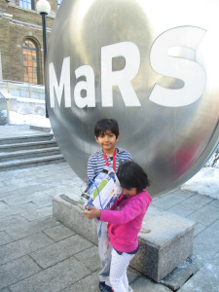
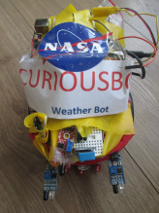
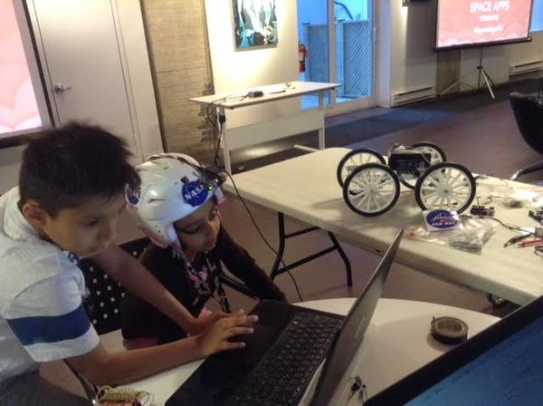
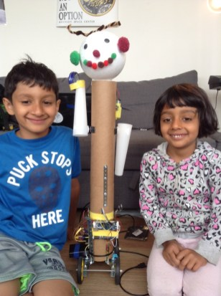
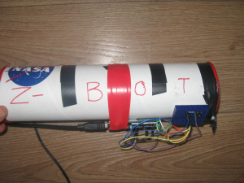
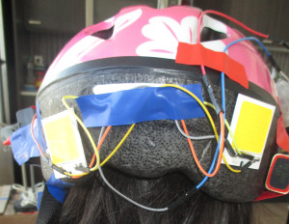
We Are Makers! Made over 20 Space Projects
Canada Arm
Saturn V Rocket
Galactic Bot
Curious Bot
Gesture Sensing Helmet
MARS Rover
Z-Bot for Mars
Astro Health

Slide 3
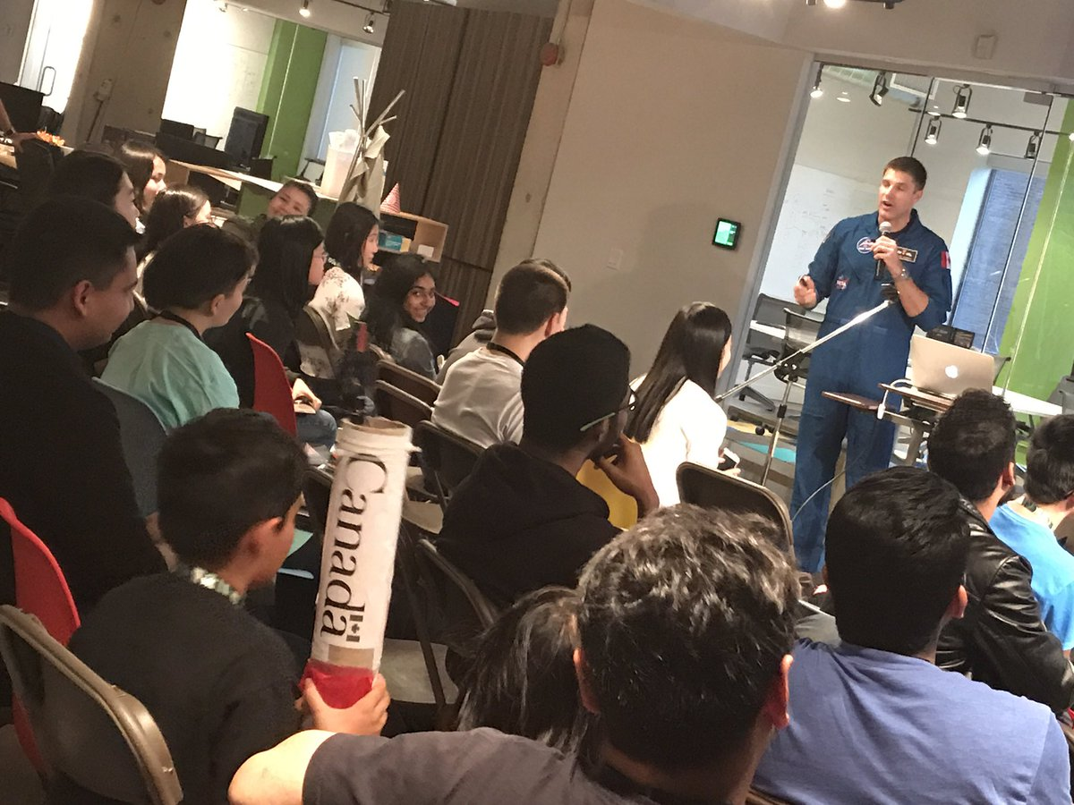
28 April 2017: Space Apps Challenge, Toronto
If we were to stop Space for 10 minutes we will have a big problem!
Canadian Astronaut Jeremy Hansen
TWG Office, Toronto

Slide 4
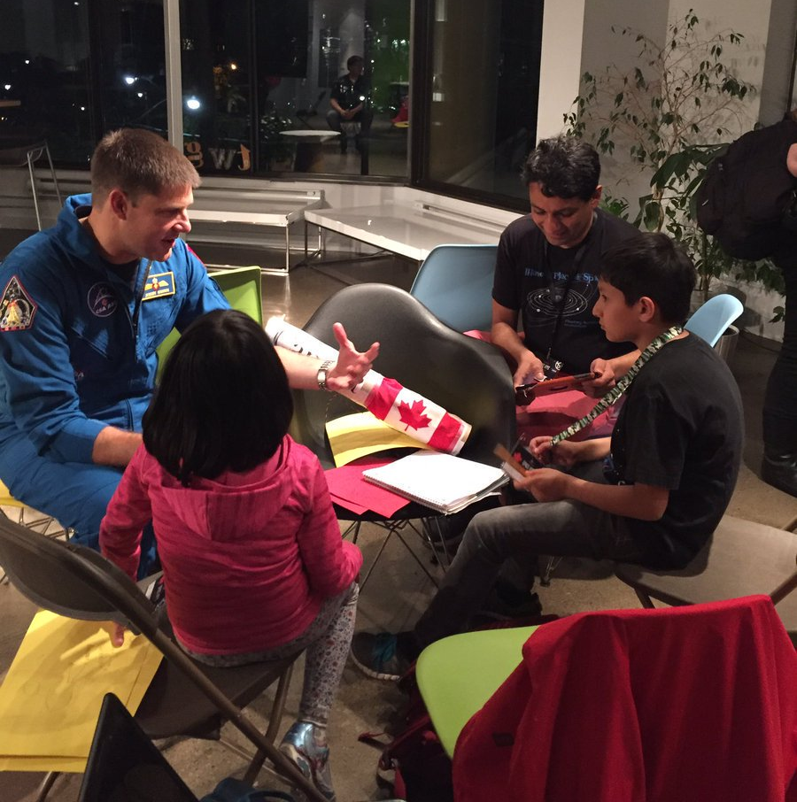
So I thought what problems we will have?

Slide 5
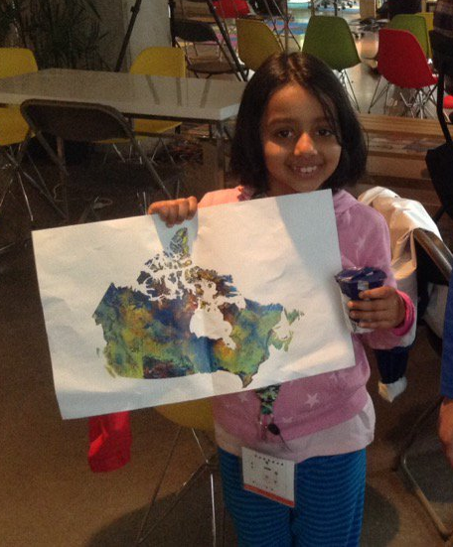
I went to the Toronto Reference Library.
Got a big print out of the image of Canada from the Canadian Satellite RadarSat-2

Slide 6
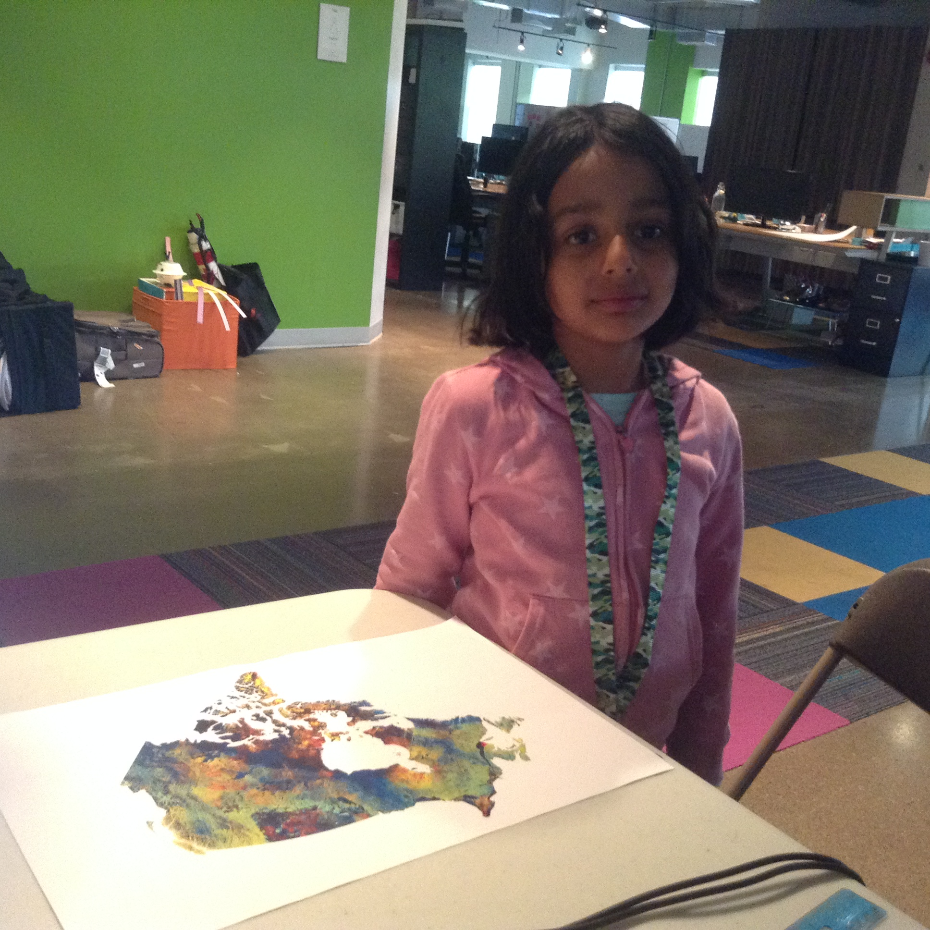
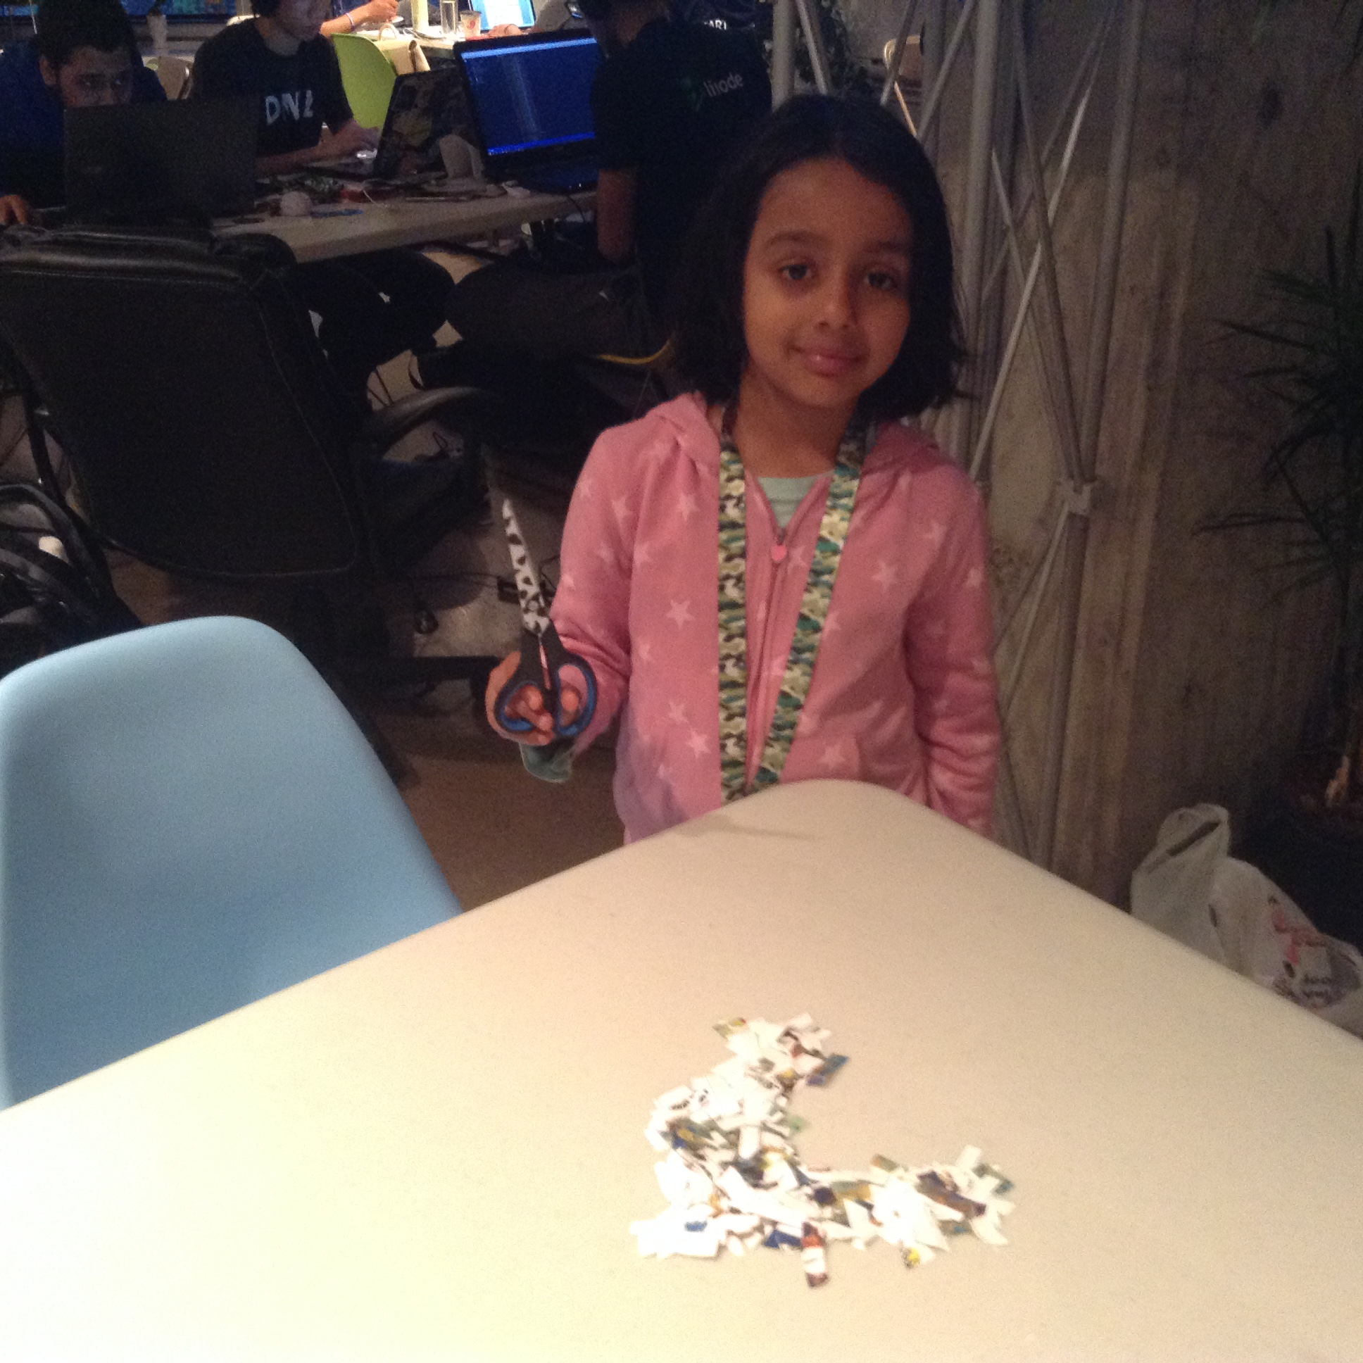
Processing the Canadian Satellite RadarSat -2 Data

Slide 7
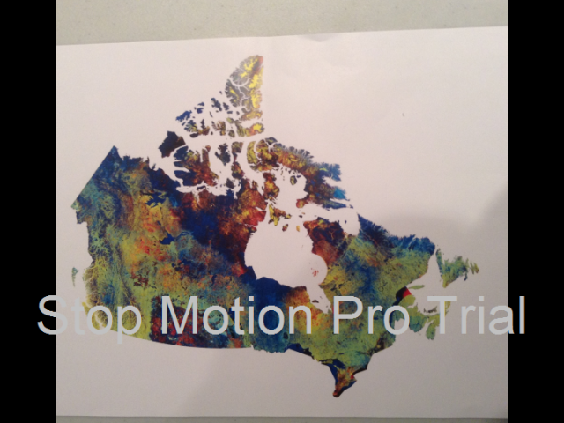
Data Processing Animation

Slide 8
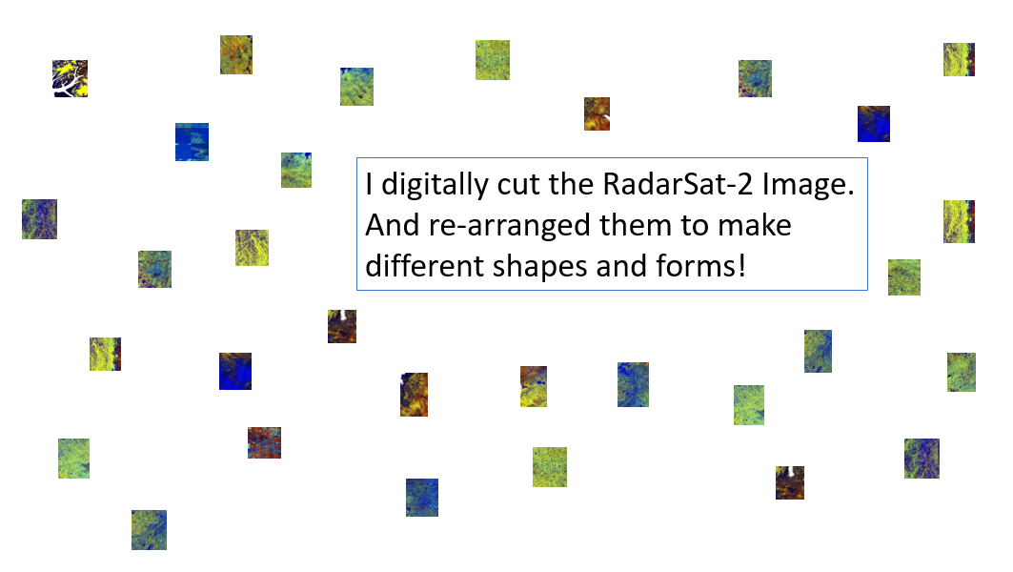

Slide 9

Space makes our phones work!

Slide 10

Space makes the GPS work.

Slide 11
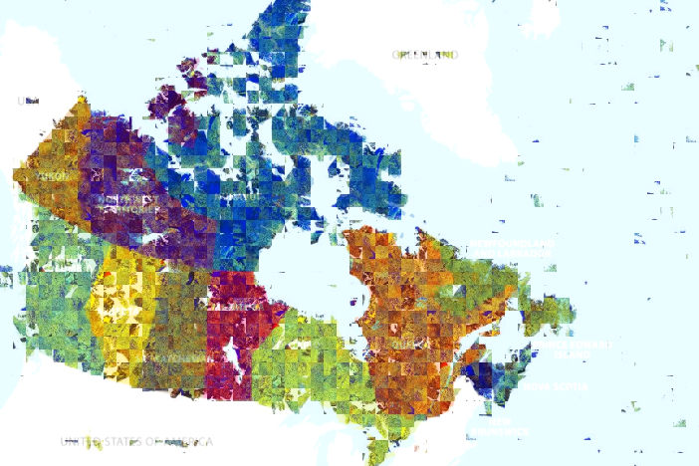
Space brings Canada together!

Slide 12
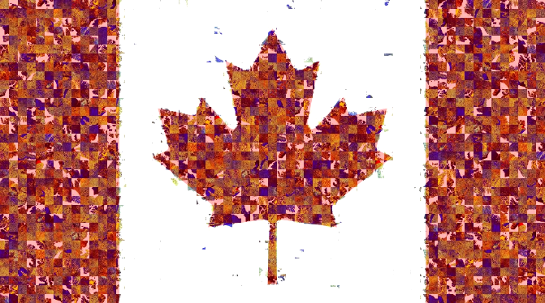
Space makes us Canadians!

Slide 13

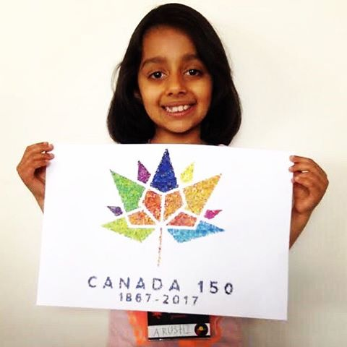
Arushi Nath @wonrobot

