Slide 1
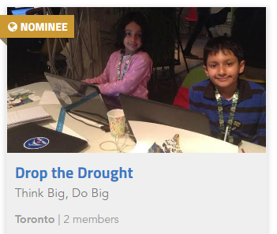

Maker Families:
Building Together on Space, Science, and Technology
Artash Nath
Arushi Nath
Vikas Nath
HotPopRobot.com
@wonrobot
International Space Development Conference, St. Louis, USA, 25-29 May 2017

Slide 2

We go to the moon!
Bringing Discussions on Space and Science in our Everyday Conversation
Apollo 11 / Saturn V Launch Model

Slide 3
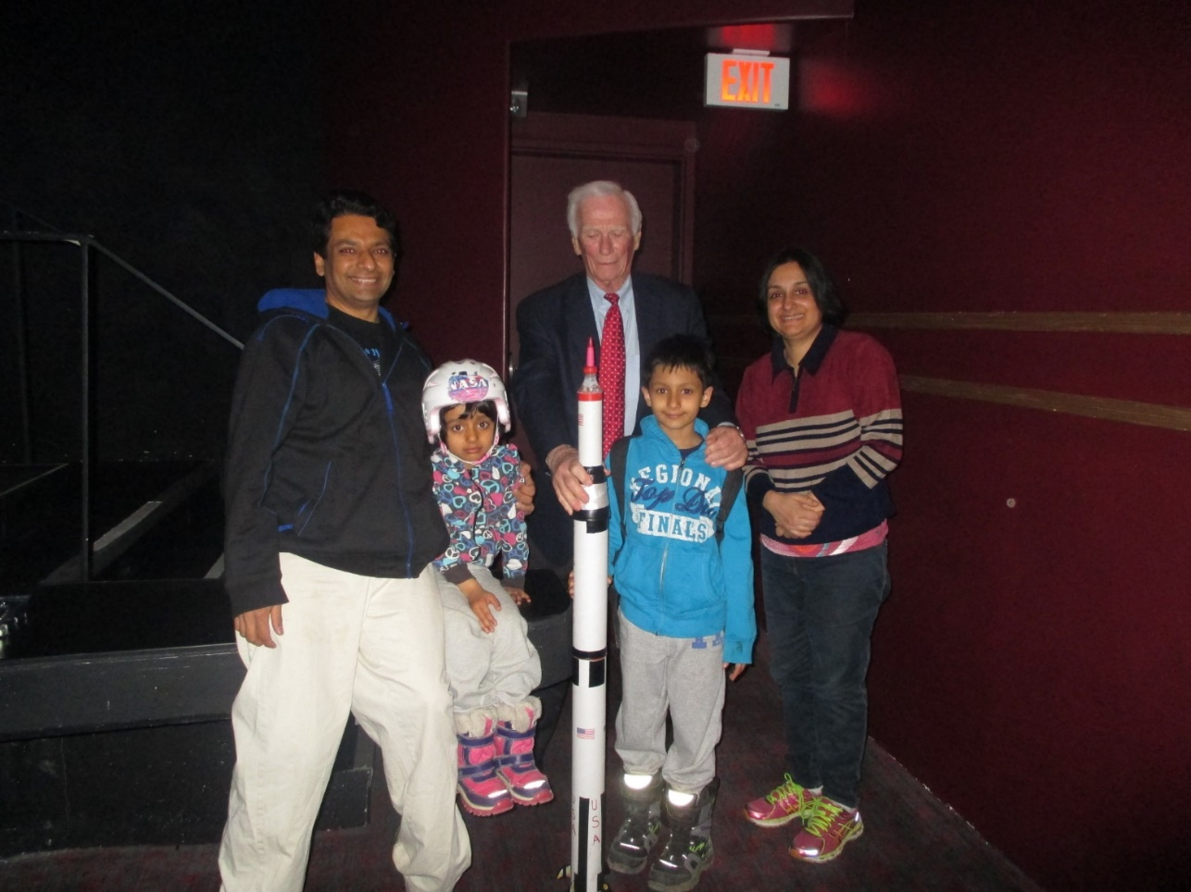
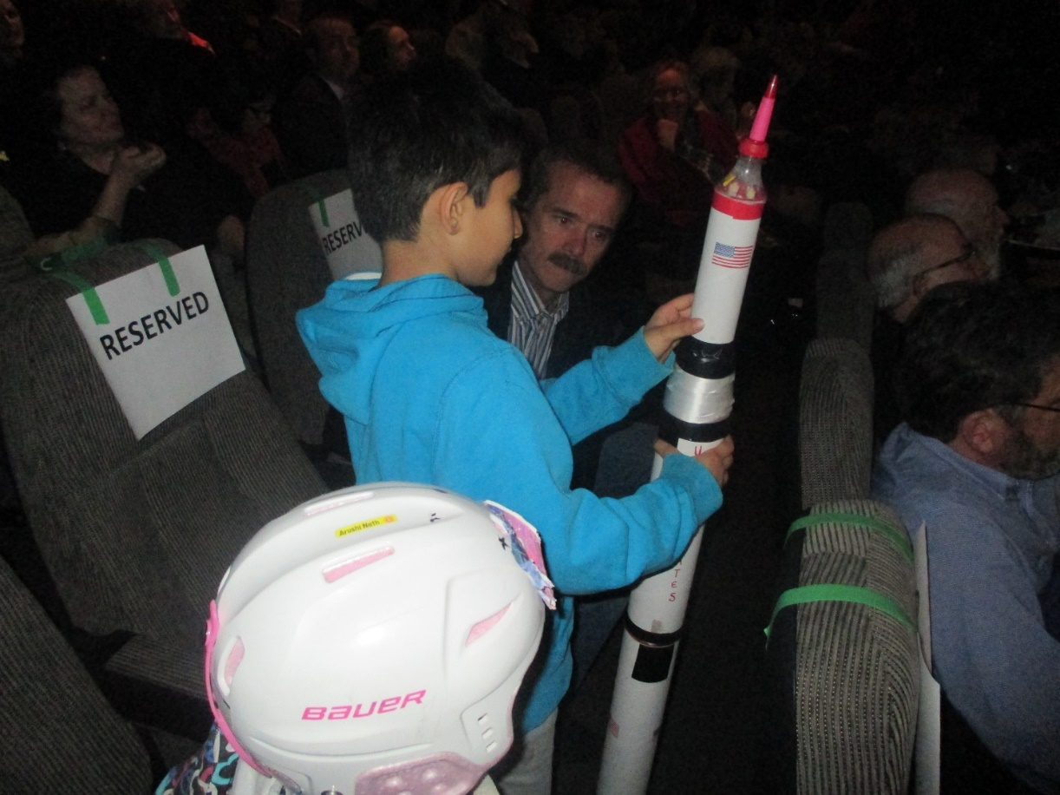
With Gene Cernan, Apollo XVII Astronaut
The Last Man on the Moon
With Canadian Astronaut Chris Hadfield

Slide 4
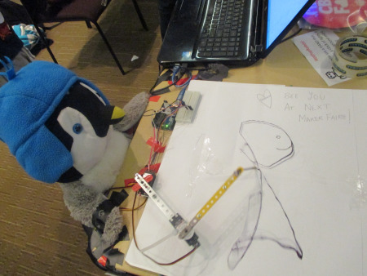
Hacking toys with motors and microprocessors
Pengy the Drawing Robot
Presented at MakerFaire Toronto 2015!

Slide 5
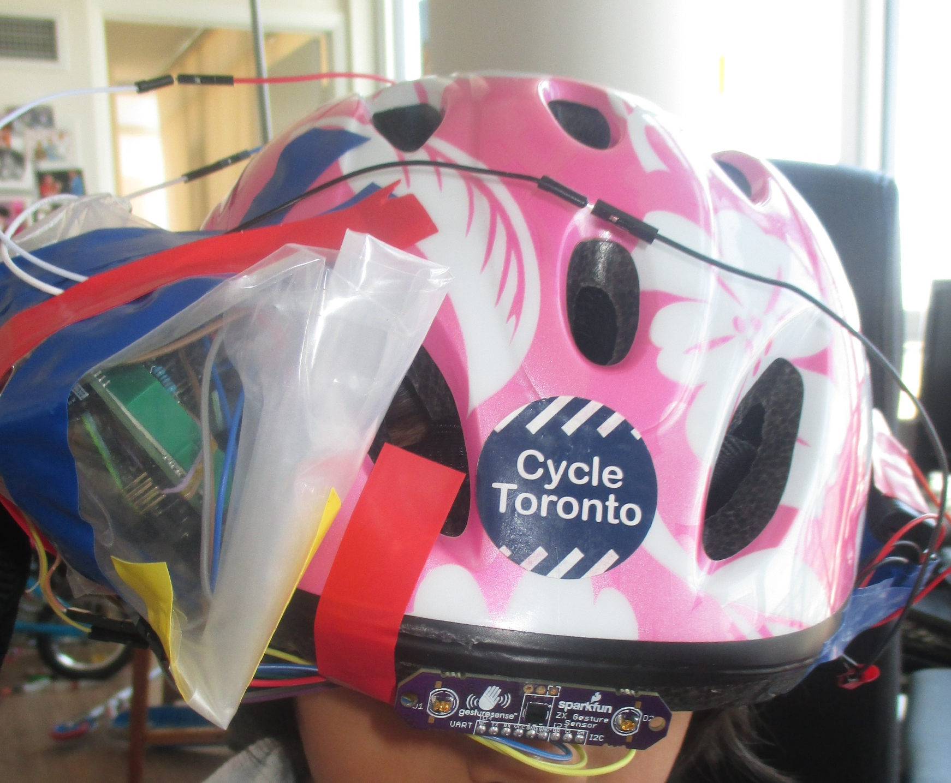
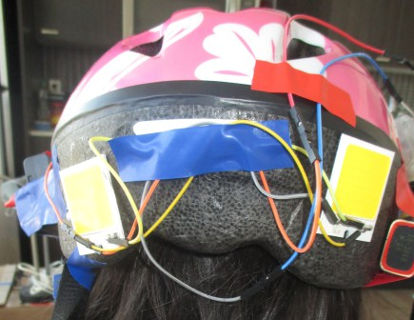
Integrating making with your daily activities
Gesture Sensing Helmet for Cyclists
Presented at Hack n’ Talk 2016

Slide 6
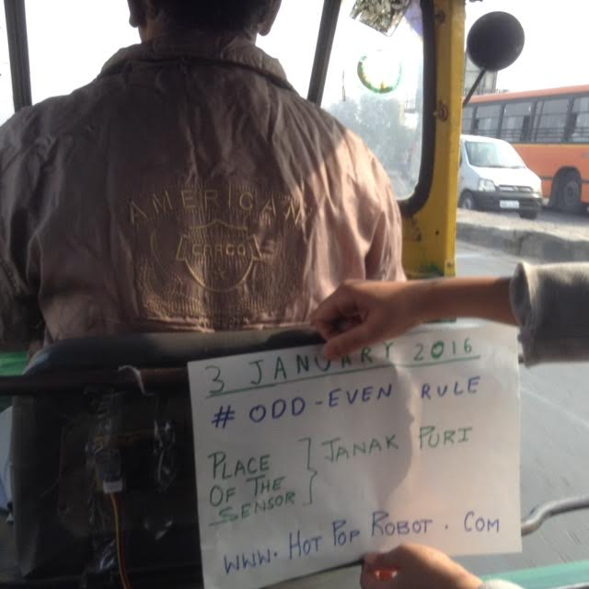
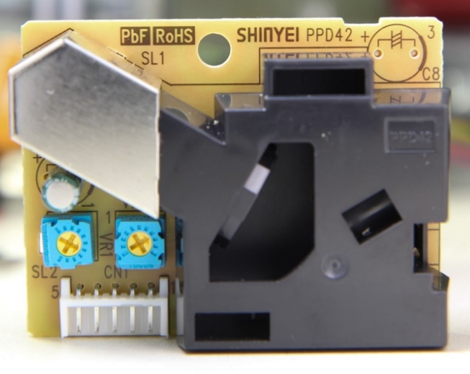
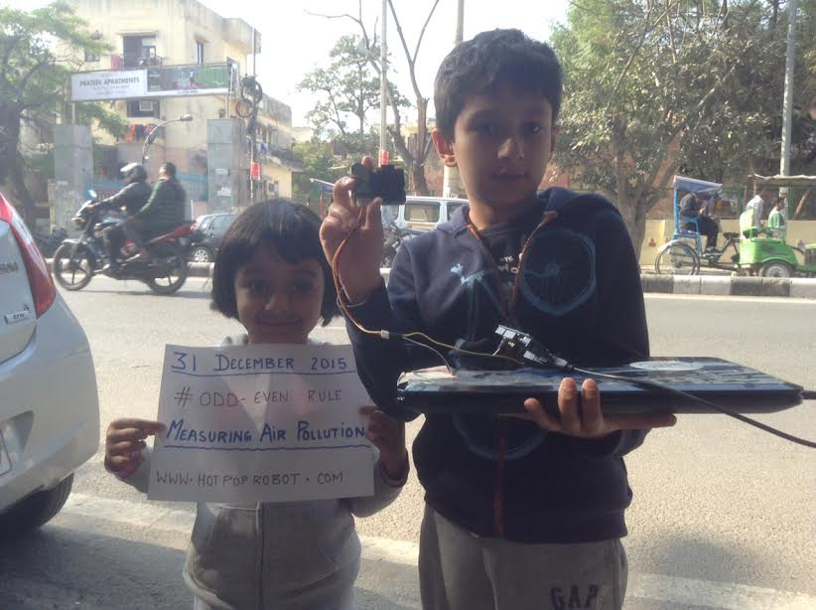
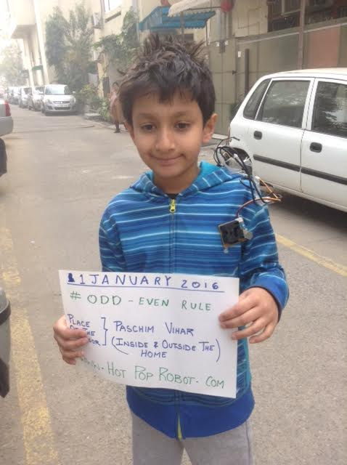
Integrating making with society around Us
Pollution Sensor built using Arduino, Optical Dust Sensor and used to calculate pollution levels in 2016

Slide 7
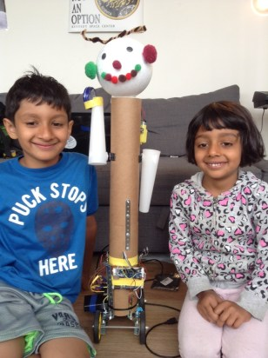
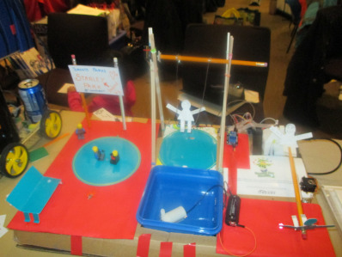
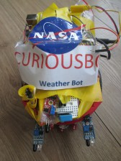
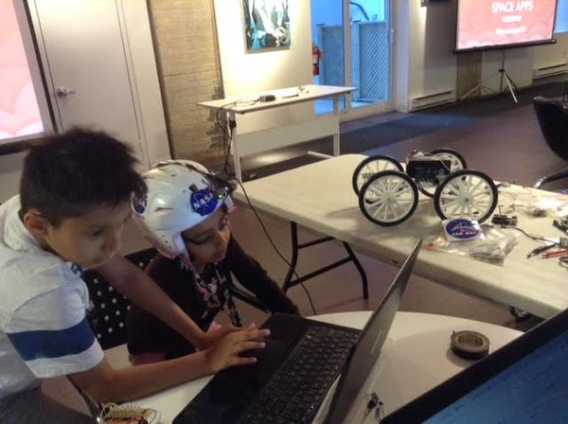
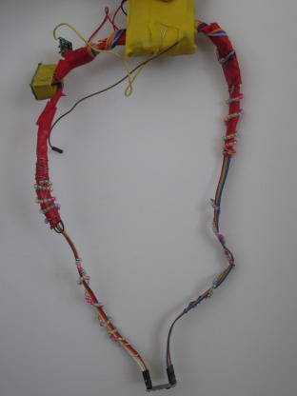
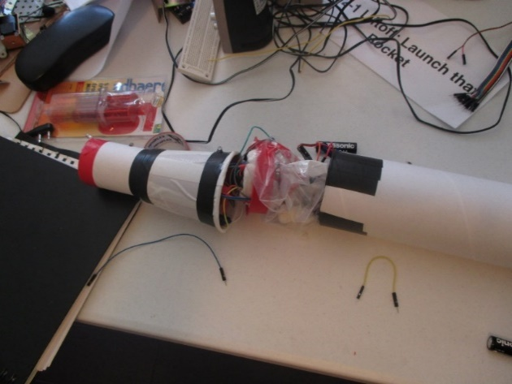
Some of our recent creations!

Slide 8
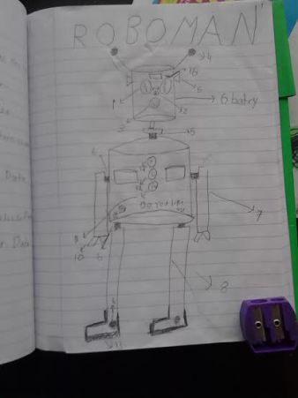
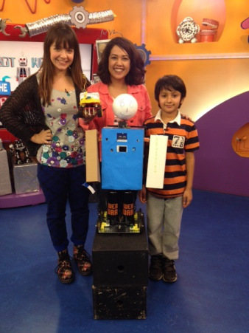
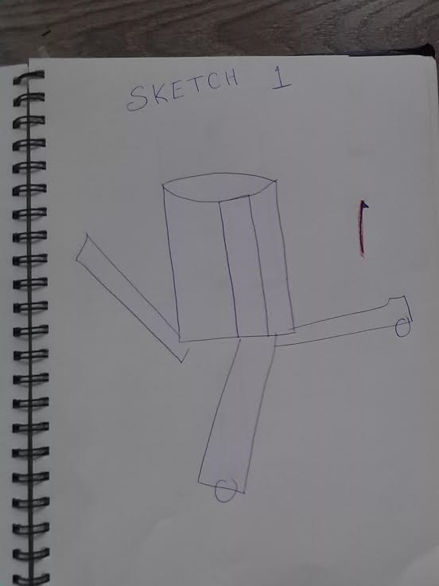
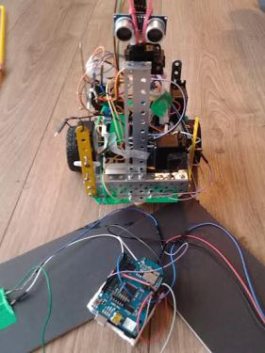
Making starts from a Dream! Followed by Paper and Designing.

Slide 9
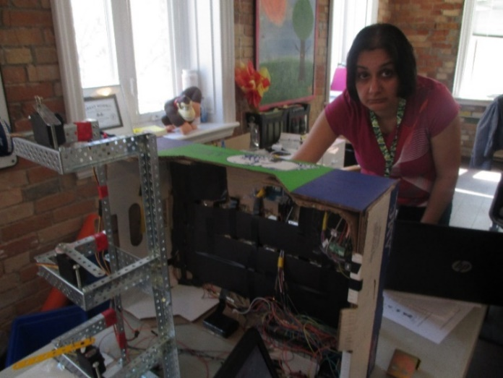
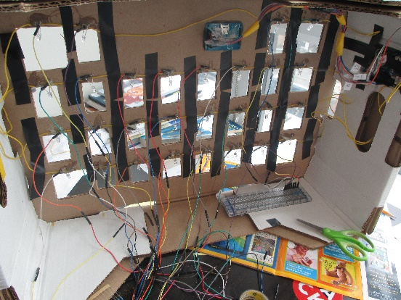
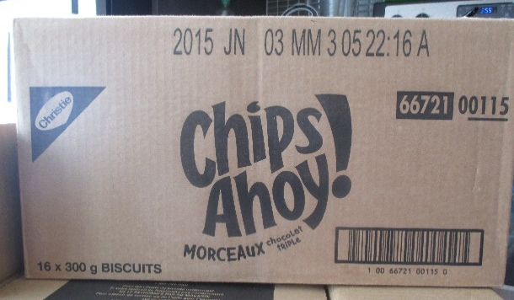
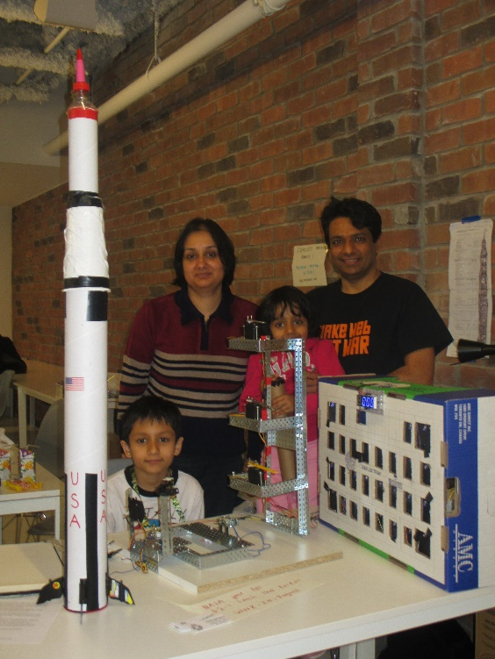
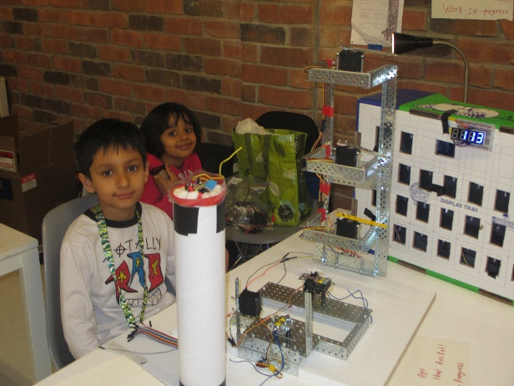
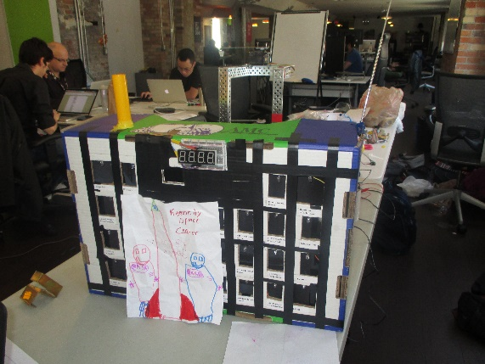
And Making requires Cardboard boxes!

Slide 10
How to encourage Next Gen?
Making starts at home
Encourage Questions : “Why”, “What”, “How” ……
Learn to say “Let us find out”
Give freedom in making - to bring out creativity
Build together!

Slide 11
When looking up at the Night Sky
Kids are always full of questions:
How hot the stars are?
How old the stars are?
What stars are made of?
Learning by saying “Let us find out”

Slide 12
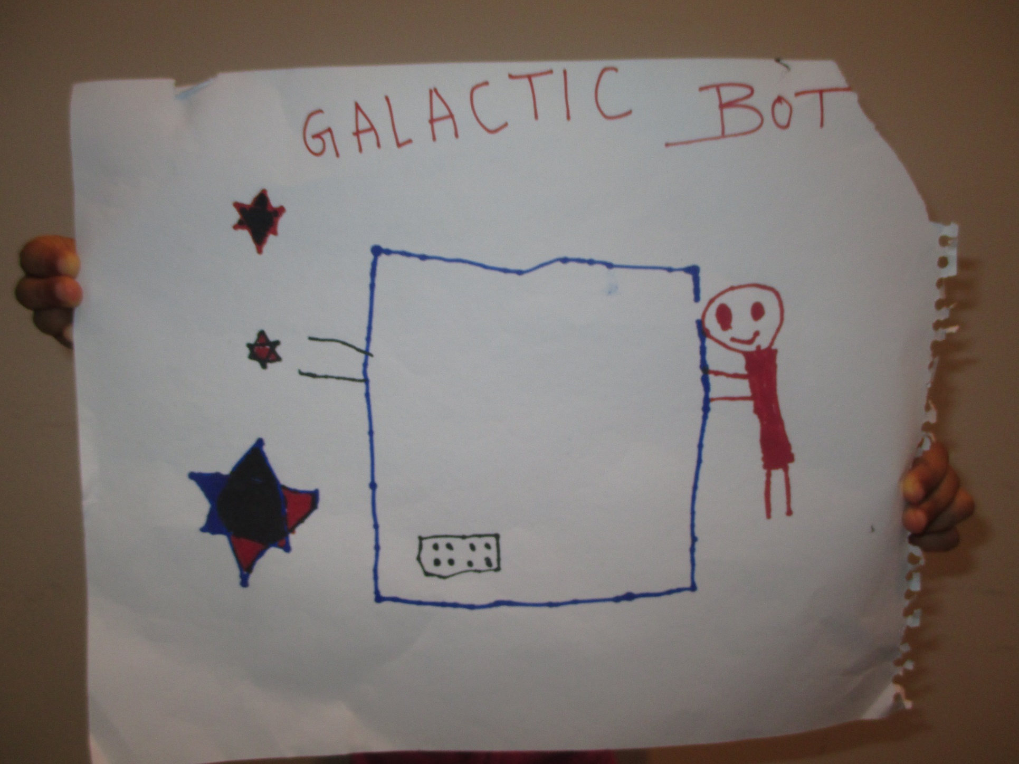
We Dreamt!

Slide 13
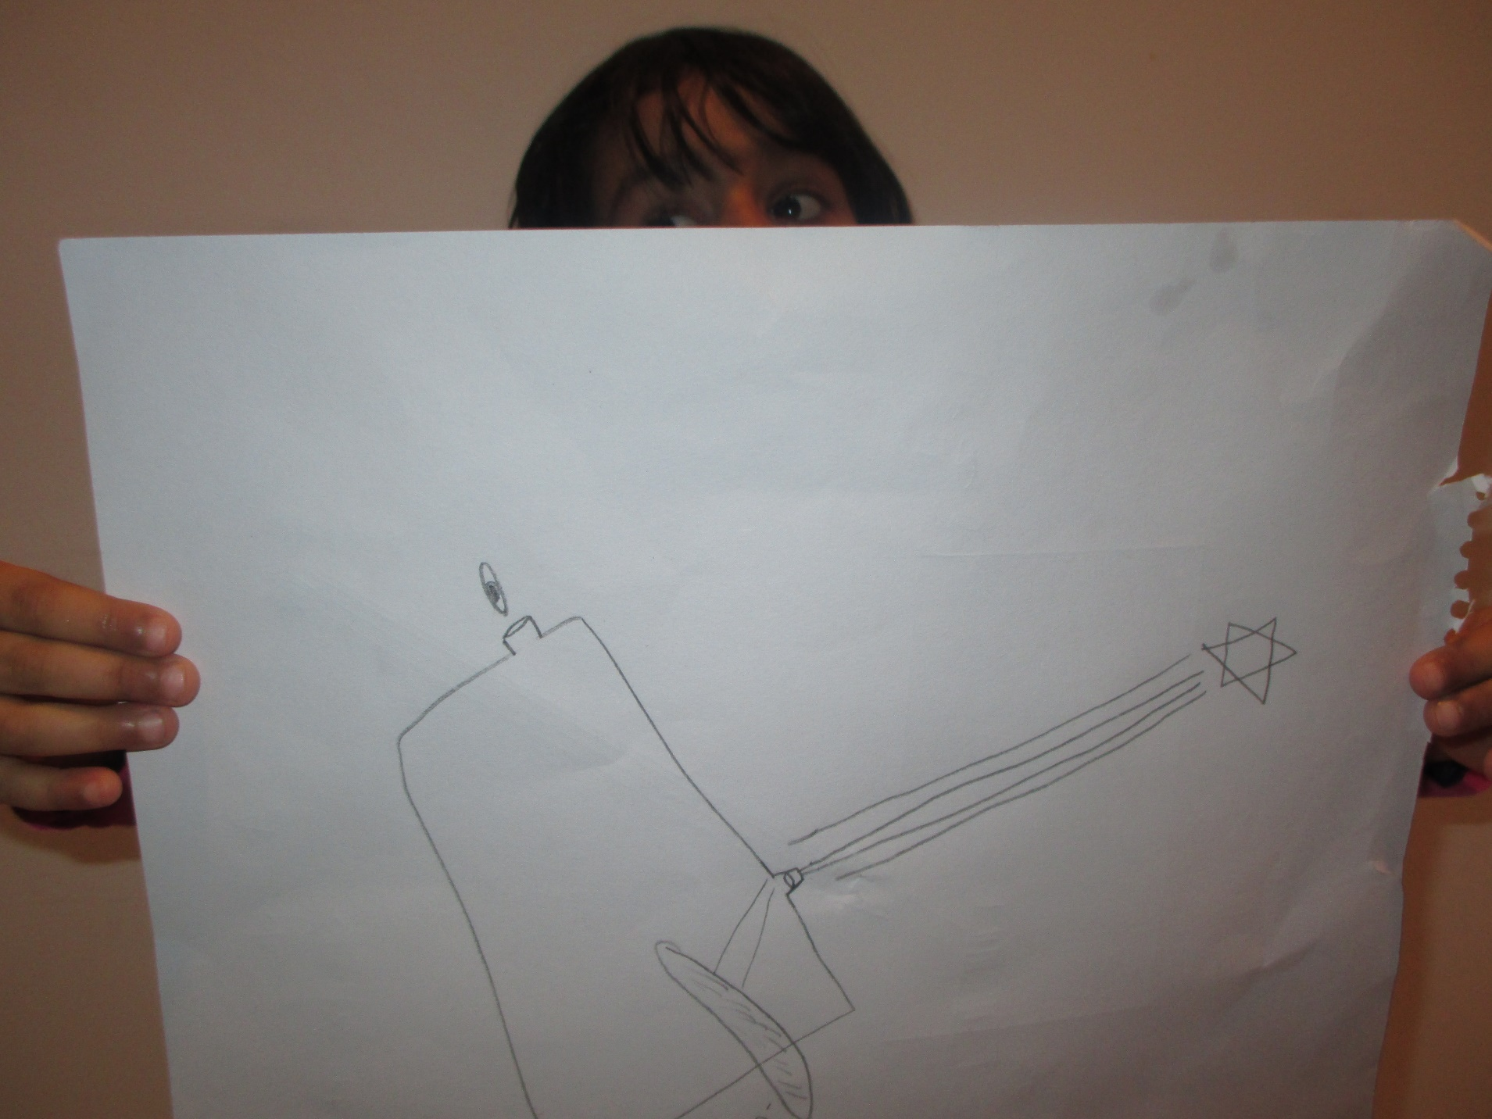
We planned!

Slide 14
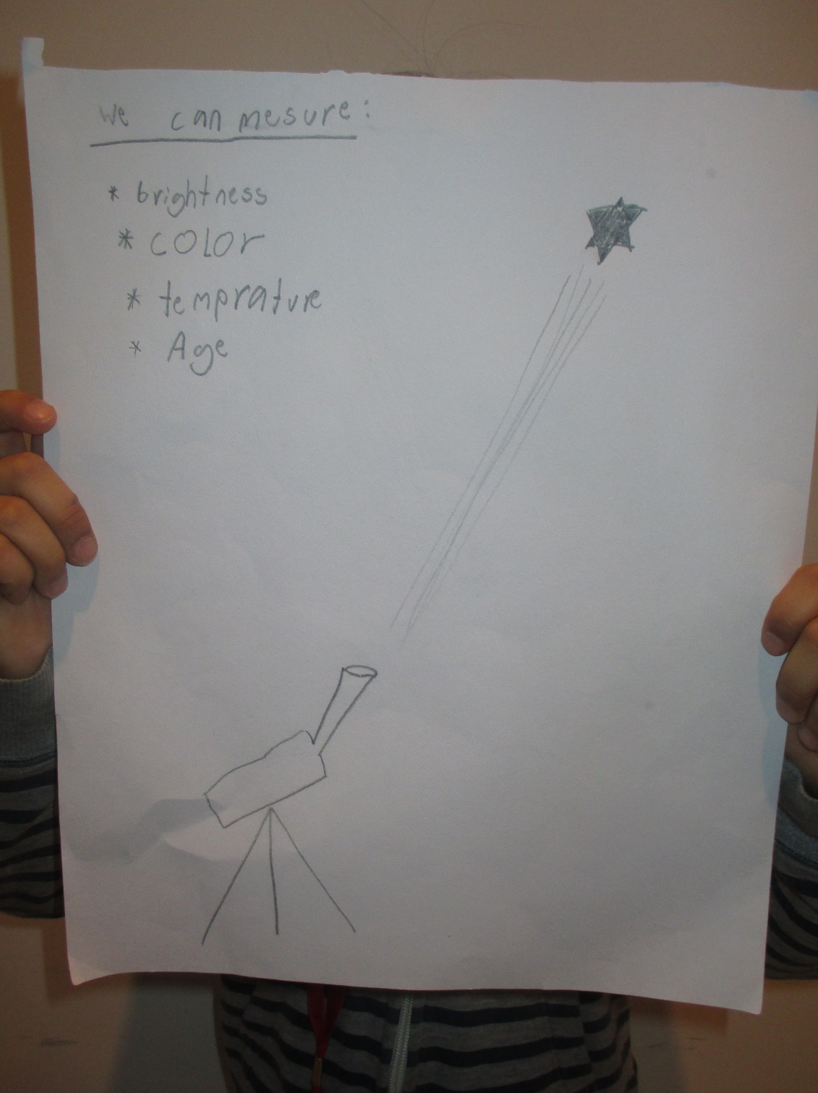
We got better in planning!

Slide 15
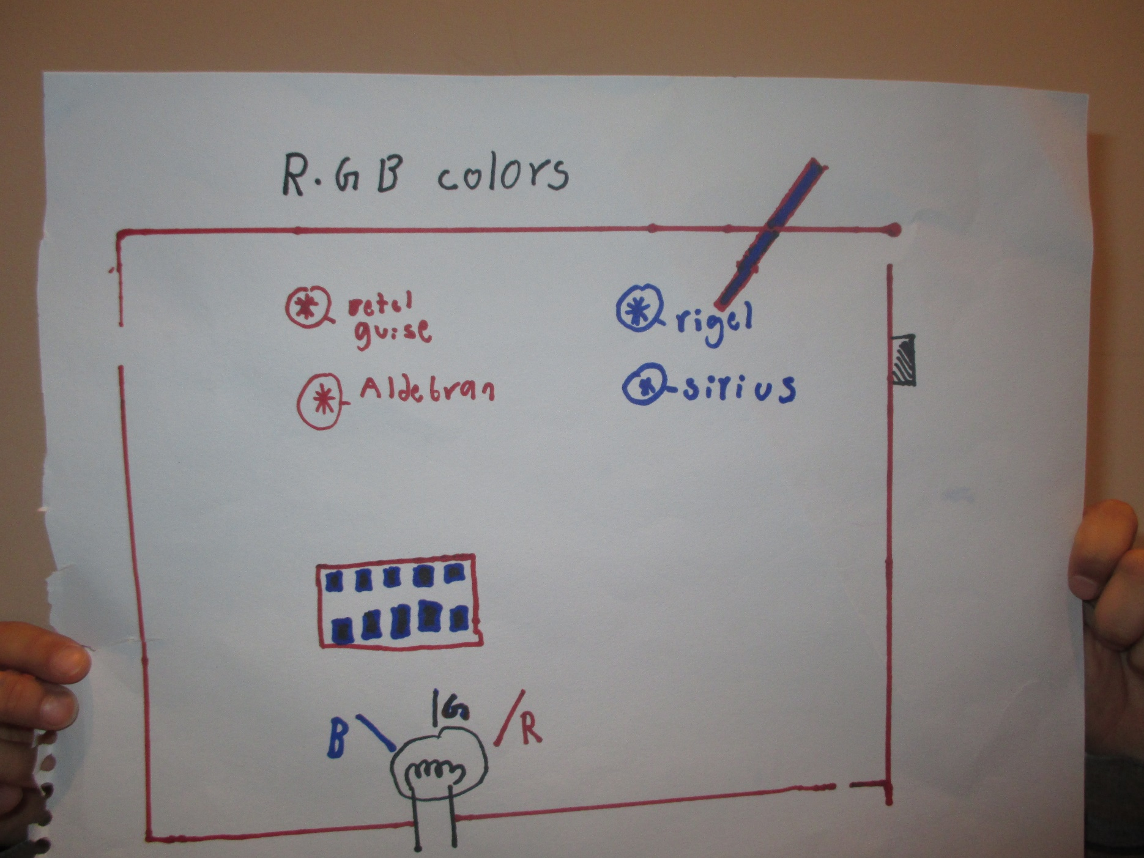
We improved!

Slide 16
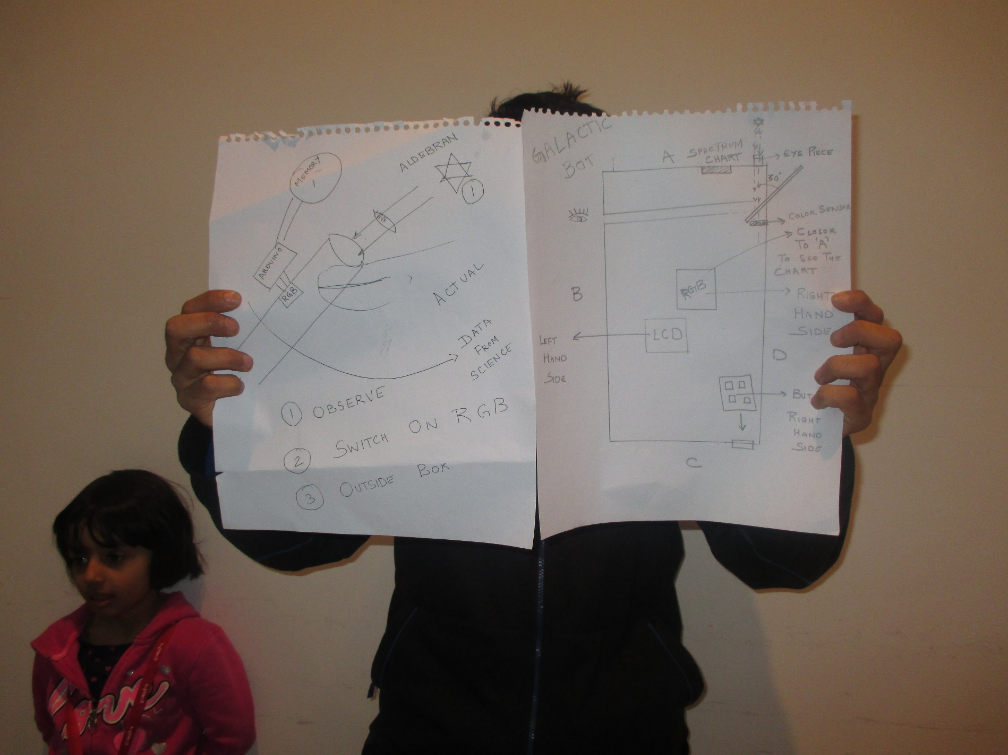
We changed the design!

Slide 17
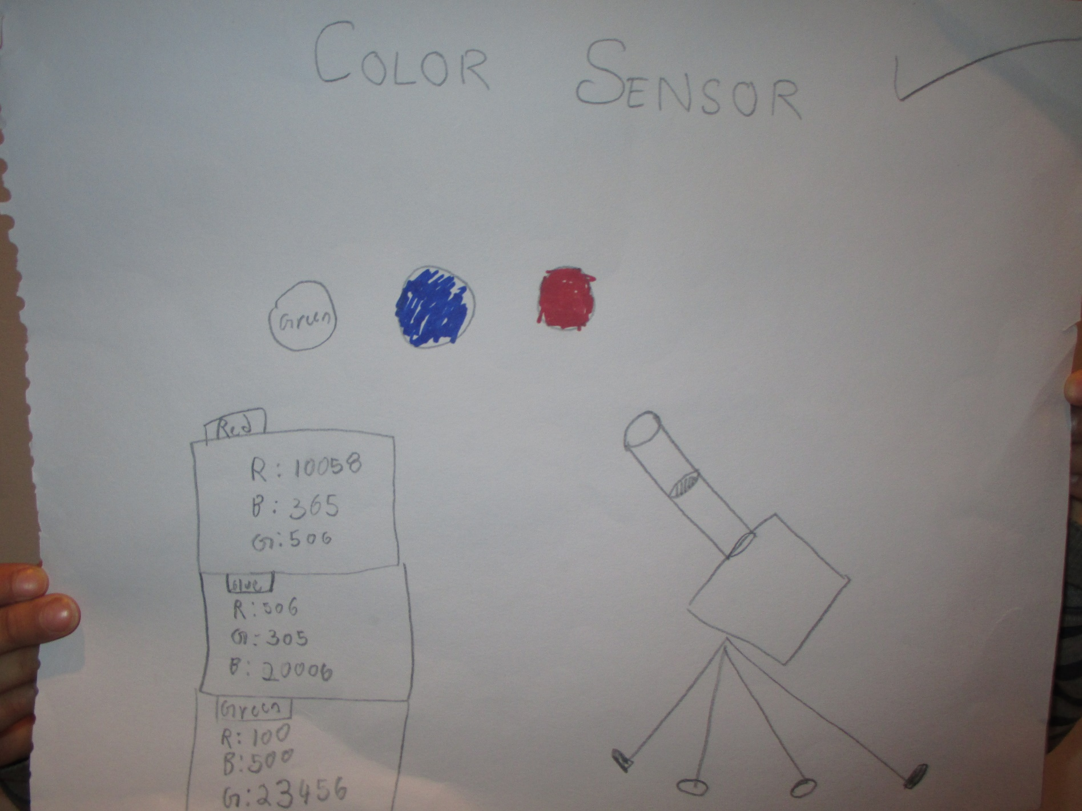
And we started to make!

Slide 18
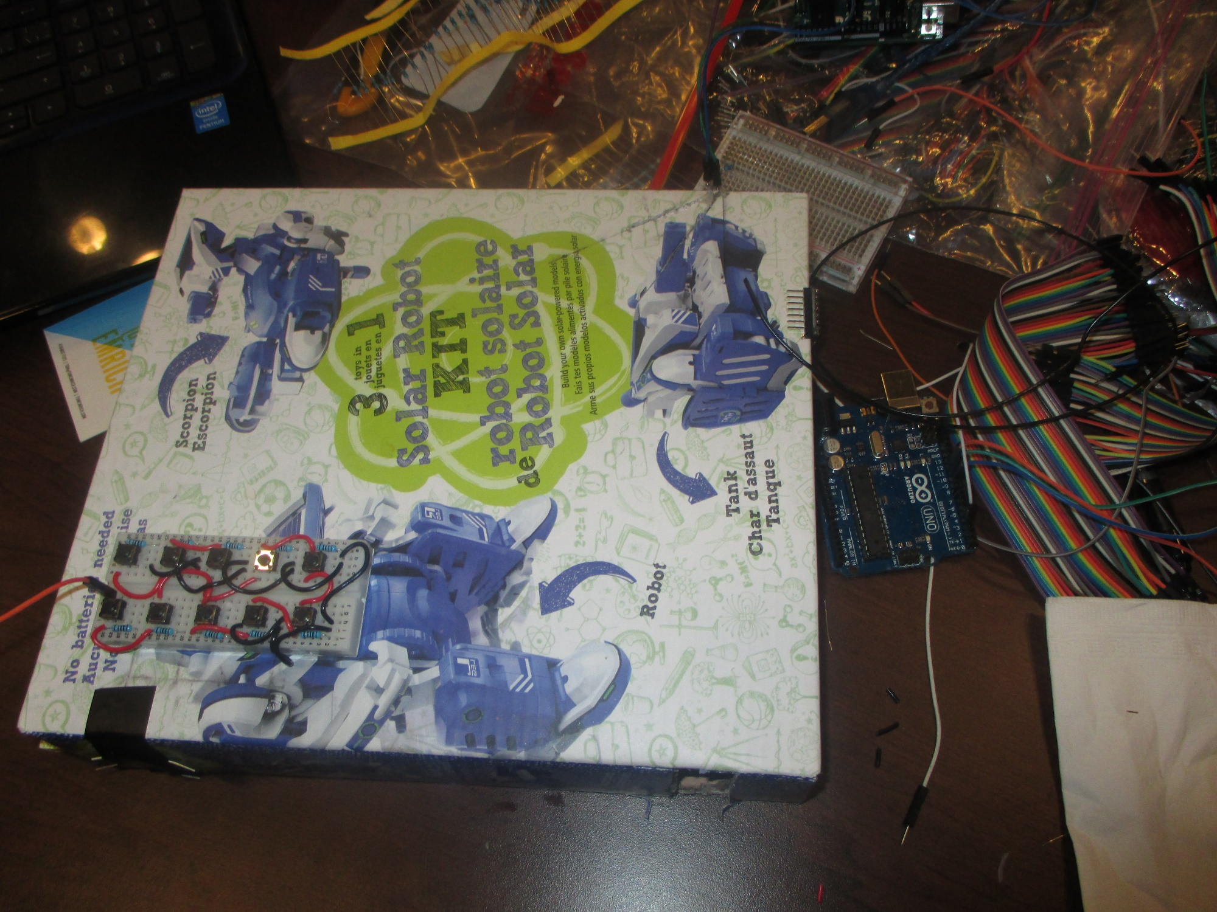
Everything starts from a Box!
Lots of building, wiring and coding.

Slide 19
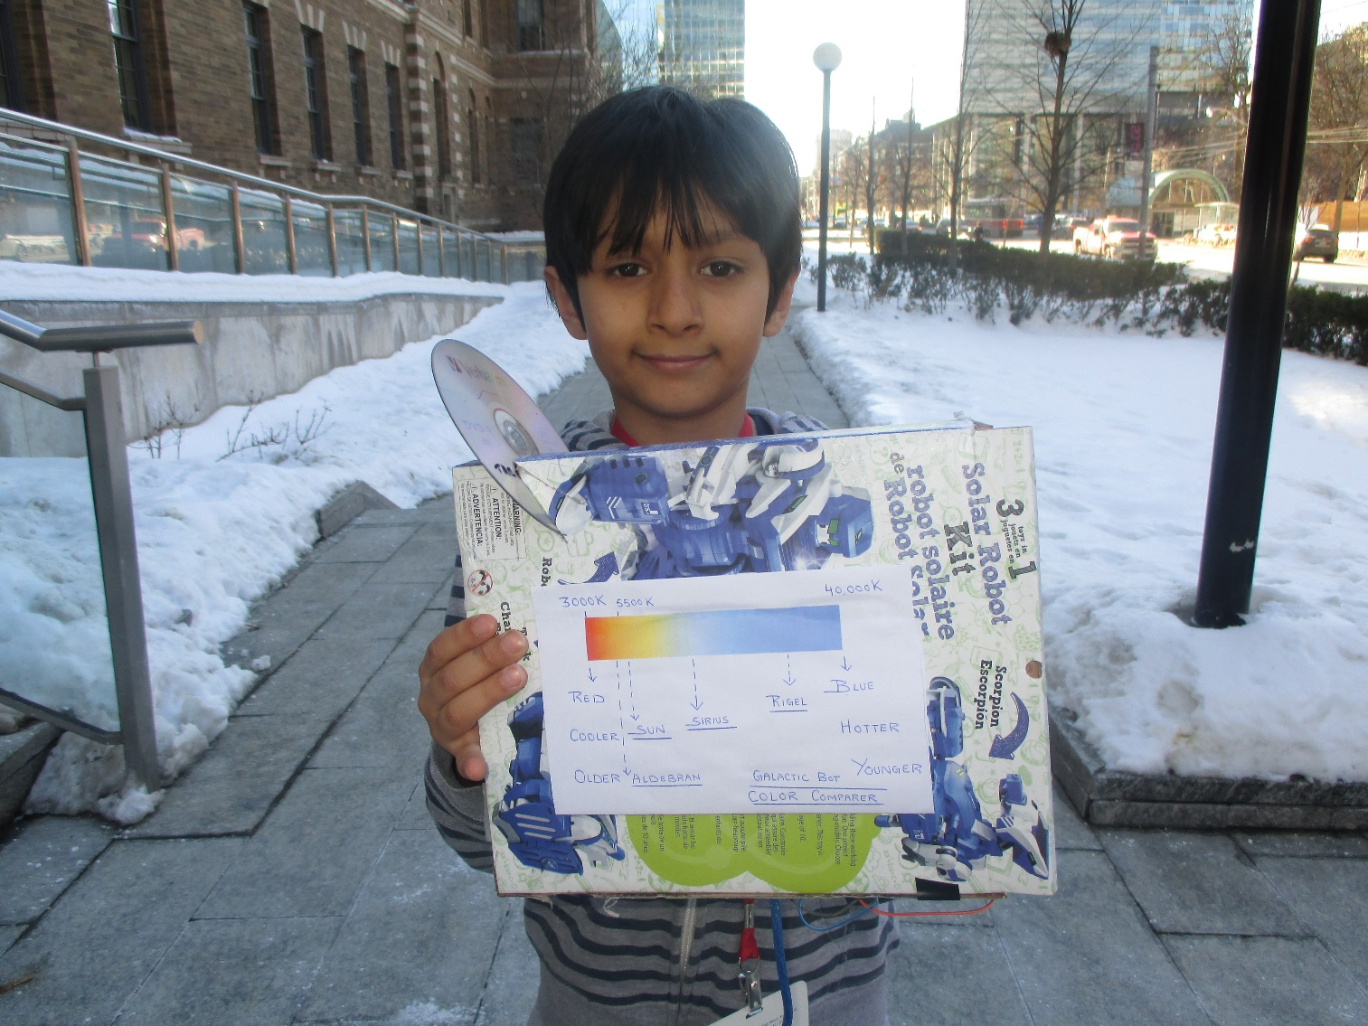
Galactic Bot is Ready!
Sensor for getting Red, Green, Blue composition of objects.
Color Comparer to get Temperature and Age of the star.

Slide 20
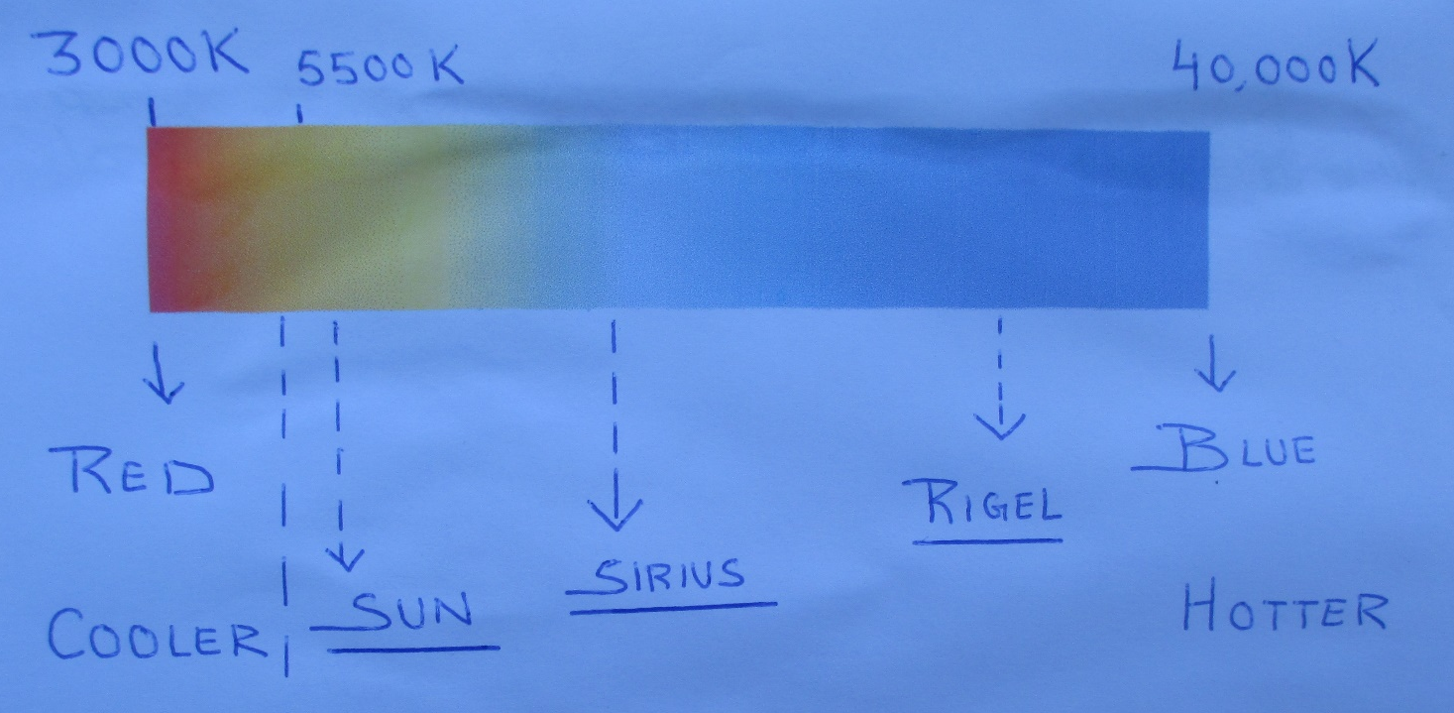
Galactic Bot: Color and Temperature Chart to analyse data
Cooler stars are also older stars while hotter stars are younger stars.

Slide 21
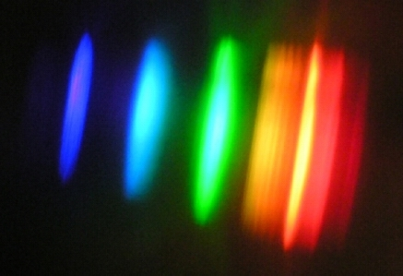
Galactic Bot: Spectrum from from bright light saver bulbs
It clearly shows some lines are missing!

Slide 22
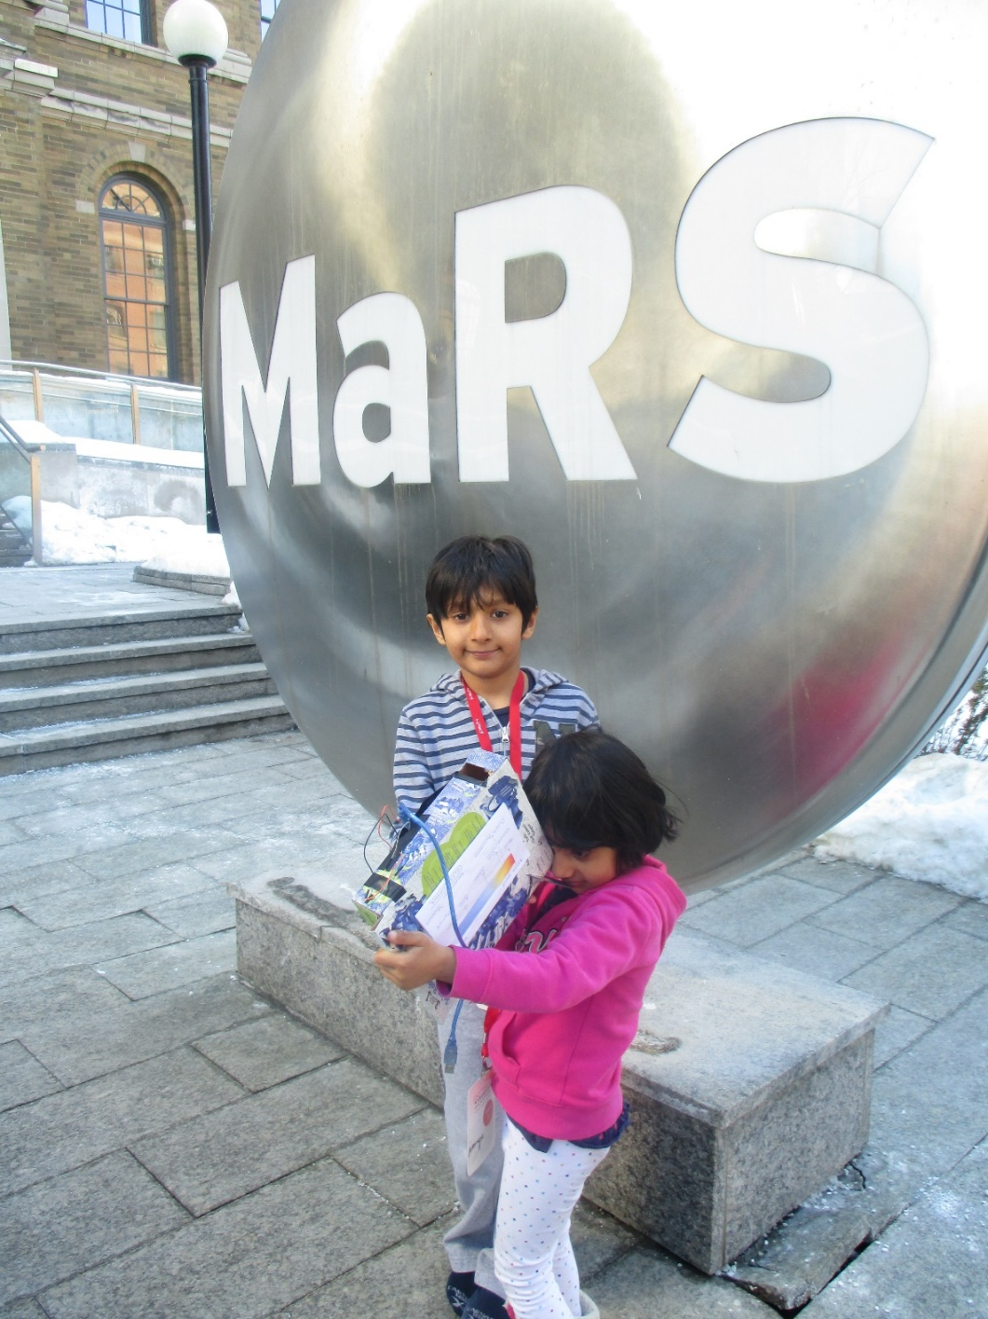
Solving Questions almost always lead to more Questions!
But what are stars made off?
How can we use Galactic Bot to study the sun (our closest star!)?

Slide 23
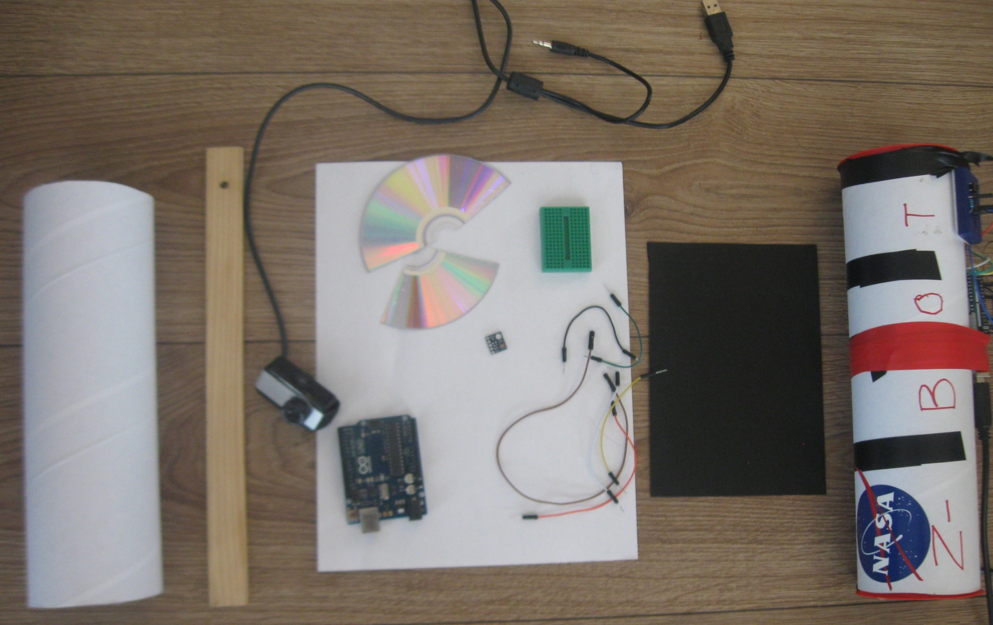
Parts needed to make Z-Bot
(an improved Galactic Bot)
Tube
Ruler
Web Camera
CD-Rom piece
Arduino
Wires
BreadBoard
Red Green Blue Sensor
Litmus Paper
Black Piece of paper to make slit

Slide 24
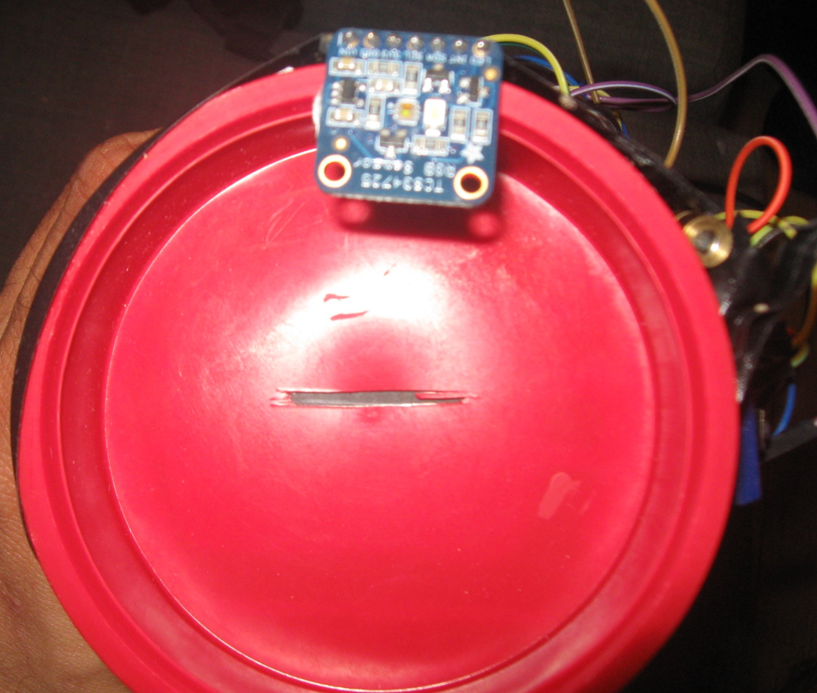
Added a Red Laser along with the Red Green Blue (RGB) Sensor on the Slit End.

Slide 25
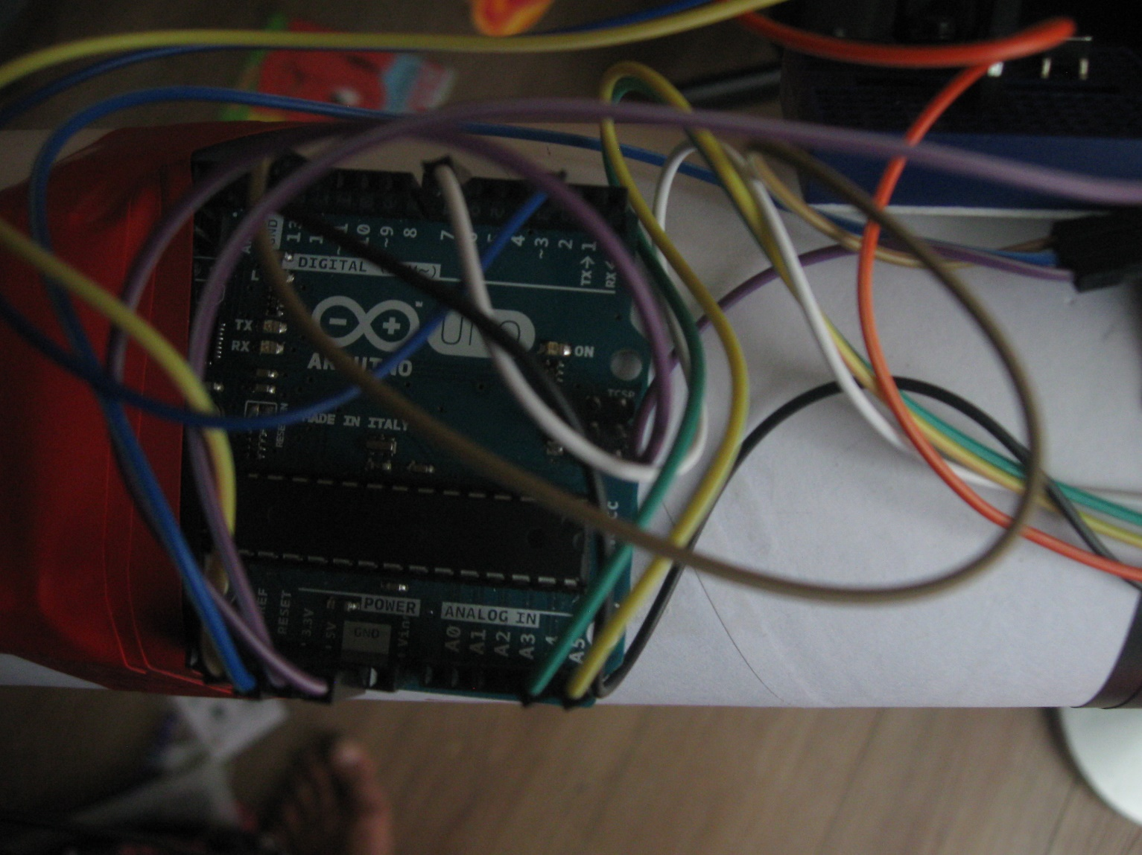
Arduino: Controller
Arduino was used to program and control the Red Green Blue Sensor so that the data coming from it can be analyzed easily.

Slide 26
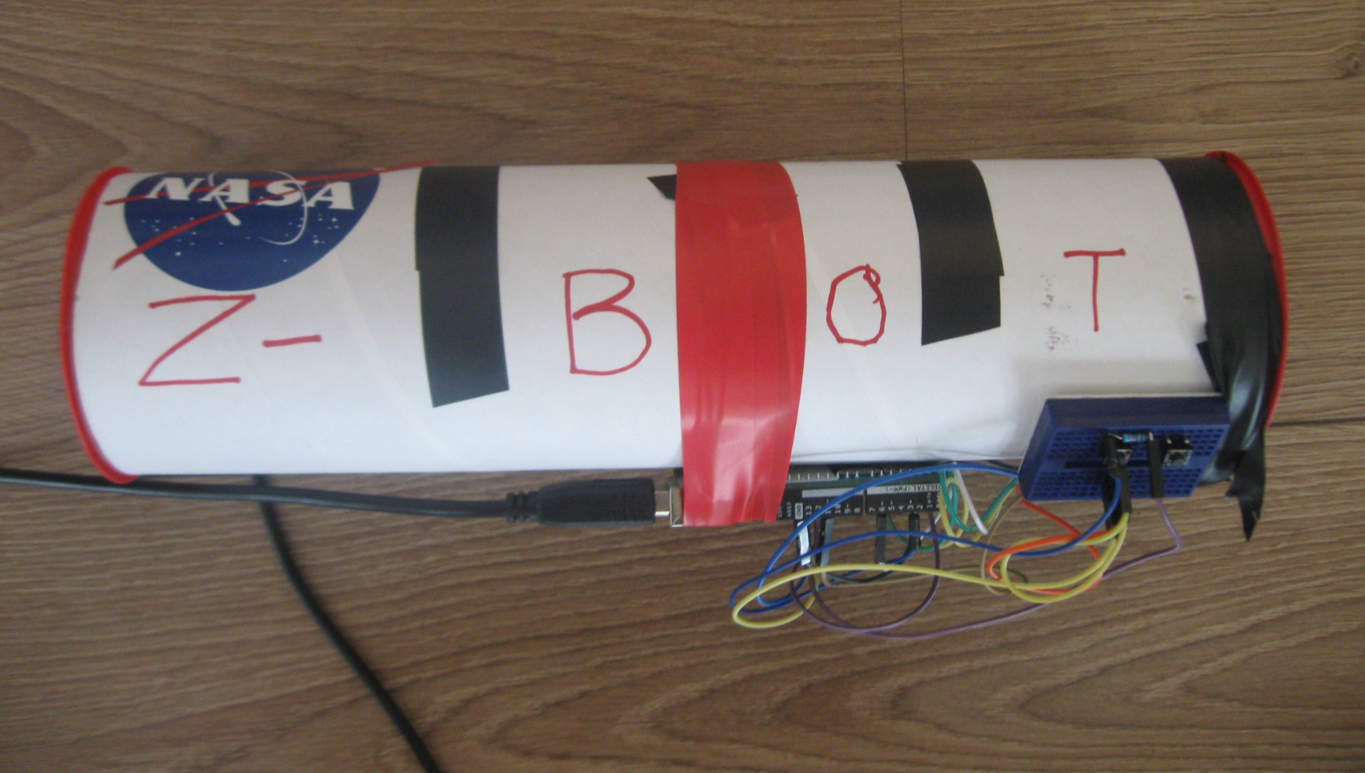
And finally the Z-Bot is ready for testing on the Sun:

Slide 27
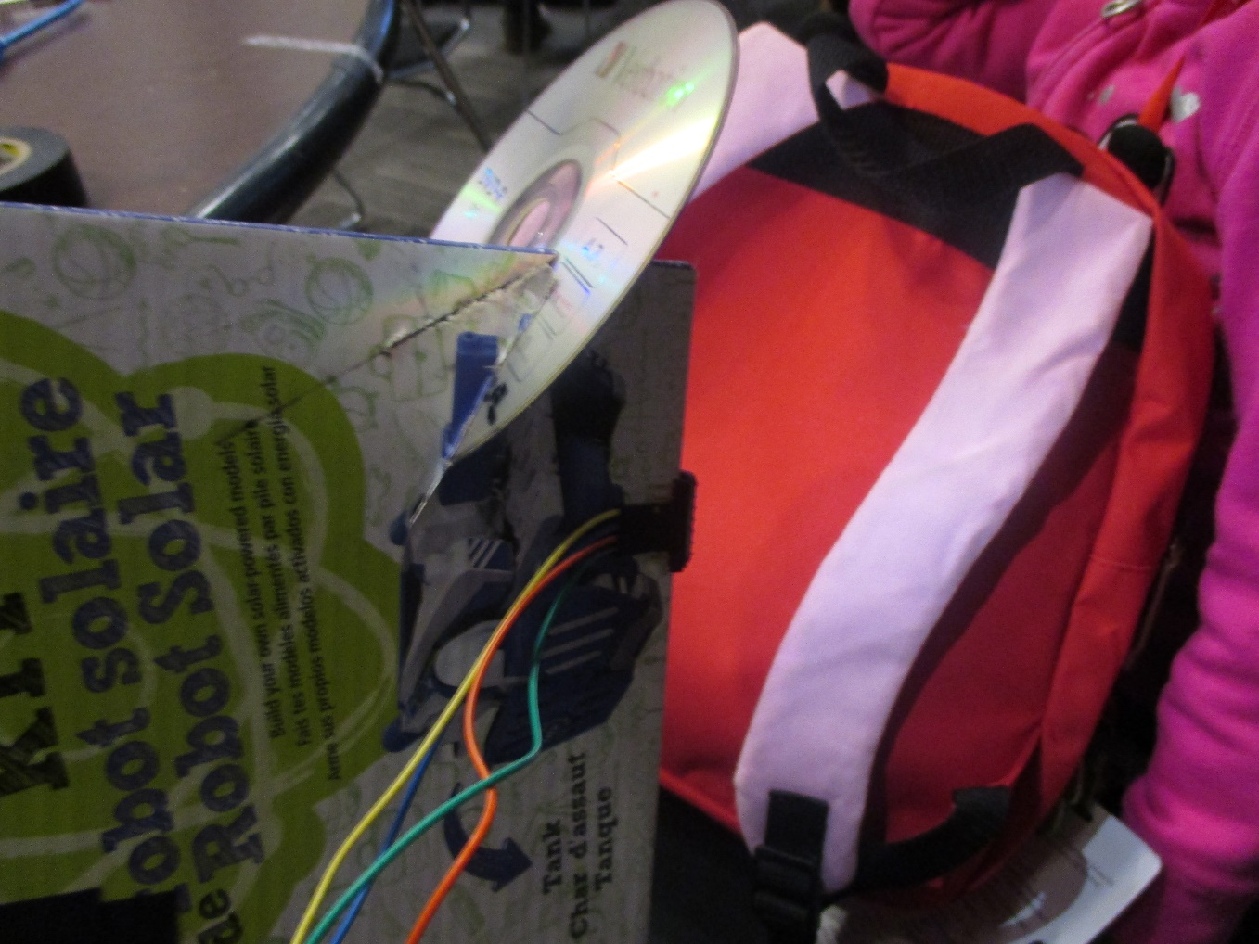
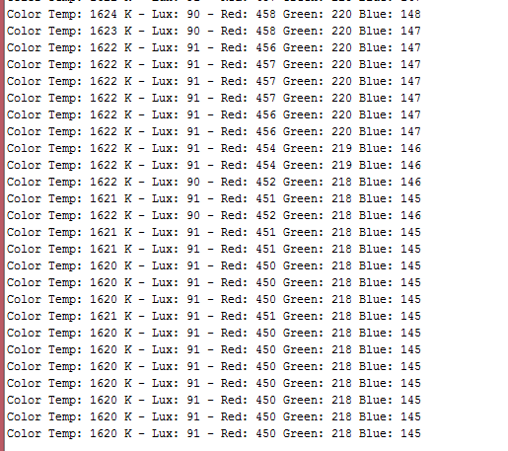
Red Green Blue Sensor at Work!

Slide 28
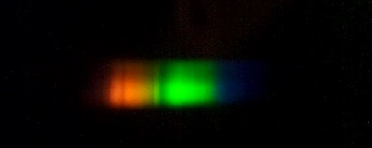
Z-Bot: Spectrum from the Sun, finally!
Continuous Spectrum from the Sun

Slide 29
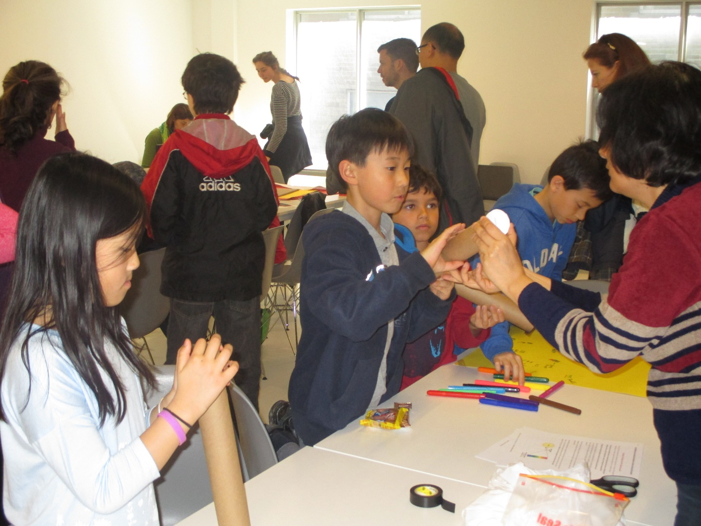
Spreading the Word around on how to make similar projects
So that we can keep learning about stars and space
from an early age.

Slide 30
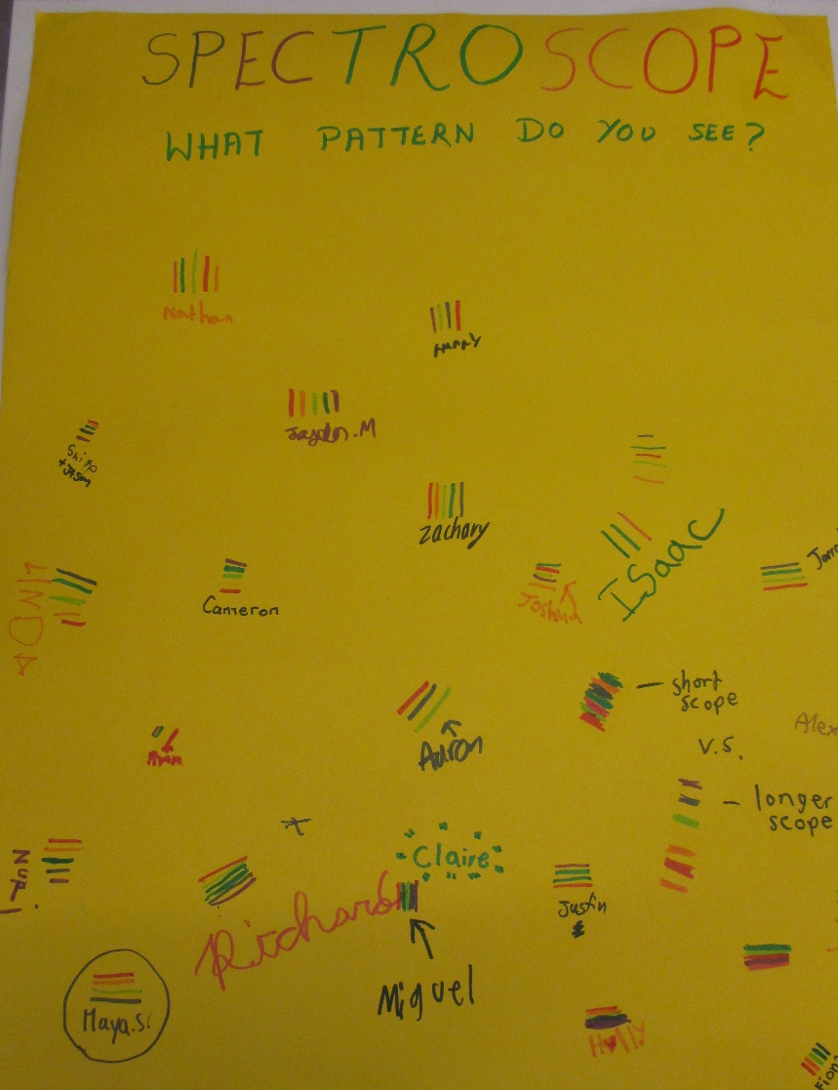
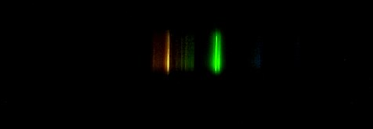
Z-Bot: Spectrum Seen by Different Children and Marked on Chart Paper

Slide 31

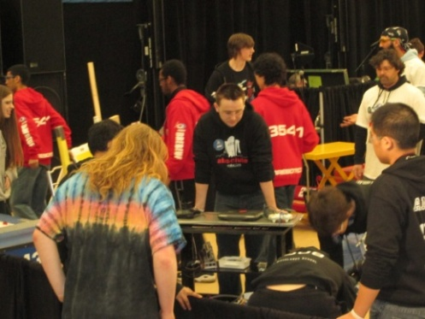

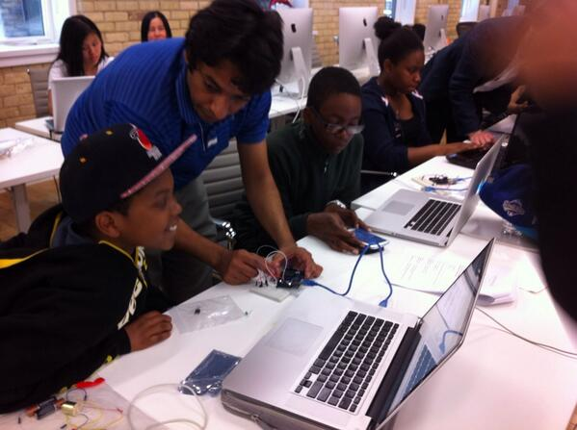

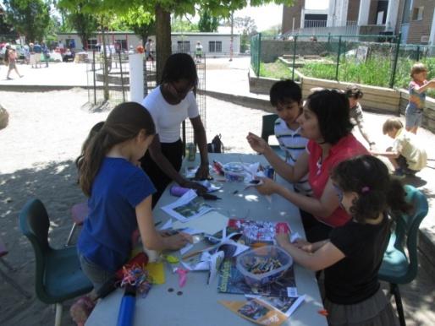














Outreach!
Ignite Passion and Drive among youths. Career is more than a job!

Slide 32


Spend $50 and create a Maker Box in Home!
Bulbs
Motors
Wires
Arduino
Breadboard
Transistors
Resistances
Sensors
Tool Kit (Screwdrivers)
Broken Toys

Slide 33
Maker Families:
Building Together on Space, Science, and Technology
Artash Nath
Arushi Nath
Vikas Nath
HotPopRobot.com
@wonrobot
International Space Development Conference, St. Louis, USA, 25-29 May 2017

