Slide 1
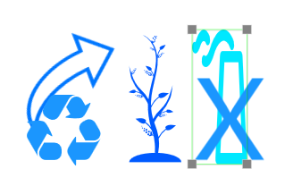

FIX THE
HotPopRobot Family Team
Artash Nath
Arushi Nath
Vikas Nath
Rati Mehrotra
www.HotPopRobot.com

Slide 2
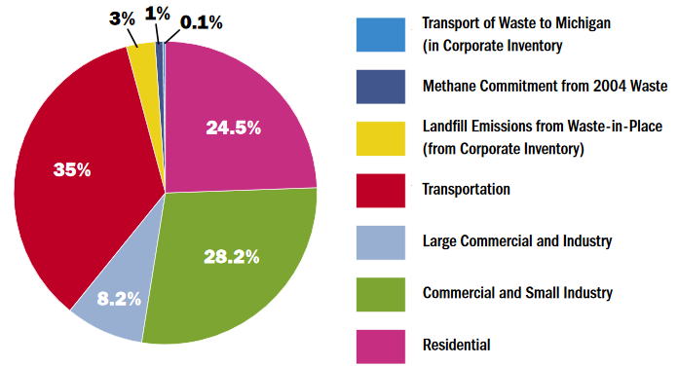
Green House Gas Emissions by Sector
Transportation Sector
8,000,000 Million Tonnes / Year
Source: Greenhouse Gas & Air Emissions Inventory . 2013

Slide 3
Goal of #Climathon
5% Reduction in Emissions from the Transportation Sector (400,000 tonnes / year)
Achieve it in Cost-Neutral Way
But we put.... 2 Additional Goals
Inter-Generational Solution to pass benefits to future generations too.
Eco-Centric Solution: Should benefit the whole ecosystem (Birds, Animals, Bees, Native Species...) and NOT JUST HUMANS

Slide 4
Fix the Six Proposes:
Use Trees to Absorb Carbon Emissions
Increase habitat for other species
Promote Green and Healthy Toronto!

Slide 5
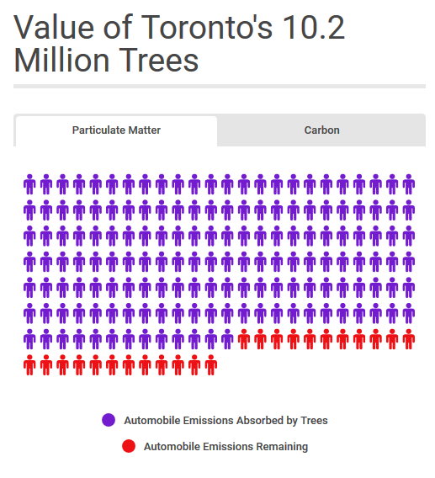
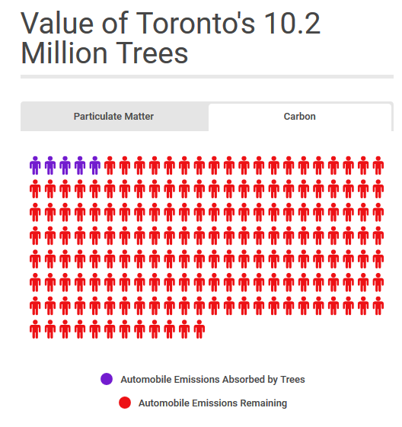
TREES IN TORONTO ARE BUSY WORKING .....
Particulate Matter
Carbon

Slide 6
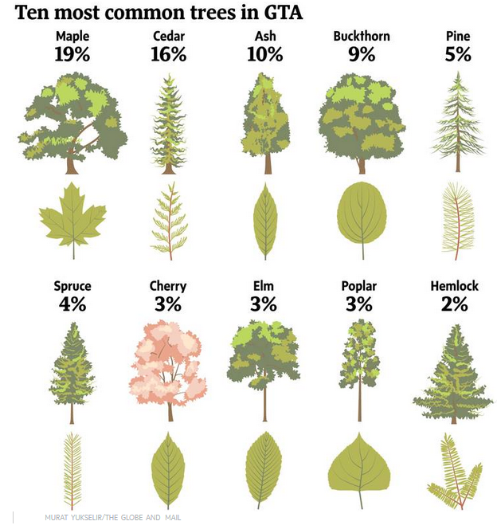
Native Tree
Medium - Fast Growth Rate
High Carbon Sequestration Rate
Native but Slow Growth Rate

Slide 7
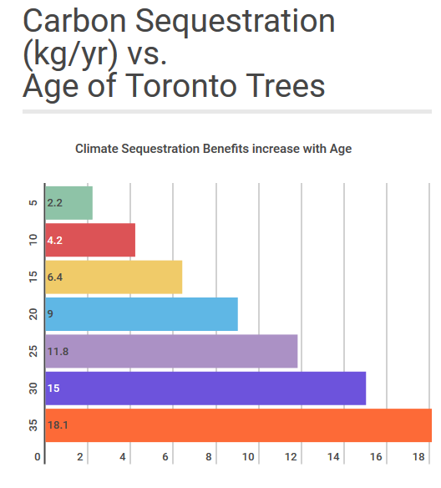
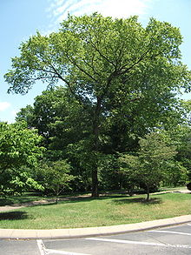
Elm tree
Age of Tree (Years)
A 60 Years Old Tree can – sequester 72 kg of carbon/yr
Carbon Sequestration (Kgs / Year)

Slide 8
Data Sets Used
Secondary Data
Street Tree Map
24 hours Traffic Map
Primary Data
Tree Counting
Local Emissions Data using Infrared Emission Sensors on King Street and Queen Street, Toronto

Slide 9
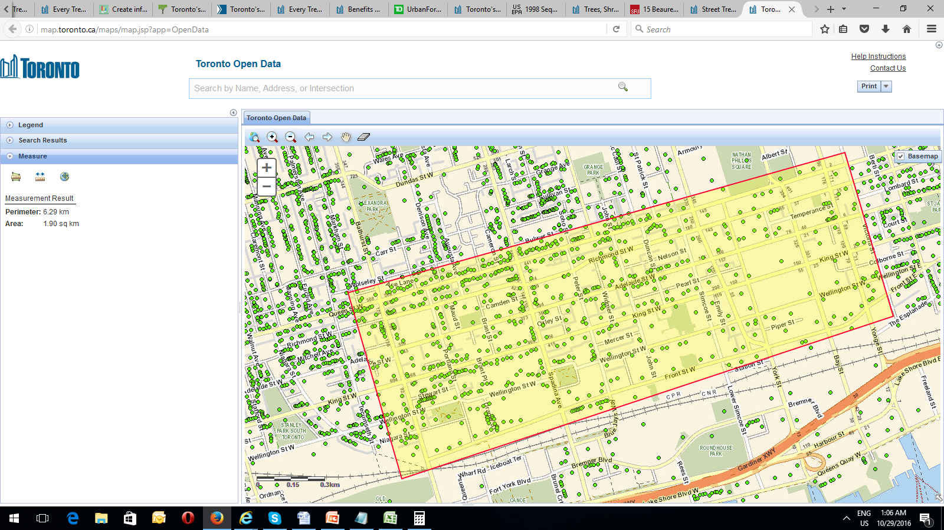
Street Tree Data Analysis Carried out By the Team
Street | Distance | Tree Count | Carbon Sequestration (kgs / Year) | Total Economic Value ($) | Tree Intensification Potential
King St (Bathurst to Yonge) | 2.2 kms | 142 | 1278 | 1128.9 | 90%
Queen St (Bathurst to Yonge) | 2.2 kms | 271 | 2439 | 2154.45 | Baseline

Slide 10
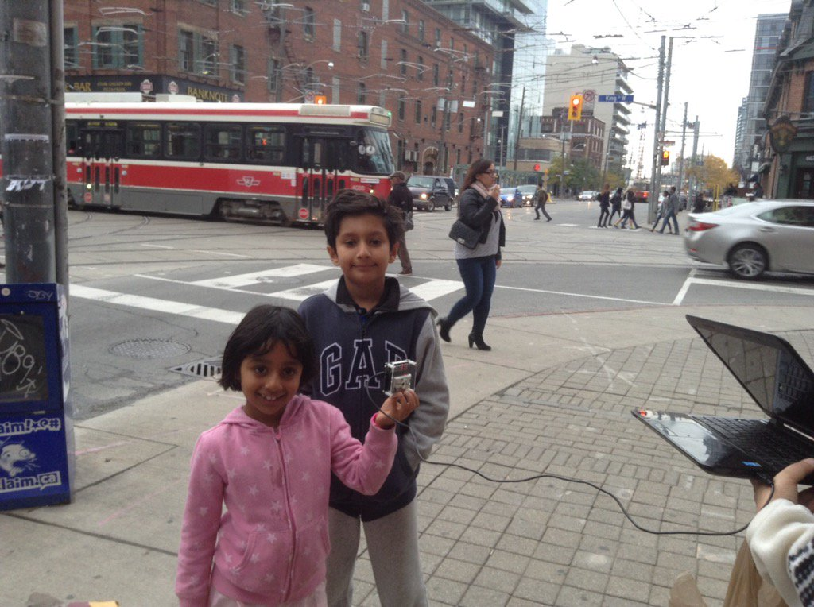
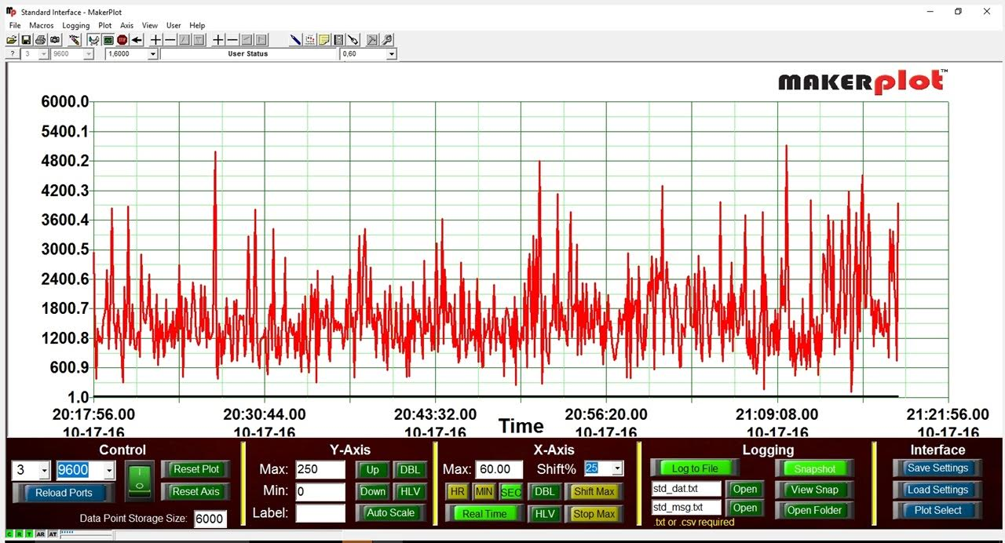
More Trees Help in Emission Reduction
- shown by Primary Data Collection and Analysis
King Street Emissions Count (PM2.5): 17 micrograms per cubic meter
Queen Street Emissions Count (PM2.5):
11 micrograms per cubic meter
29 October 2016, King and Bathurst

Slide 11
Tree Intensification Needed to Reach the 5% Goal
Trees Intensification | Additional Trees | Additional Carbon Sequestration (tonnes/year) | Cost (million CAD) | Environmental Benefit (million CAD)
50% | 5 million | 100,000 (1.25%) | 29 – 124.5 | 39.75
100% | 10 million | 200,000 (2.5%) | 58 - 249 | 79.5
200% | 20 million | 400,000 (5%) | 116-498 | 159 (Benefit-Cost Ratio: 1.35-3.2)
Are we ready to plant 20 Million More Native Trees in Toronto?

Slide 12
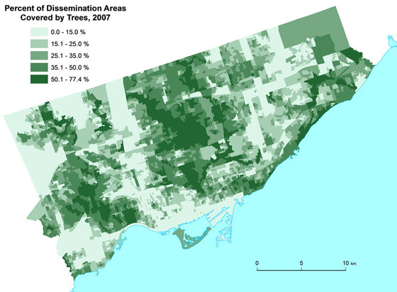
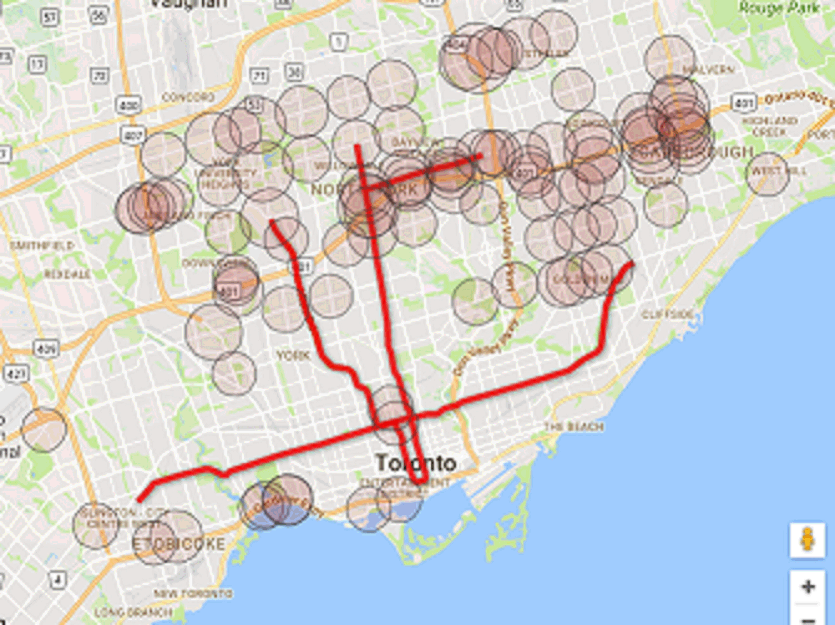

There is a lot of Space in Toronto!
High Traffic Corridors Need More Trees!
High Traffic Areas
24 Hours Traffic Map
Tree Density Map

Slide 13
First Moves have been made
April 2015: Green lungs of Toronto are being better preserved.
Rouge Park converted to Rouge Urban National Park – allowing more protection of older trees.
2016: Ontario Climate Change Plan and Carbon Tax. It will put greater value on trees and intensify tree planting.
Citizen Start Ups Emerging: Matching property with right kind of trees.

Slide 14
FIX THE
HotPopRobot Family Team
Artash Nath
Arushi Nath
Vikas Nath
Rati Mehrotra
www.HotPopRobot.com

