Slide 1
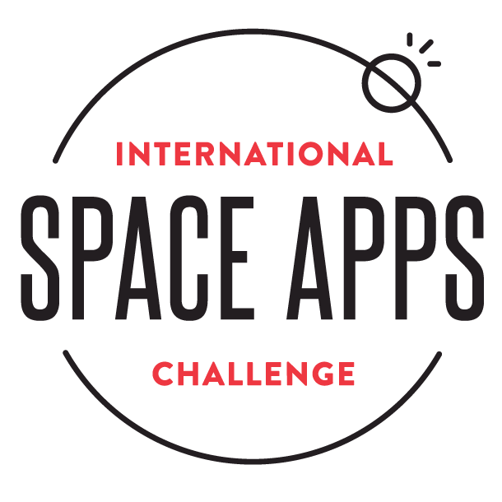
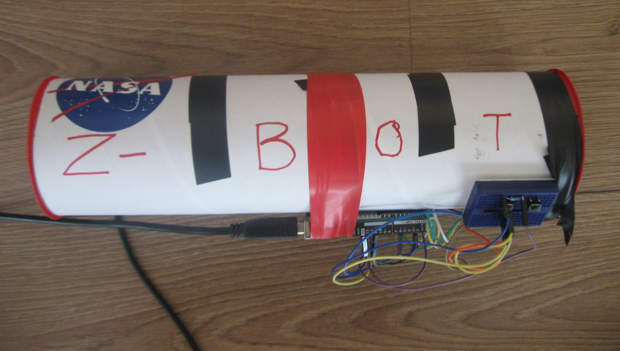

NASA SpaceApps 2015 Challenge (Space Wearables)
Z-Bot Tool: We go to Mars!
Family Team
Arushi (5 years)
Artash (8 years)
Rati Mehrotra
Vikas Nath

Slide 2
What we wanted to do?
When explorers go to Mars, what tool will be affixed to the Z-SpaceSuit?
To create a tool which can be used by Explorers to Mars and beyond, as well as scientists and children on Earth to study rocks, atmosphere, and stars.
Study spectrum of objects to find their composition
Find temperature of objects, including stars
Estimate age of stars

Slide 3
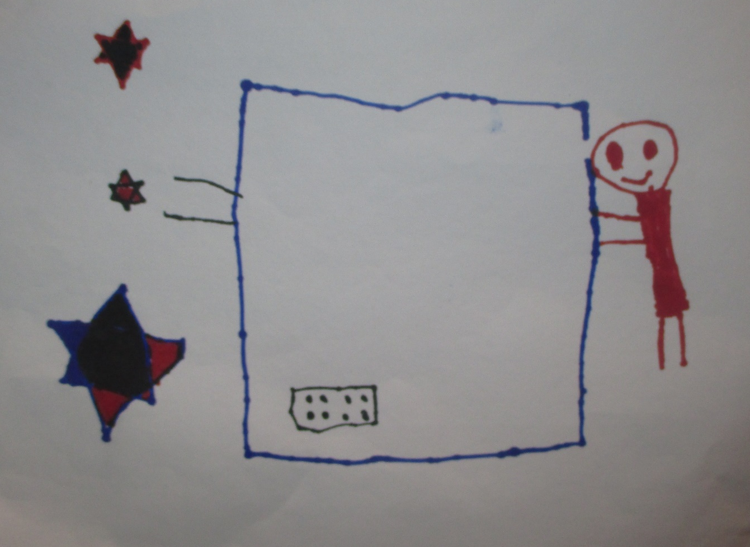
We Dreamt!

Slide 4
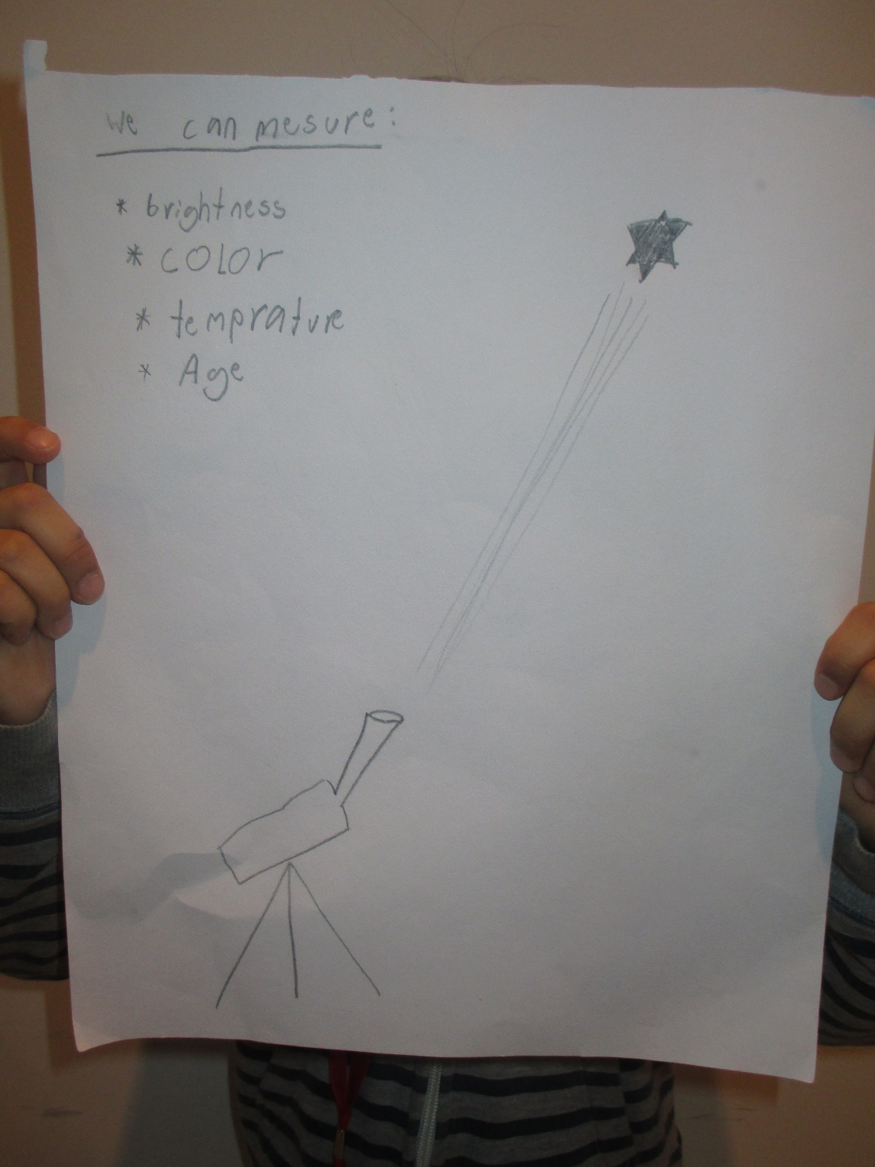
We planned!

Slide 5
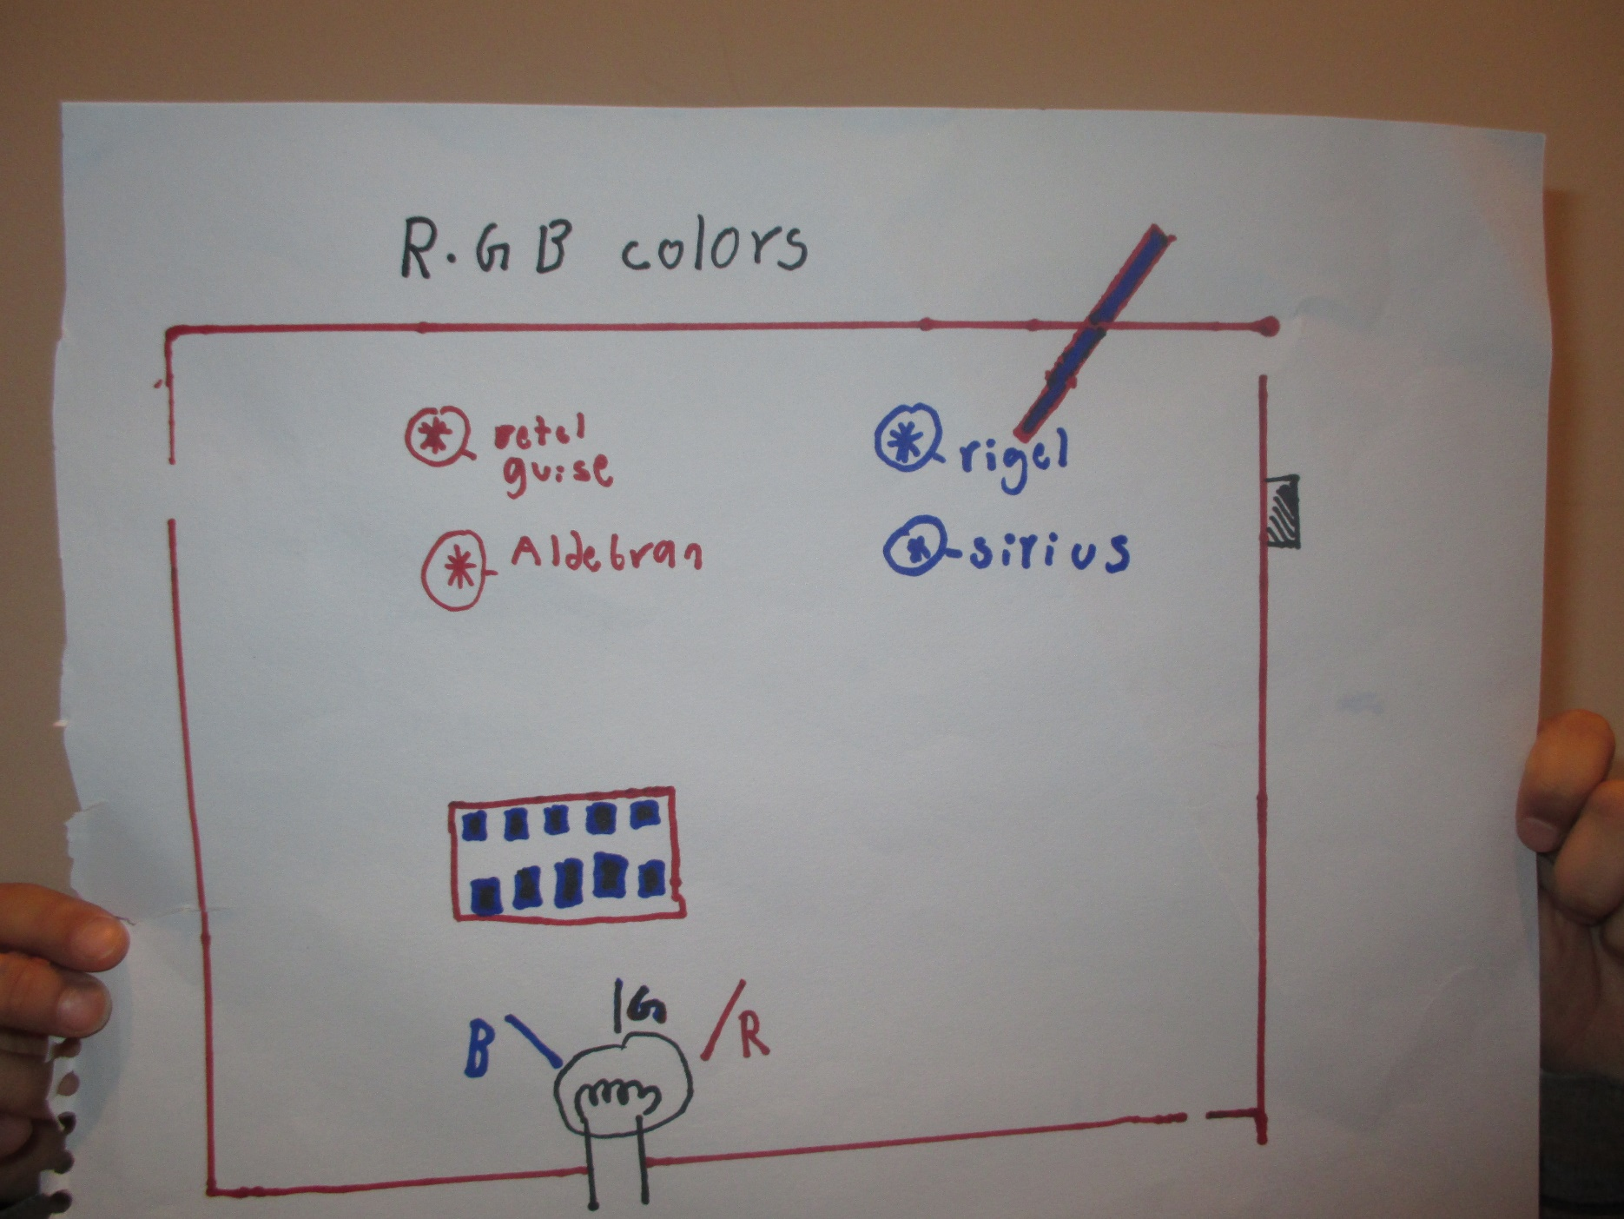
We got better in planning!

Slide 6
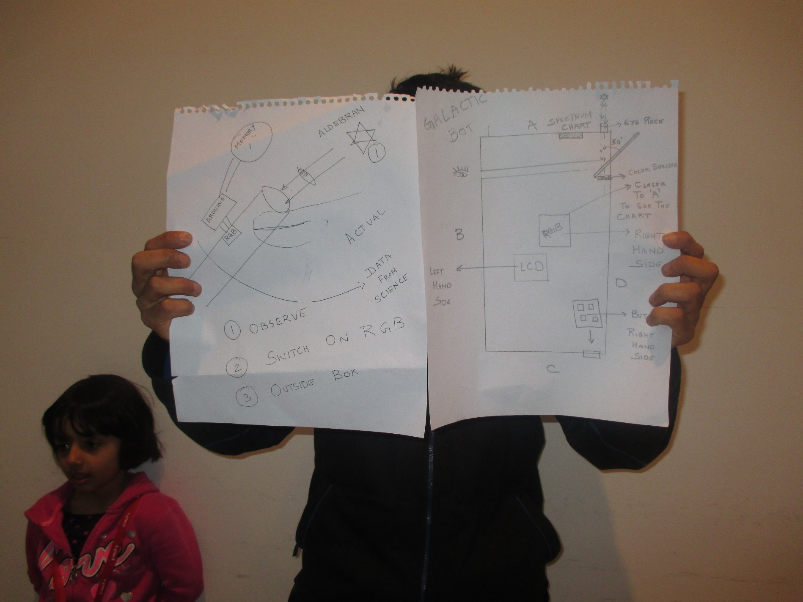
We changed the design!

Slide 7
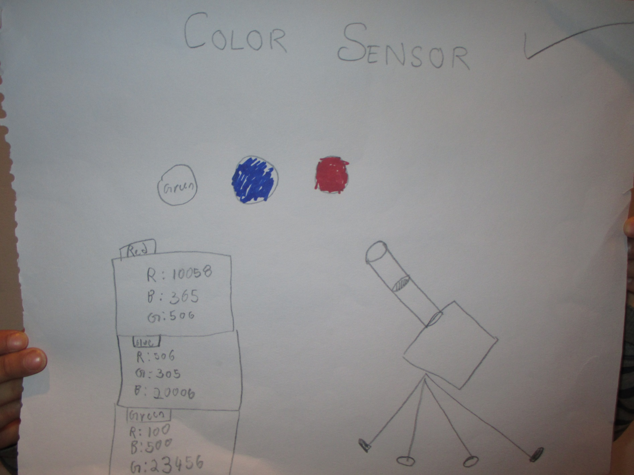
And we started to make!

Slide 8
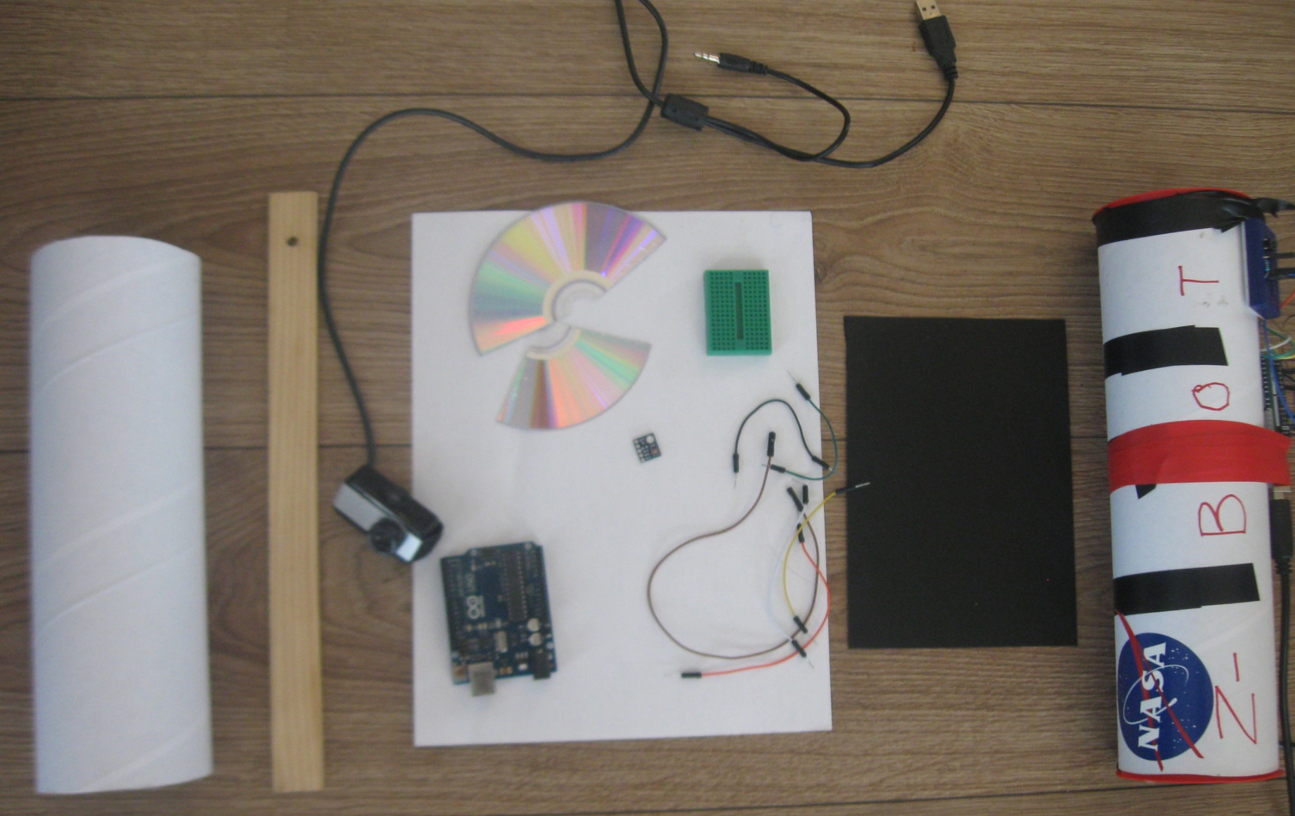
Parts needed to make a Z-Bot
Tube
Ruler
Web Camera
CD-Rom piece
Arduino
Wires
BreadBoard
Red Green Blue Sensor
Litmus Paper
Black Piece of paper to make slit

Slide 9
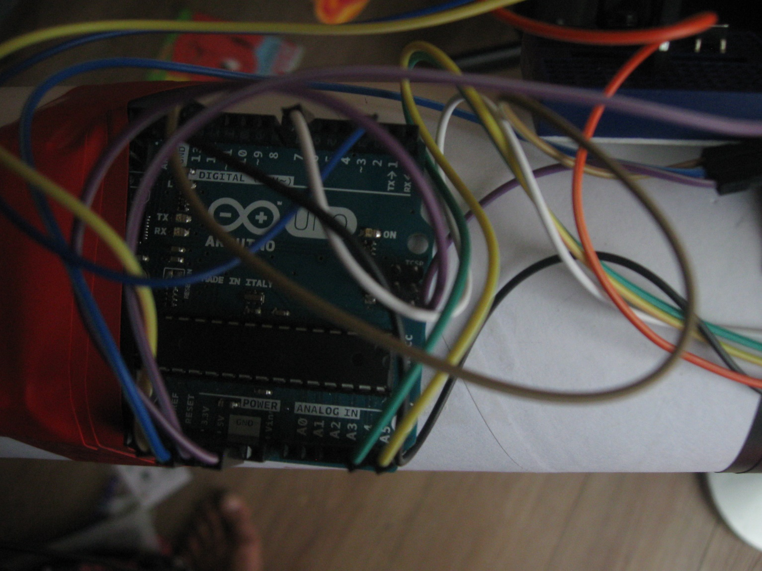
Arduino: Controller
Arduino was used to program and control the Red Green Blue Sensor so that the data coming from it can be analyzed easily.

Slide 10
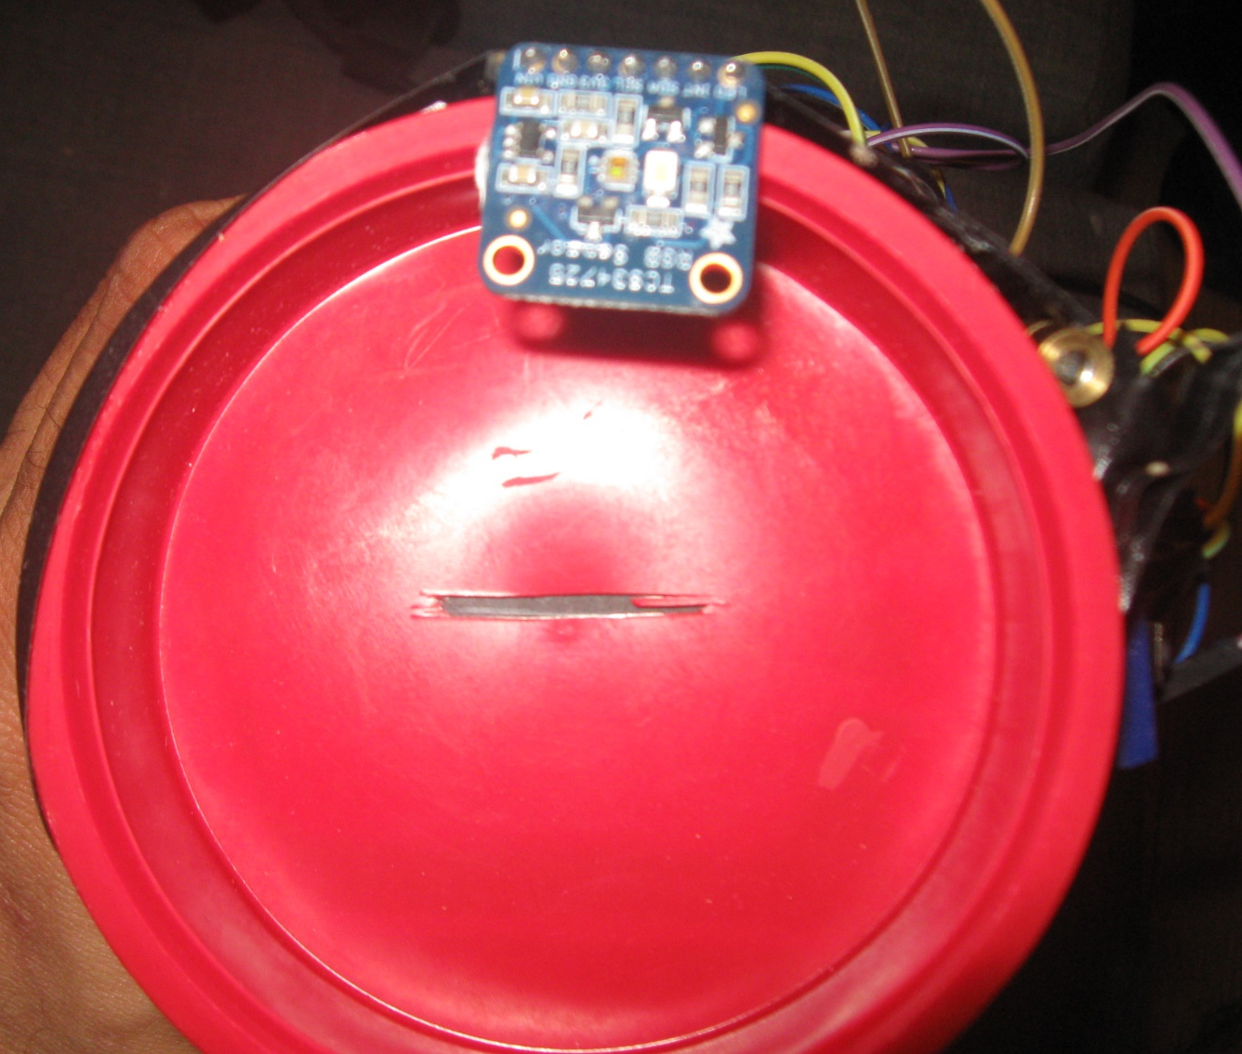
Slit End with the Red Green Blue Sensor

Slide 11
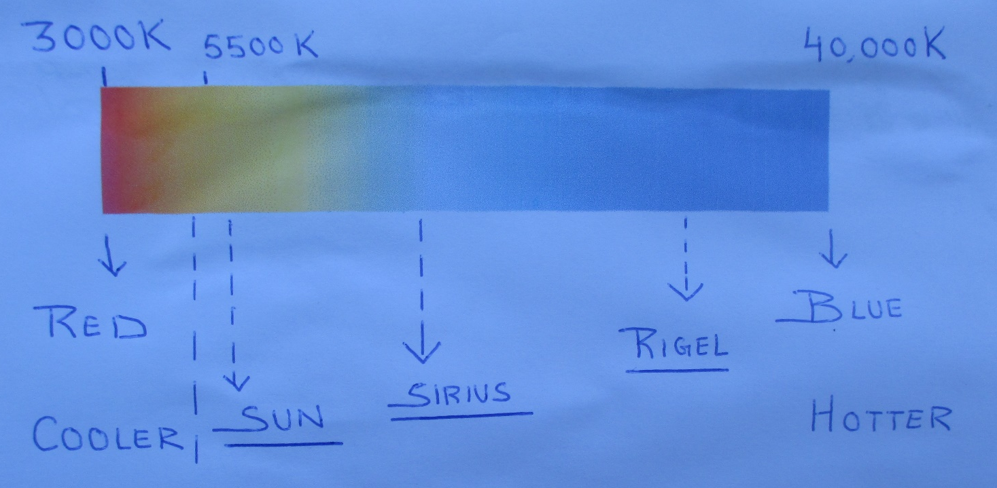
Z-Bot: Color and Temperature Chart to analyse data
Cooler stars are also older stars while hotter stars are younger stars.

Slide 12
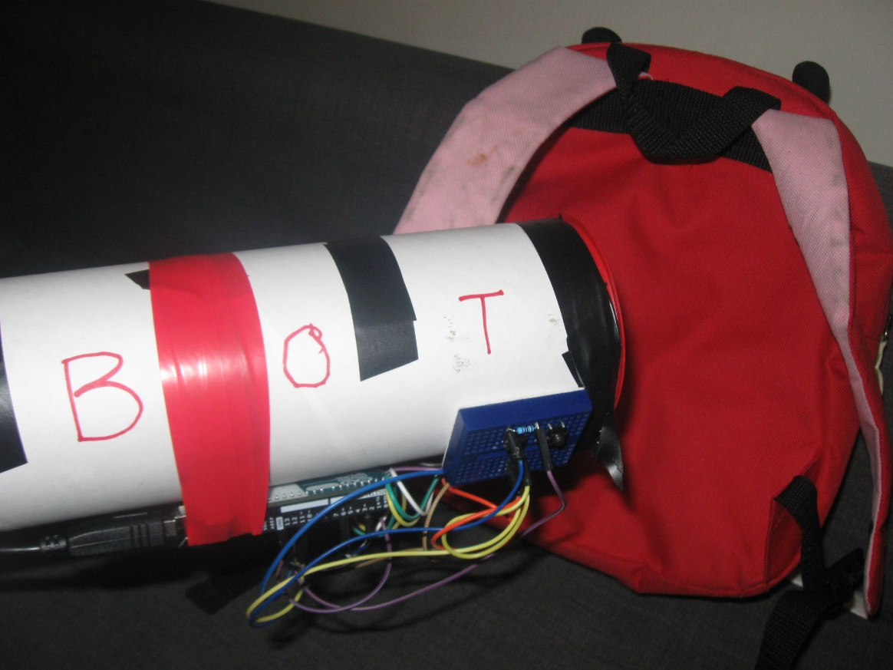
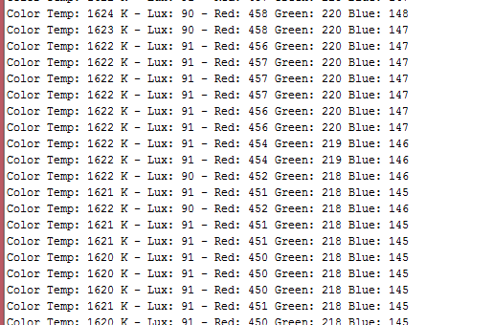
Red Green Blue Sensor at Work
Placed in front a red colored school bag acting as a Red-Colored Star!
Z-Bot Results
T = 1622 K. “Red” composition is the highest. Thus older and cooler than our Sun.

Slide 13

Z-Bot Tool: 4 results we achieved
Spectrometer: What stars are made of?
Get Red, Green, Blue composition of objects.
Estimate Temperature and Age of the star.
Does not require direct viewing, and can be used to study Spectrum of bright objects, such as Sun, and share it remotely.
Costs less than USD 15 to make. Every family can make one!

Slide 14
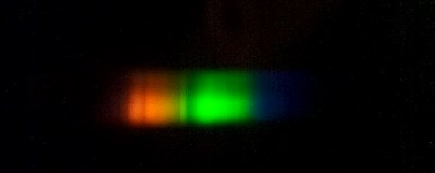
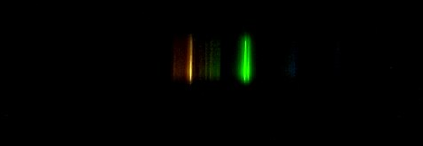
Z-Bot: Spectrums from different objects
Continuous Spectrum from the Sun
Emission Spectrum from a Fluorescent Bulb

Slide 15
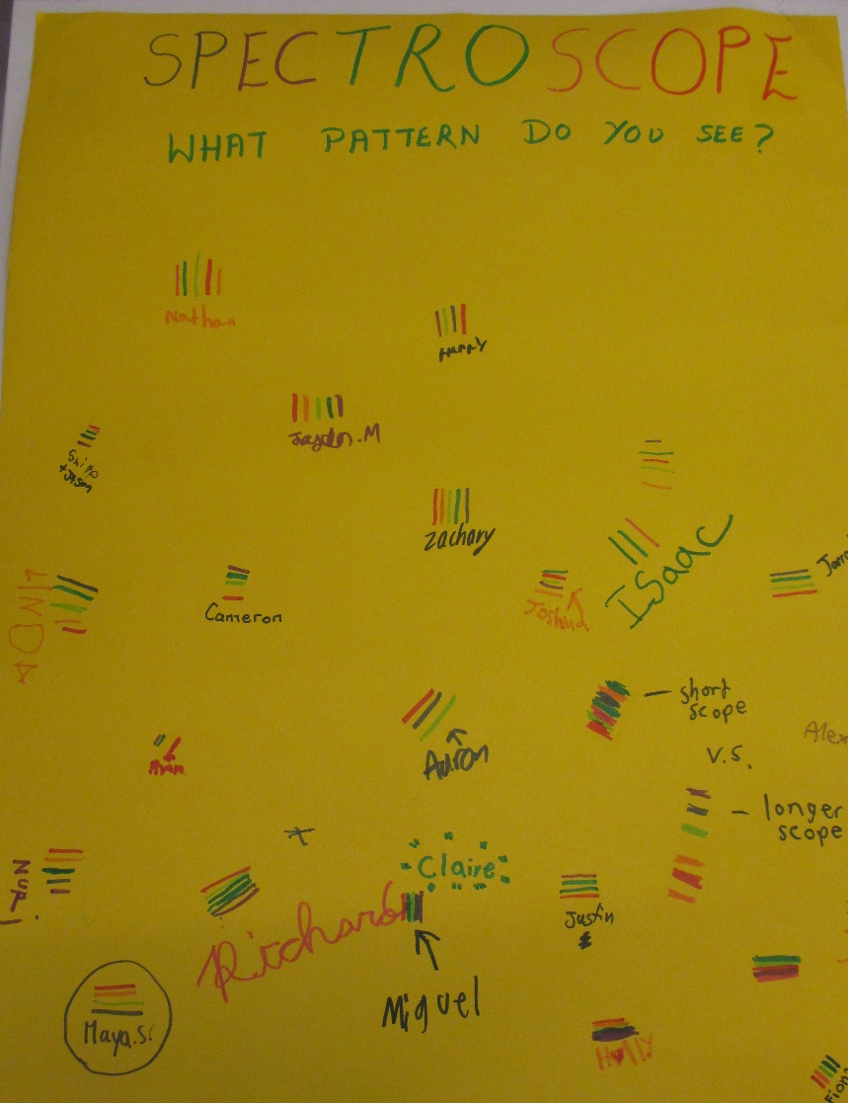
Z-Bot: Spectrum Seen by Different Children and Marked on Chart Paper

Slide 16
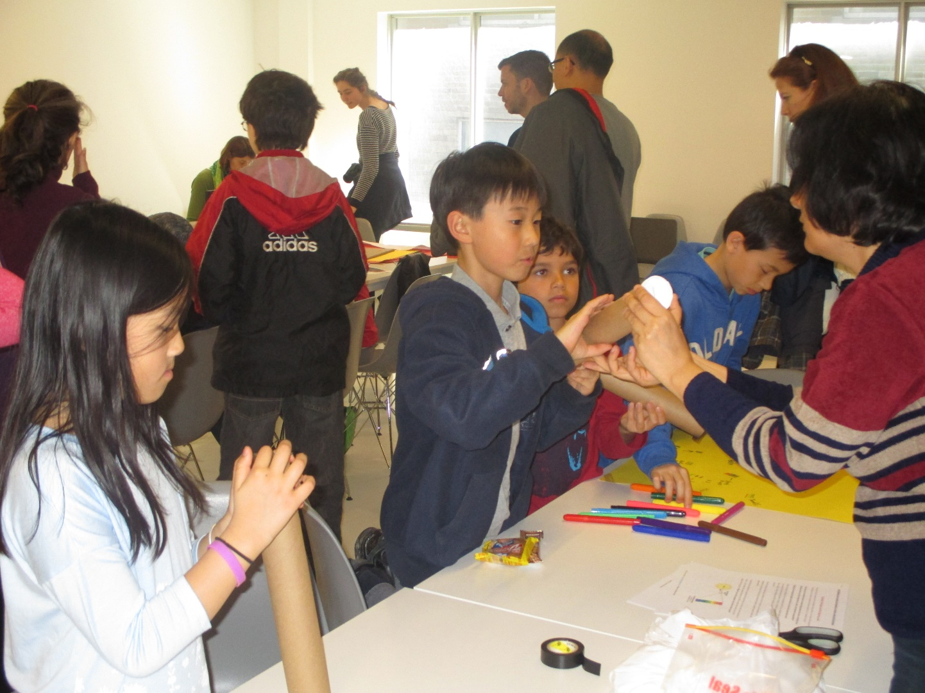
Our Aim: One Z-Bot Per Child
So that we can keep learning and exploring stars and space
from an early age.

