Slide 1


3-2-1 Liftoff!
We go to the moon
16th July 1969, Apollo 11 / Saturn V Launch Experience
Family Team:
Artash (8yr)
Arushi (5yr)
Vikas Nath
Rati Mehrotra

Slide 2
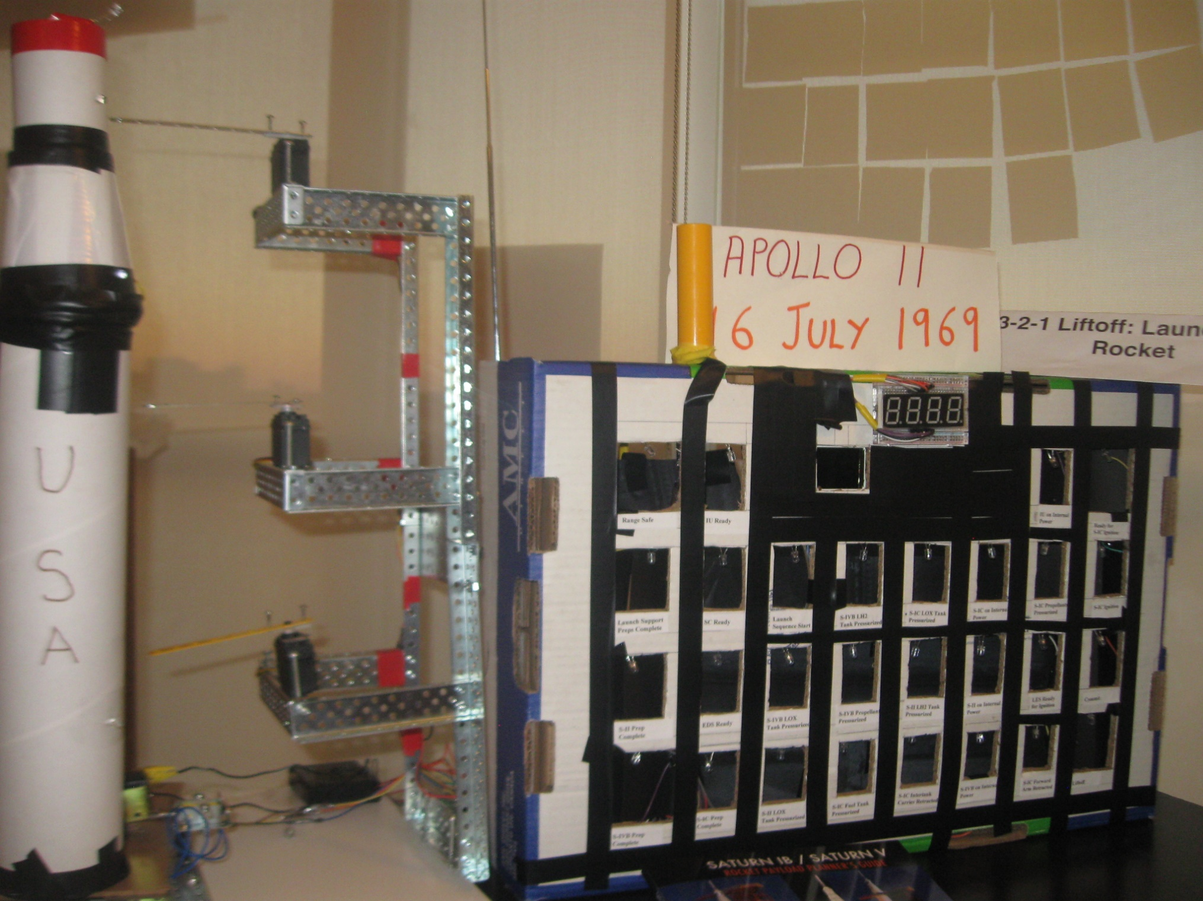

Slide 3
Inspiration
400,000 scientists and engineers worked together to put humans on the moon in 1969,
“not because it is easy but because it is hard”.
This is the vision we want to remember and inspire youths.
It is over 45 years and we have not seen manned spaceflight beyond lower earth orbit.
This is what we want to change.

Slide 4
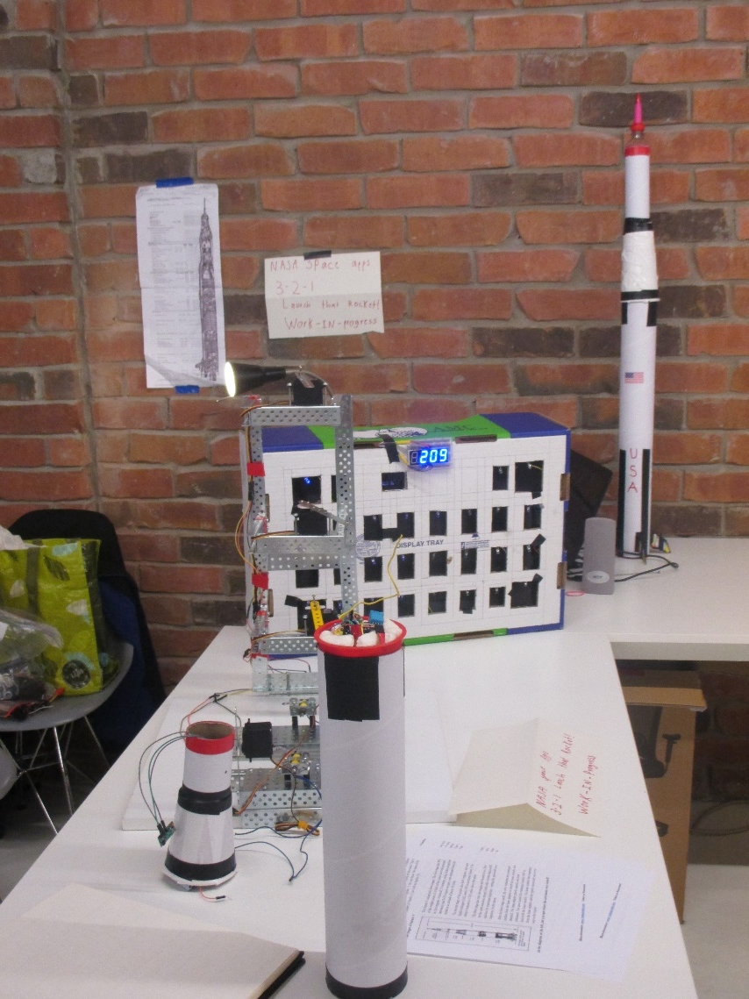
Our project
Project inspired by visit to the Kennedy Space Center in 2015 and seeing the Apollo II Control Room and the Saturn V rocket.
We built a:
Apollo 11 Sequence Panel
Countdown Clock
Launch Pad 39A
3-stage Saturn V Rocket
Electric Bolts and Mechanical Release to launch rocket
Telemetry Data Transmitter in the Rocket
Display Panel for receiving Telemetry Data
Audio System with NASA Audio clips in last 10 seconds of countdown

Slide 5
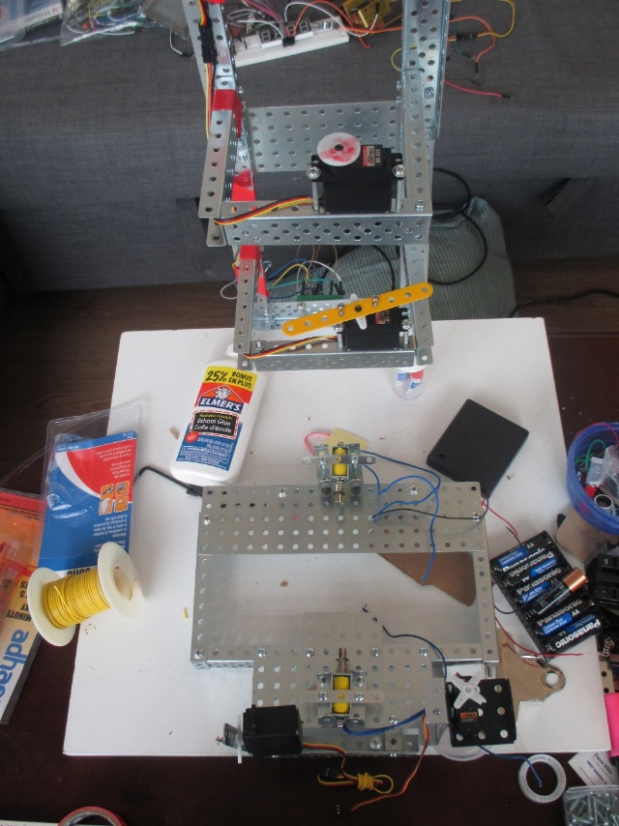
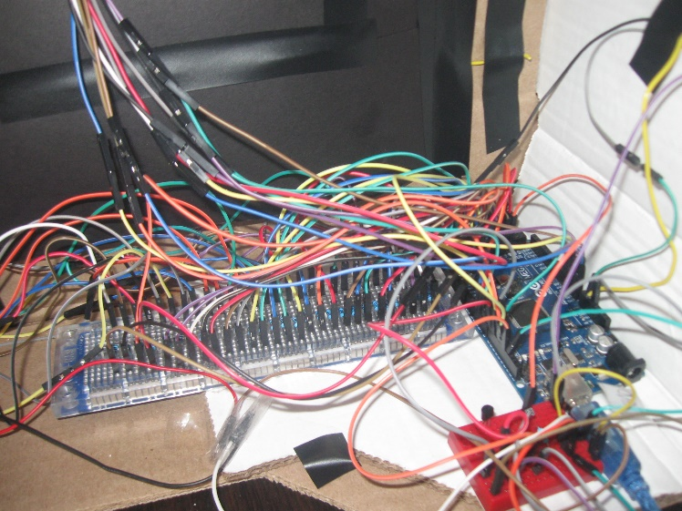
Components Used
Cardboard Tubes, Cups, Meccanos
4 Arduinos, 4 Servos, Relays
6 sensors (Gyro, Accelerometer, Temperature, Altitude, Pressure, Magnetic Heading )
433 Mhz radio frequency transmitter and receiver.
Solenoids acting as Electric firing bolts
Original audio of the launch to bring sounds of the launch of Apollo 11.
Speakers

Slide 6
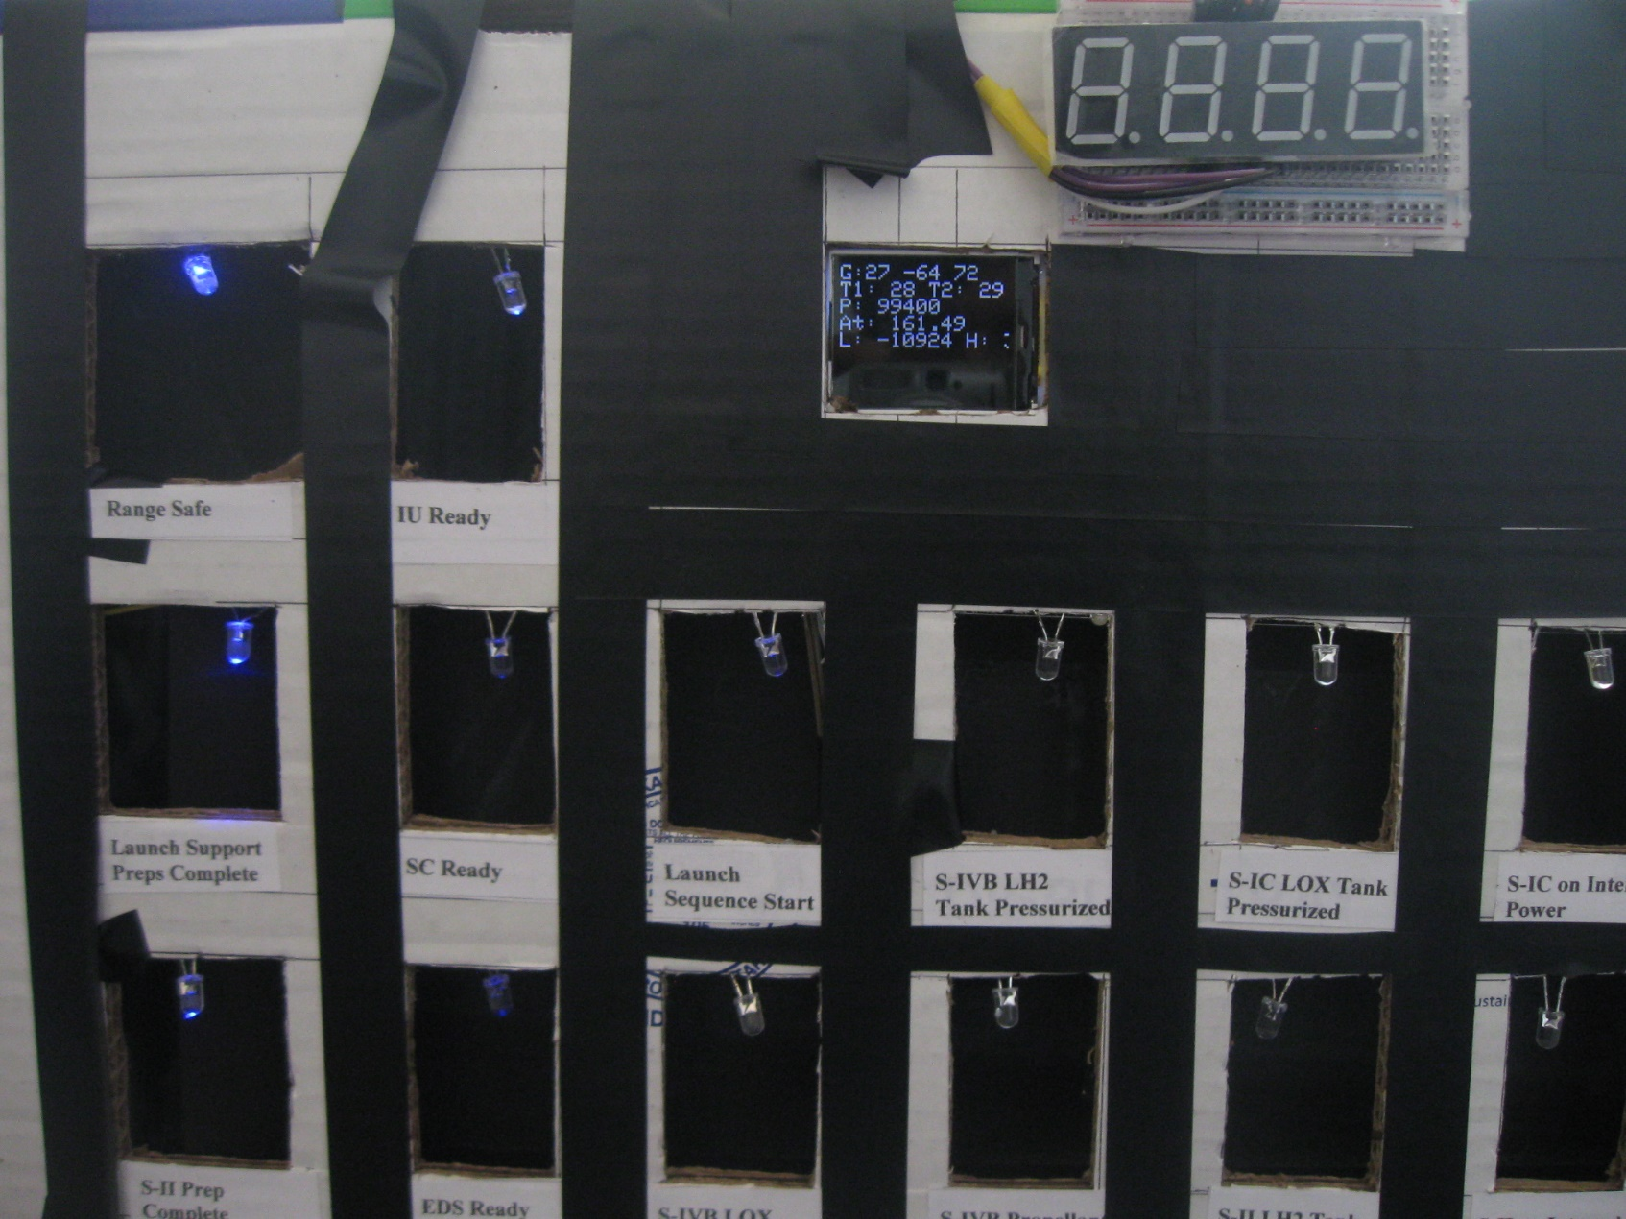
Complexity and Innovation
Sequence Panel
Gives status of 28 system checks by lighting up LEDs.
Eg: Range Safe, IU Ready,
S-IC LOX Tank Pressurised.
Sequence Panel is connected to Countdown Clock and is linked to actions taking place. Eg: When it lights up “S-IC on Internal Power” then Rockets First stage lights up. Similarly with Gantry Arms retraction.

Slide 7
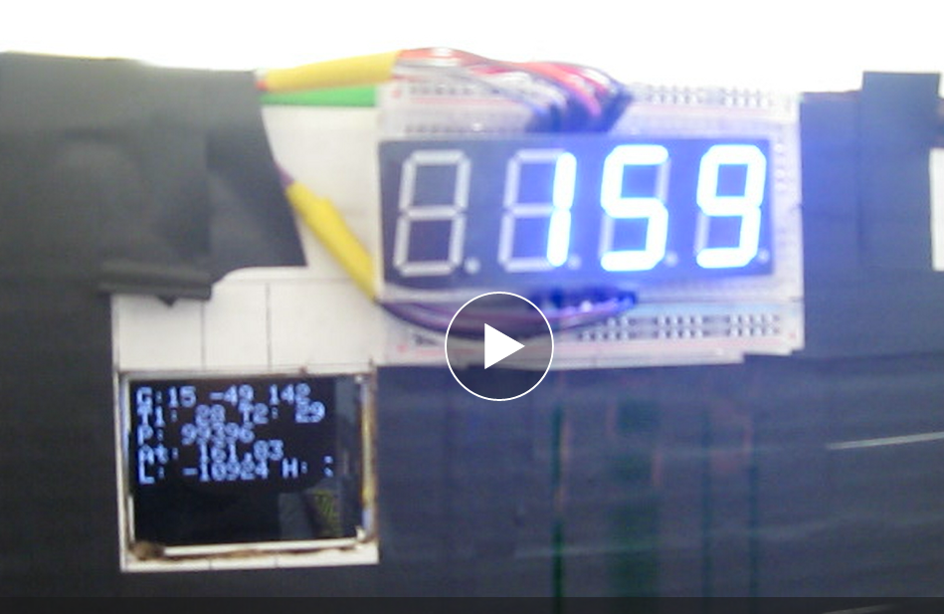
Complexity and Innovation
Countdown Clock
The heart of the Launch Experience. All data taken from NASA Apollo 11 Archives is linked to the Countdown clock so that correct information is displayed and correct action undertaken.
Automatic Launch Sequence starts from T-00:03:07

Slide 8
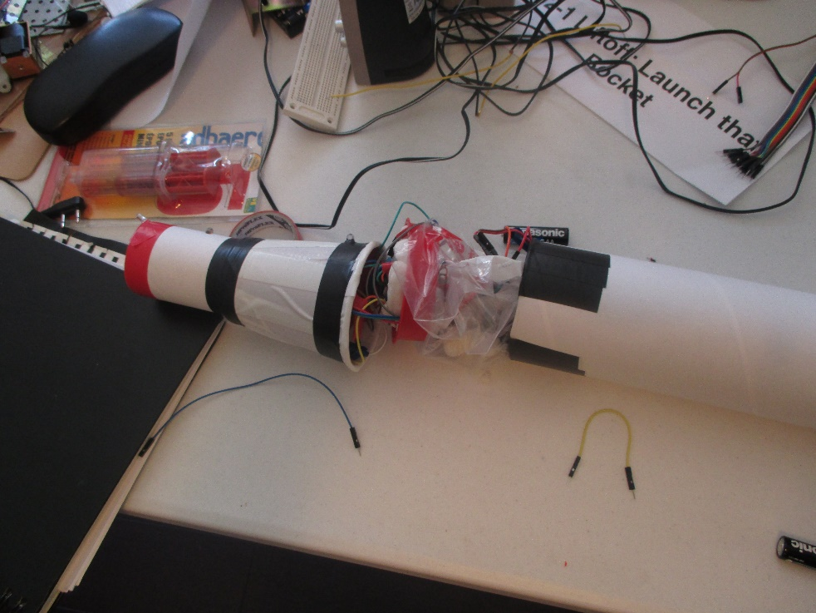
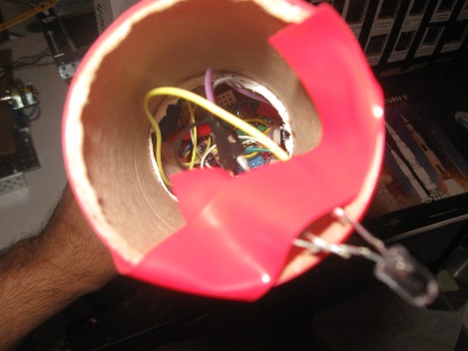
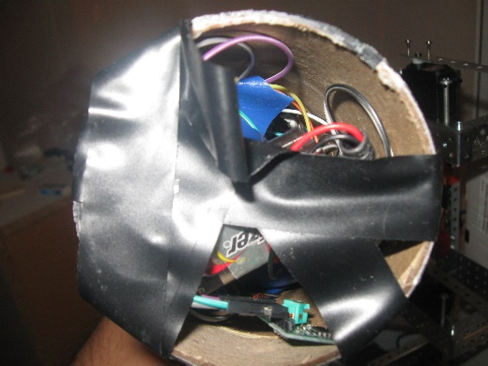
Complexity and Innovation
The Saturn V Rocket
70 cm tall and can send telemetry data on:
Acceleration on various axes
Gyro (Roll, pitch and yaw)
Altitude
Pressure
Magnetic headings
Temperature
The data is sent wirelessly by the Rocket to the Display on the Sequence Panel.

Slide 9
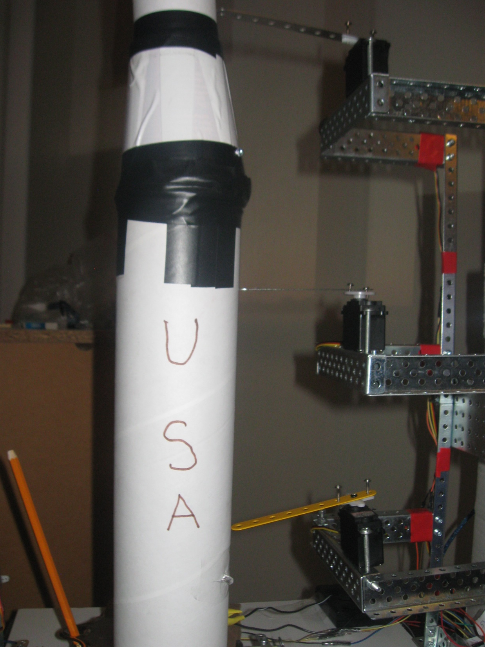
Complexity and Innovation
Launch Pad
Made by meccanos.
Has 3 arms and servos.
Arms Retraction controlled by Countdown Clock at T- 00:03:56, T-00:01:026 and T-00:00:01.
Has electric bolts (Solenoids) automatically linked to Countdown Clock.

Slide 10

Complexity and Innovation
Telemetry Data / Display Screen
Wireless Transmission happening between Saturn V and Sequence Panel / Display Screen at all times using 433 MHz transreceiver.
Sequence Panel sends command to the Rocket to switch to internal power etc.
Rocket sends back telemetry data for display on LCD / Display screen.
G = Gyro Data (Roll, Pitch, Yaw)
T1 = Temperature
P= Pressure
At = Altitude L = Heading

Slide 11
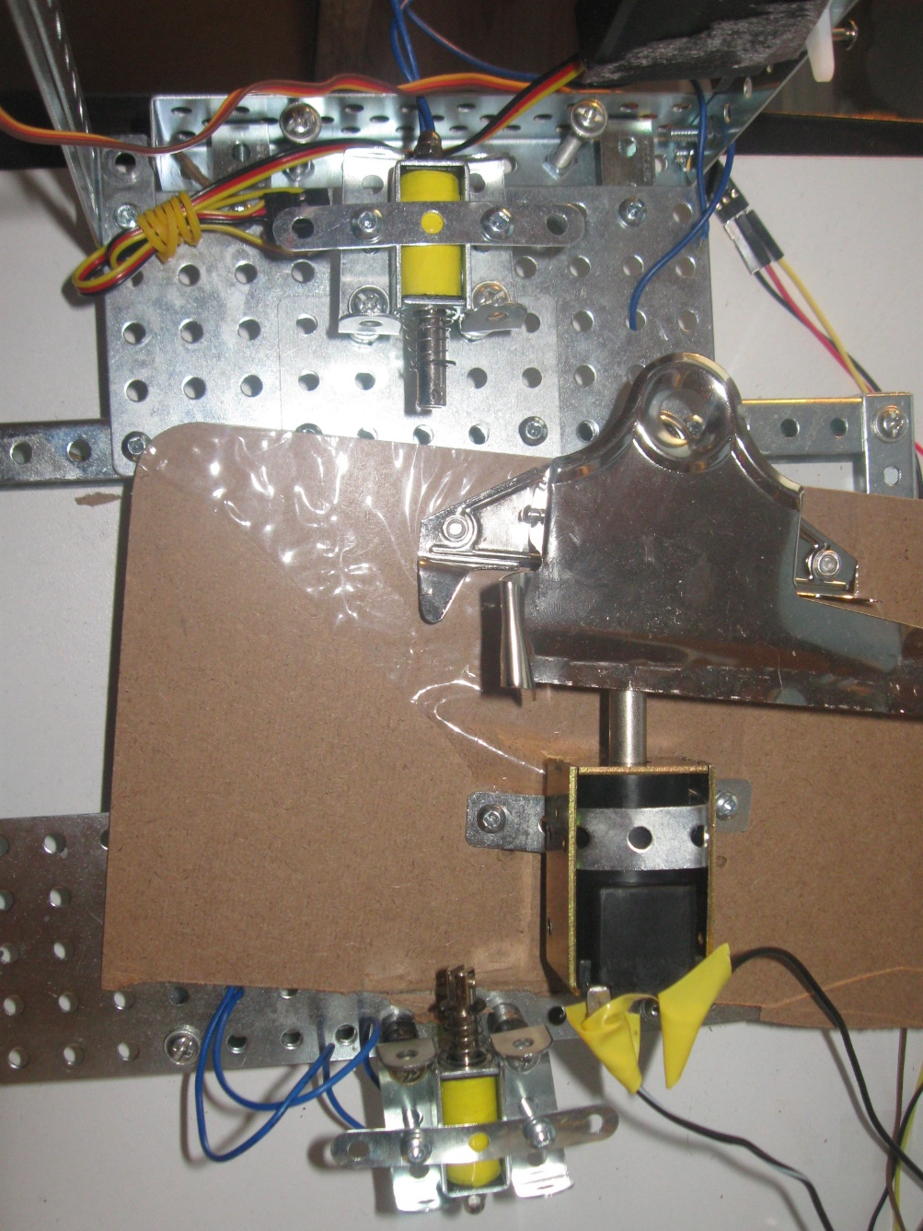
Complexity and Innovation
Electric Bolts and Launch
Three Solenoids act as electric bolts controlled by Arduinos
When electric bolts are released, the solenoid moves back and released the mechanical force (springs and clips) to blast off the rocket.

Slide 12
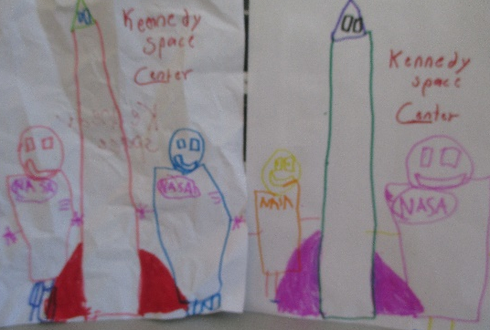
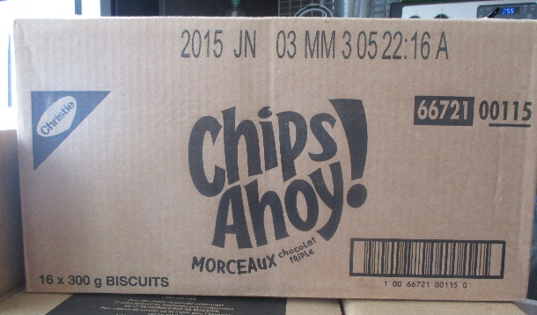
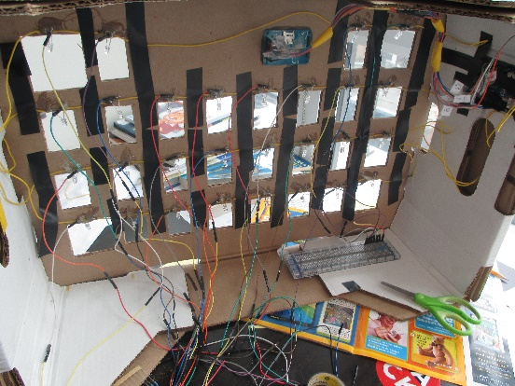
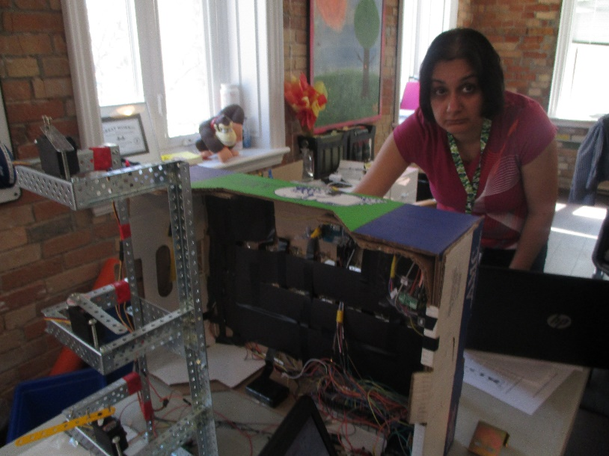
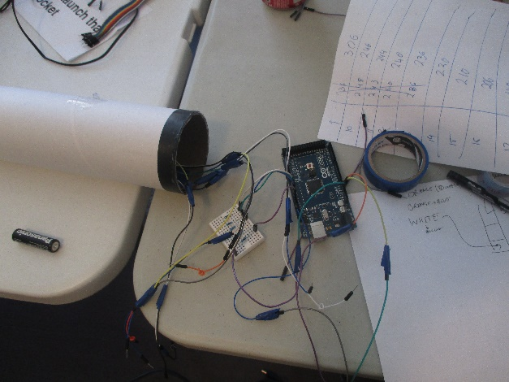
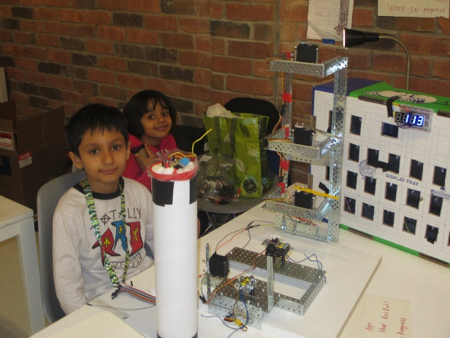
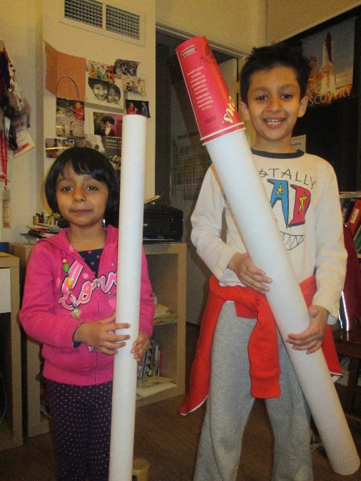
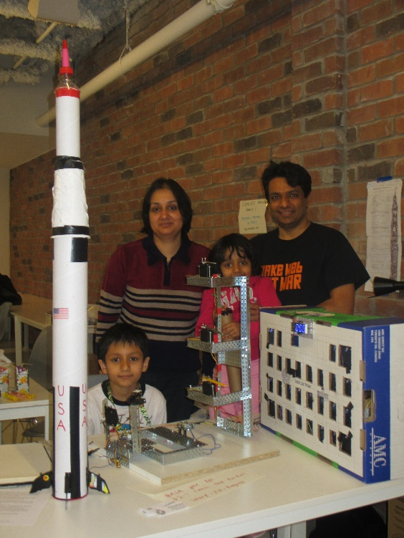
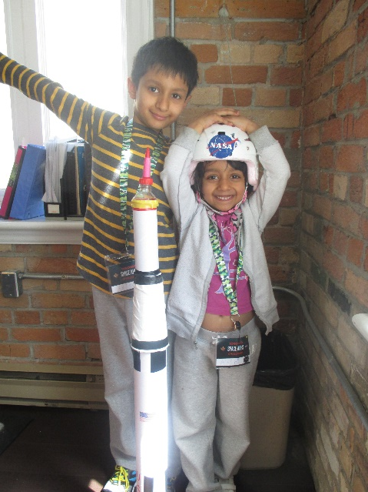
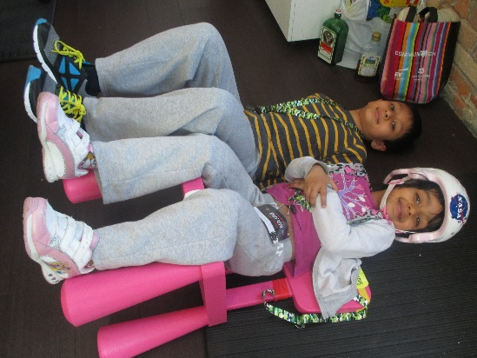
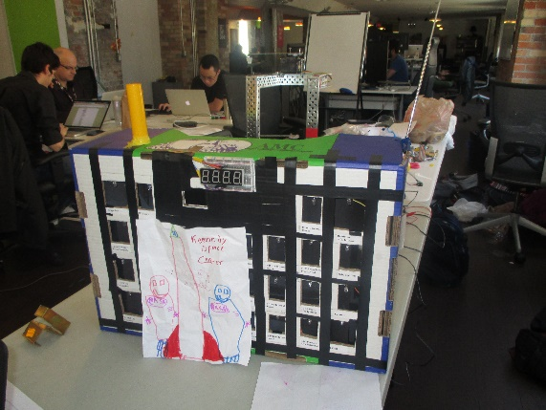
How our family worked 48 hours nonstop to turn dream to reality?
Not because it was easy but because it was hard!

Slide 13
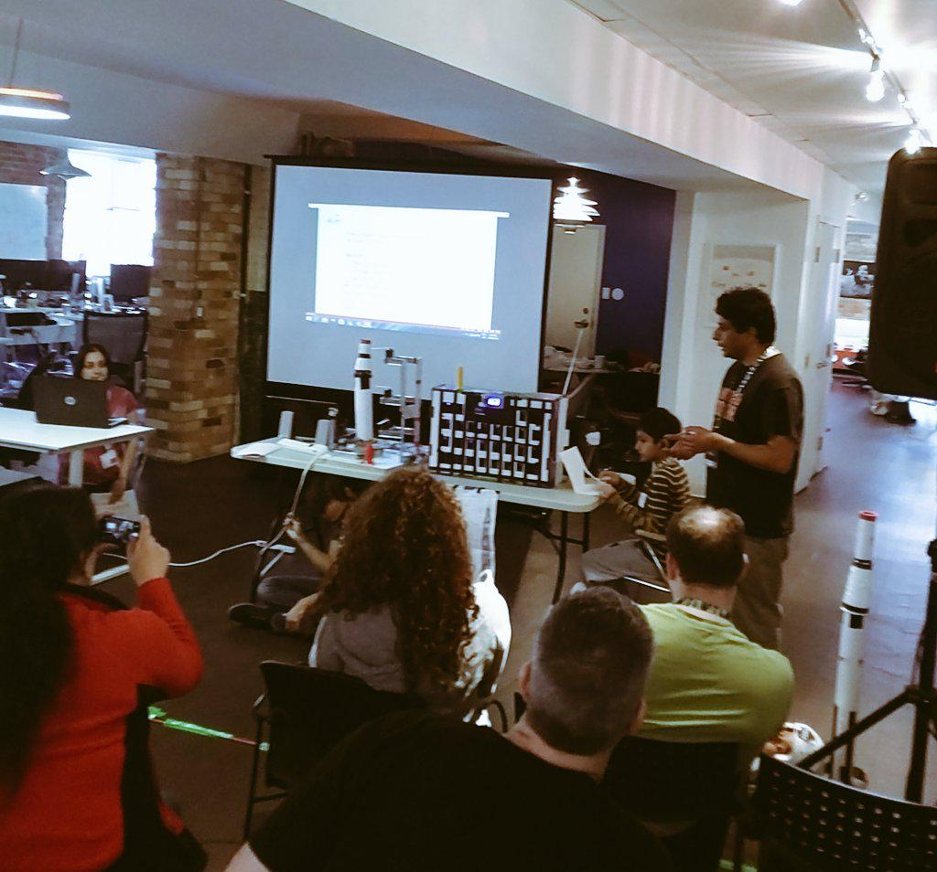
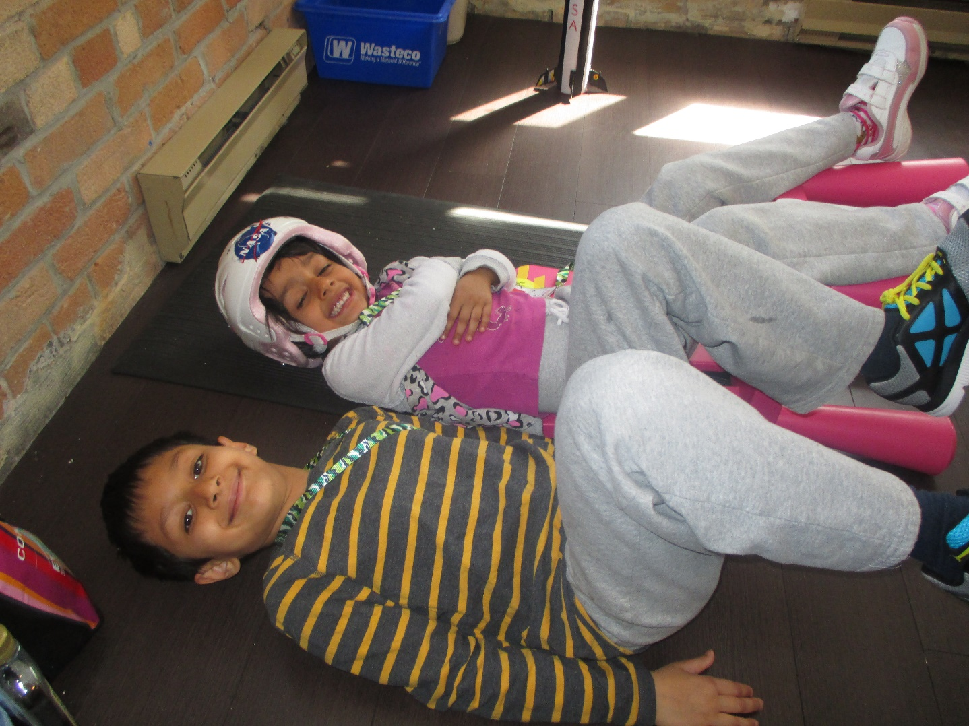
3-2-1 LIFTOFF!
We go to the Moon.
And then we go to Mars!

