Slide 1
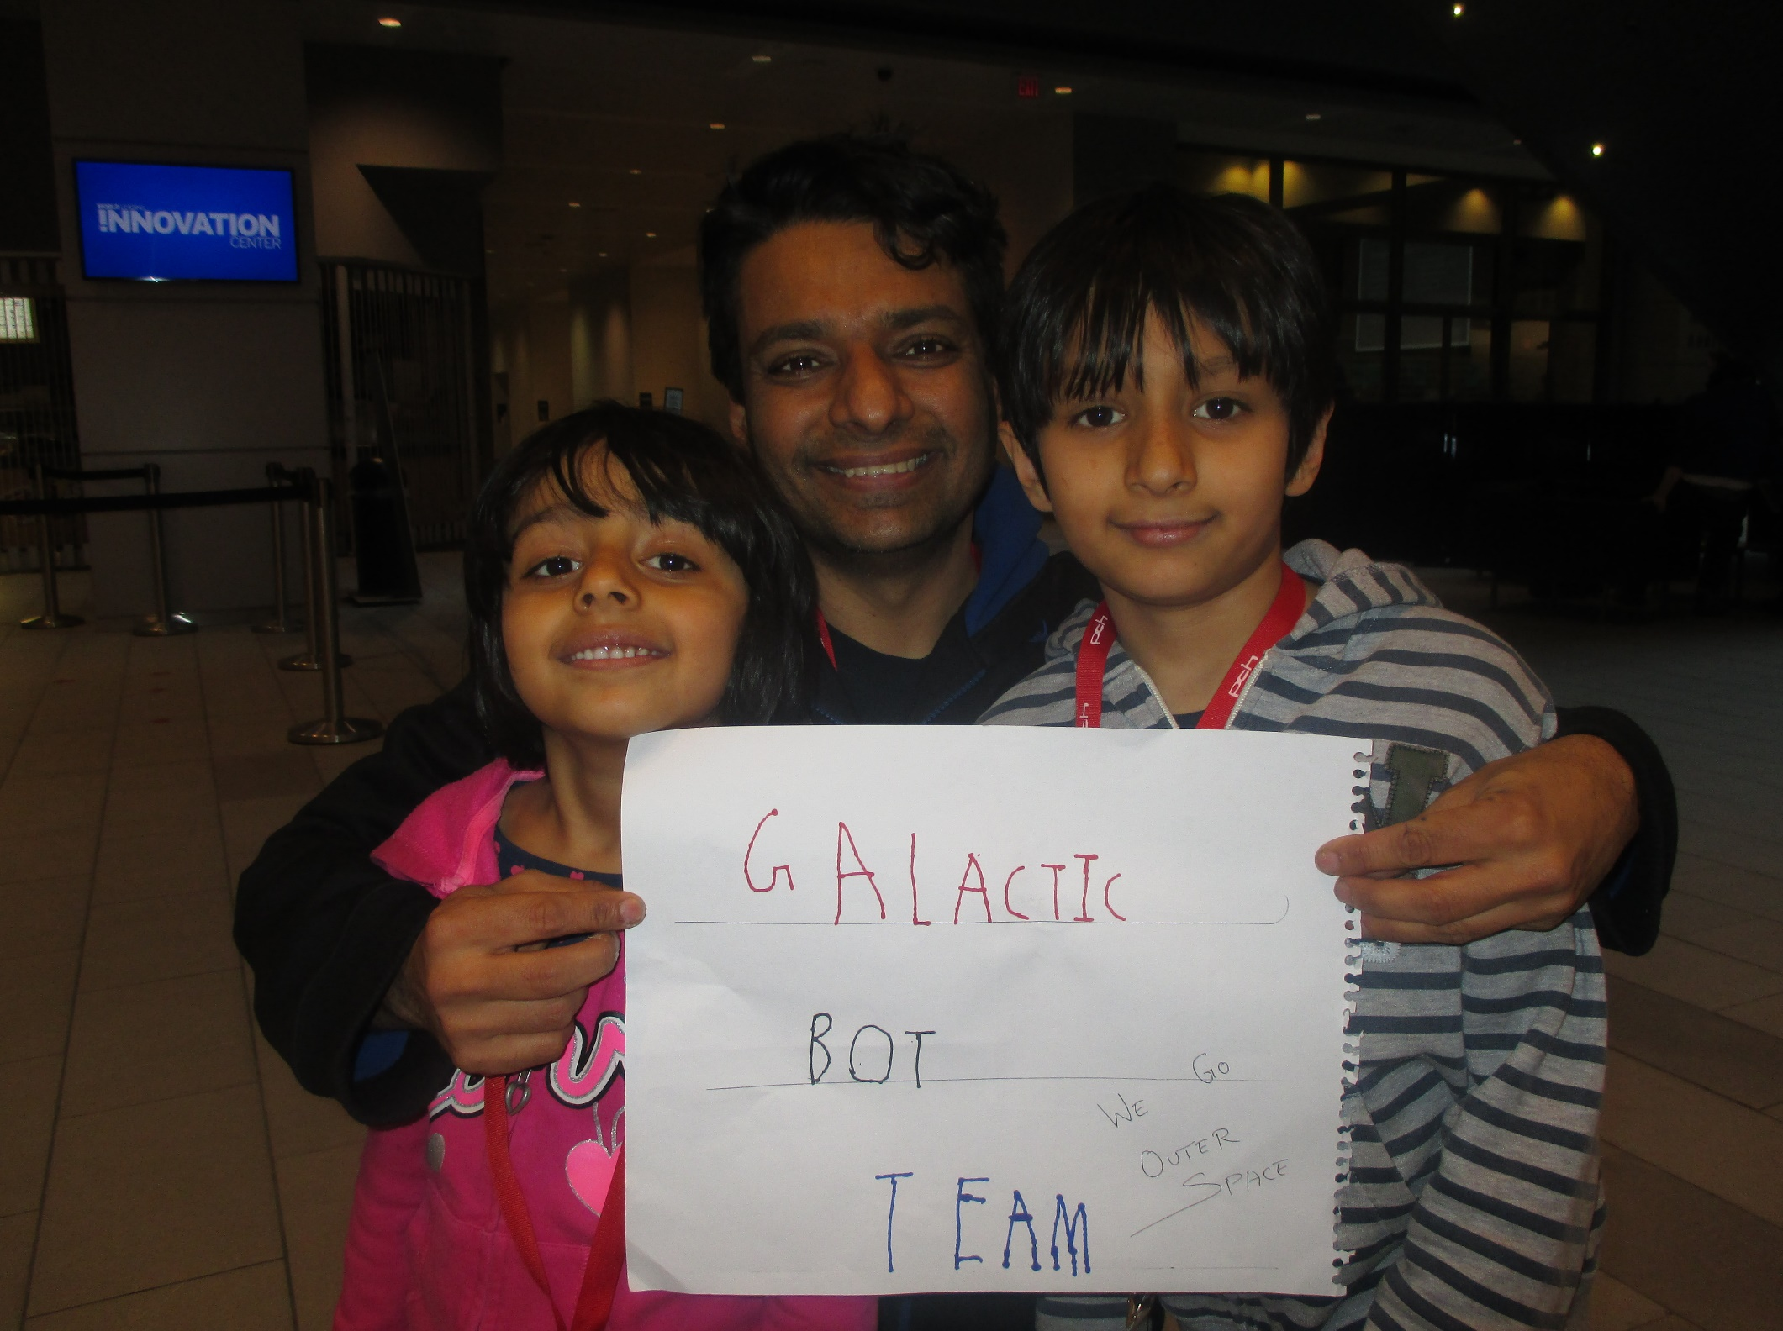
Arushi
Vikas
Artash

Slide 2
What we wanted to do?
To learn more about the stars
What stars are made of?
How hot the stars are?
How old the stars are?

Slide 3
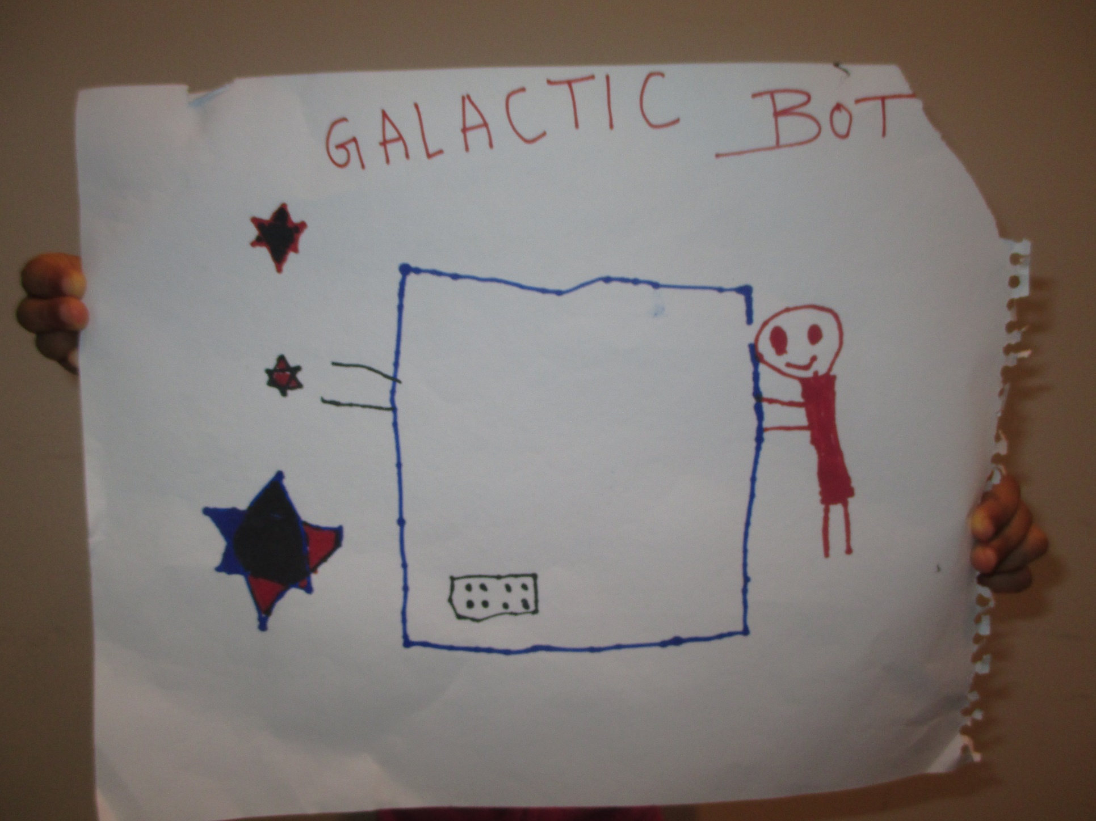
We Dreamt!

Slide 4
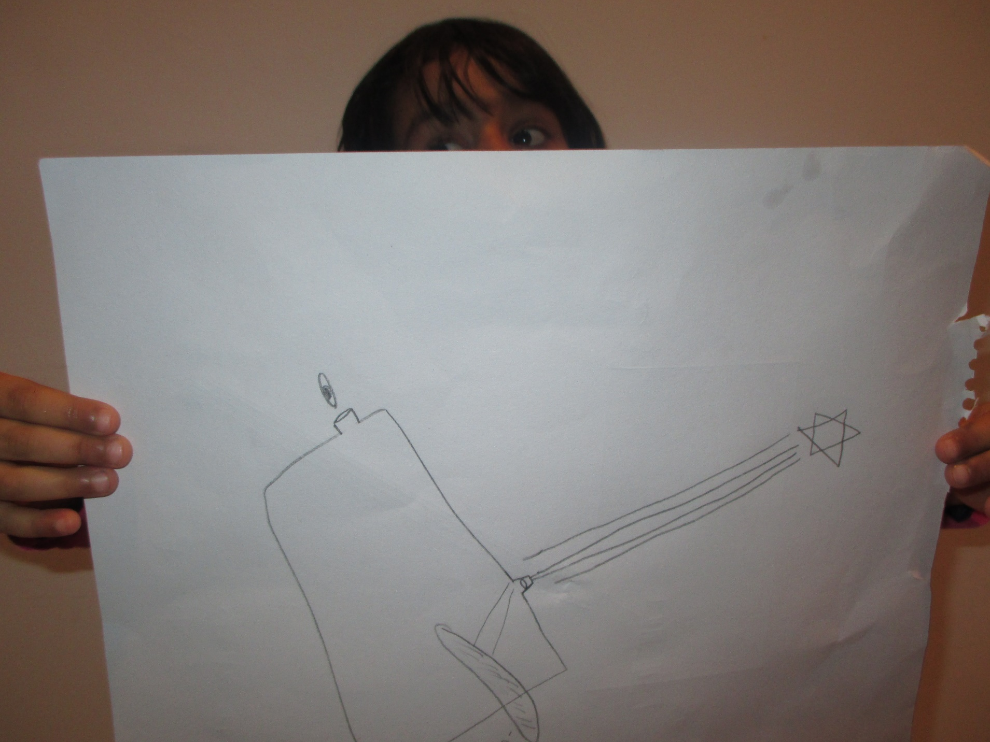
We planned!

Slide 5
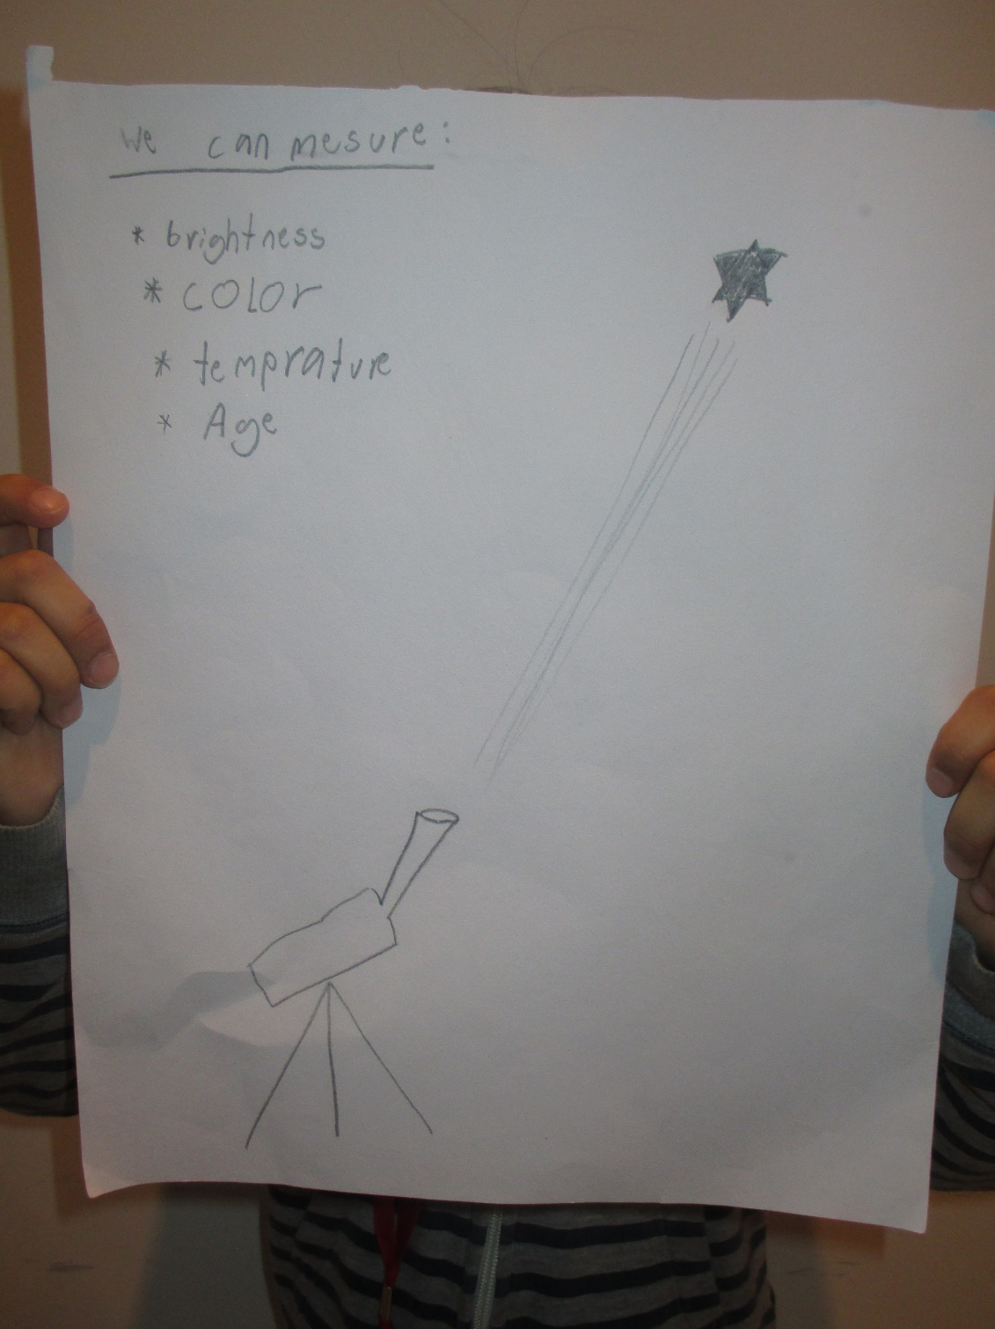
We got better in planning!

Slide 6
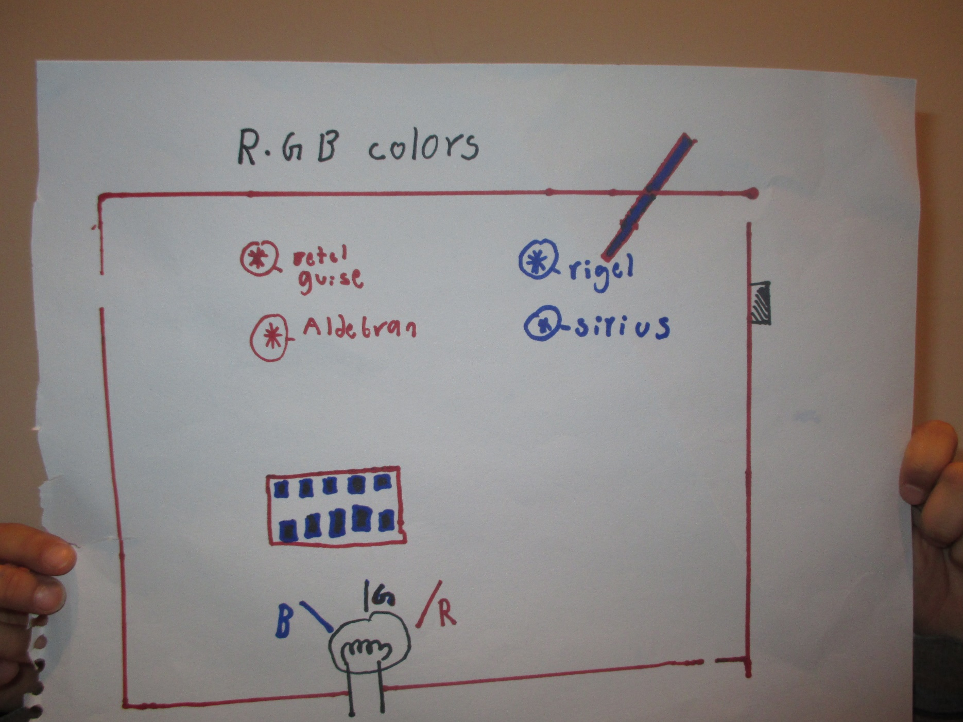
We improved!

Slide 7
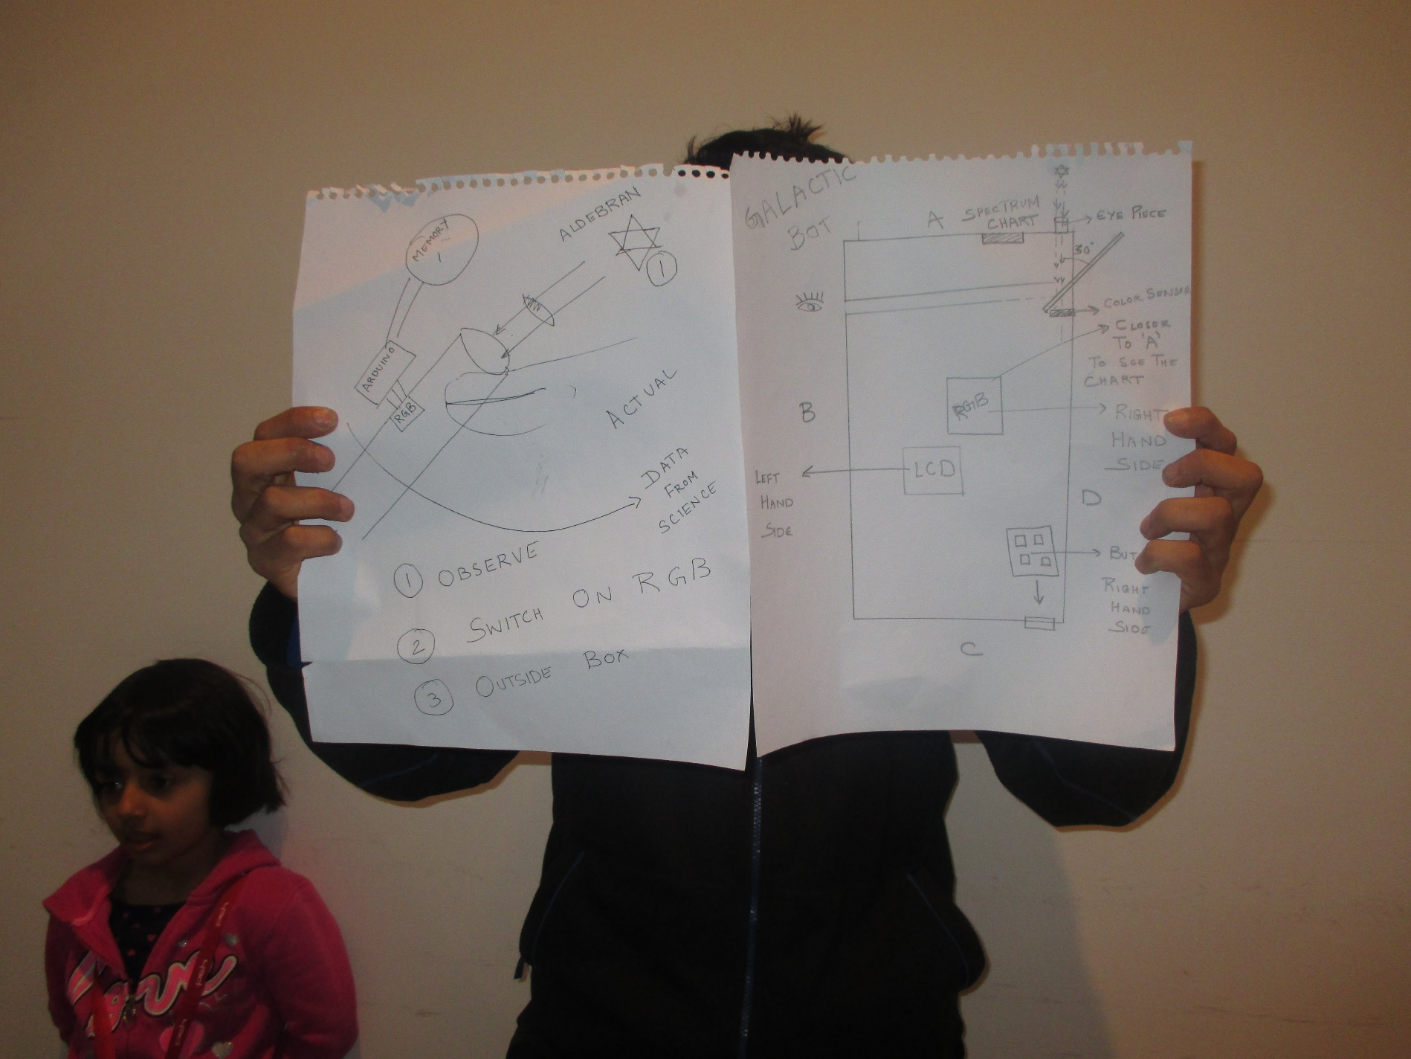
We changed the design!

Slide 8
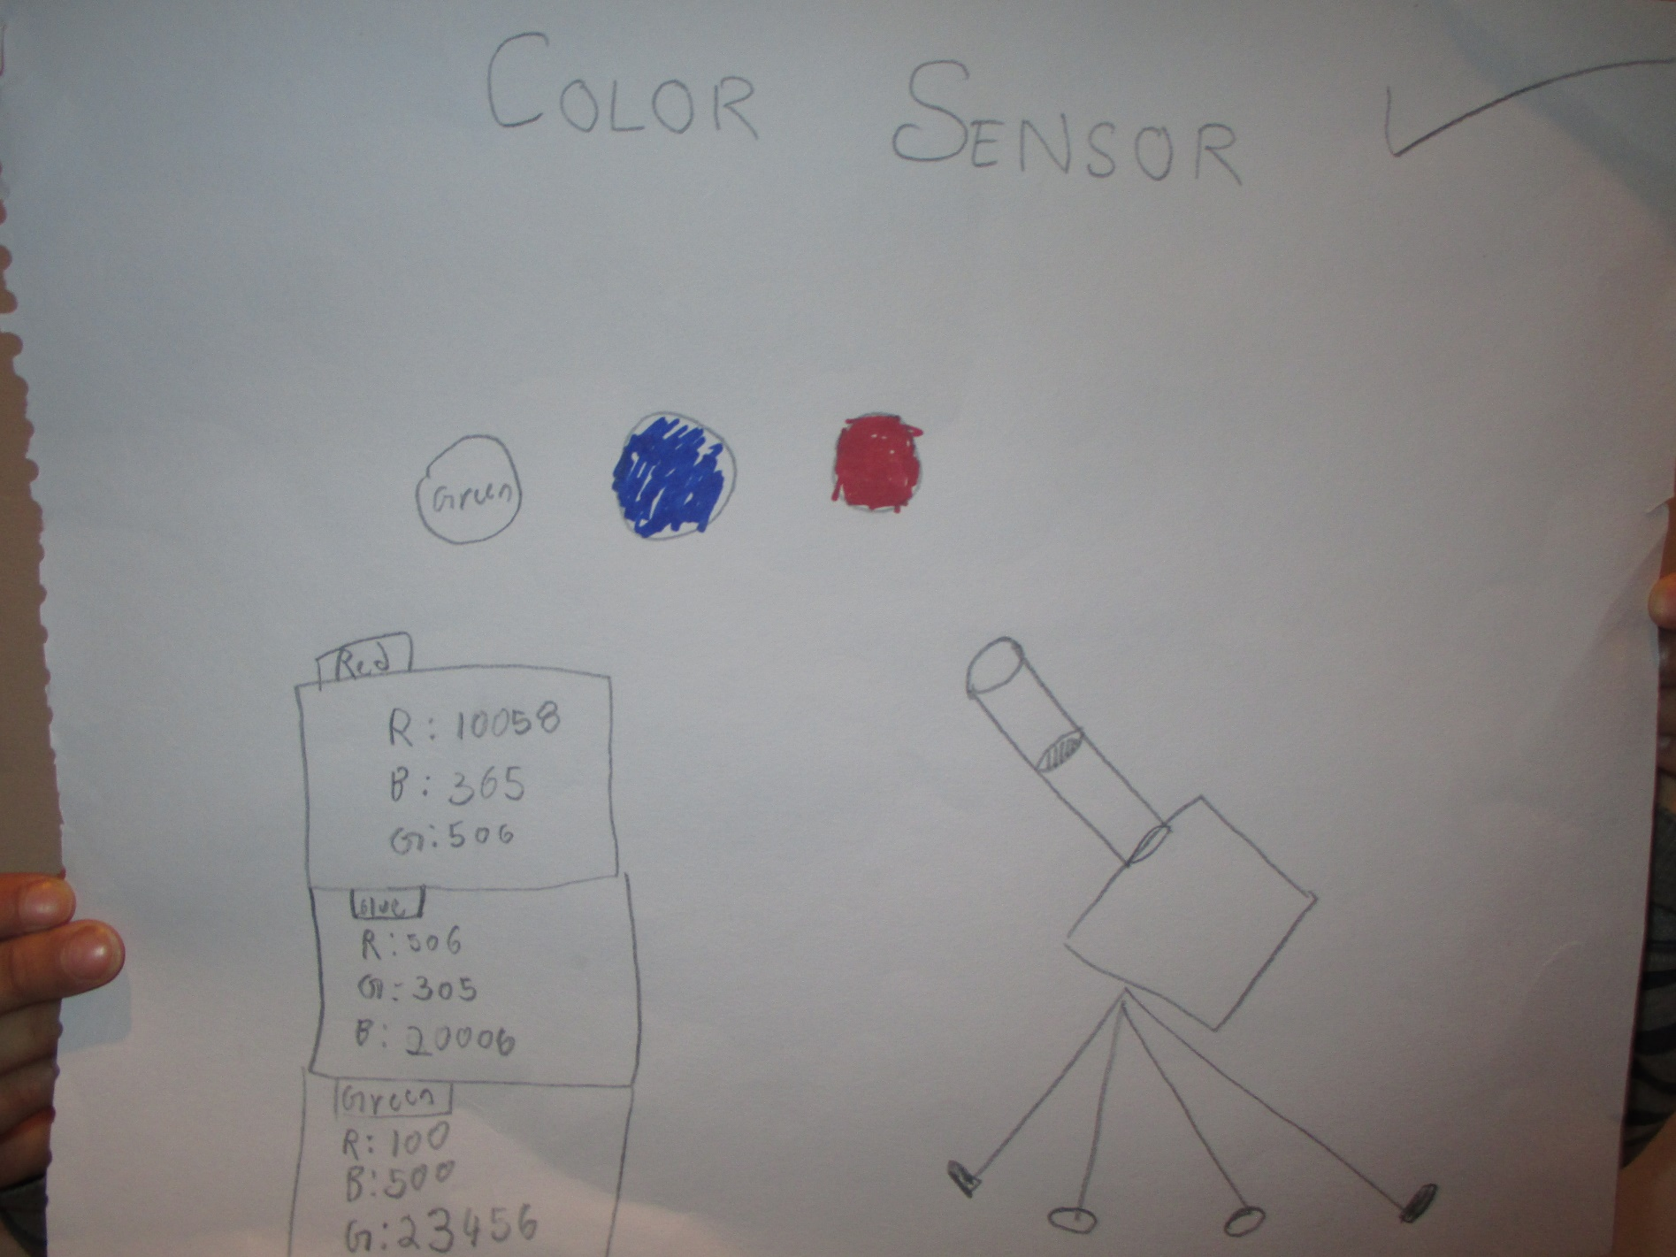
And we started to make!

Slide 9
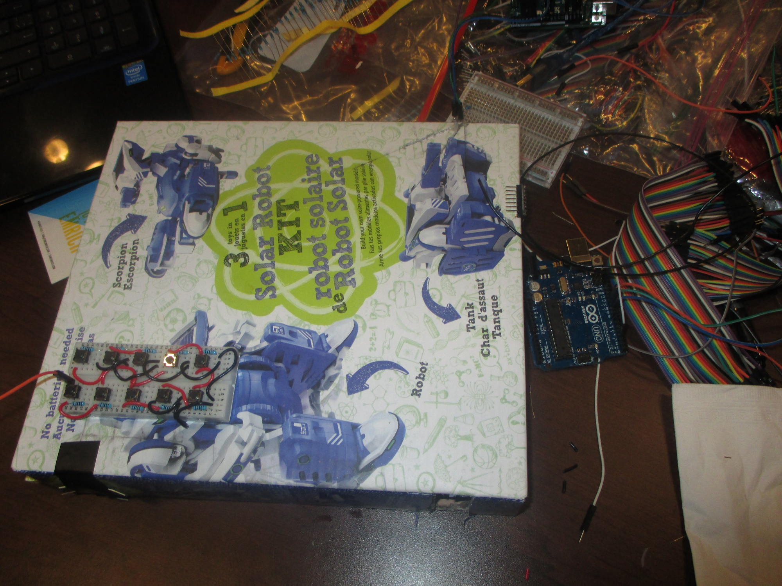
Lots of work!

Slide 10
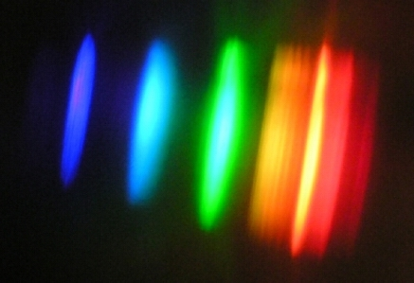
Galactic Bot: Spectrum from from bright light saver bulbs
It clearly shows some lines are missing!

Slide 11
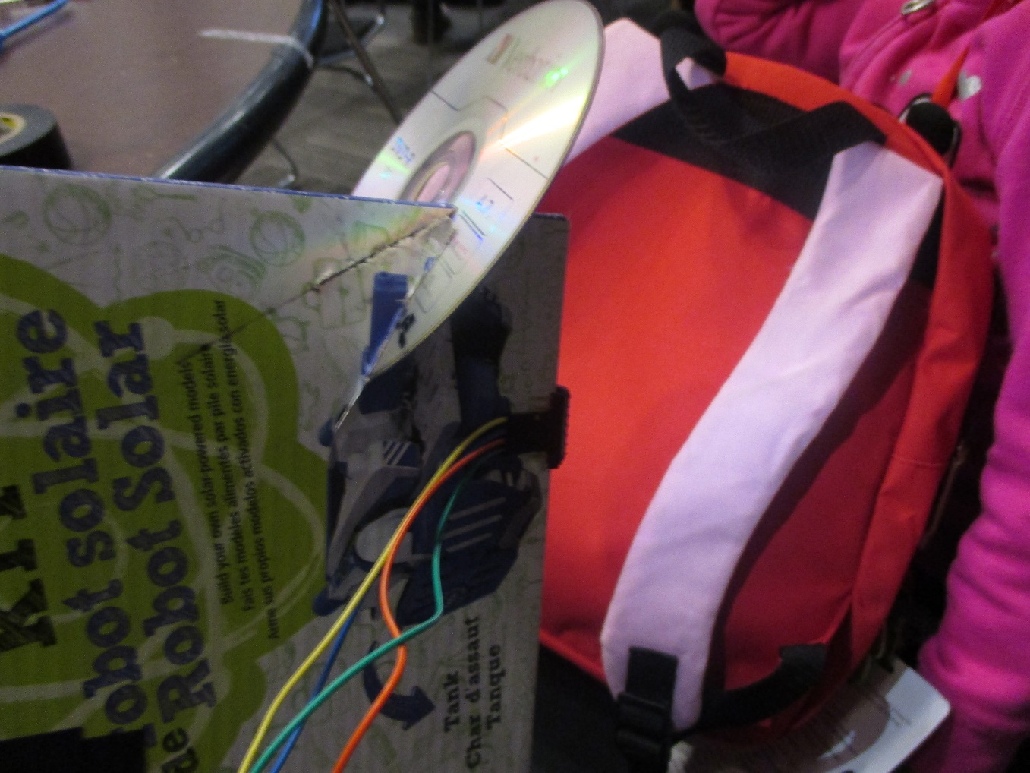
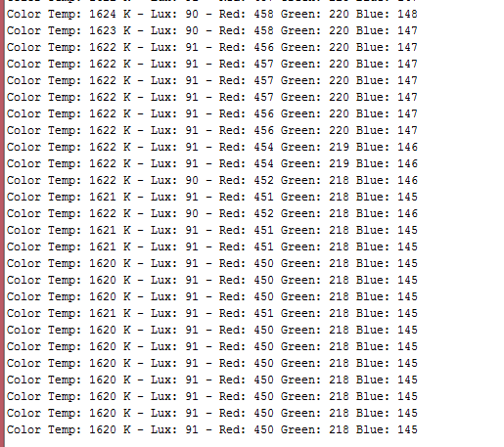
Red Green Blue Sensor at Work!

Slide 12
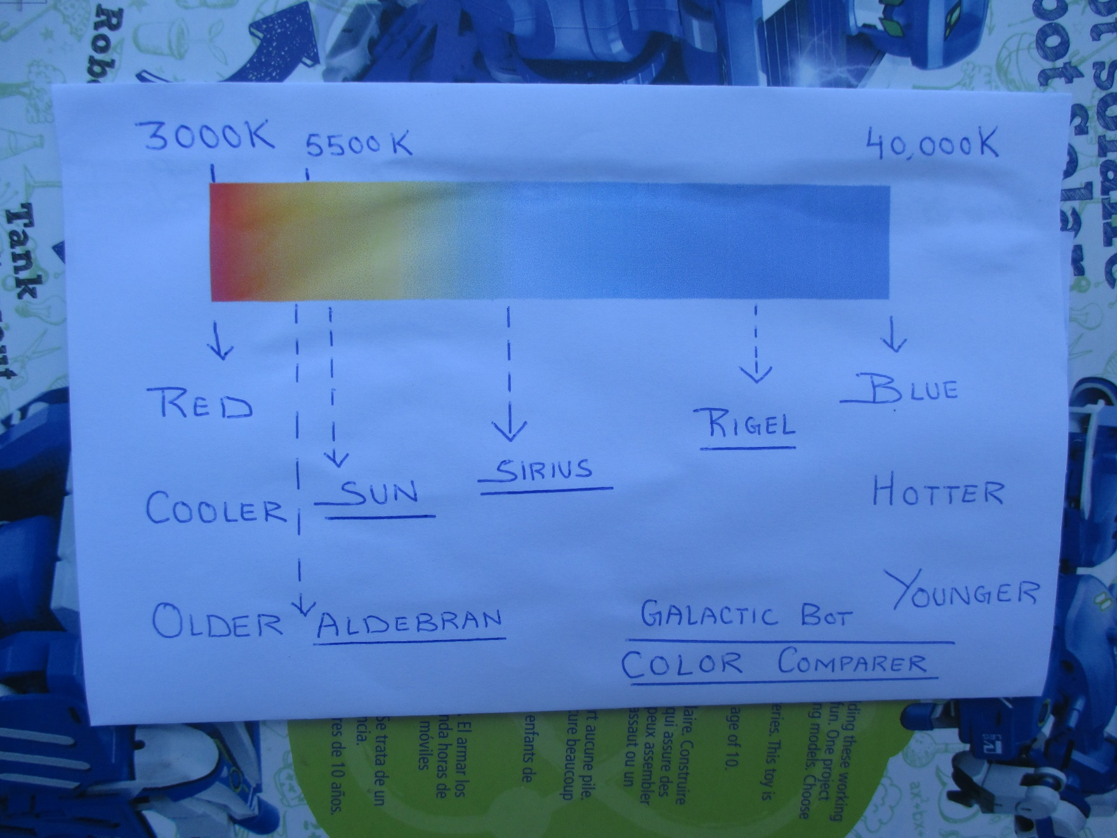
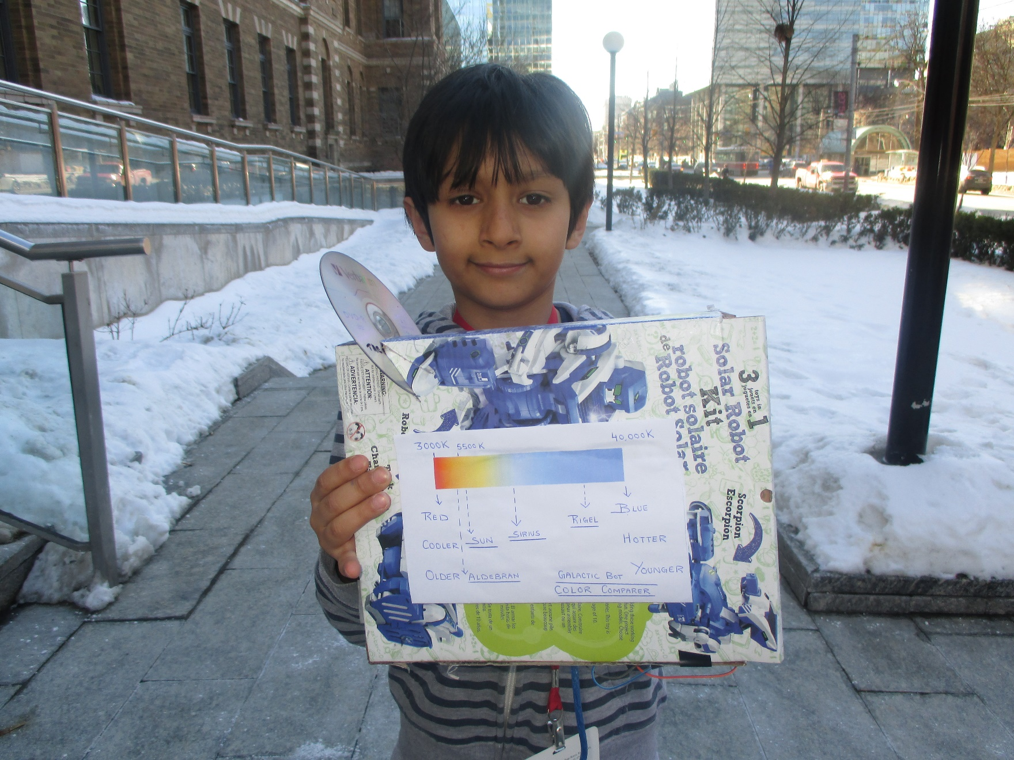
Galactic Bot: Color – Temperature Legend

Slide 13
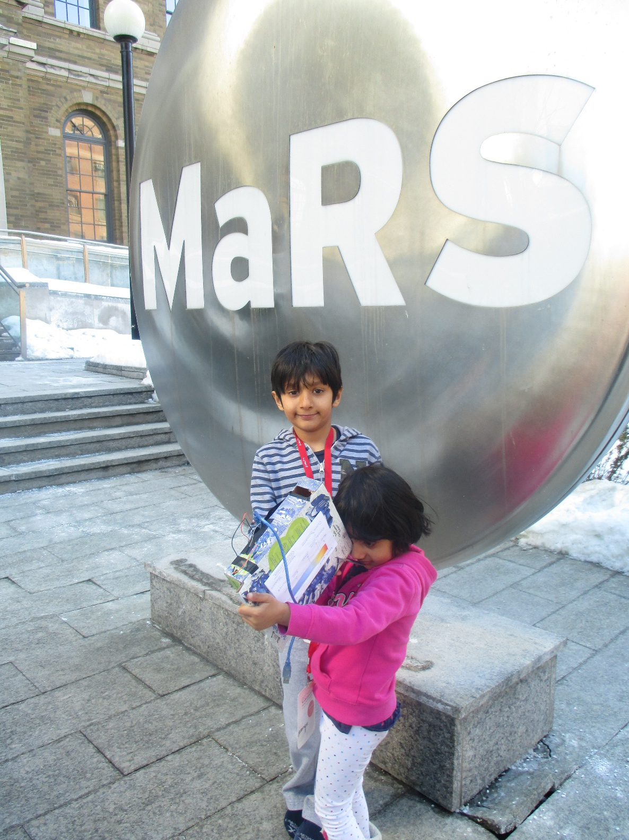
Galactic Bot for Stars: Achieved in 48 hours!
Spectrometer: What stars are made off?
Sensor for getting Red, Green, Blue composition of objects.
Color Comparer to get Temperature and Age of the star.

Slide 14

Our Aim is to have
One Galactic Bot per Child.
Increase focus on Science and Space in Canada.
The cost is less than CAD 30.
Even children can make it!
www.HotPopRobot.com Twitter: @wonrobot

Slide 15


